Slide 1
Welcome to Maastricht University
Faculty of Health, Medicine and Life Sciences
Meet & Greet BA Medicine
Notes:
Marleen: Play music while this slide is in the background and students enter the session
Marleen starts with this slide and welcomes everyone and gives coordinator(s) and student ambassador the opportunity to introduce themselves shortly.

Slide 2
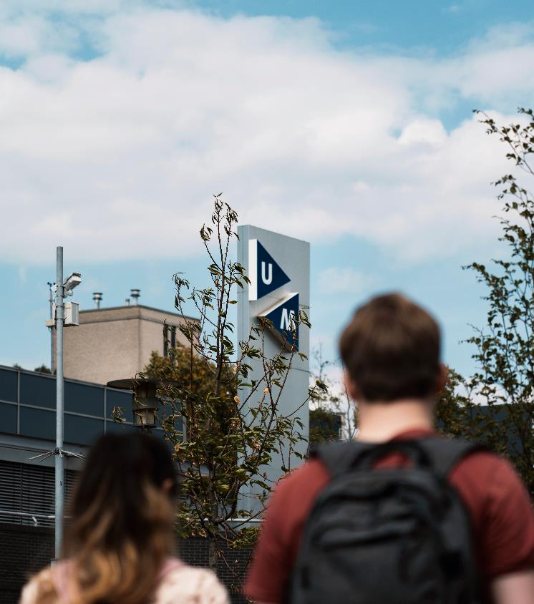
What is this session about?
Introduction: Let’s introduce ourselves
Curriculum and programme structure
Experiences of student Dara
Key dates and sources for practical information
Study association Pulse
Time for questions
Notes:
Outline of the session:
Staff members and current student introduce themselves
Short introduction new students (Wooclap) → Where are you from? What do you expect of the first year? → by Marleen
Introduction of what students can expect of the first year/blocks, from us and of what we expect from our students by coordinator(s)
@ Coordinators: do students need to prepare anything before the start of their study?? → share it now
Experience with being a student (both studying and student life) by the current student ambassador
Dates and what to expect before starting your study → by Marleen
Settling down in Maastricht (as an international student) → My Maastricht and their webinars in summer
INKOM, faculty Introduction and start of the academic year
When to expect more information (mailings, calendarium, time schedules)
Time for questions! → by students (answers by student ambassador and staff members)
Still any doubts or questions → possibility to schedule a campus tour.

Slide 3
Let’s introduce ourselves

Slide 4
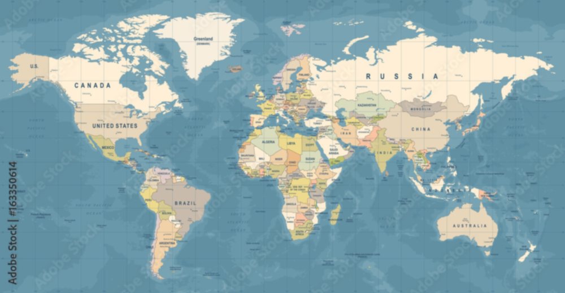
Where are you from?
Notes:
Wooclap question by Marleen: Answers live on screen

Slide 5
What do you expect from your study Medicine?
Notes:
Wooclap question by Marleen: Answers live on screen

Slide 6
Curriculum and programme structure

Slide 7

Y O U M A Y T H I N K . . .
Was it not: International Track of Medicine?
Why is it : Bachelor of Medicine?
Curriculum revision
  Which is more than the change in name..

Slide 8
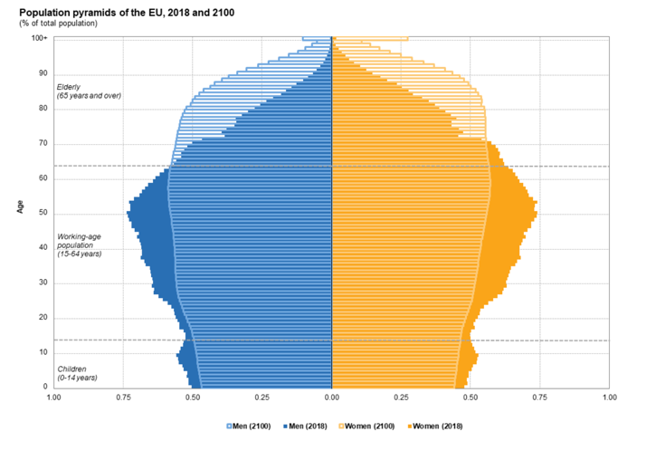
Curriculum 2022 - Bachelor of Medicine addressing: Changes in health care
More people over 65 years
More chronic diseases
Focus on prevention
Focus on network medicine, working together
Digitalization (apps, health-analytics, e-health)
https://ec.europa.eu/eurostat/web/products-eurostat-news/-/DDN-20190710-1

Slide 9



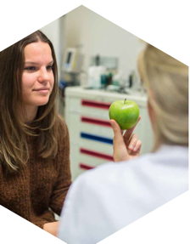
Curriculum 2022 - Bachelor of Medicine
Content update for 2030 and beyond
Next step in educational formats used @UM
  problem-based learning
More choices in your program, e.g. minor period
Supporting professional & personal development
Full program revision, leading to an identical curriculum in the English track and Dutch track
Visiedocument Medisch Specialist 2025

Slide 10
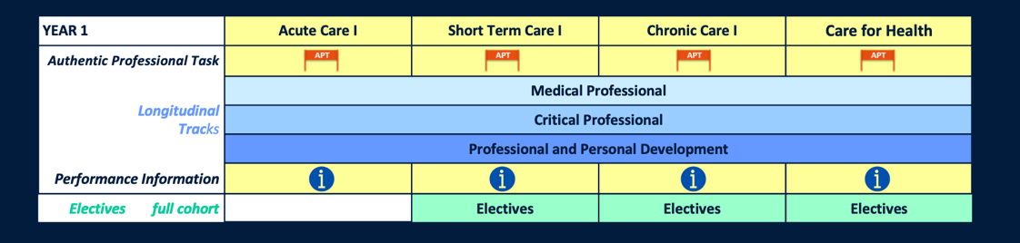
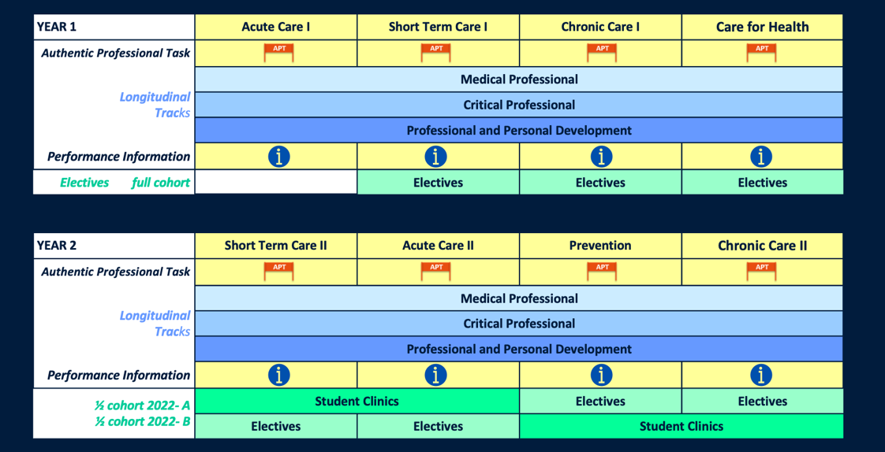
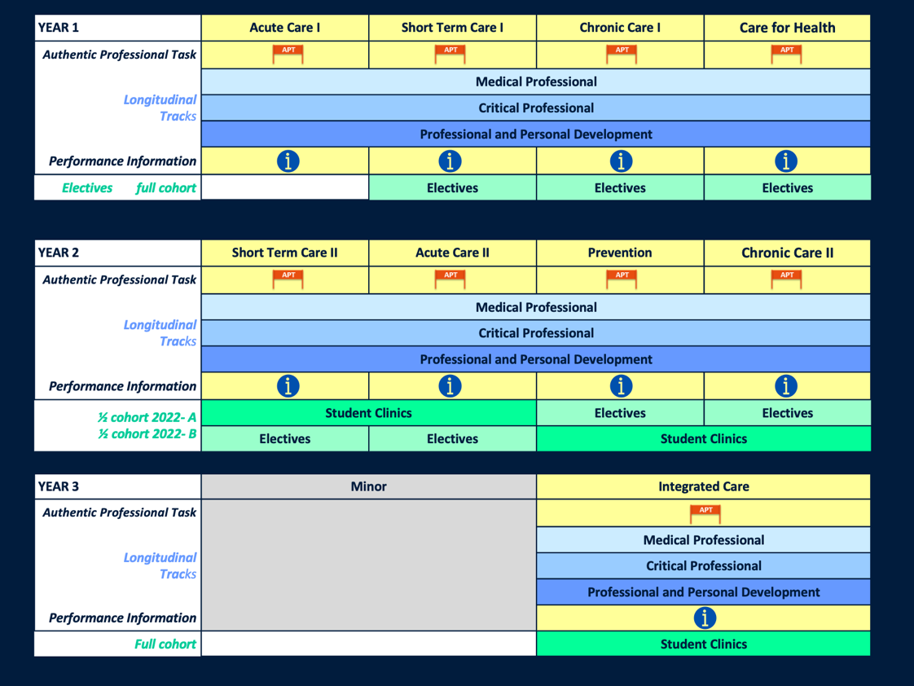

Slide 11
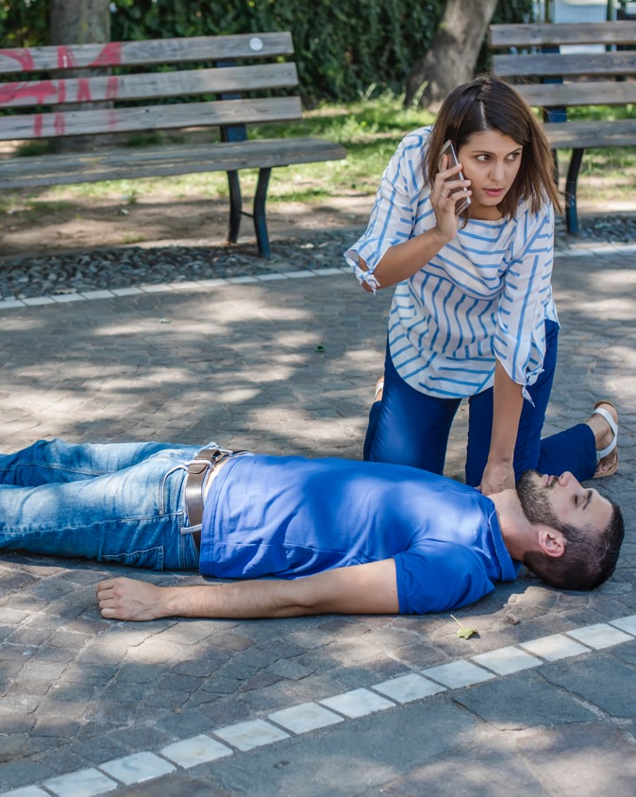
A U T H E N T I C P R O F E S S I O N A L T A S K
Authentic Task – as the entry point for learning
Used –
  To align the performance objectives with learning/teaching activities and performance information and assessment
  To integrate themes of periods and performance objectives of 3 longitudinal tracks
Also used –
  in the structuring of the period
P E R I O D 1 – A C U T E C A R E

Slide 12
A U T H E N T I C P R O F E S S I O N A L T A S K
A C U T E C A R E I
L E A R N I N G O U T C O M E S 3 T R A C K S
  Medical professional – e.g. to:
    - explain tissue oxygenation and blood pressure regulation
    - identify all cardio-vascular anatomical structures at the macro-microscopic level
    - apply the ABCDE method in a physiological context
  Critical professional – e.g. to:
    - explain evidence-base for ABCDE method
    - apply in the context of medical oath and duty of care
  Professional and Personal development – e.g. to:
    - reflect on effect on self after an acute situation
    - analyse and reflect on personal learning strategy and take action

Slide 13
C U R R I C U L U M 2 0 2 2
Content (contextual; constructive)
Collaborative learning
Self-regulated learning
  Performance information
  Using to learn, and progress
Assessment
  At the competency level

Slide 14

C O L L A B O R A T I V E &
S E L F – R E G U L A T E D L E A R N I N G
Community of students and teachers
5 learning teams
1 team of 10 students – same coach, for year 1
Learning team coach - guidance
  learning within the APT
  learning and follow-up of performance information
  personal & professional development
  competency exam

Slide 15
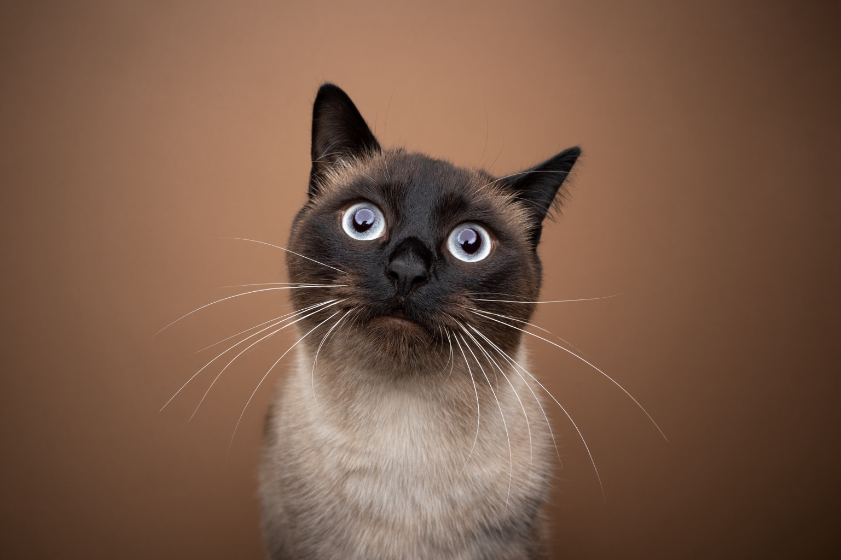

Slide 16
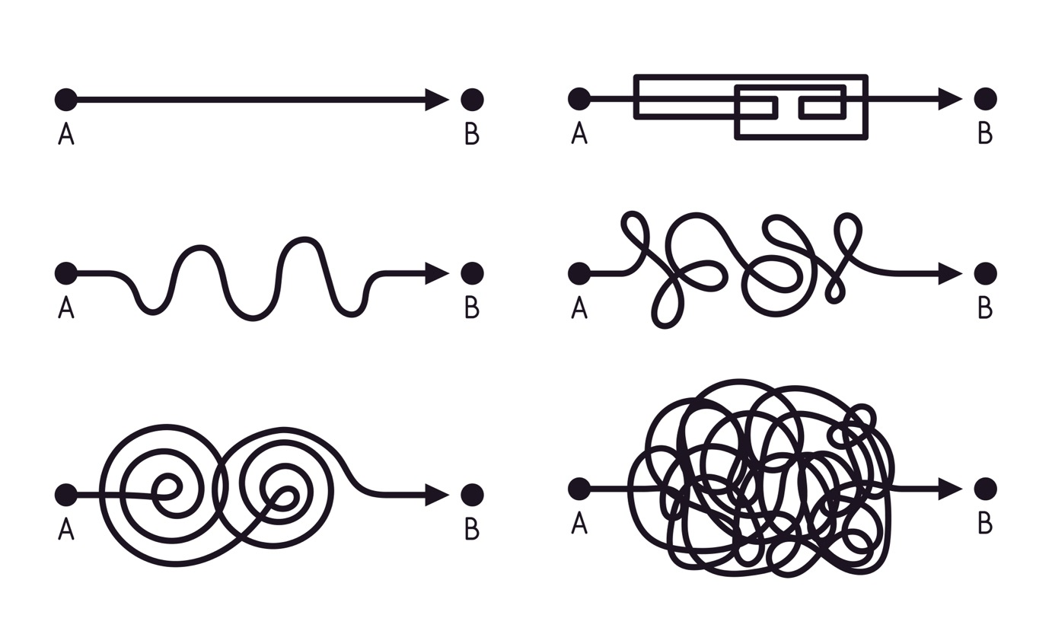

Slide 17
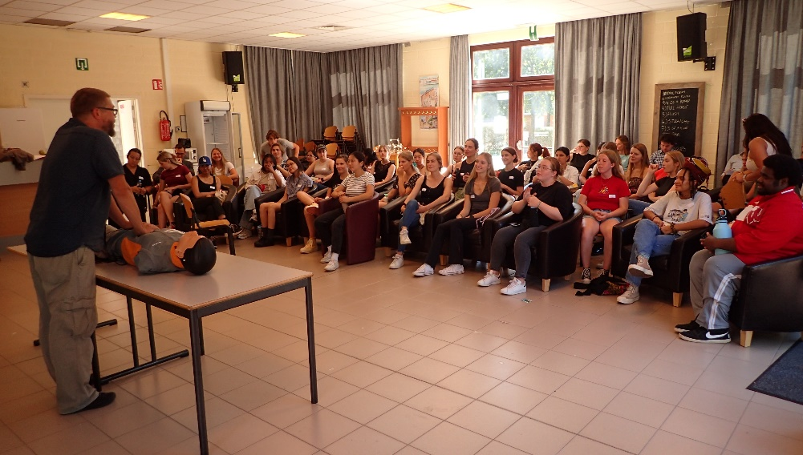
P E R I O D M E D 1 0 0 1 – I N W E E K 1
Getting started!
  Community, getting to know your peers and teachers
  Getting to know - Teaching and learning formats in BA-MED
  S T A R T of Period Acute care I
Photographs used with permission of people in pictures

Slide 18
W H A T Y O U C A N E X P E C T
F R O M U S A N D W H A T W E
E X P E C T F R O M Y O U . . .
Notes:
A few slides by the coordinator(s)

Slide 19
E X P E C T :
F R O M B A – M E D &
T E A C H E R S:
E X P E C T :
F R O M Y O U:
Enthusiasm and dedication
Receptive to feedback
Commitment for your professional and personal development
Bachelor program fit for future
Bachelor program preparing you for Master in Medicine
Enthusiasm and curiosity
Responsibility for yourself and team
Accountable for your actions and behaviour
Open and active learning attitude
Participation in program
Receptive and responsive to guidance and feedback
Able to manage insecurities

Slide 20

Experiences of Dara
1st Year Student
@daraa.juliaa

Slide 21
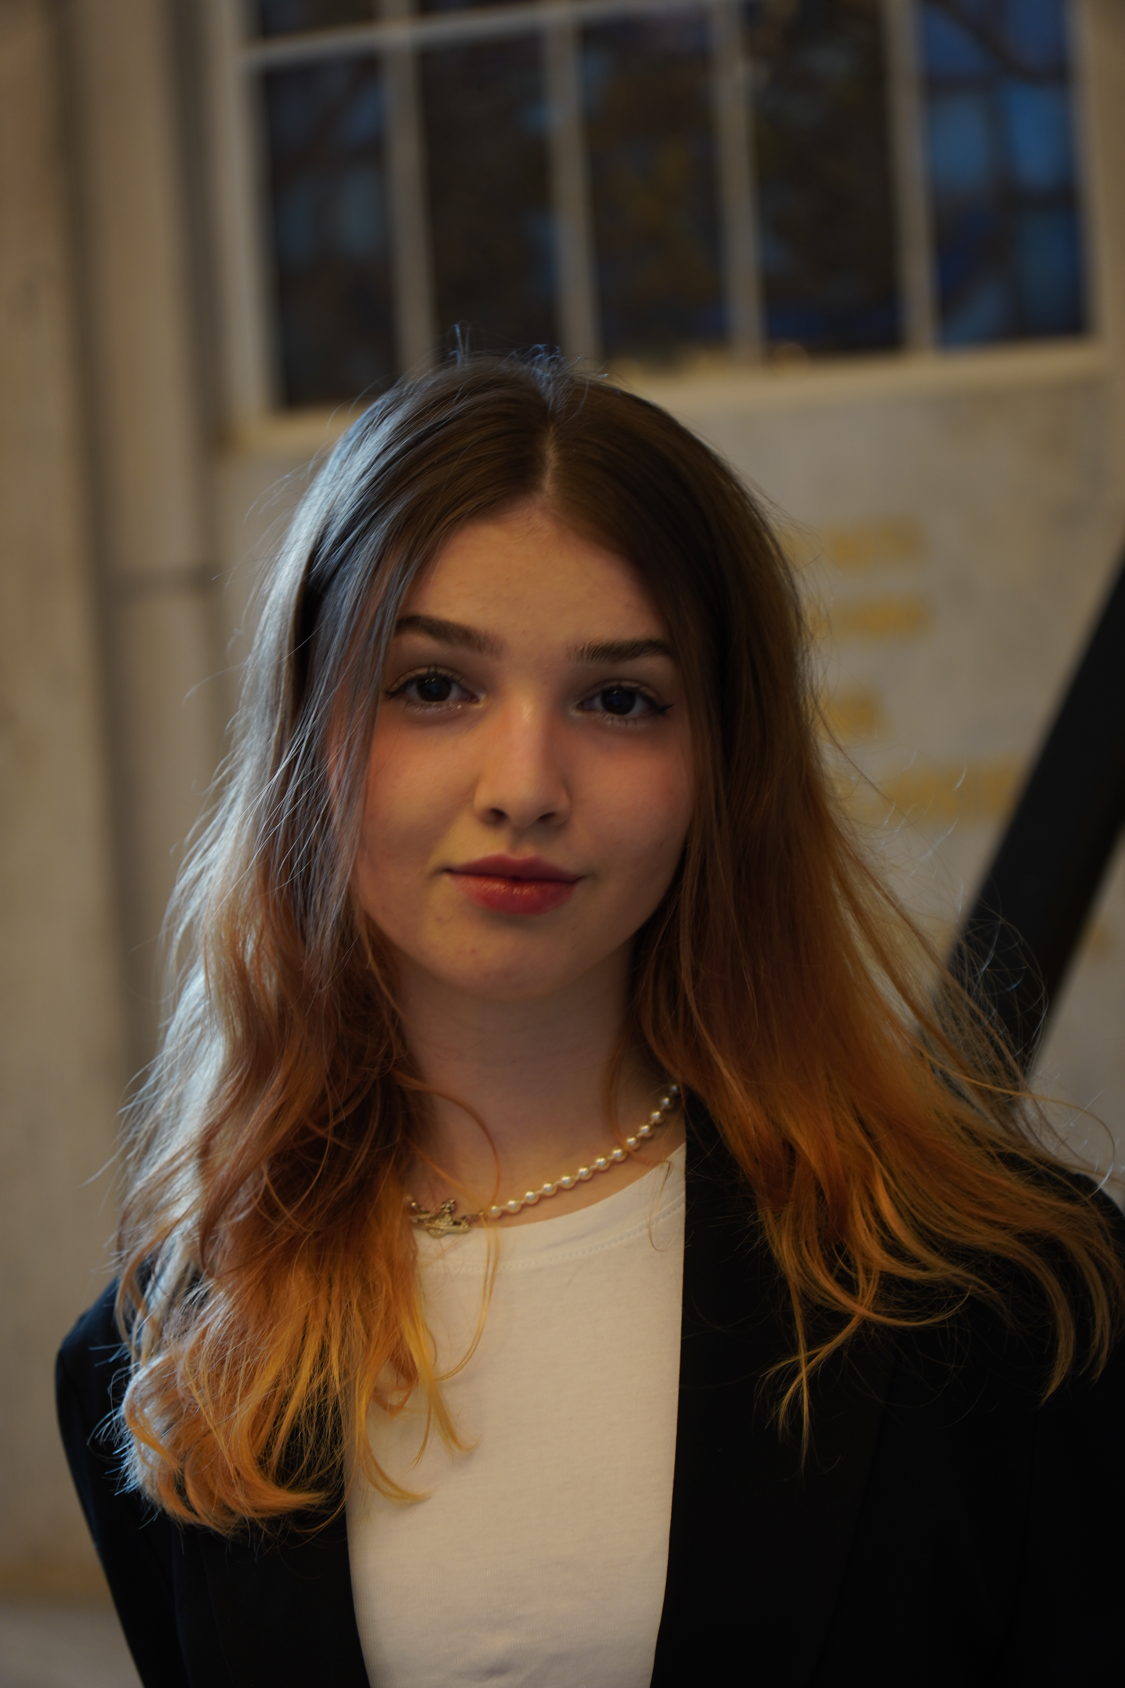
Who am I?
Dara Nitu
BaMed Student
from Romania
19yo
Love travelling, music and making good food for good people
Notes:
Feel free which information to share here,
Include pictures of yourself to visualise

Slide 22
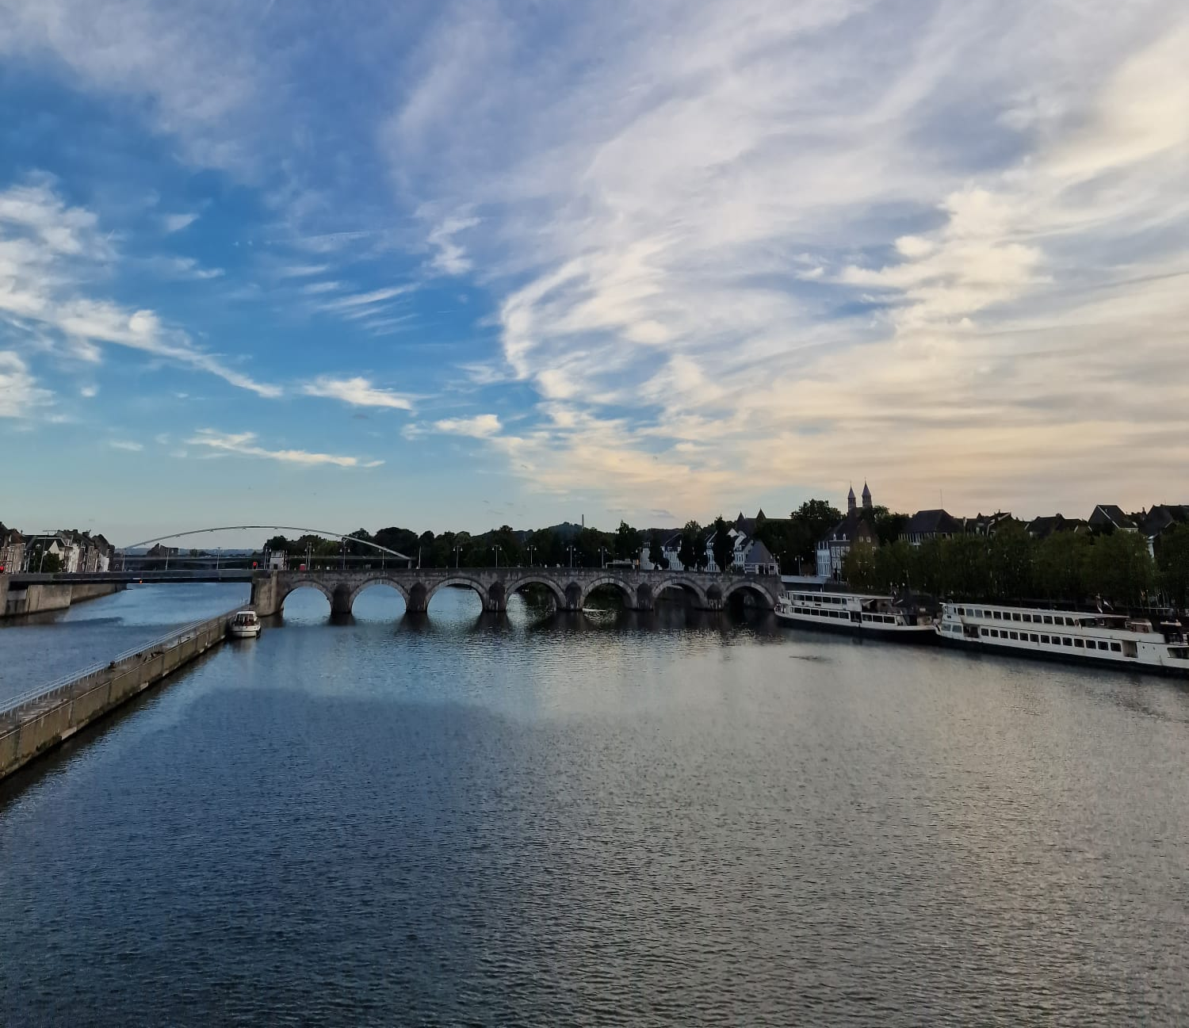
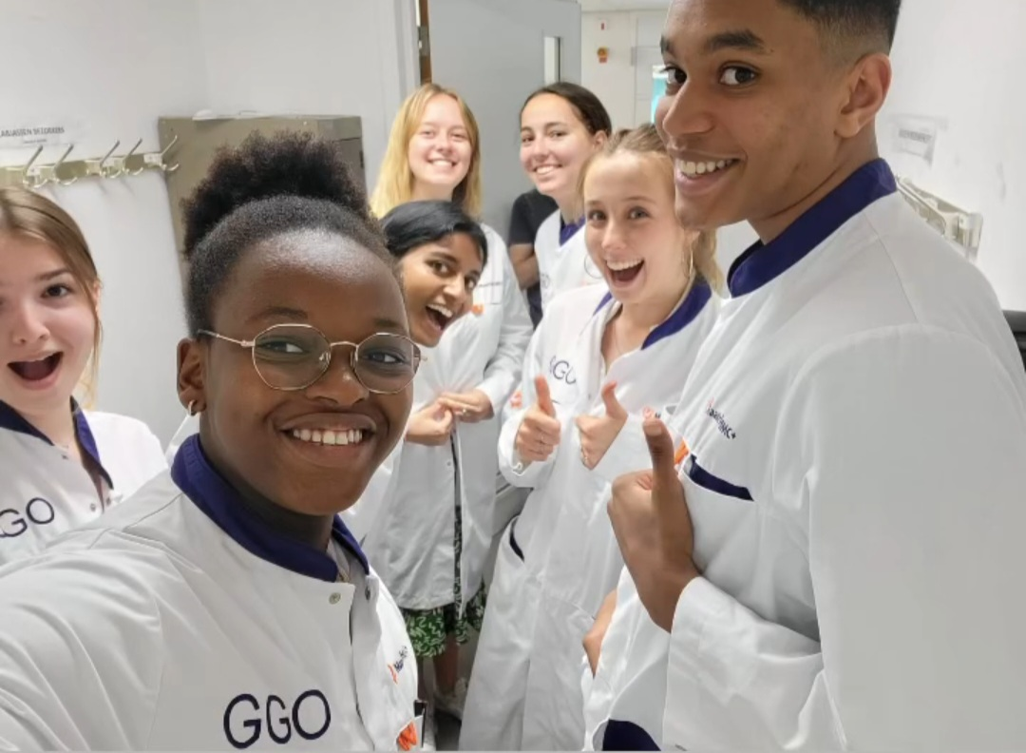
What is my background?
  Study background: High school in Bucharest (Romanian diploma) , BaMed student
  Why did I choose BaMed?
  Have always wanted to study medicine
  Unique curriculum – collaboration and self-regulation
  Numerous hands-on opportunities and closeness to professionals
  Lovely city
Notes:
Feel free which information to share here,
Include pictures of yourself to visualise

Slide 23
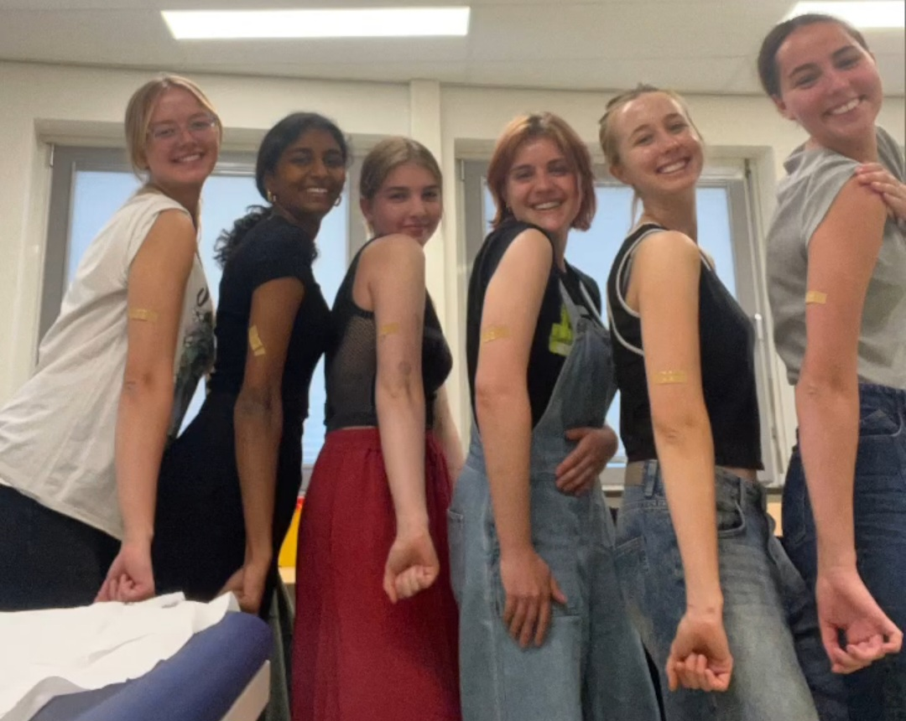
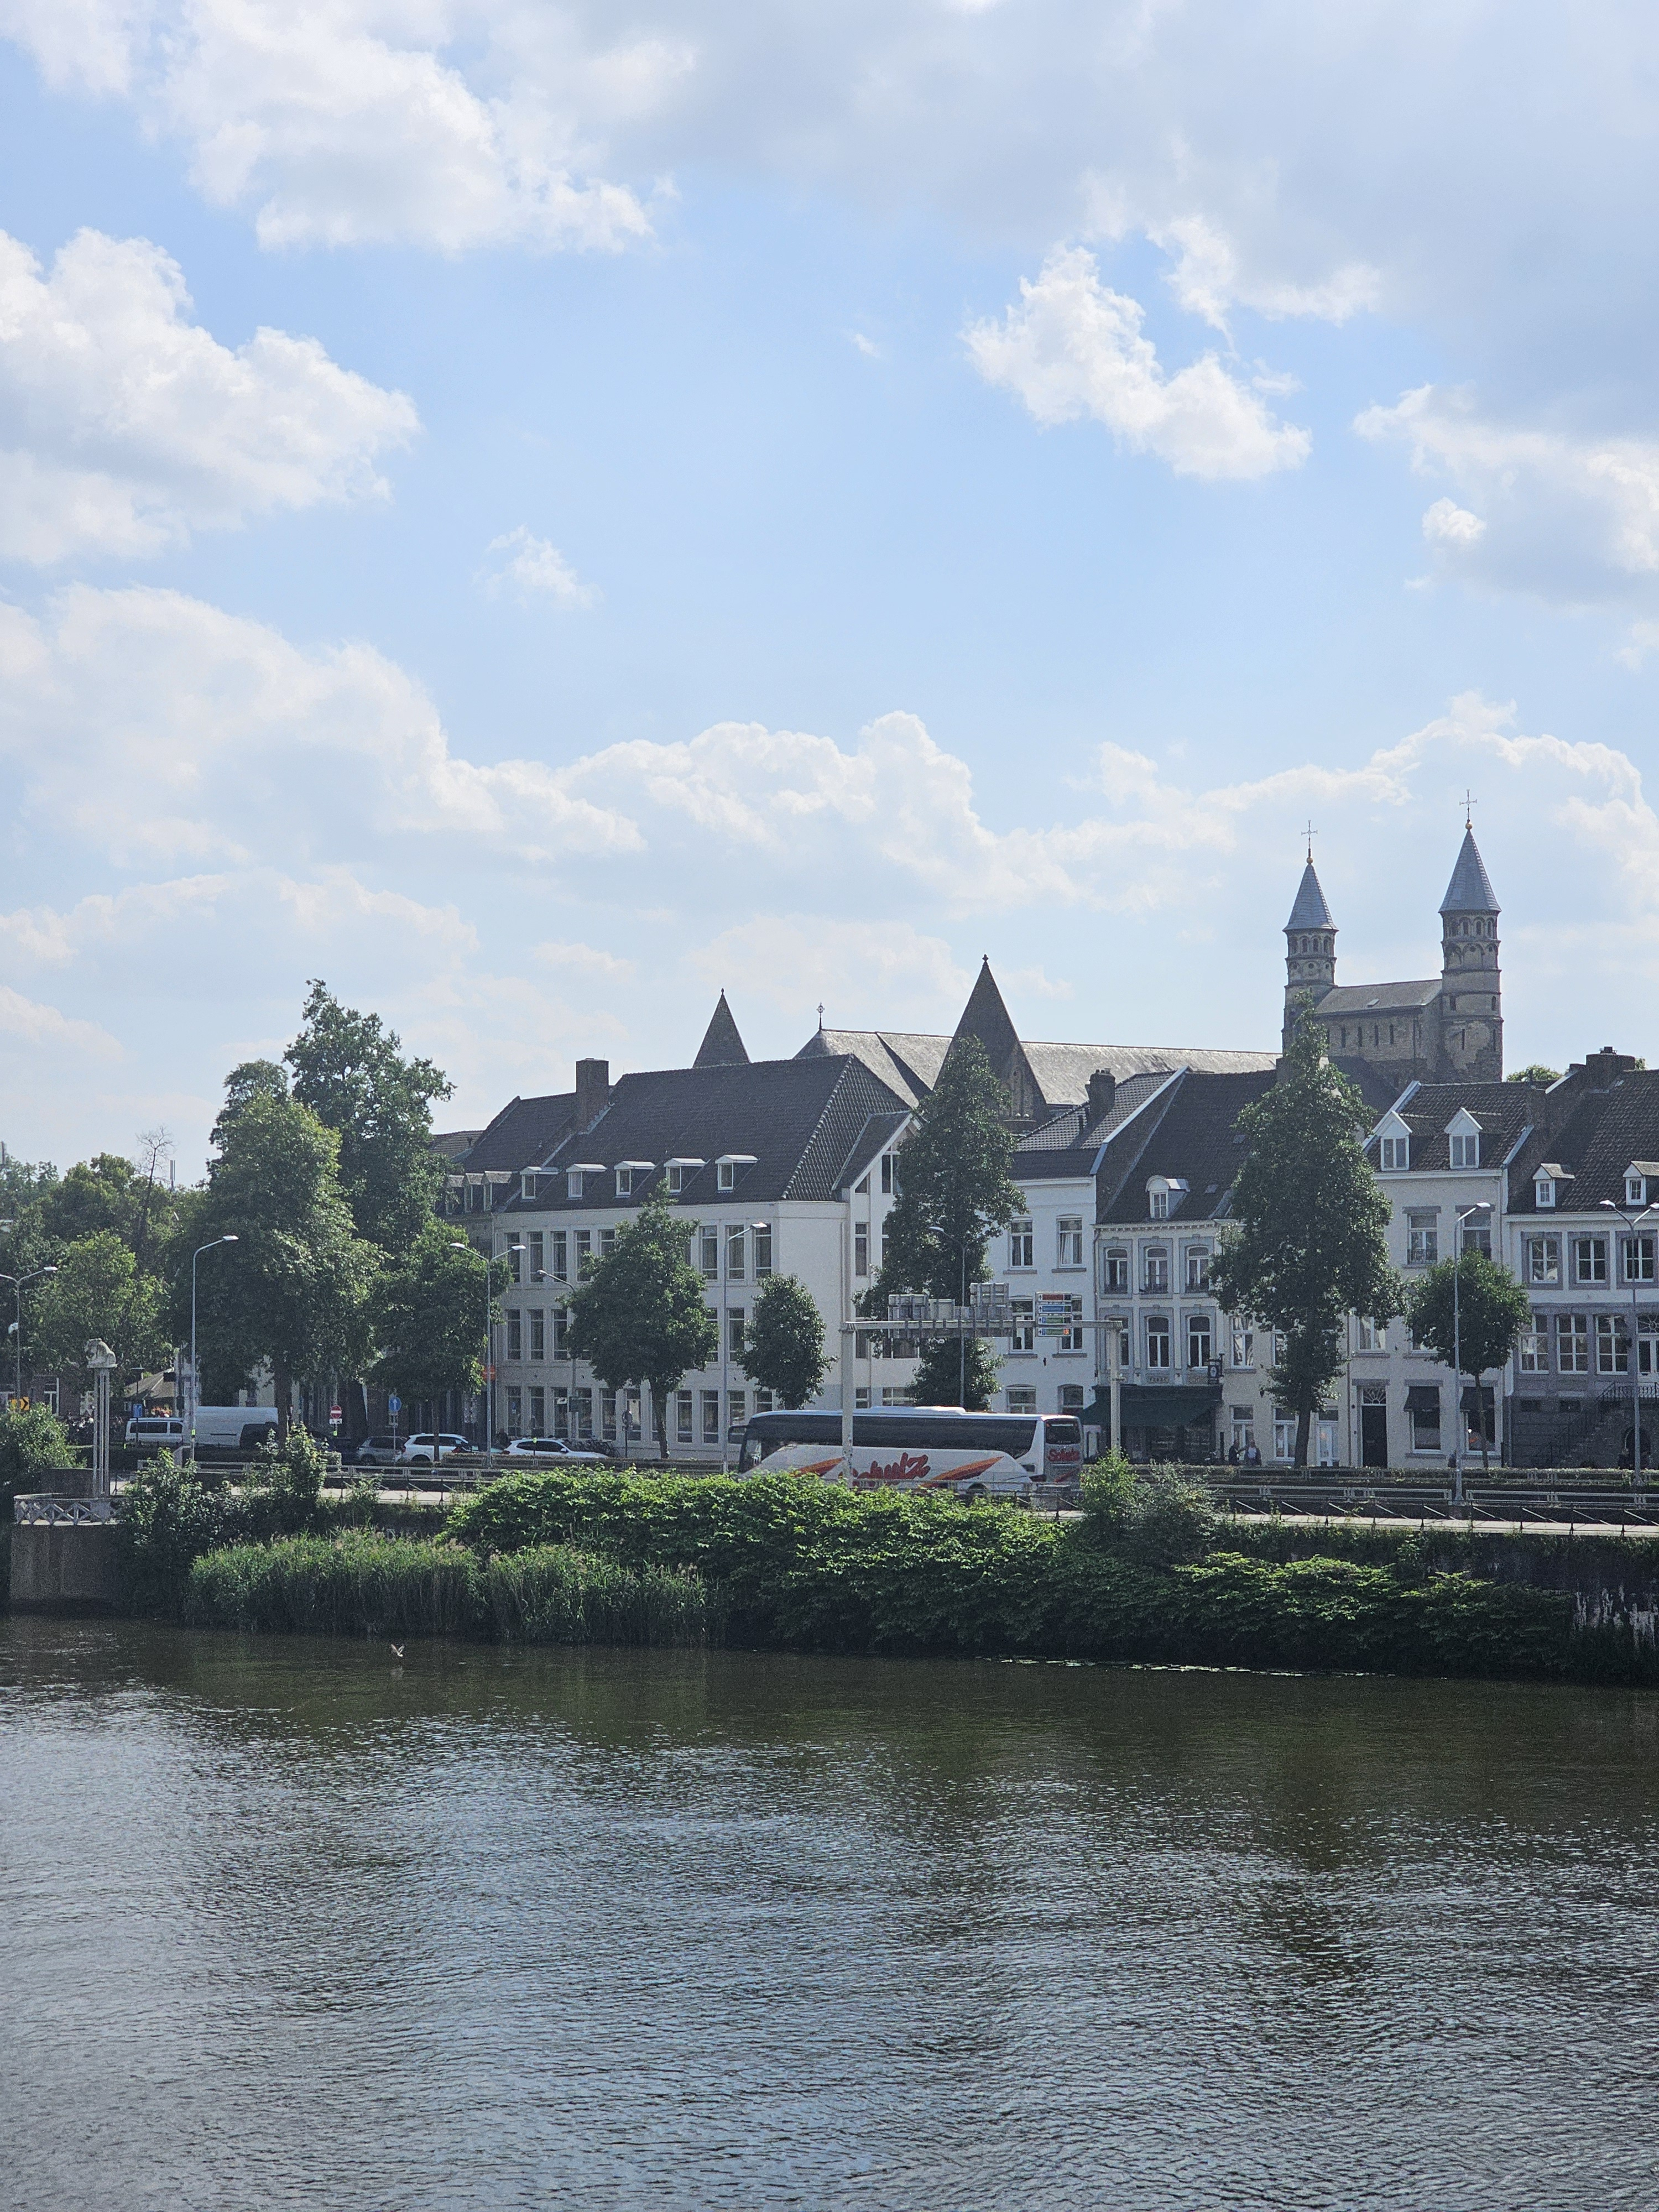
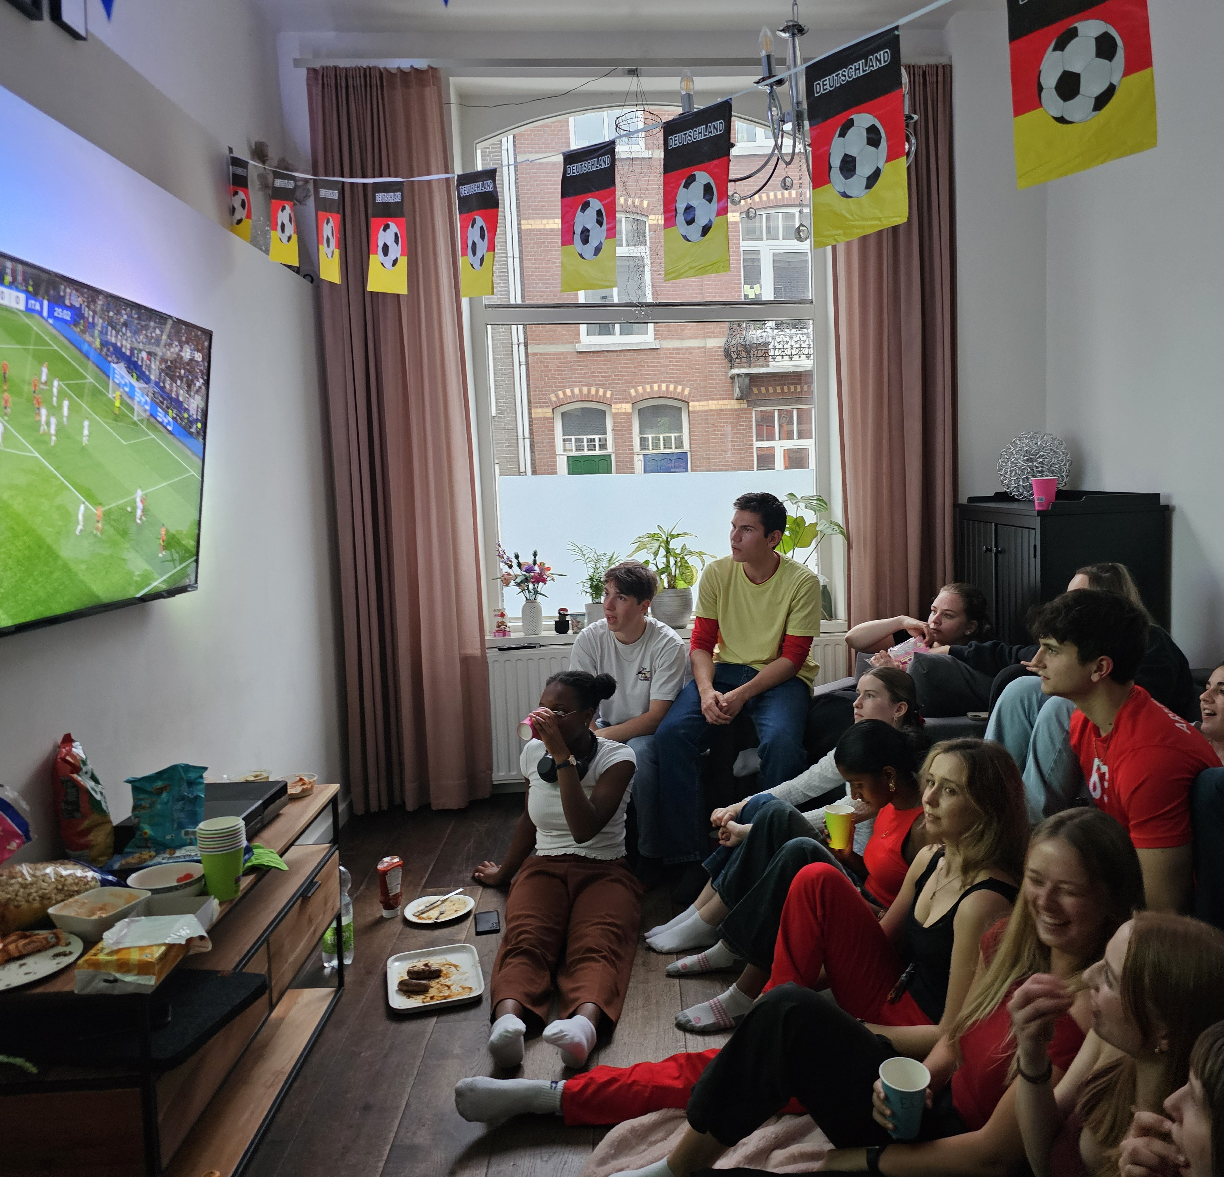
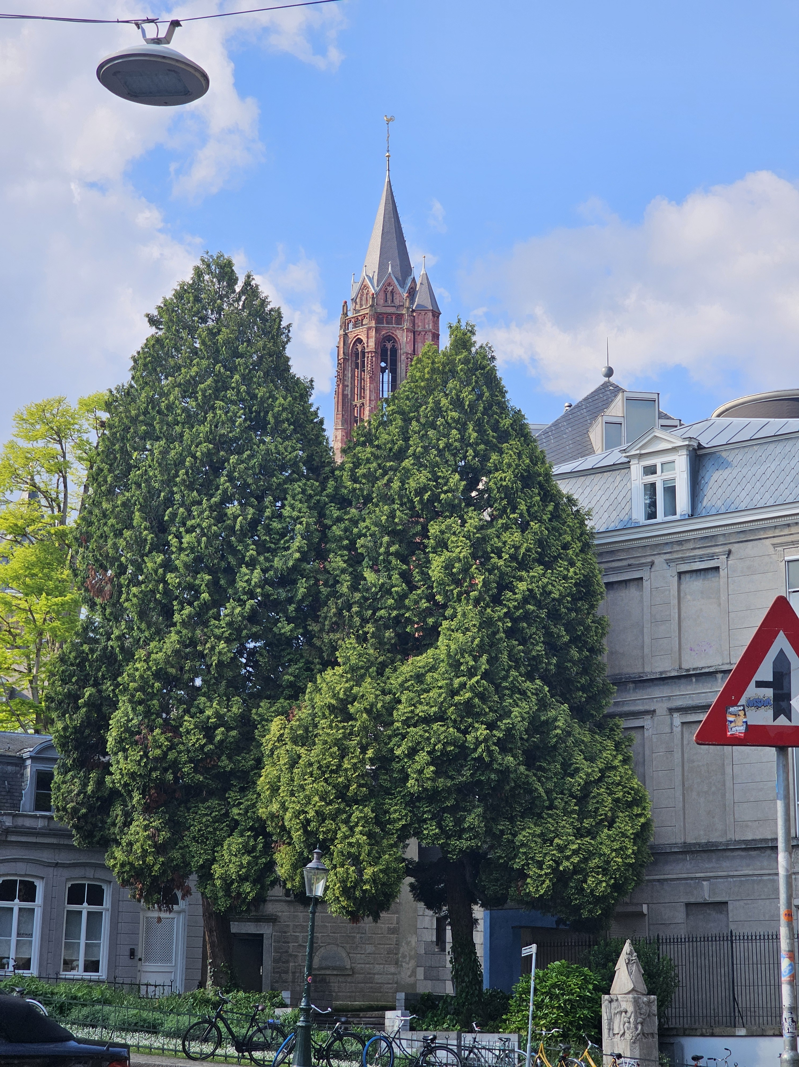
My recommendations for you as prospective students
  Get to know future classmates
  Understand thought behind program
  Do not hesitate to ask questions
  find the balance that works for you
  Start integrating Dutch into your life
Notes:
Feel free which information to share here,
Include pictures of yourself to visualise

Slide 24
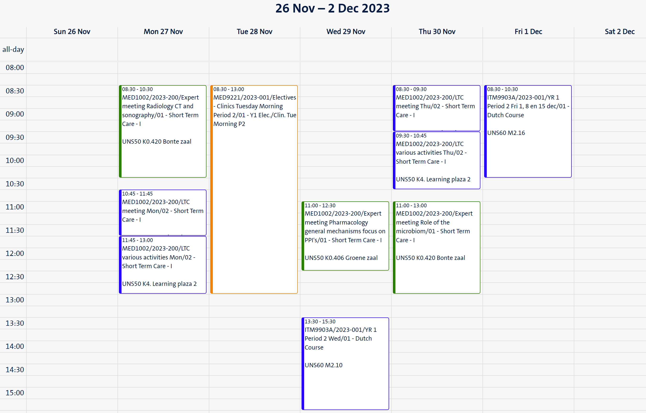
How does my week look like?
Notes:
Include a visual of your student portal or weekly calendar and explain how your week looks like

Slide 25
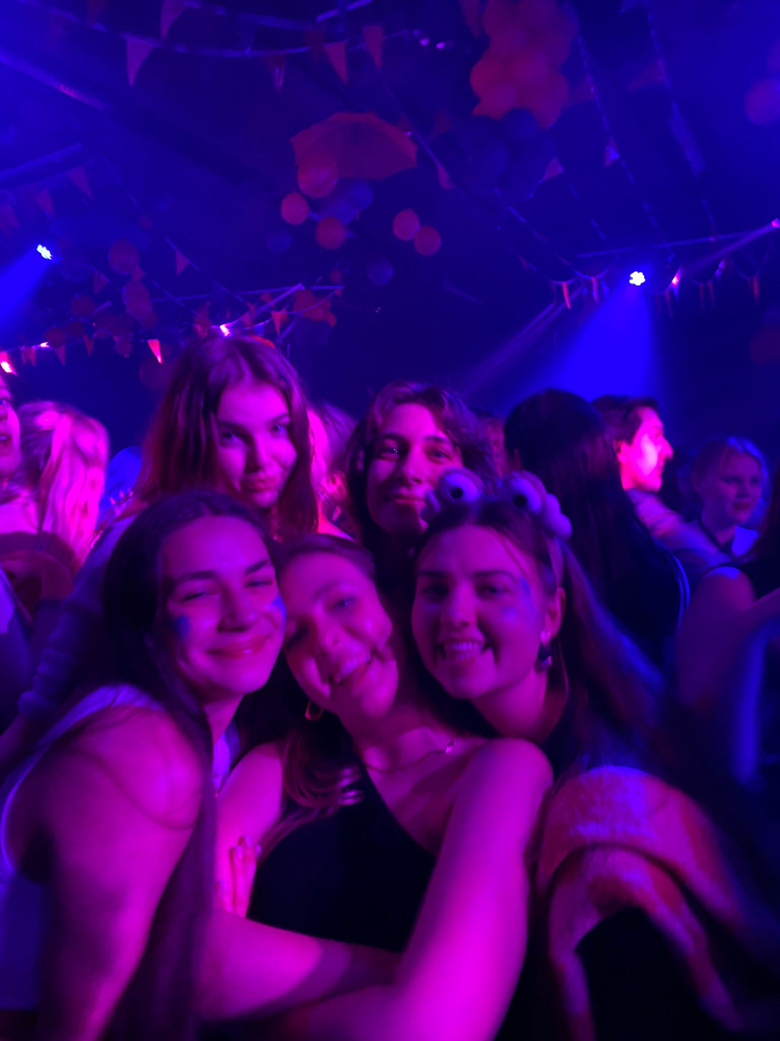
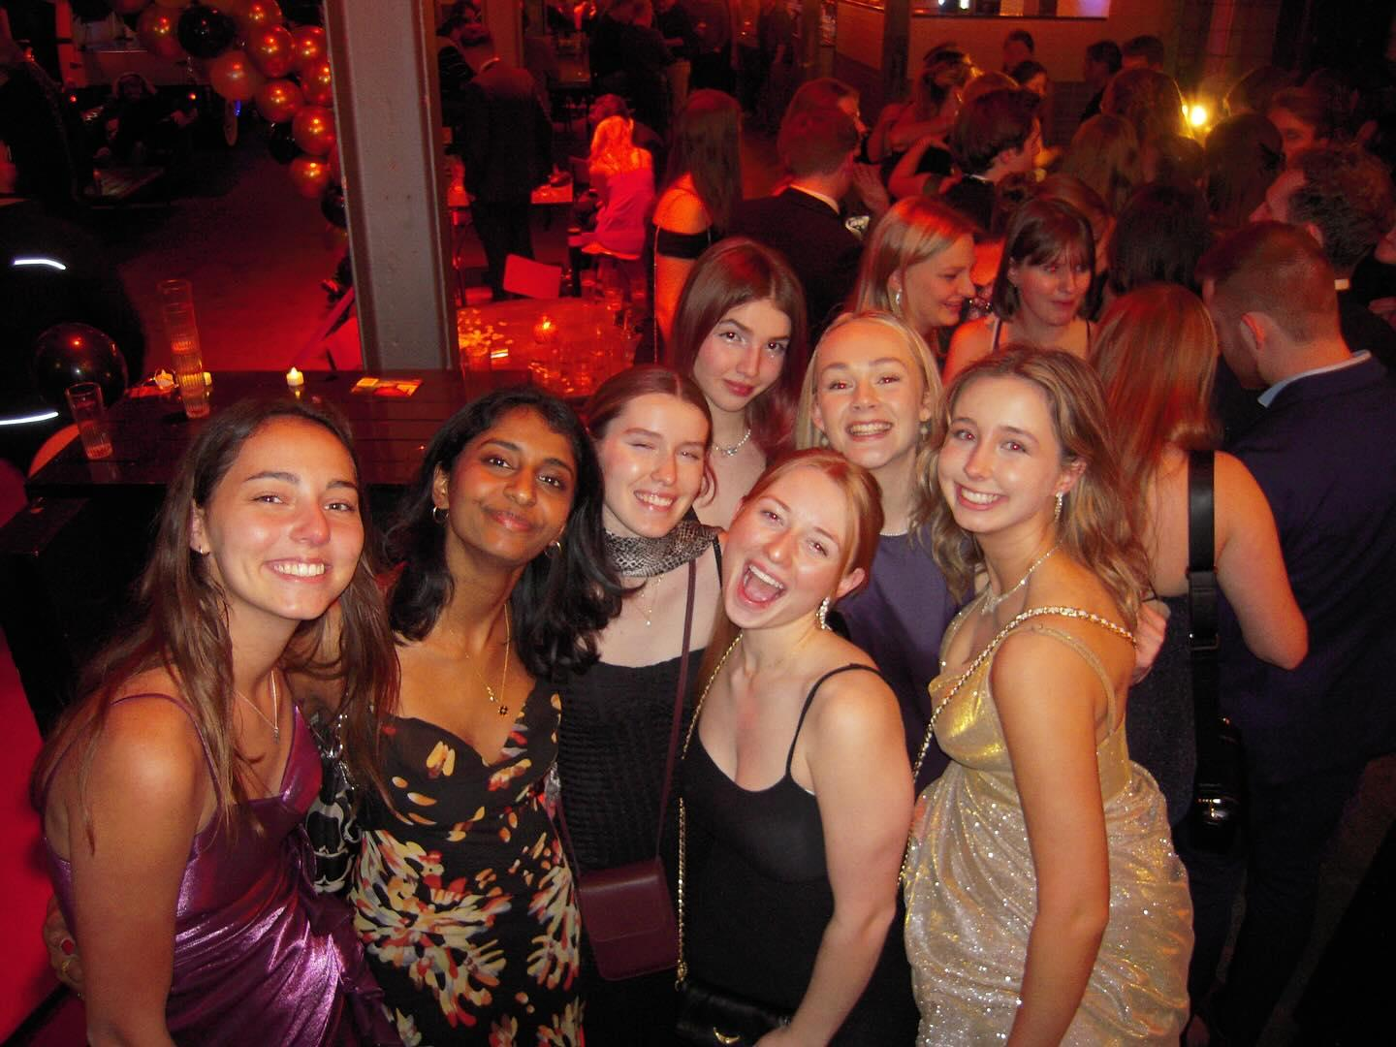
Student life in Maastricht
Randwyck Library
UM Sports
Associations
Friends
Travelling
Notes:
See an example of a best practise how to visualise on the next slide

Slide 26
Why study MED at UM?
Collaborative mentality
Personal and academic development
Lifelong learning
Likeminded peers
Notes:
If not yet covered in other slides ☺

Slide 27
Key dates and sources for practical information

Slide 28
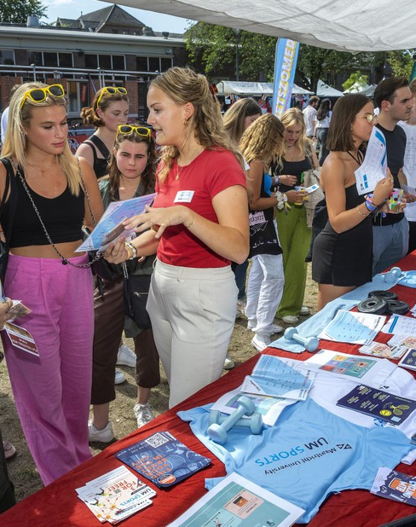
Important dates
INKOM Maastricht: 19 – 22 August 2024
Faculty Introduction Day: Tuesday 2 September 2024
Start of the academic year: 3 September 2024

Slide 29
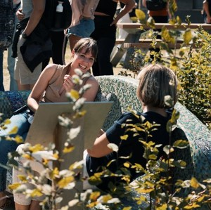
When to expect/where to find information
4 mails before/about the faculty introduction:
  15 July: save the date and practical information
  29 July: need to know information before the start of your study
  12 august: nice to know information before he start of your study
  Day before your introduction day: Last practical information and group number
Time schedules available 2 weeks before start of
the study
Study Association Pulse:
Organizes activities, both in the field of education and services and in the field of recreation, to make a useful, but also pleasant contribution to your student life.

Slide 30
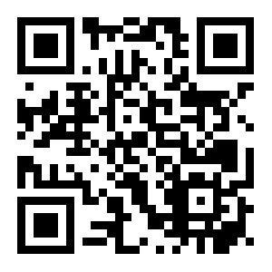

When to expect/where to find information
Questions about practical things such as housing, where to get a bike, or the student culture?
→ www.mymaastricht.nl
…or join their webinars on 8th July & 1st August

Slide 31
Join the WhatsApp group:
Connect with fellow students
Stay updated on the latest developments
Ask education-relation questions
Notes:
https://chat.whatsapp.com/Gil5RZ20iabAOyfj1WCtuD

Slide 32
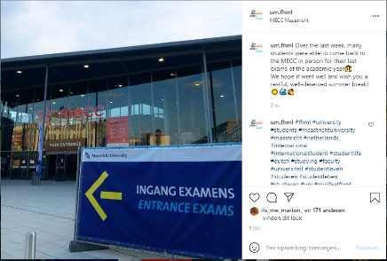
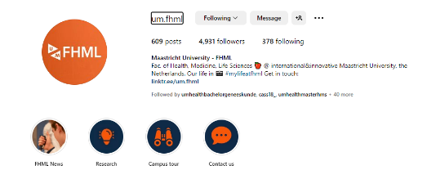

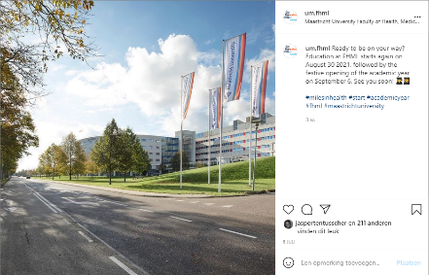
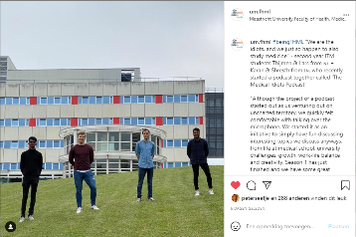
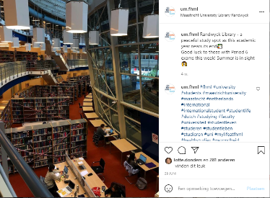
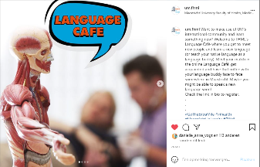

Slide 33
Time for
Questions & Answers!
Notes:
Wooclap question by Marleen: Answers live on screen

Slide 34
Thank you for joining
Have a great summer!
See you in August!
Notes:
By Marleen:
Mogelijkheid evt. Campus tour nog aanbieden → mailen naar study-fhml@maastrichtuniversity.nl

