Slide 1
Welcome to Maastricht University
Faculty of Health, Medicine and Life Sciences Meet & Greet BA EPH
28 juni 12:00 CET
Notes:
Marleen: Play music while this slide is in the background and students enter the session
Marleen starts with this slide and welcomes everyone and gives coordinator(s) and student ambassador the opportunity to introduce themselves shortly.

Slide 2
What is this session about?
Introduction: Let’s introduce ourselves
Curriculum and programme structure
Experiences of student Noemi.
Key dates and sources for practical information
Study association Eunitas
Time for questions
Notes:
Outline of the session:
Staff members and current student introduce themselves
Short introduction new students (Wooclap) → Where are you from? What do you expect of the first year? → by Marleen
Introduction of what students can expect of the first year/blocks, from us and of what we expect from our students by coordinator(s)
@ Coordinators: do students need to prepare anything before the start of their study?? → share it now
Experience with being a student (both studying and student life) by the current student ambassador
Dates and what to expect before starting your study → by Marleen
Settling down in Maastricht (as an international student) → My Maastricht and their webinars in summer
INKOM, faculty Introduction and start of the academic year
When to expect more information (mailings, calendarium, time schedules)
Time for questions! → by students (answers by student ambassador and staff members)
Still any doubts or questions → possibility to schedule a campus tour.

Slide 3
Let’s introduce ourselves

Slide 4
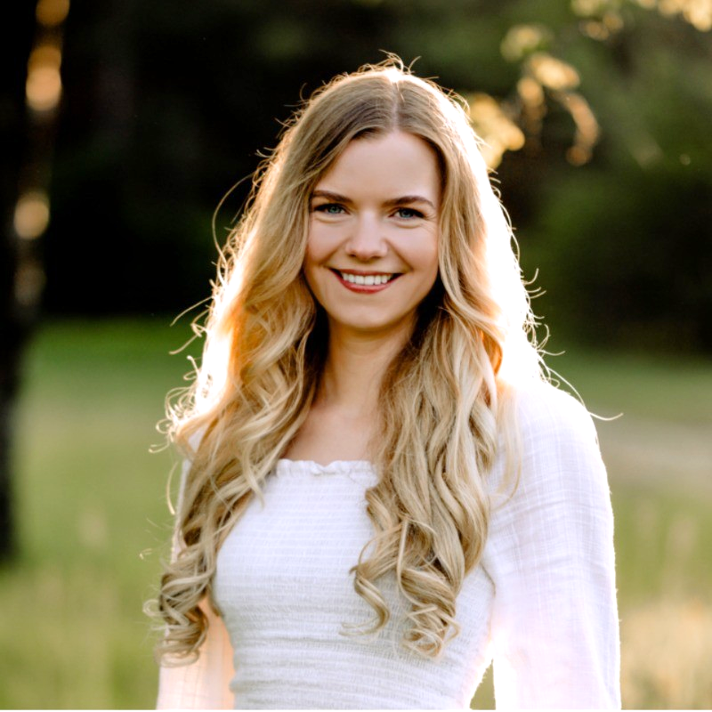
Let’s introduce ourselves
Matt Commers Programme Coordinator
Bachelor of European Public Health
Veerle Houben Bachelor recruiter FHML
Noemi Vasili Student European Public Health

Slide 5
WHERE ARE YOU FROM?

Slide 6
WHAT DO YOU EXPECT FROM YOUR STUDY OF EUROPEAN PUBLIC HEALTH?

Slide 7
Curriculum and programme structure

Slide 8
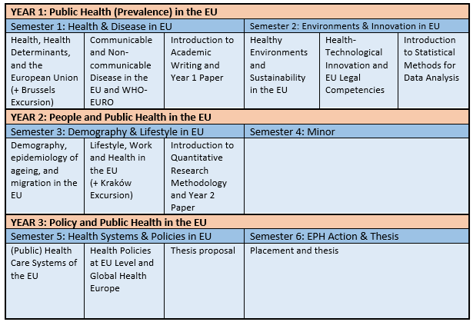

Slide 9
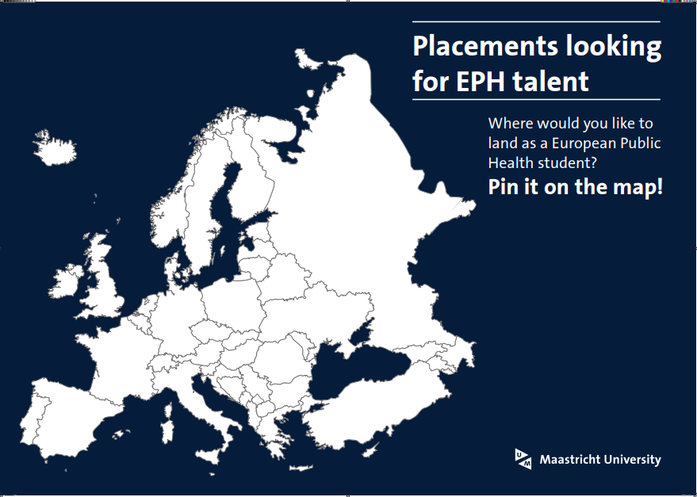

Slide 11
Experiences of Noemi

Slide 12
Experiences of Noemi
Settling down in Maastricht
Housing
Check your health insurance
Explore Maastricht

Slide 13
Experiences of Noemi
First weeks as a student in Maastricht and student life
INKOM
Meet your fellow UM students and have fun!
Introduction to study associations and sports offer
Faculty introduction
FHML and Meet EPH students
Start of the study and first tutorial group

Slide 14
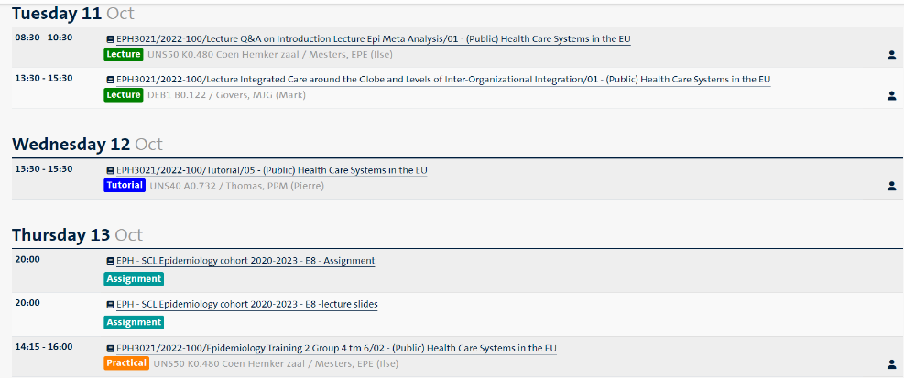

Slide 15
Experiences of Noemi
Way of studying
Tutorials (8- 12 students)
Problem based learning (PBL)
Lectures (interactive)
Active Recall (asking questions)
Quizzes
Studying in groups

Slide 16
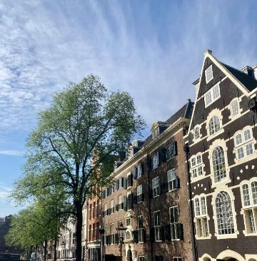
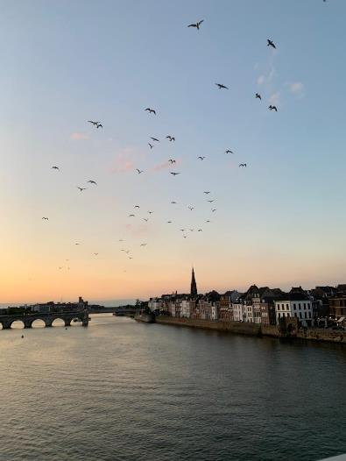
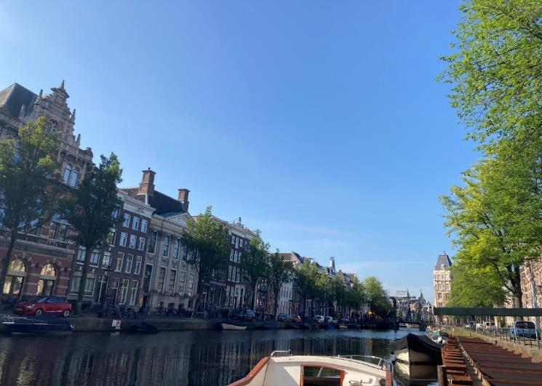
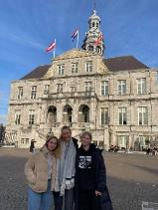
Experiences of Noemi
Best tips for new students
Take part in INKOM
Join EUnitas and UM Sports (and other associations/ projects if you like)
Get a bike (for example Swapfiets or find a second hand bike)
Take the opportunity to travel

Slide 17
Key dates and sources for practical information

Slide 18
Important dates
INKOM Maastricht: 19 - 22 August 2024
Faculty Introduction Day: Tuesday 27 August 2024
Start of the academic year: 2 September 2024

Slide 19
When to expect/where to find information
4 mails before/about the faculty introduction:
15 July: save the date and practical information
29 July: need to know information before the start of your study
12 august: nice to know information before he start of your study
Day before your introduction day: Last practical information and group number
Time schedules available 2 weeks before start of the study
Study Association EUnitas: Organizes activities, both in the field of education and services and in the field of recreation, to make a useful, but also pleasant contribution to your student life.

Slide 20
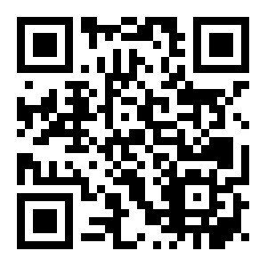
When to expect/where to find information
Questions about practical things such as housing, where to get a bike, or the student culture? → www.mymaastricht.nl
…or join their webinars on 8th July & 1st August

Slide 21
Join the WhatsApp group:
Connect with fellow students
Stay updated on the latest developments
Ask education-relation questions
Notes:
https://chat.whatsapp.com/Gil5RZ20iabAOyfj1WCtuD

Slide 22
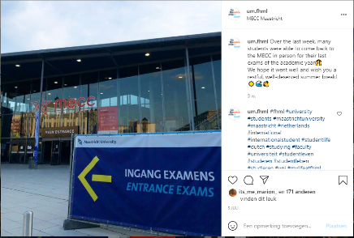
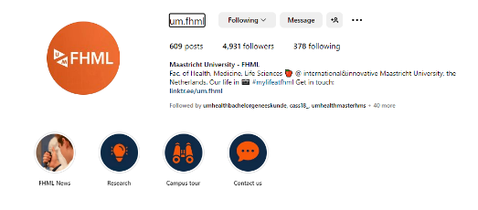
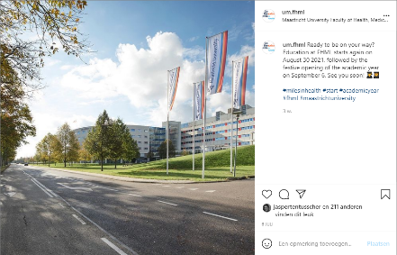
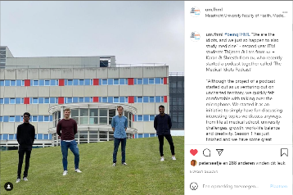
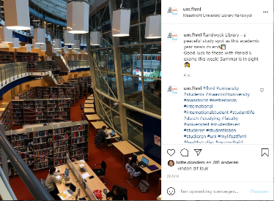

Slide 23
Study association

Slide 24
EUnitas - European Public Health Student Association
@eunitas_um

Slide 25
Our Mission
We are the voice of ALL student of European Public Health Bachelor
Our goal is to make the life of the students of our programme rewarding and fun, both in the education and in social environment!

Slide 26
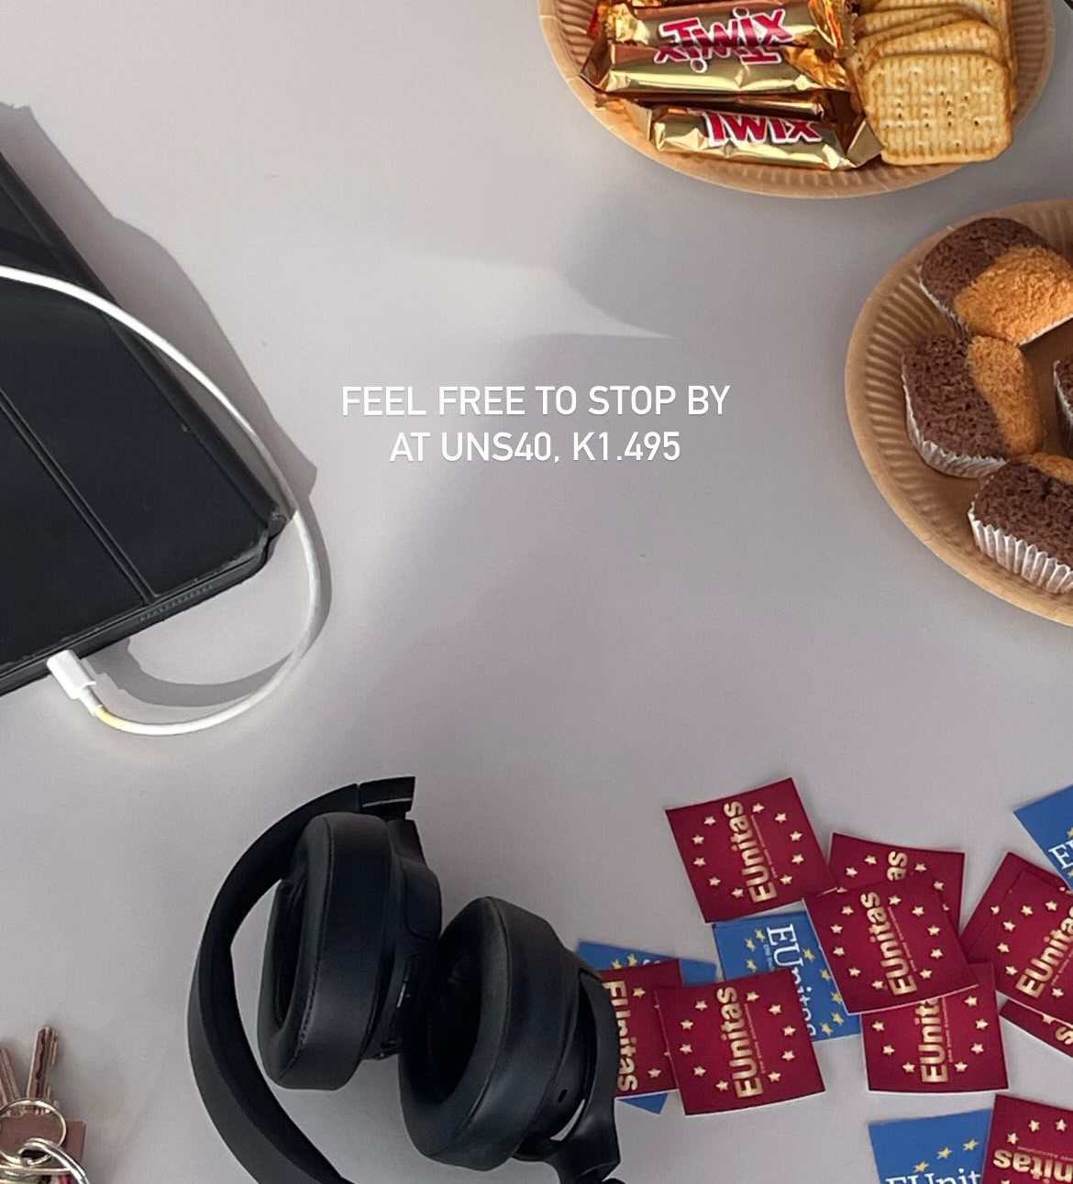
EUnitas’ previous activities!

Slide 27
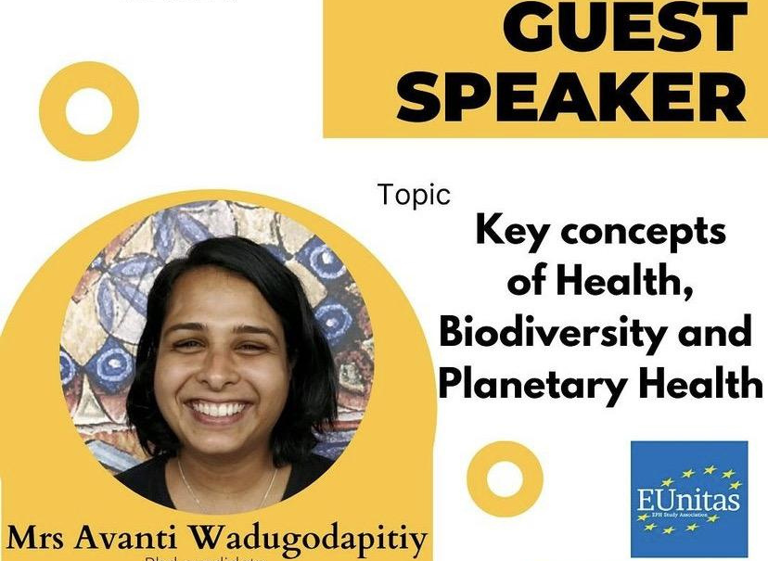
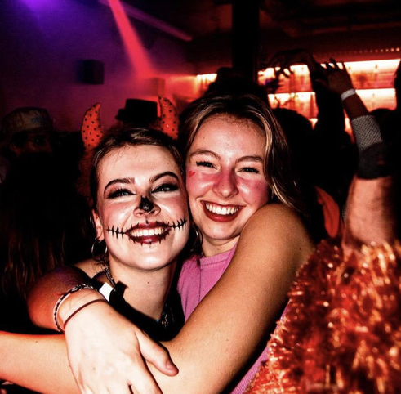
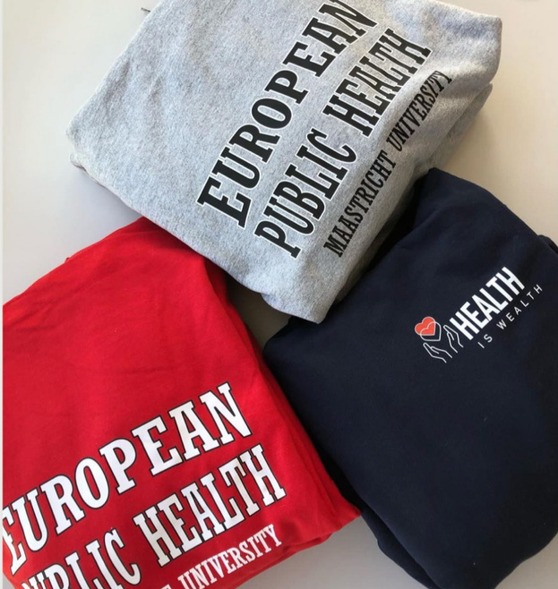

Slide 28
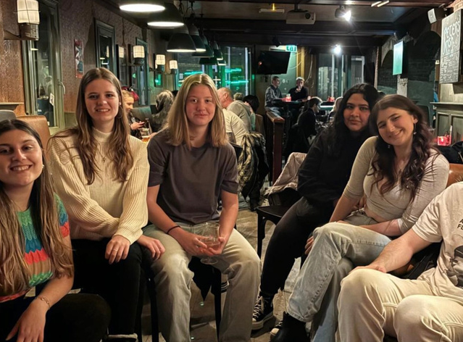
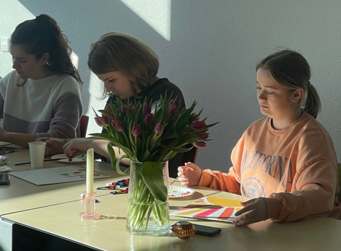
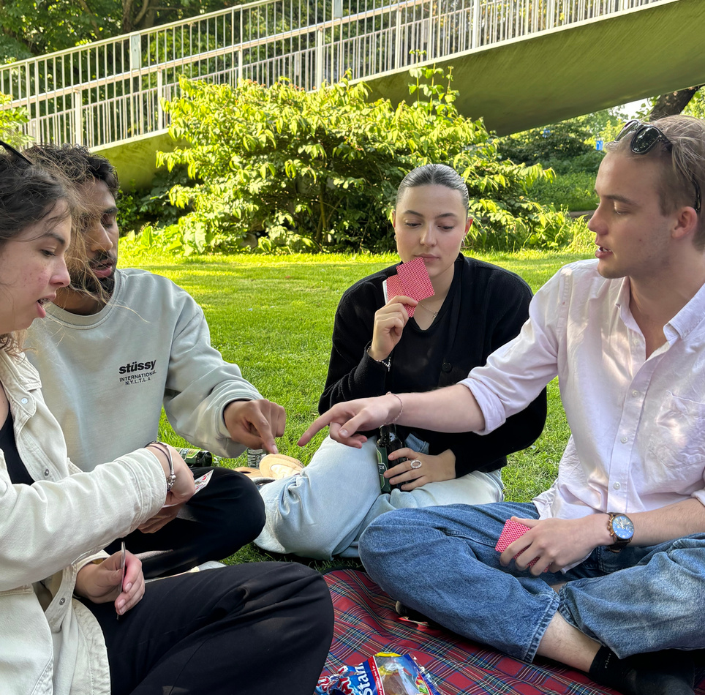
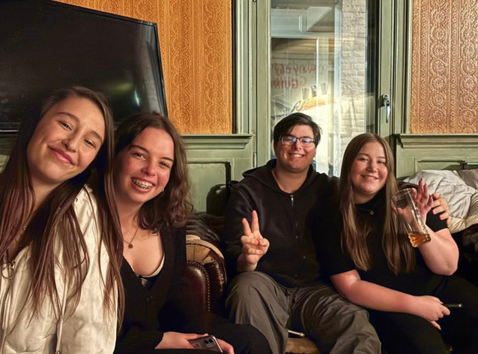
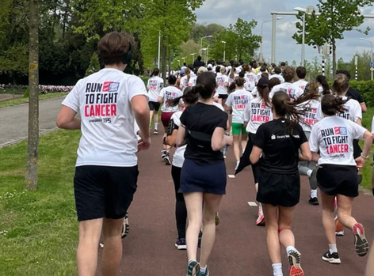

Slide 29
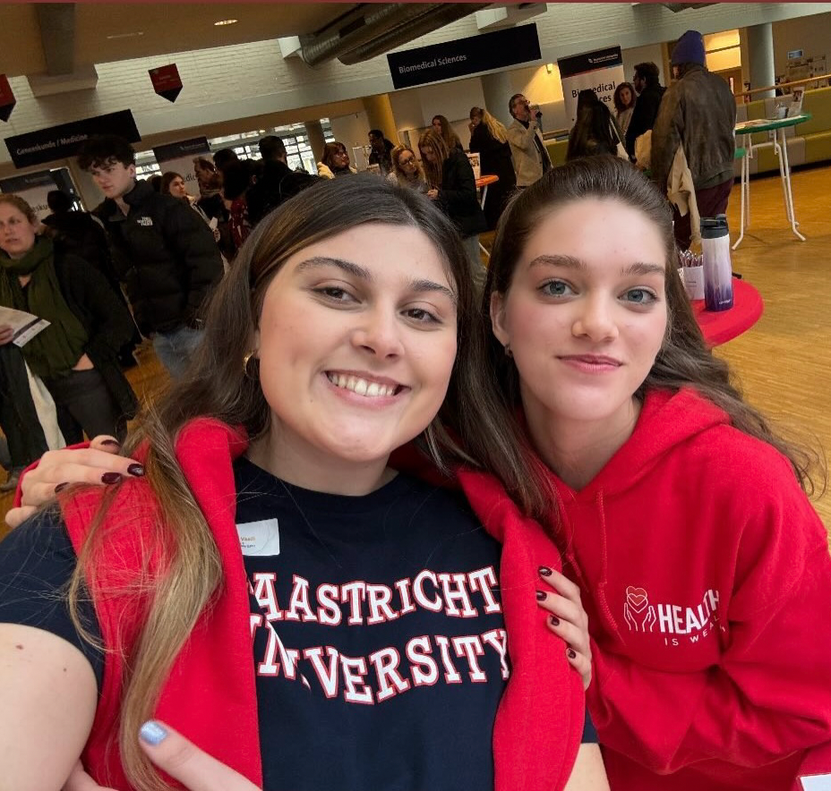
Our current projects!

Slide 30
Student Evaluation Panel
Working to make a difference!

Slide 31
Let’s chill together!
Networking activities!

Slide 32
“From students to students” Soon!
Interested in studying for a minor abroad or having an internship at the European Commission?
Follow our social media for firsthand experiences shared by fellow students and study tips!
@eunitas_um

Slide 33
Follow us on social media and keep an eye on updates!
Linkedin:
EUnitas (Study Association)
Instagram
@eunitas_um
Facebook:
@EUnitas

Slide 34
Do you have a question or need any help?
Don't hesitate to contact us via email:
Eunitas@maastrichtuniversity.nl
or
Come to our office at UNS 40 K1.495

Slide 35
Time for Questions & Answers!
Notes:
Wooclap question by Marleen: Answers live on screen

Slide 36
Thank you for joining
Have a great summer!
See you in August!
Notes:
By Marleen:
Mogelijkheid evt. Campus tour nog aanbieden → mailen naar study-fhml@maastrichtuniversity.nl

