Slide 1
Welcome to Maastricht University
Faculty of Health, Medicine and Life Sciences Meet & Greet BA BMS
25 juni 12:00 CET

Slide 2
What is this session about?
Introduction: Let’s introduce ourselves
Curriculum and programme structure
Experiences of Chemène
Key dates and sources for practical information
Study association Eunitas
Time for questions

Slide 3
Let’s introduce ourselves

Slide 4
WHERE ARE YOU FROM?

Slide 5
WHAT DO YOU EXPECT OF STUDYING BIOMEDICAL SCIENCES?

Slide 6
Curriculum and programme structure

Slide 7
Courses year 1 Biomedical Sciences
Period 1
Period 2
Period 3
Period 4
Period 5
Period 6
The Lego® bricks of life
Homeostasis and organ systems
Statistics
Brain Function, Behaviour and Movement
Human Genetics, Reproduction and Prenatal Development
Critical Appraisal of Biomedical Publication
Disciplines
Anatomy, Biochemistry, Cell Biology, Genetics, Histology, Methodology, Neurosciences, Physiology,Statistics

Slide 8
Entire programme at a glance
Period 1
Period 2
Period 3
Period 4
Period 5
Period 6
Course 1.1
Course 1.2
C 1.3
Course 1.4
Course 1.5
C 1.6
Year 1
E2.6a
Course 2.1
Elective 2.4a
Elective 2.5a
Year 2
Course 2.2
C 2.3
E2.6b
Elective 2.4b
Elective 2.5b
E2.6c
Minor
Free 3.4
Bachelor Thesis
Year 3
Notes:
Indication of year structure (blokken, weeks, exams)
Knowledge (give examples of first year courses)
Research skills (what)
Academic skills: scientific thinking, critical reading, presentation and writing skills
Aanpassing minoren

Slide 9
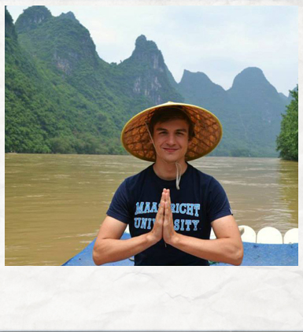
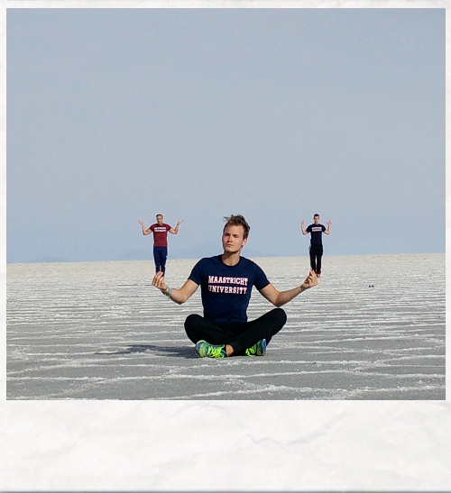
International Exchange
Minor or thesis
Own responsebility
Additional costs
Notes:
That brings me to the third new ingredient, what we call the BioMEDs. We think that to be successfull as a biomedical scientist you need more than only knowledge of the processes that are present in the human body. You will have to be able to communicate about your work, to collaborate, to organize your work, to set your goals, to be curious and to have passion for what your are doing . This is not something that we figured out completely ourselves, but which as has also been acknowledge by others.
English:
Language of labour market
Allows international admission and provides experience with cultural diversity
Personalize:Explosively knowledge domain, you have to know the basics and find and define your own profile ➔ BMS@UM gives you a wide range of options
Show programme lay-out and stress opportunities to personalise

Slide 10
What makes BMS@UM special
English
A broad programme with many options to personalize
More than merely biomedical knowledge
Notes:
LD: misschien leuk om hier ook honours programma van FHML te benoemen voor studenten die (nog) meer uitdaging zoeken – Eleonora heeft dit ook gedaan.
That brings me to the third new ingredient, what we call the BioMEDs. We think that to be successfull as a biomedical scientist you need more than only knowledge of the processes that are present in the human body. You will have to be able to communicate about your work, to collaborate, to organize your work, to set your goals, to be curious and to have passion for what your are doing . This is not something that we figured out completely ourselves, but which as has also been acknowledge by others.
English:
Language of labour market
Allows international admission and provides experience with cultural diversity
Personalize:Explosively knowledge domain, you have to know the basics and find and define your own profile ➔ BMS@UM gives you a wide range of options
Show programme lay-out and stress opportunities to personalise

Slide 11
Biomedical
Expert
Investigator
Scholar
Collaborator
Communicator
Professional
Organizer
Notes:
http://www.astrozine.nl/geluk/zaaien-en-oogsten/

Slide 12
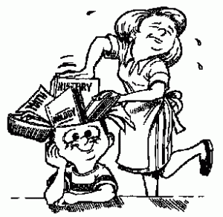
You learn, we support
Notes:
Benoemen mentoraat – begeleiding studenten

Slide 13
You enjoy
Being challenged to unravel the origin of health and disease
Being submerged in an international atmosphere
Taking responsibility over your future
Working on and reflecting on self-development
Searching information source, not be channeled in a specific direction
Notes:
-kleinschalig: Biomedische Wetenschappen heeft jaarlijks ongeveer 400 nieuwe studenten, dat lijkt veel maar doordat we werken in onderwijsgroepen van 10-12 studenten, is het toch kleinschalig met veel aandacht voor individuele studenten
Dat werkt ook activerend, enerzijds door dat je met echte problemen werkt, maar ook doordat je je in de kleine groepen niet goed kunt verstoppen, je moet je onderwijsgroepsbijeenkomst voorbereiden, dat betekent dus dat je je stof moet bijhouden, niet opeens 3 dagen voor de toets kunt bedenken, o ik had eigenlijk misschien toch eerder met leren moeten beginnen.
Levenslang leren, cultuur van …., je leert hier om te leren, hoe je dat aanpakt, je ontwikkelt ook een attitude van als ik iets wil weten dan weet ik waar en hoe ik er achter kan komen, zelfredzaamheid en zelfstandigheid
Maar ook presentatievaardigheden e.d. noemen.
Volgens Johnson creëert leren in coöperatieve studentengroepen mogelijkheden die individueel en/of competitief leren niet kan bieden. Leren hoe discussies te voeren, concepten begrijpen, feedback ontvangen door student-collegae en door hun gestimuleerd en ook verantwoor-delijk gemaakt worden voor dingen uit te zoeken en te onthouden, steun bieden, rolmodellen in student-collegae zien en vinden, houdingen en instellingen veranderen zijn voorbeelden van wat mogelijk is door coöperatief leren in kleine groepen. Volgens het Centre of Interprofessional Educa-tion, University of Toronto, 2013, zijn de kenmerken van een goed functionerende groep:
• Participants know what is expected of them and their individual goals are consistent with those of the overarching team
• There is a healthy balance between structure and spontaneity
• Power and authority is used in the interests of the team
• The team is cohesive and participants feel safe and trusting
• Information is shared across the membership of the team
• Leadership is facilitative rather than controlling
• Conflict and disagreement are viewed as opportunities for growth
• Communication is overt and direct
• Communication flows between all members and participants
• Being part of this team enhances personal and professional effectiveness and wellbeing

Slide 14
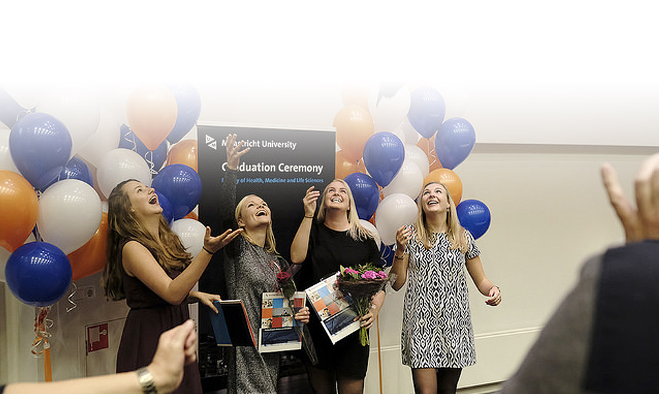
After the Bachelor …

Slide 15
Masters
BioMedical Sciences
Genetics & Genomics
Inflammation & Pathophysiology
Metabolism, Nutrition & Physical Activity
Regenerative Medicine
Biomedical Imaging
Neuromodulation
Health Food Innovation Management
Human Movement Sciences

Slide 16
Career perspectives
Research Universities, research institutes, Philips, Unilever, Danone, pharmacy, biotechnology), hospitals
Education Universities, universities for applied science
Commerce Biotechnology companies, consultancy, insurance companies
Communication Health education, journalism
Notes:
Career development
Science Cafe
Track MSc BMS – bedrijfsleven

Slide 17
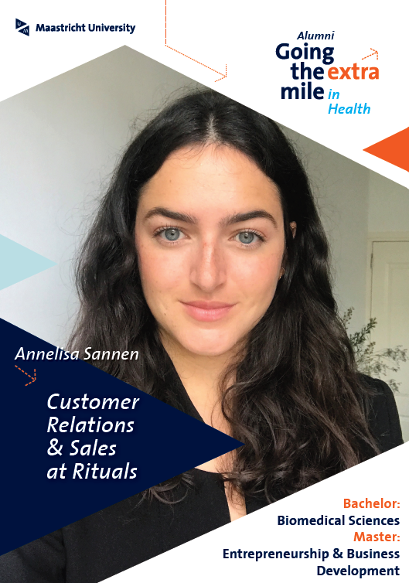
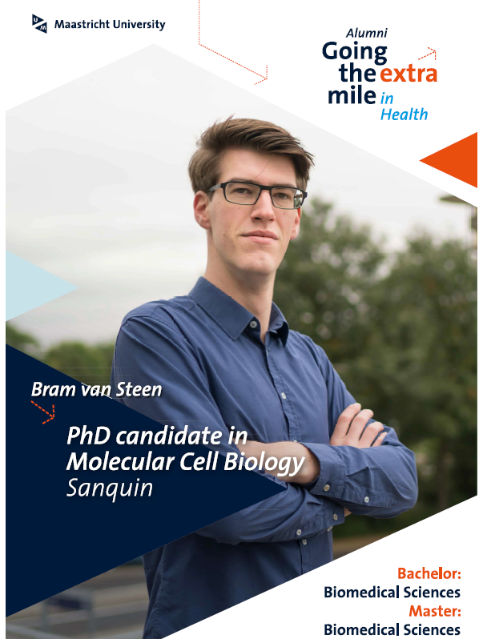
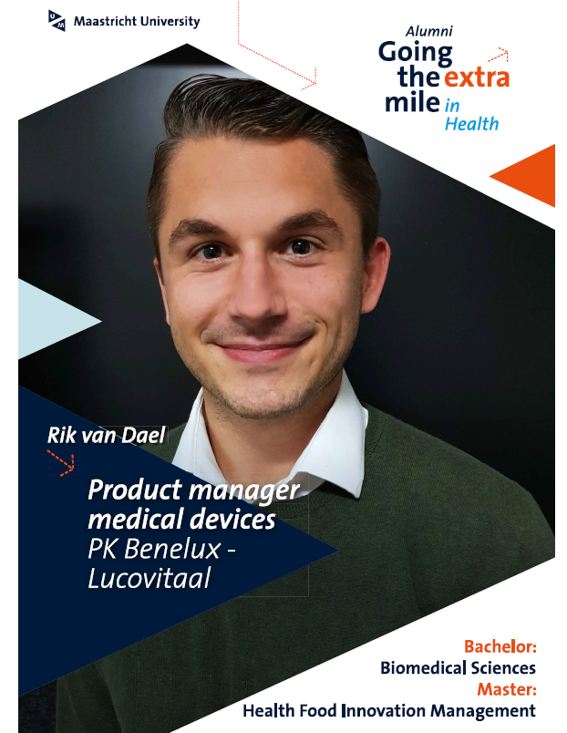

Slide 18
Experiences of Chemène

Slide 19
Who am I?
19 years old
Dutch
2nd year Biomedical Sciences
Creative
Biology

Slide 20
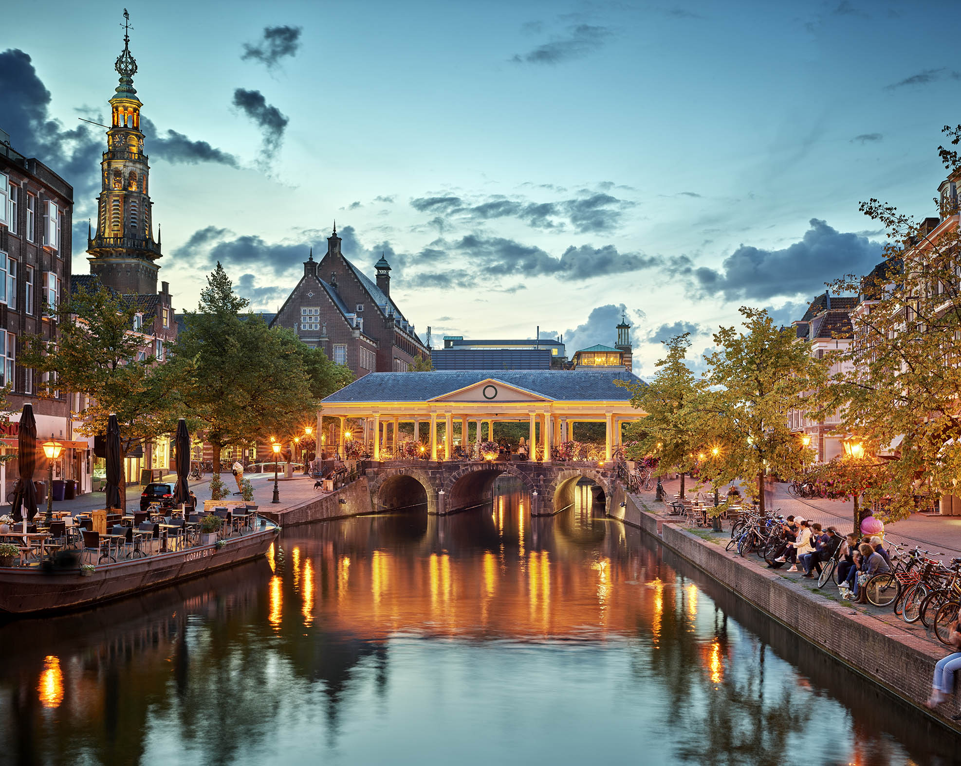
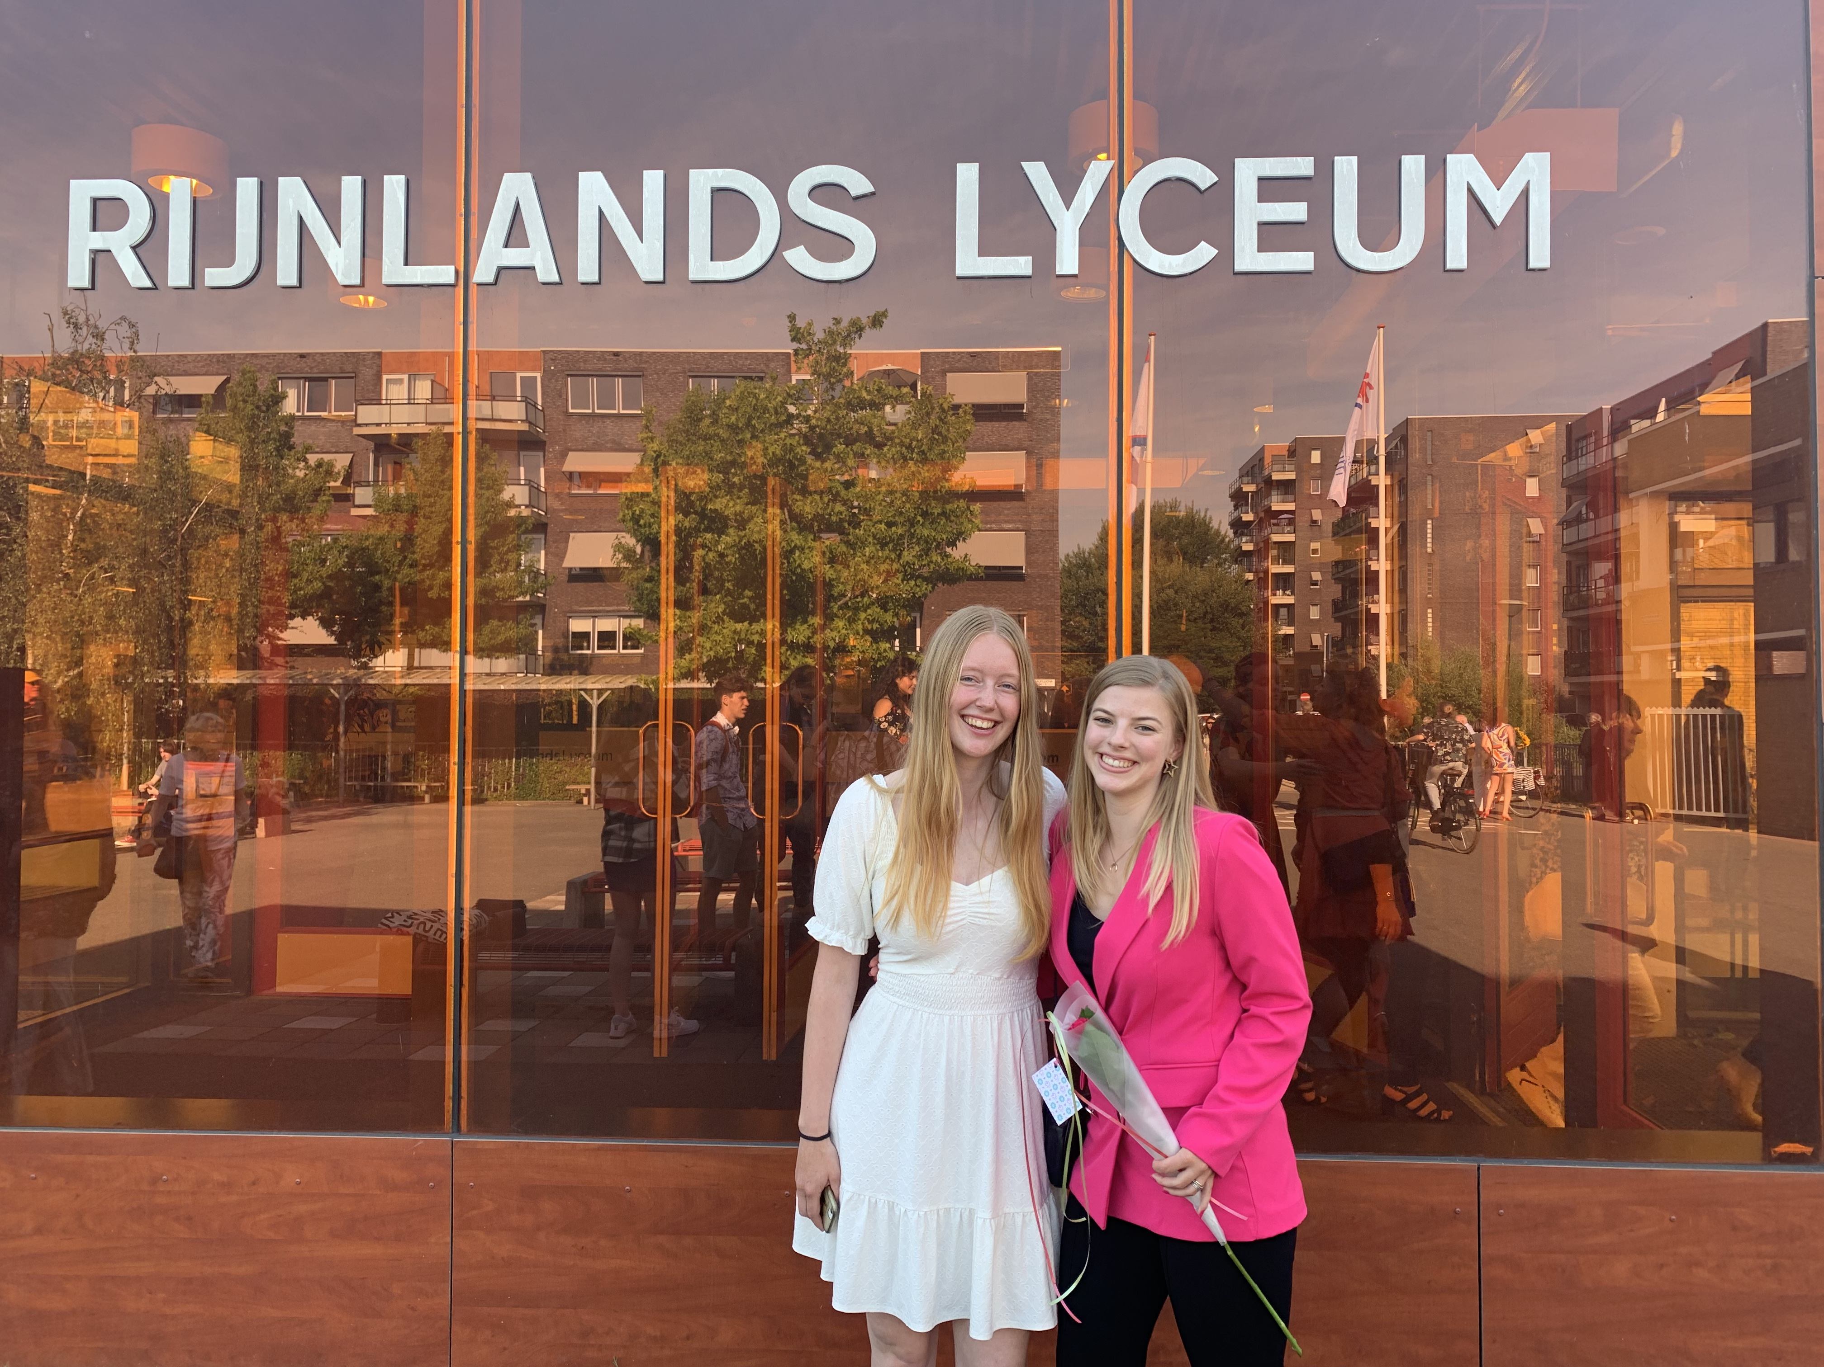
My background
Leiden
Bilingual education
“ For me it was clear to choose for Maastricht because of its internationality and problem based-learning ethic. ”

Slide 21
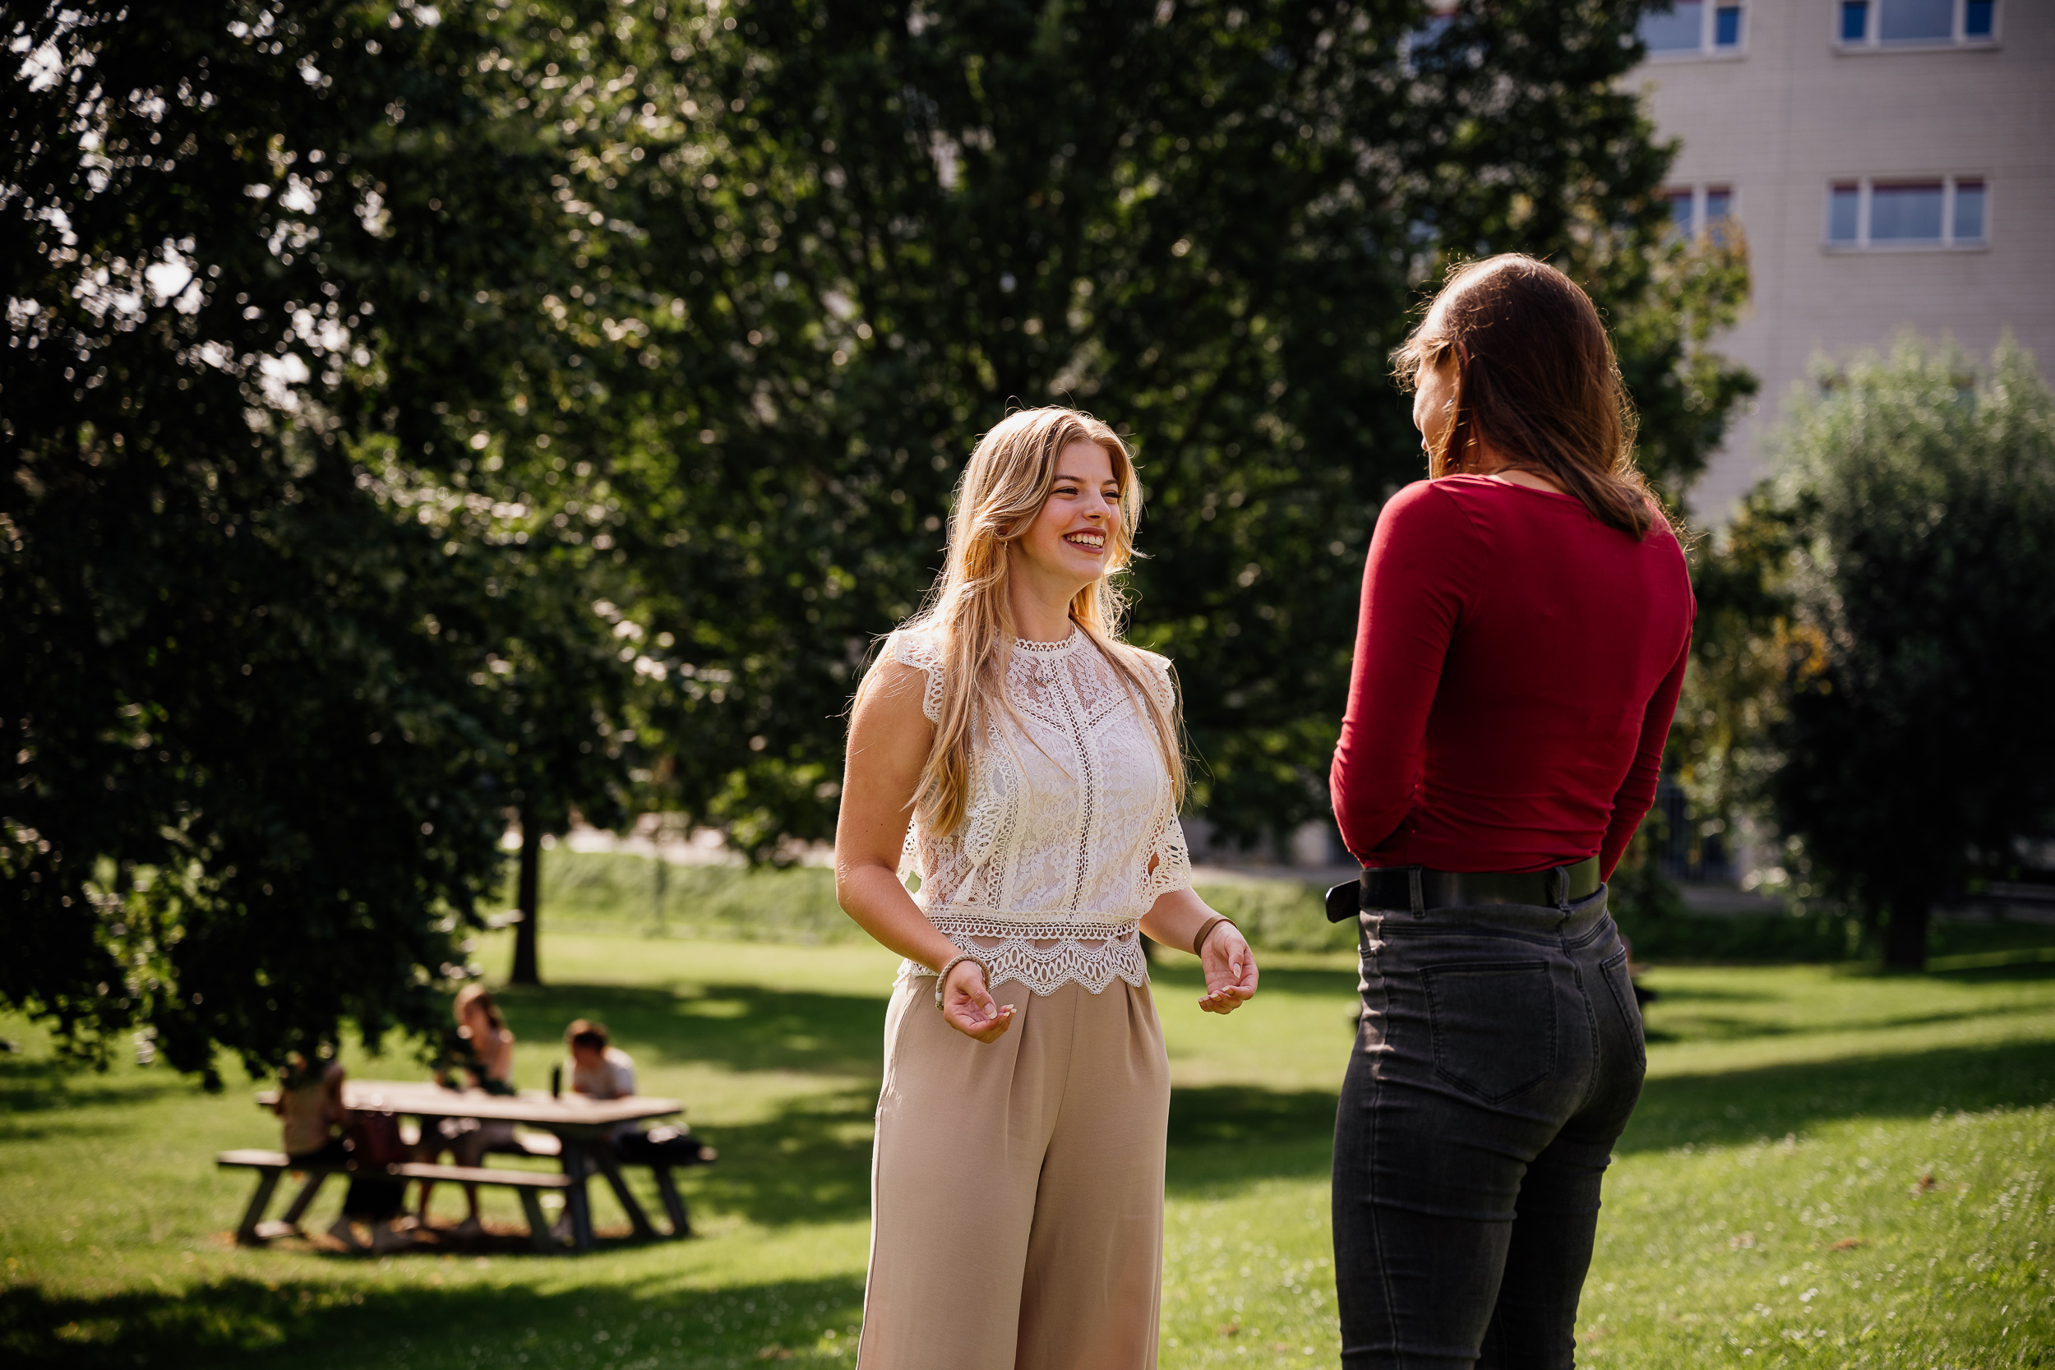
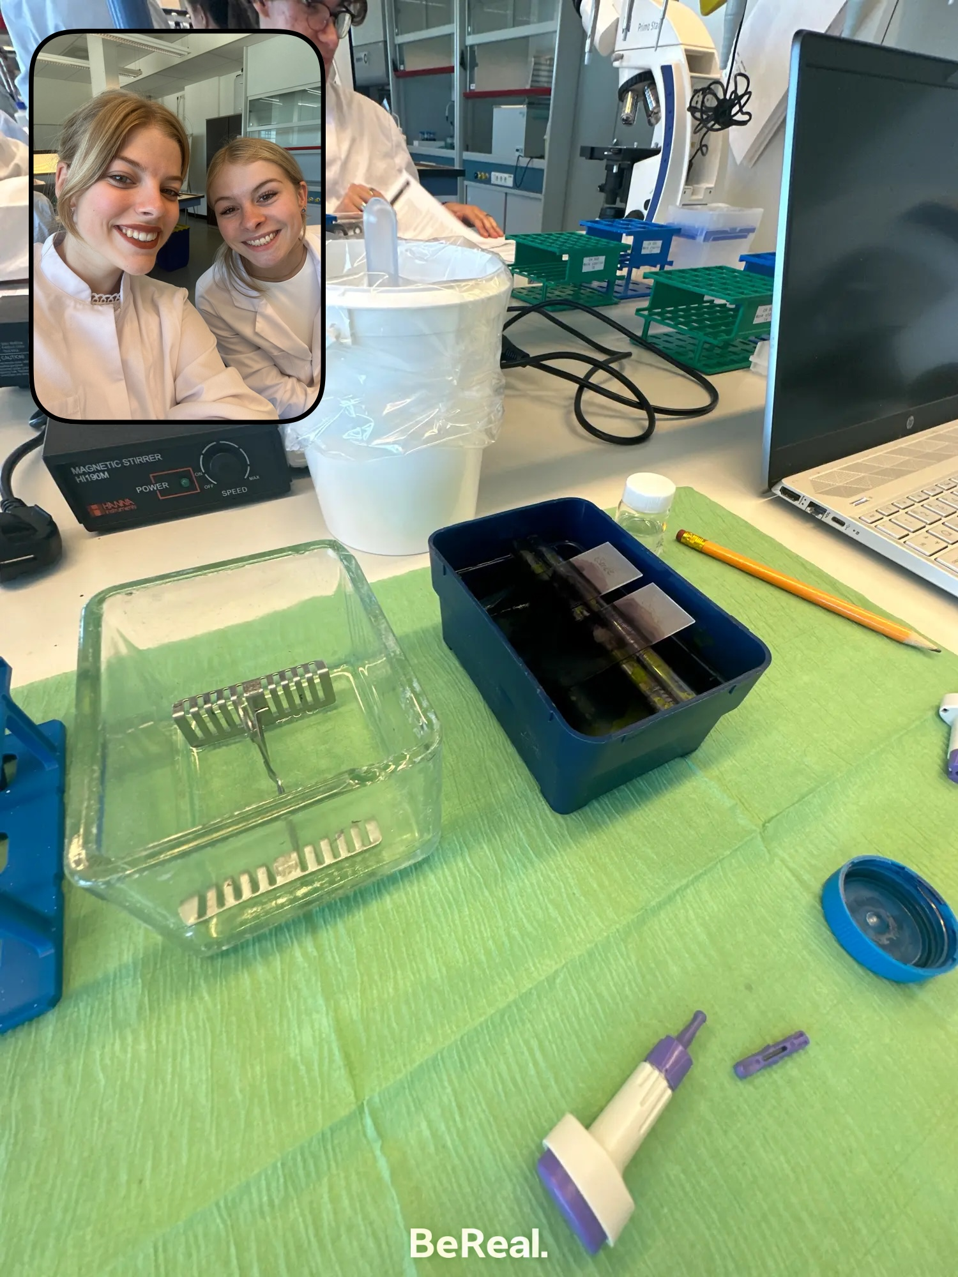
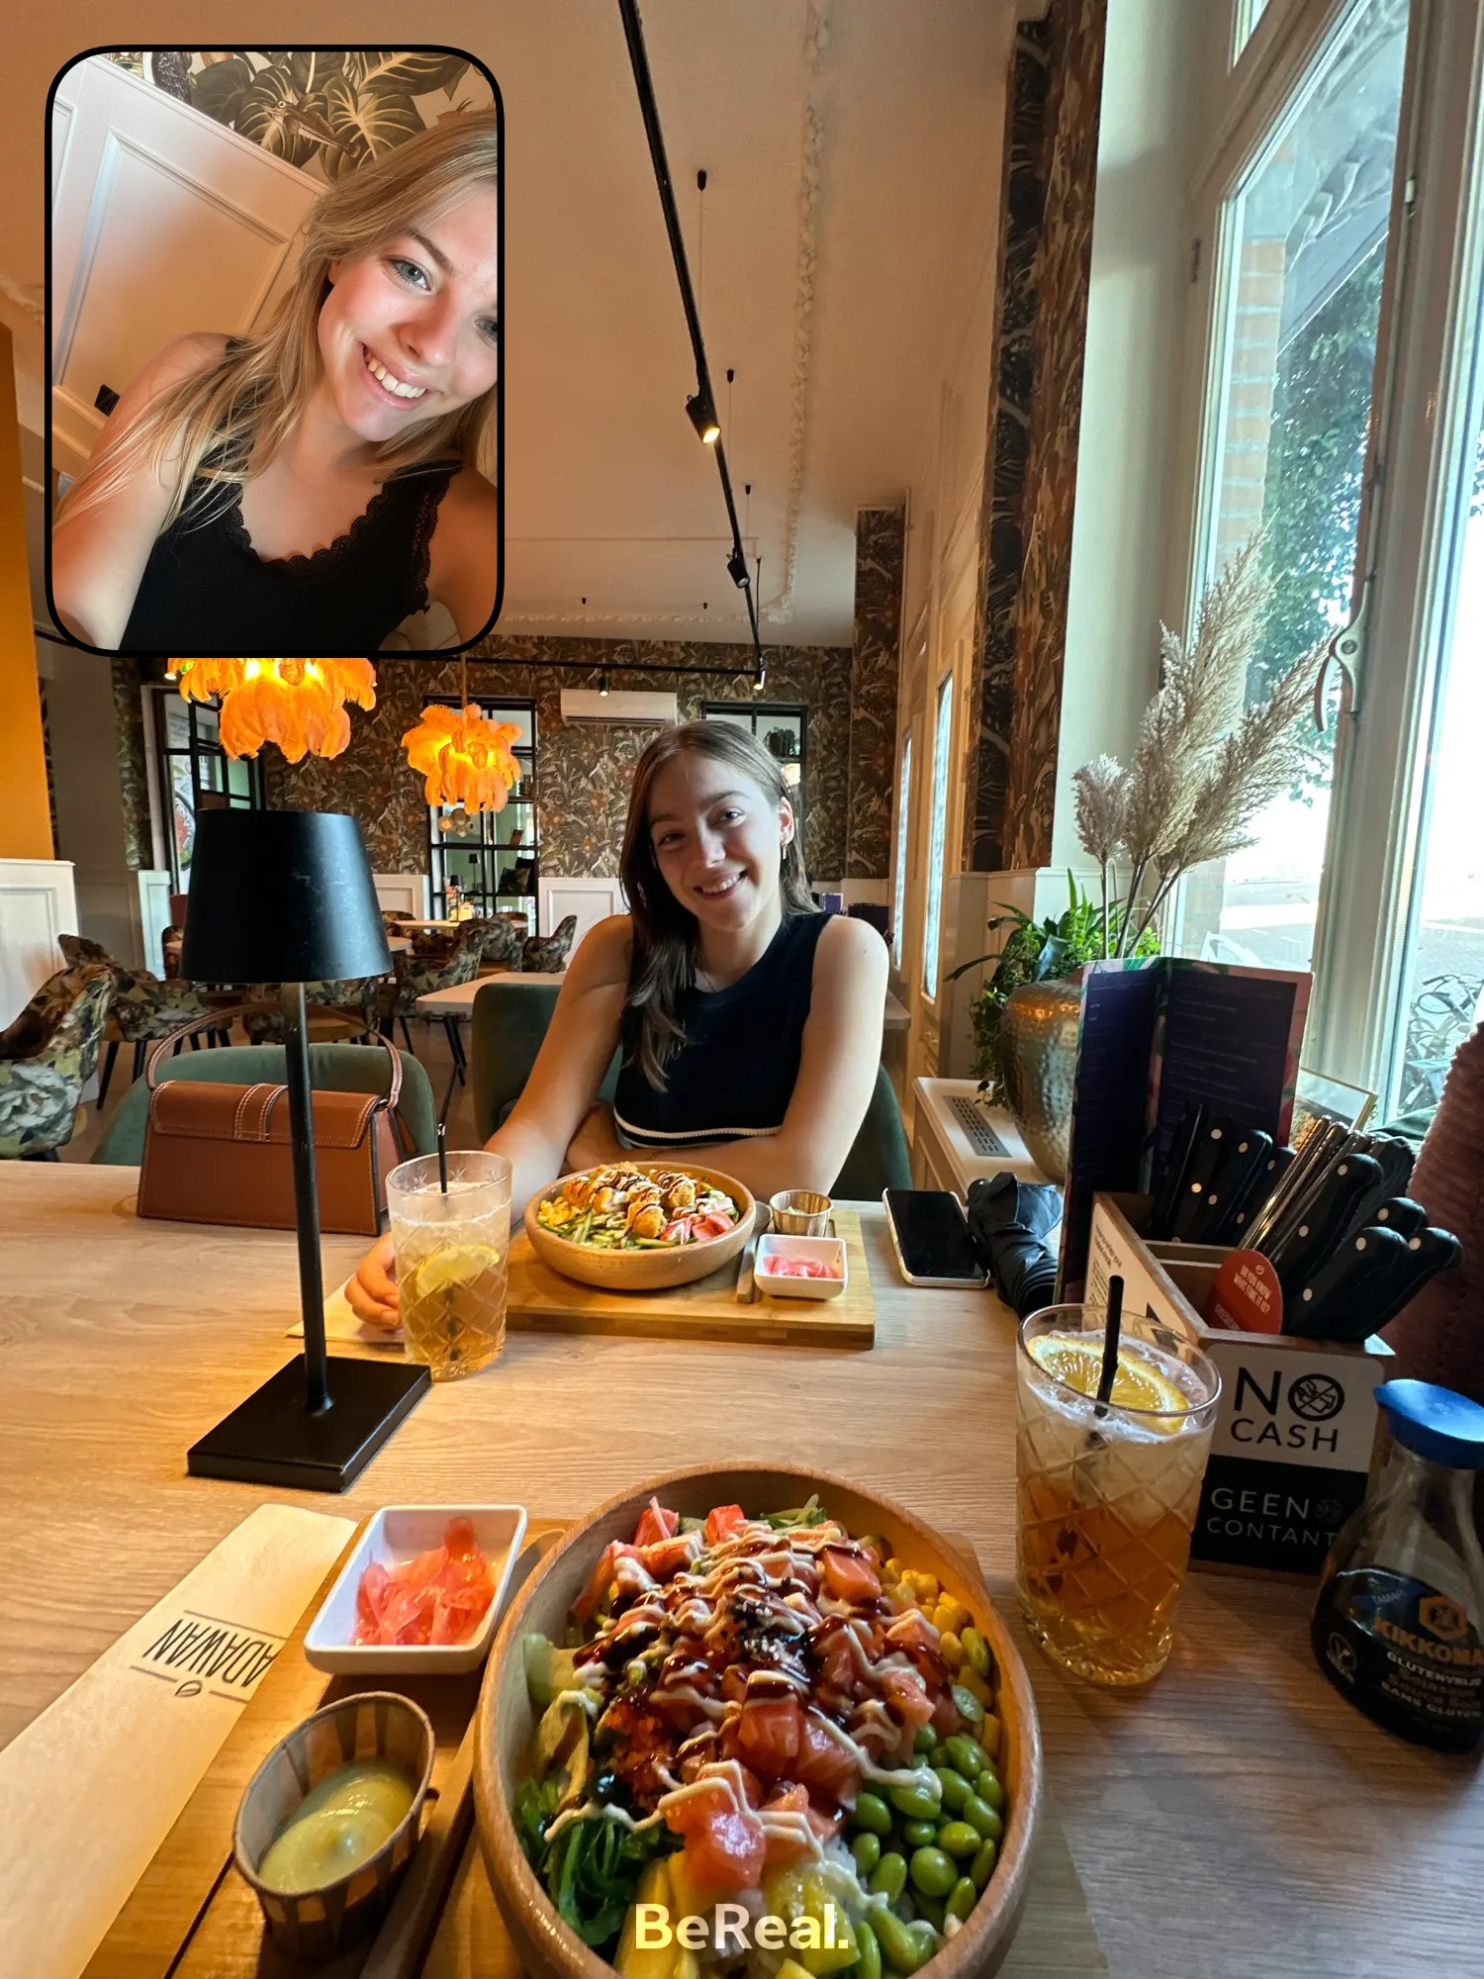
My student life in Maastricht

Slide 22
My timetable

Slide 23
Follow me on Instagram!
Weekly stories, posts and reels about student life
Questions about the study or student life? Send me a dm

Slide 24
Key dates and sources for practical information

Slide 25
Important dates
INKOM Maastricht: 19-22 August 2024
Faculty Introduction Day: Wednesday 28 August 2024
Start of the academic year: 2 September 2024

Slide 26
When to expect/where to find information
4 mails before/about the faculty introduction:
15 July: save the date and practical information
29 July: need to know information before the start of your study
12 august: nice to know information before he start of your study
Day before your introduction day: Last practical information and group number
Time schedules available 2 weeks before start of the study
Study Association Helix: Organizes activities, both in the field of education and services and in the field of recreation, to make a useful, but also pleasant contribution to your student life.

Slide 27
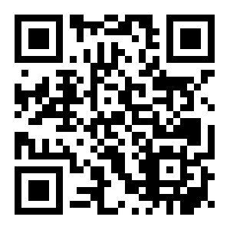
When to expect/where to find information
Questions about practical things such as housing, where to get a bike, or the student culture? → www.mymaastricht.nl
…or join their webinars on 8th July & 1st August

Slide 28
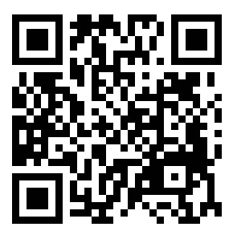
Join the WhatsApp group:
Connect with fellow students
Stay updated on the latest developments
Ask education-relation questions

Slide 29
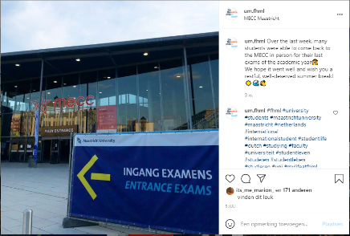
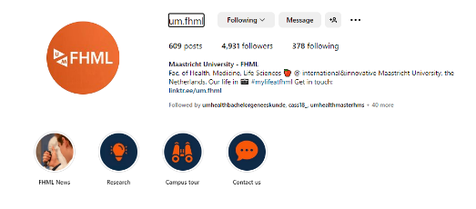
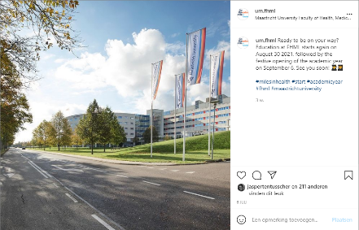
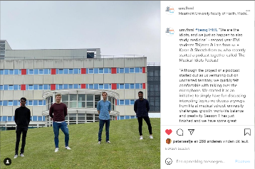
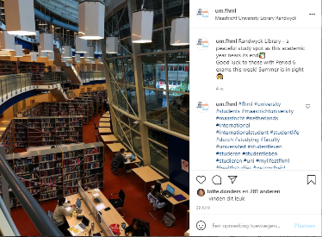
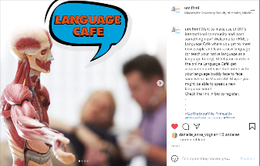

Slide 30
Study association

Slide 31
STUDY ASSOCIATION

Slide 32
Who are we?
Study Association Helix → founded on september 1993 to represent bachelor and master students of Biomedical Sciences and Regenerative Medicine & Technology.
We aim to make your time at UM as enjoyable as possible
We organise activities, both educational and non-educational

Slide 33
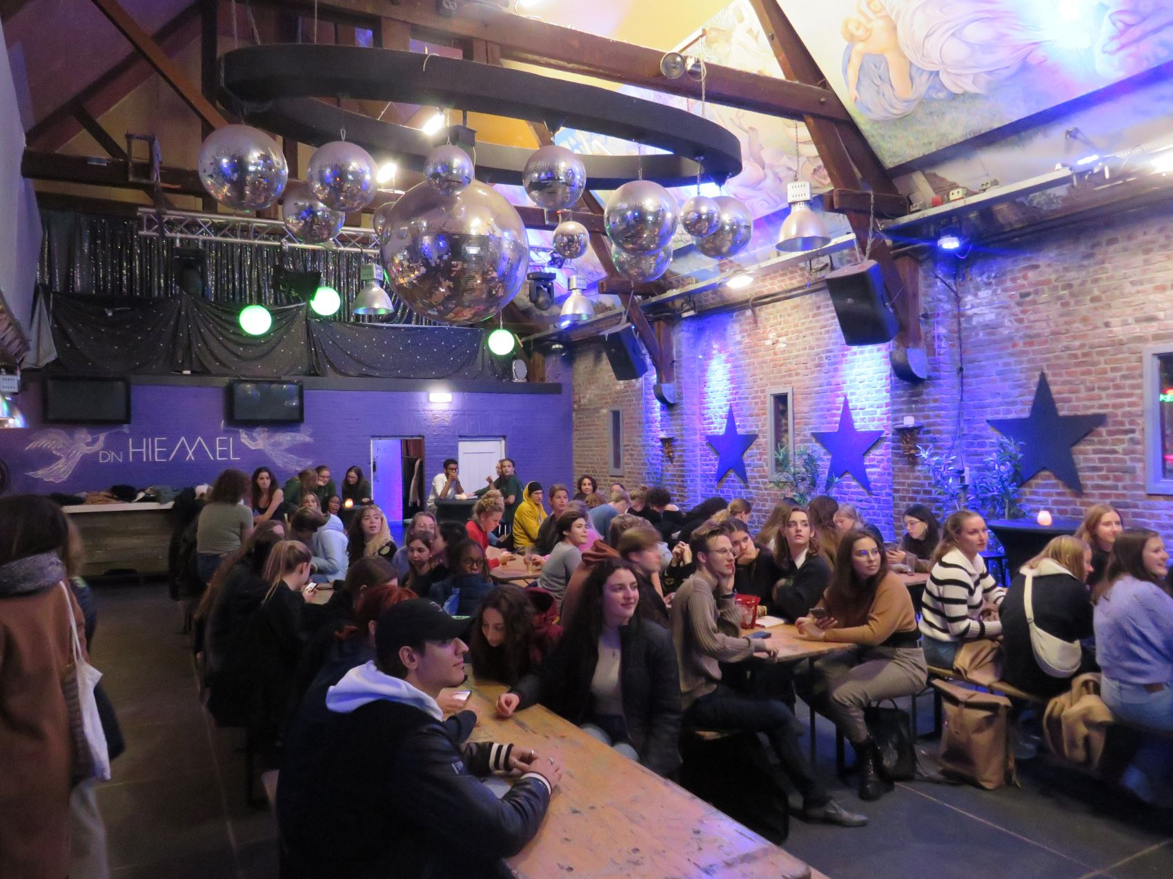
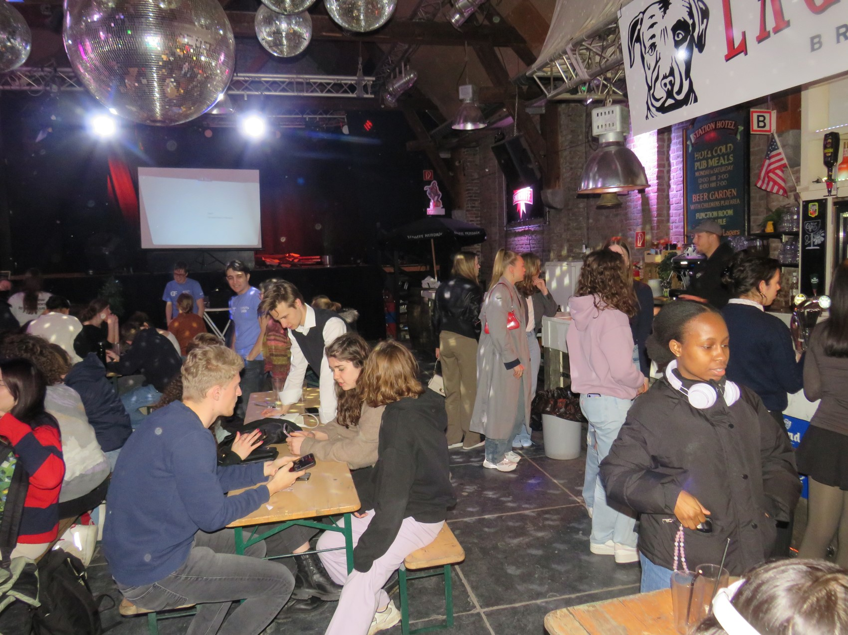
Educational Activities
Activities that focus on personal, educational and professional development.
Pub Quizzes → Best way to prepare for an upcoming exam! Join us to quiz your knowledge on course related topics.
Company Visits → Curious to see how your studies are applied in research? Be sure to participate in our company visits!

Slide 34
Educational Activities
Activities that focus on personal, educational and professional development.
Student Evaluation Panel (SEP) →
Evaluates the Courses → Insightful evaluations that ensure relevant and engaging content.
Write Reports → Detailed and compelling reports that highlight recommendations to improve our Bachelors.
Meetings with the Course Coordinators → Meetings with course coordinators to discuss reports.
Contributes to the Improvement of Courses → Your input and constructive feedback will be a vital tool for course coordinators to ensure the best educational experience for you and future students!

Slide 35
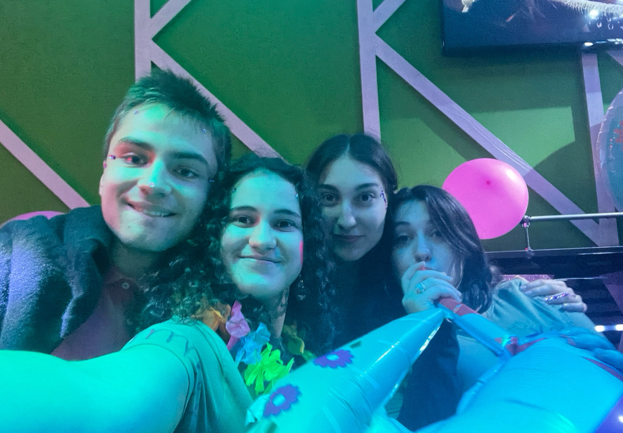
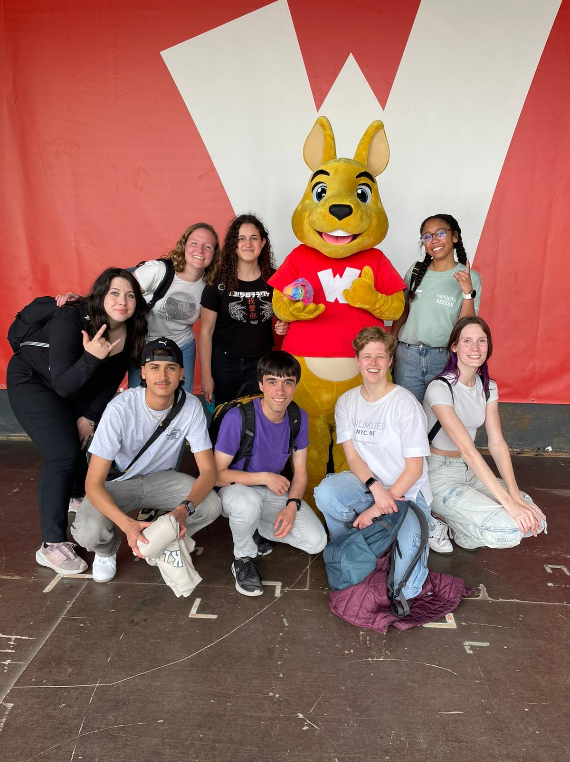
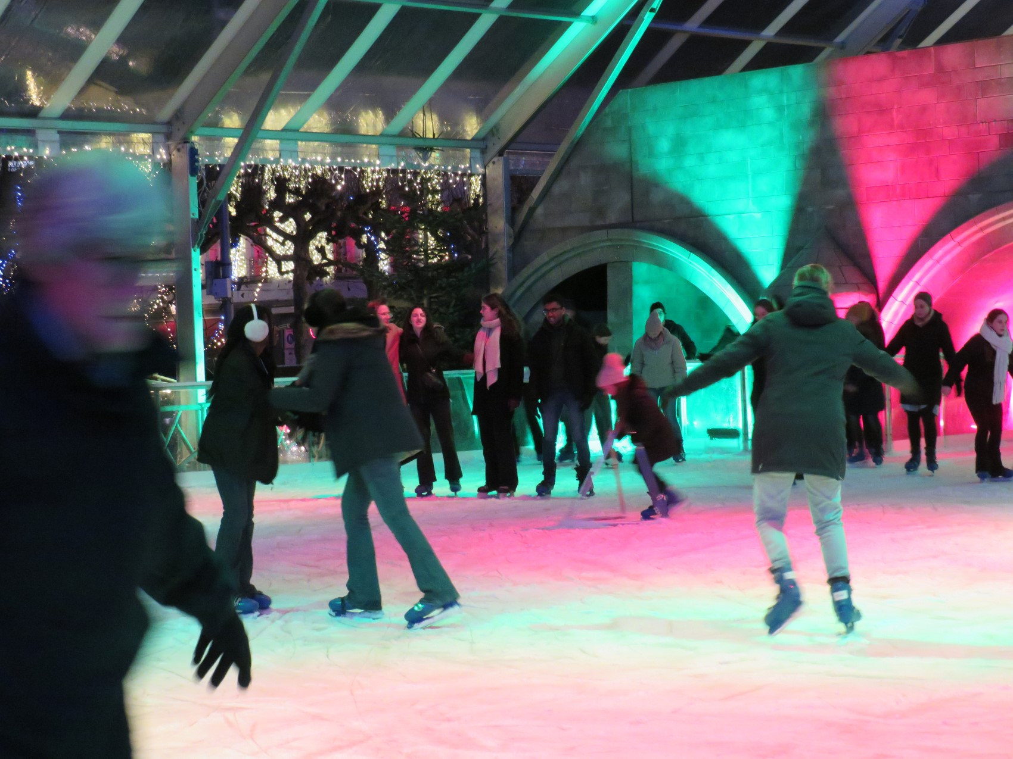
Non-Educational Activities
Course Opening Parties
Day trips and excursions
Ice skating

Slide 36
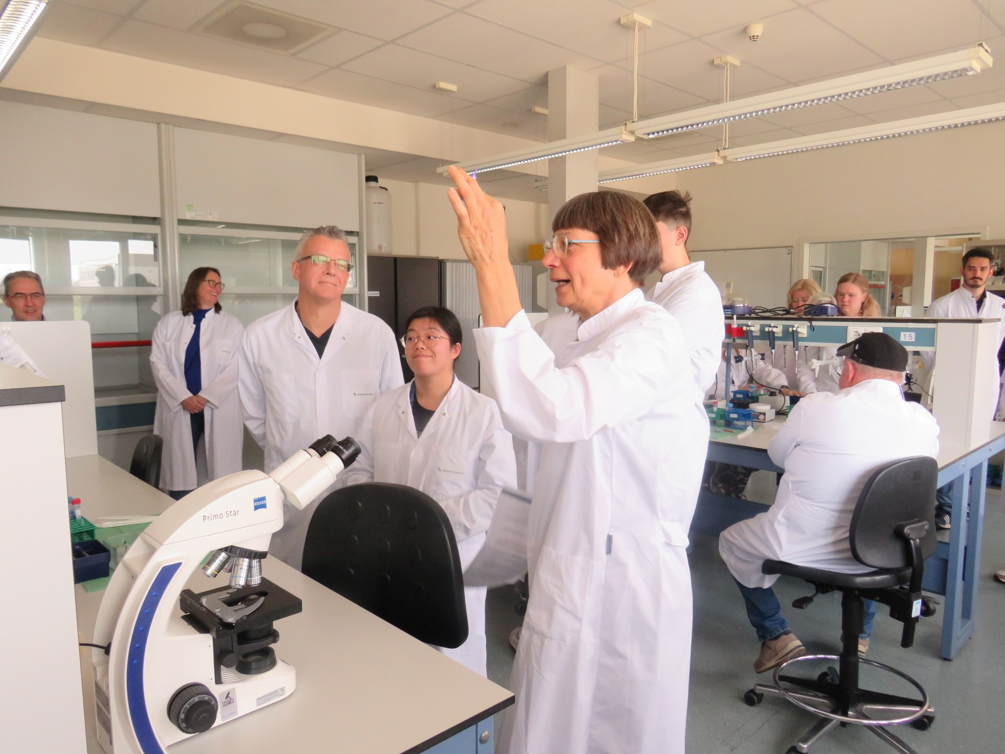
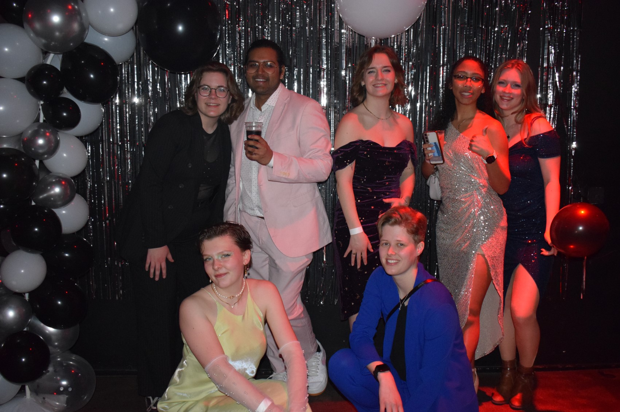
Committees
Activities/Sports Committee
Advisory council
Education Committee
Travel Committee
Family Day Committee
Financial Supervision Council
Gala Committee
Introduction Week Committee
Master Student Evaluation Panel
Promo Committee
Student council
Student Evaluation Panel
Well-being Committee

Slide 37
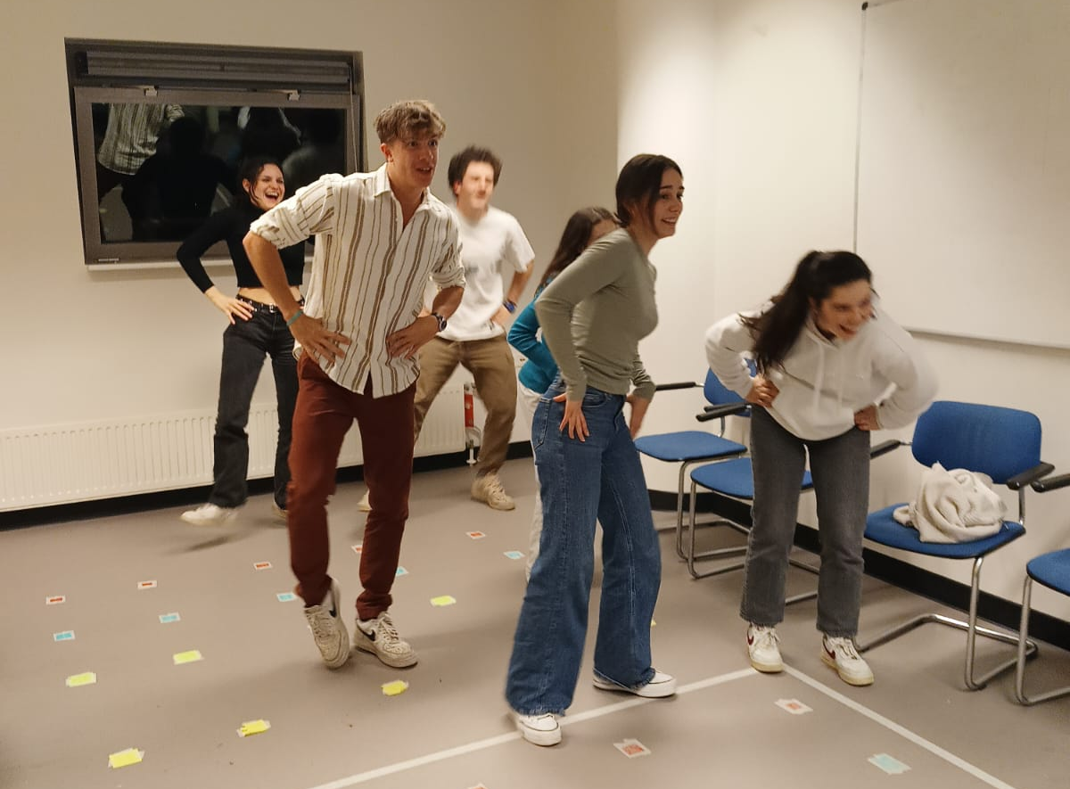
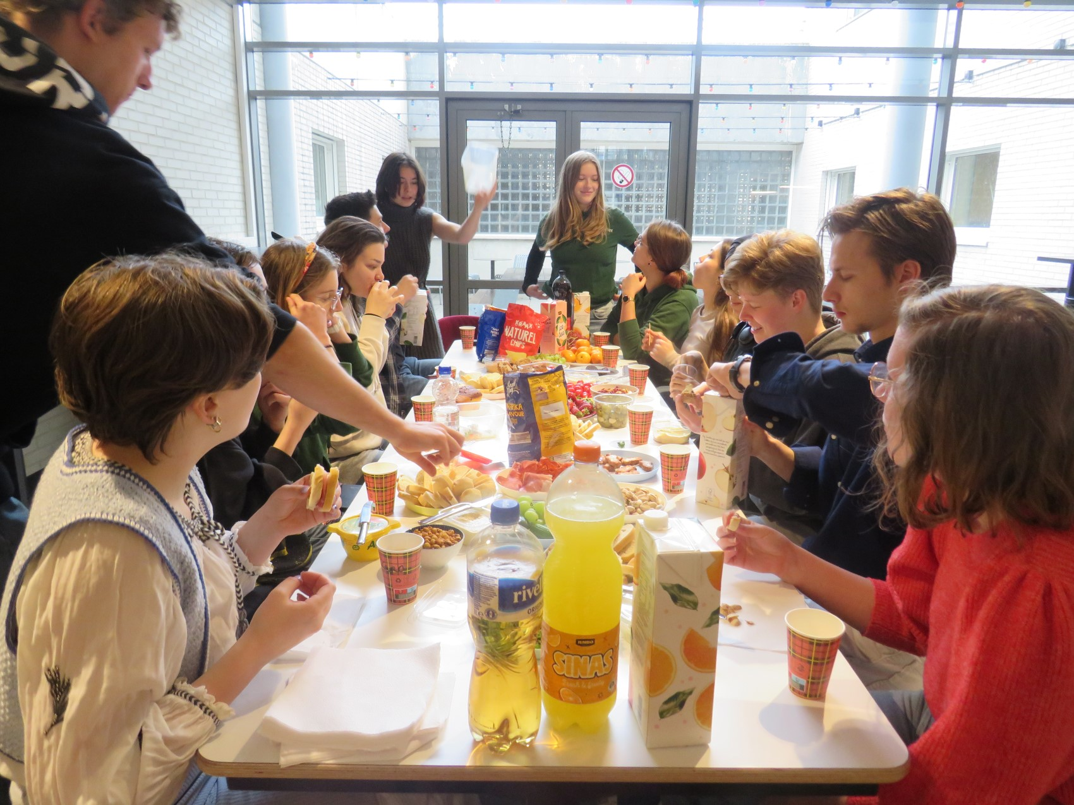
Well-Being Committee
At SA Helix, we prioritize our students' well-being, which is why we established a committee dedicated to it. Its main task is organizing activities that promote student well-being and raise awareness about the importance of well-being within the SA Helix community.
Game Night
PicNic

Slide 38
What else can SA Helix do for you?
Place to relax at university → Come find us at the SA Helix room, a welcoming space where you can unwind, recharge, and connect with fellow students!
Engage with older members from the association → Forge meaningful connections with experienced members of SA Helix. Their mentorship and advice can provide valuable insights, helping you navigate university life and your academic journey with confidence.
Valuable experience as a committee member → Gain hands-on experience and develop leadership skills by joining one of our committees. Whether organizing events or managing projects, your involvement will be a significant boost to your personal and professional growth.
Lab Coats! → Lab Coats are mandatory for Laboratory practicals and can sometimes be difficult to obtain. SA Helix is aware of how time consuming searching for lab coats is which is why we also provide

Slide 39
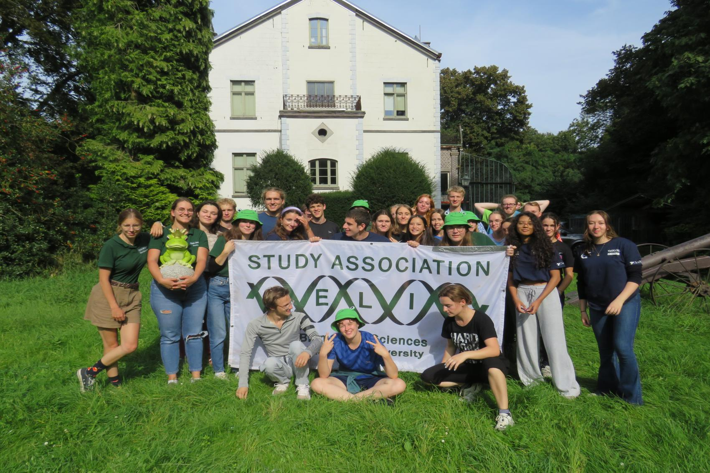
Want to get to know us better?
Join us during Introduction Week!
Every year the Introduction Week Committee organizes a week packed with fun activities during the first half of September to help Biomedical sciences and RMT first-year students get to know each other and explore the city of Maastricht.

Slide 40
Become a member!
Website → https://sahelix.nl/
Instagram → @sahelixmaastricht
Email → sahelix@maastrichtuniversity.nl

Slide 41
Time for Questions & Answers!

Slide 42
Thank you for joining
Have a great summer!
See you in August!

