Slide 1
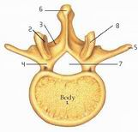
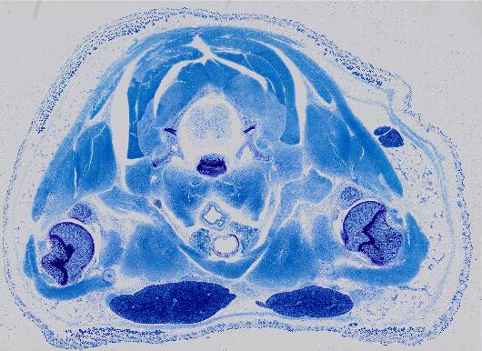
structures in a transverse section of the neck
task
1. Open the image neck mouse of the Maastricht site. A number of structures are indicated below (look at them also at a higher magnification!). Indicate the other named structures (blue text) and organs by arrows. To properly identify all structures, you will have to magnify the original image on the website.
muscle fibres transverse
skin
vertebral arch
skin muscle
spinal cord
adipose tissue
vertebral body
Save you powerpoint at regular time intervals !
skeletal muscle
joint cavity of shoulder
trachea
head of humerus
clavicula
esophagus
2. Place a bracket ({) next to the spinal cord.
submandibular (salivary) gland
thyroid gland (2 parts)
next to the trachea
alternative: image
hind limb mouse,
Maastricht University.
1. to draw a bracket { }: click “Shapes” on the “Insert” tab, then “Basic Shapes” and then select the bracket. Draw this like you would draw a line. Then adapt the form and size by moving the corner-circles. Select from the “Draw” task bar and rotate the bracket. Next, the appearance of the bracket can be set: click on it with the R-mouse, choose “Format AutoShape”. Select colour, width, or whatever else you wish to format.

Slide 2
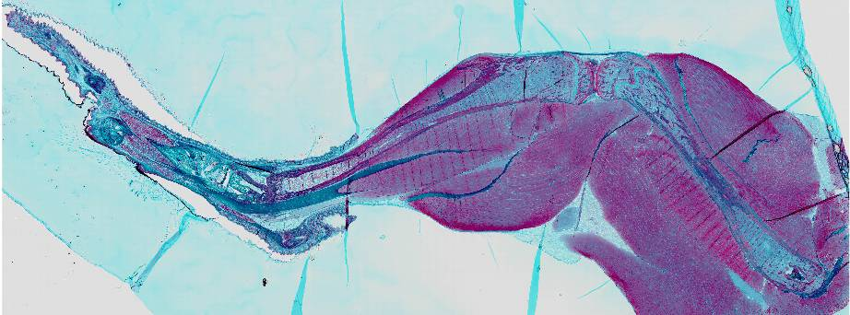
Anatomical structures in a limb
task
This histological section shows a part of the hindlimb (leg) of an adult mouse. In the knee joint, two bones meet: the femur (thigh) and the tibia (shinbone). In between the two bones, you see parts of the meniscus (two triangular shapes). The skin has mostly been removed, but in a few places it is still present.
1. Open the image hindlimb mouse. Indicate the named structures (blue terms) with arrows. Some structures can only be seen at a higher magnification.
skin
Achilles tendon
tibia
knee joint
joint cartilage
Skeletal muscle
femur
meniscus

