Slide 1
University College Maastricht

Slide 2
Maastricht, The Netherlands

Slide 3
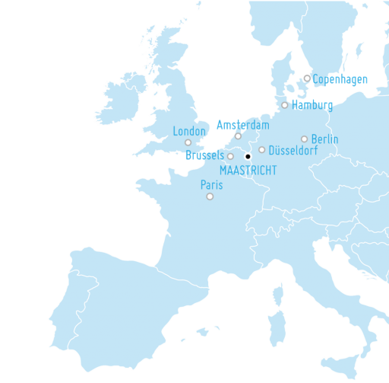
Our geographic location
Located in the heart of Europe with
easy access to many European destinations.
Nearby airports:
Amsterdam Schiphol
Brussels Zaventem
Dusseldorf
Great rail network

Slide 4
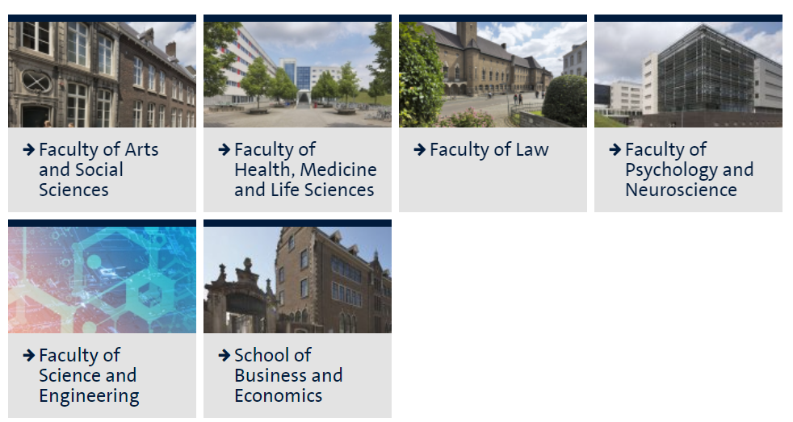
Maastricht University – our faculties

Slide 5
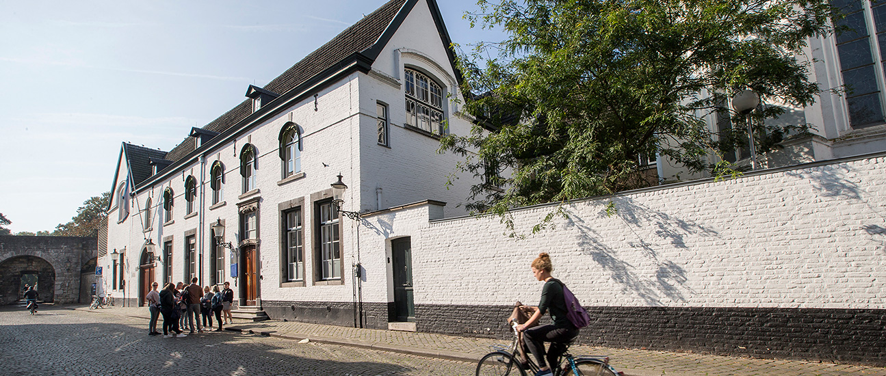
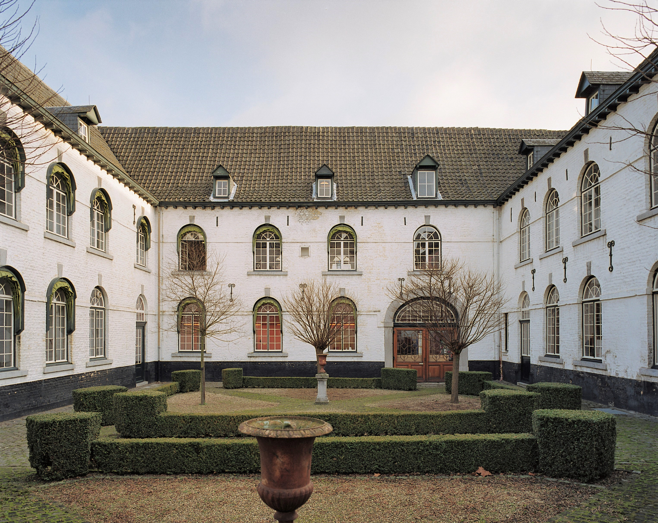
University College Maastricht
Our college is housed in the 15th century Nieuwenhof monastery.
UCM is founded in 2002, it is the second of its kind in the Netherlands.

Slide 6
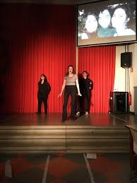
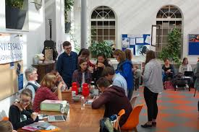
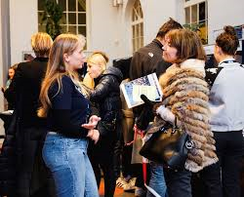
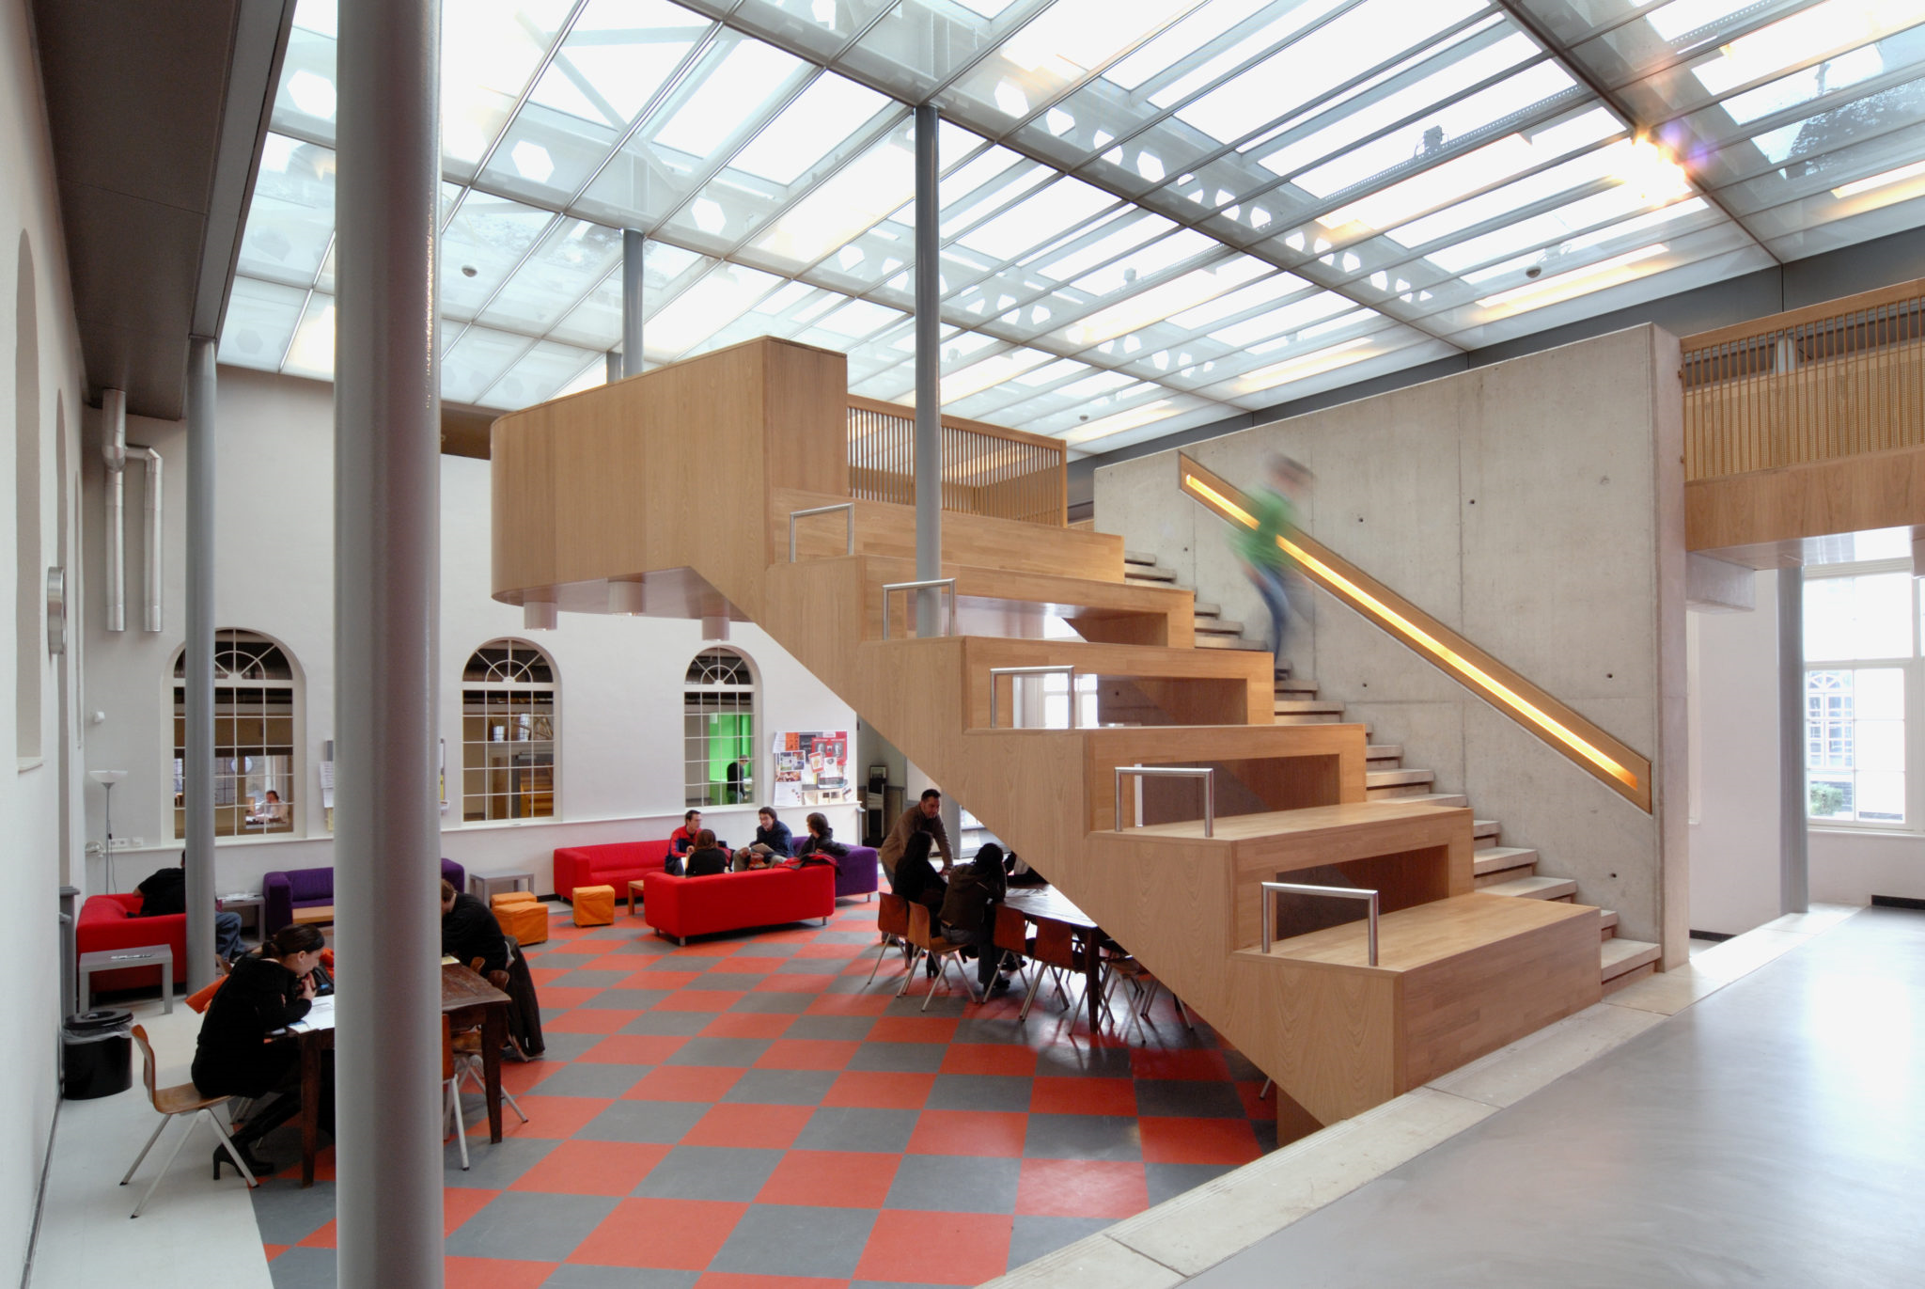
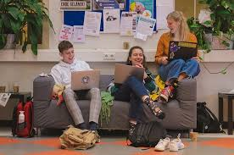
Our common room

Slide 7
Facts
Maastricht University
Founded in 1976
One of the youngest universities in The Netherlands
University College Maastricht
Founded in 2002
Has over 600 students representing over 50 nationalities
Close to 19,000 students and 4000 staff
Highest rated Liberal Arts and Science Program in The Netherlands

Slide 8
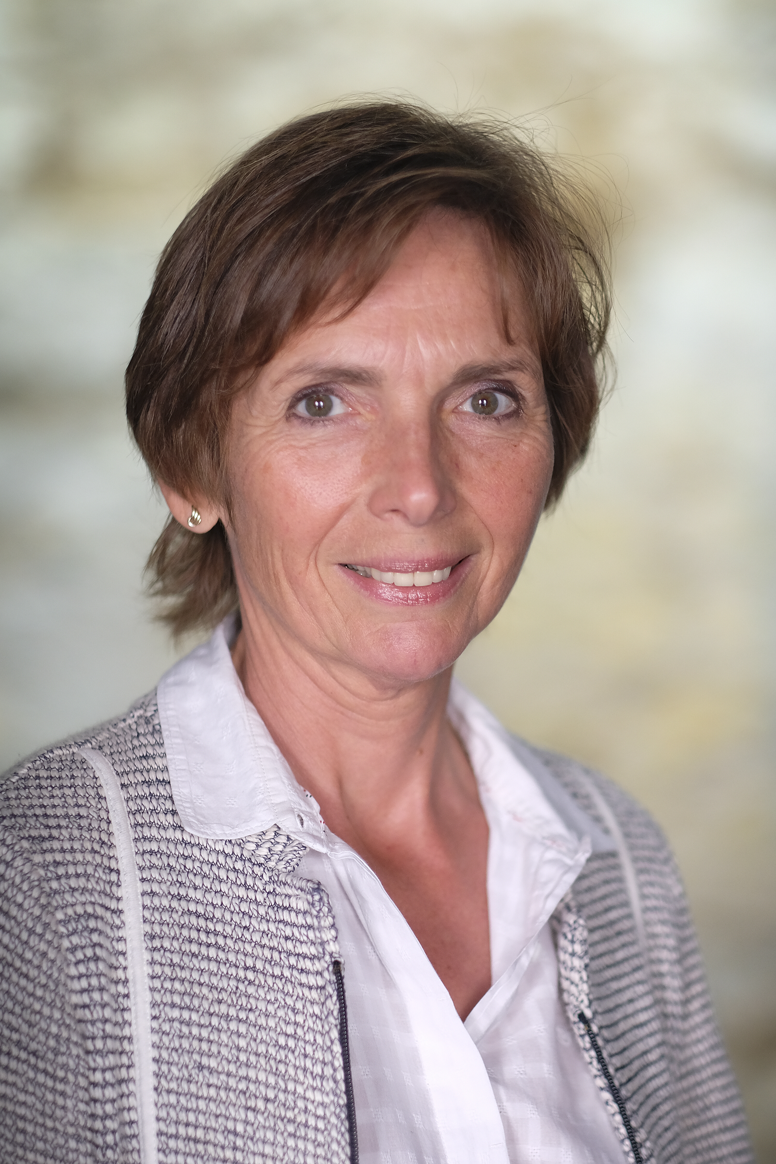
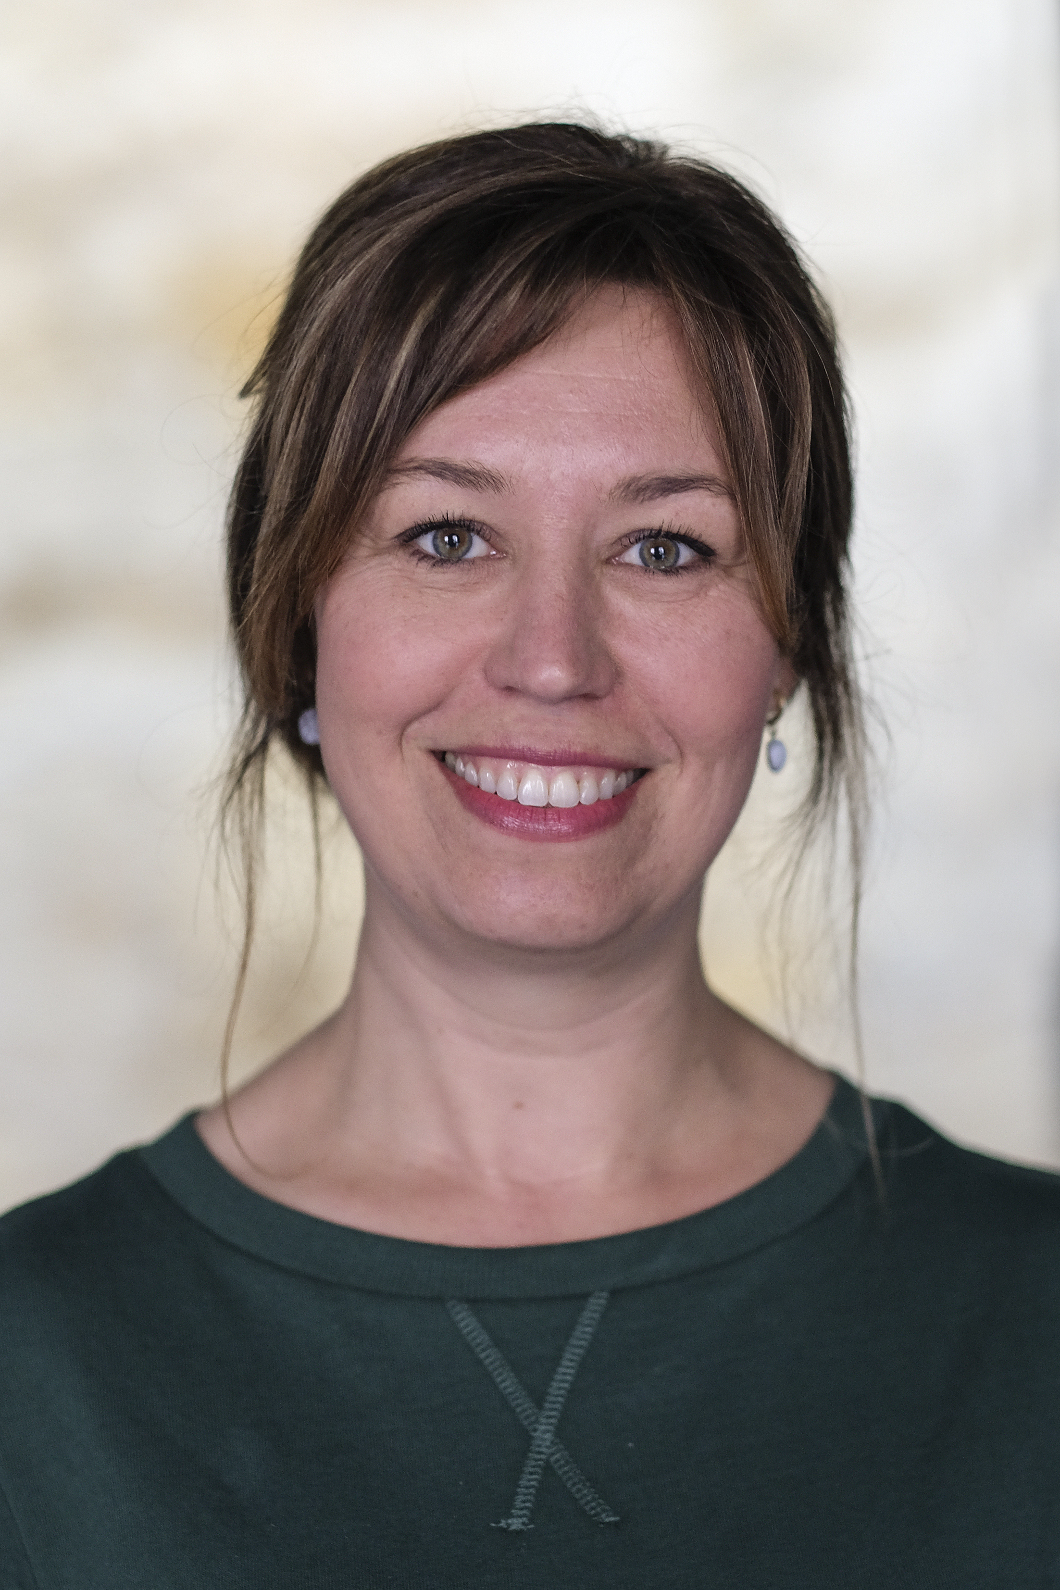
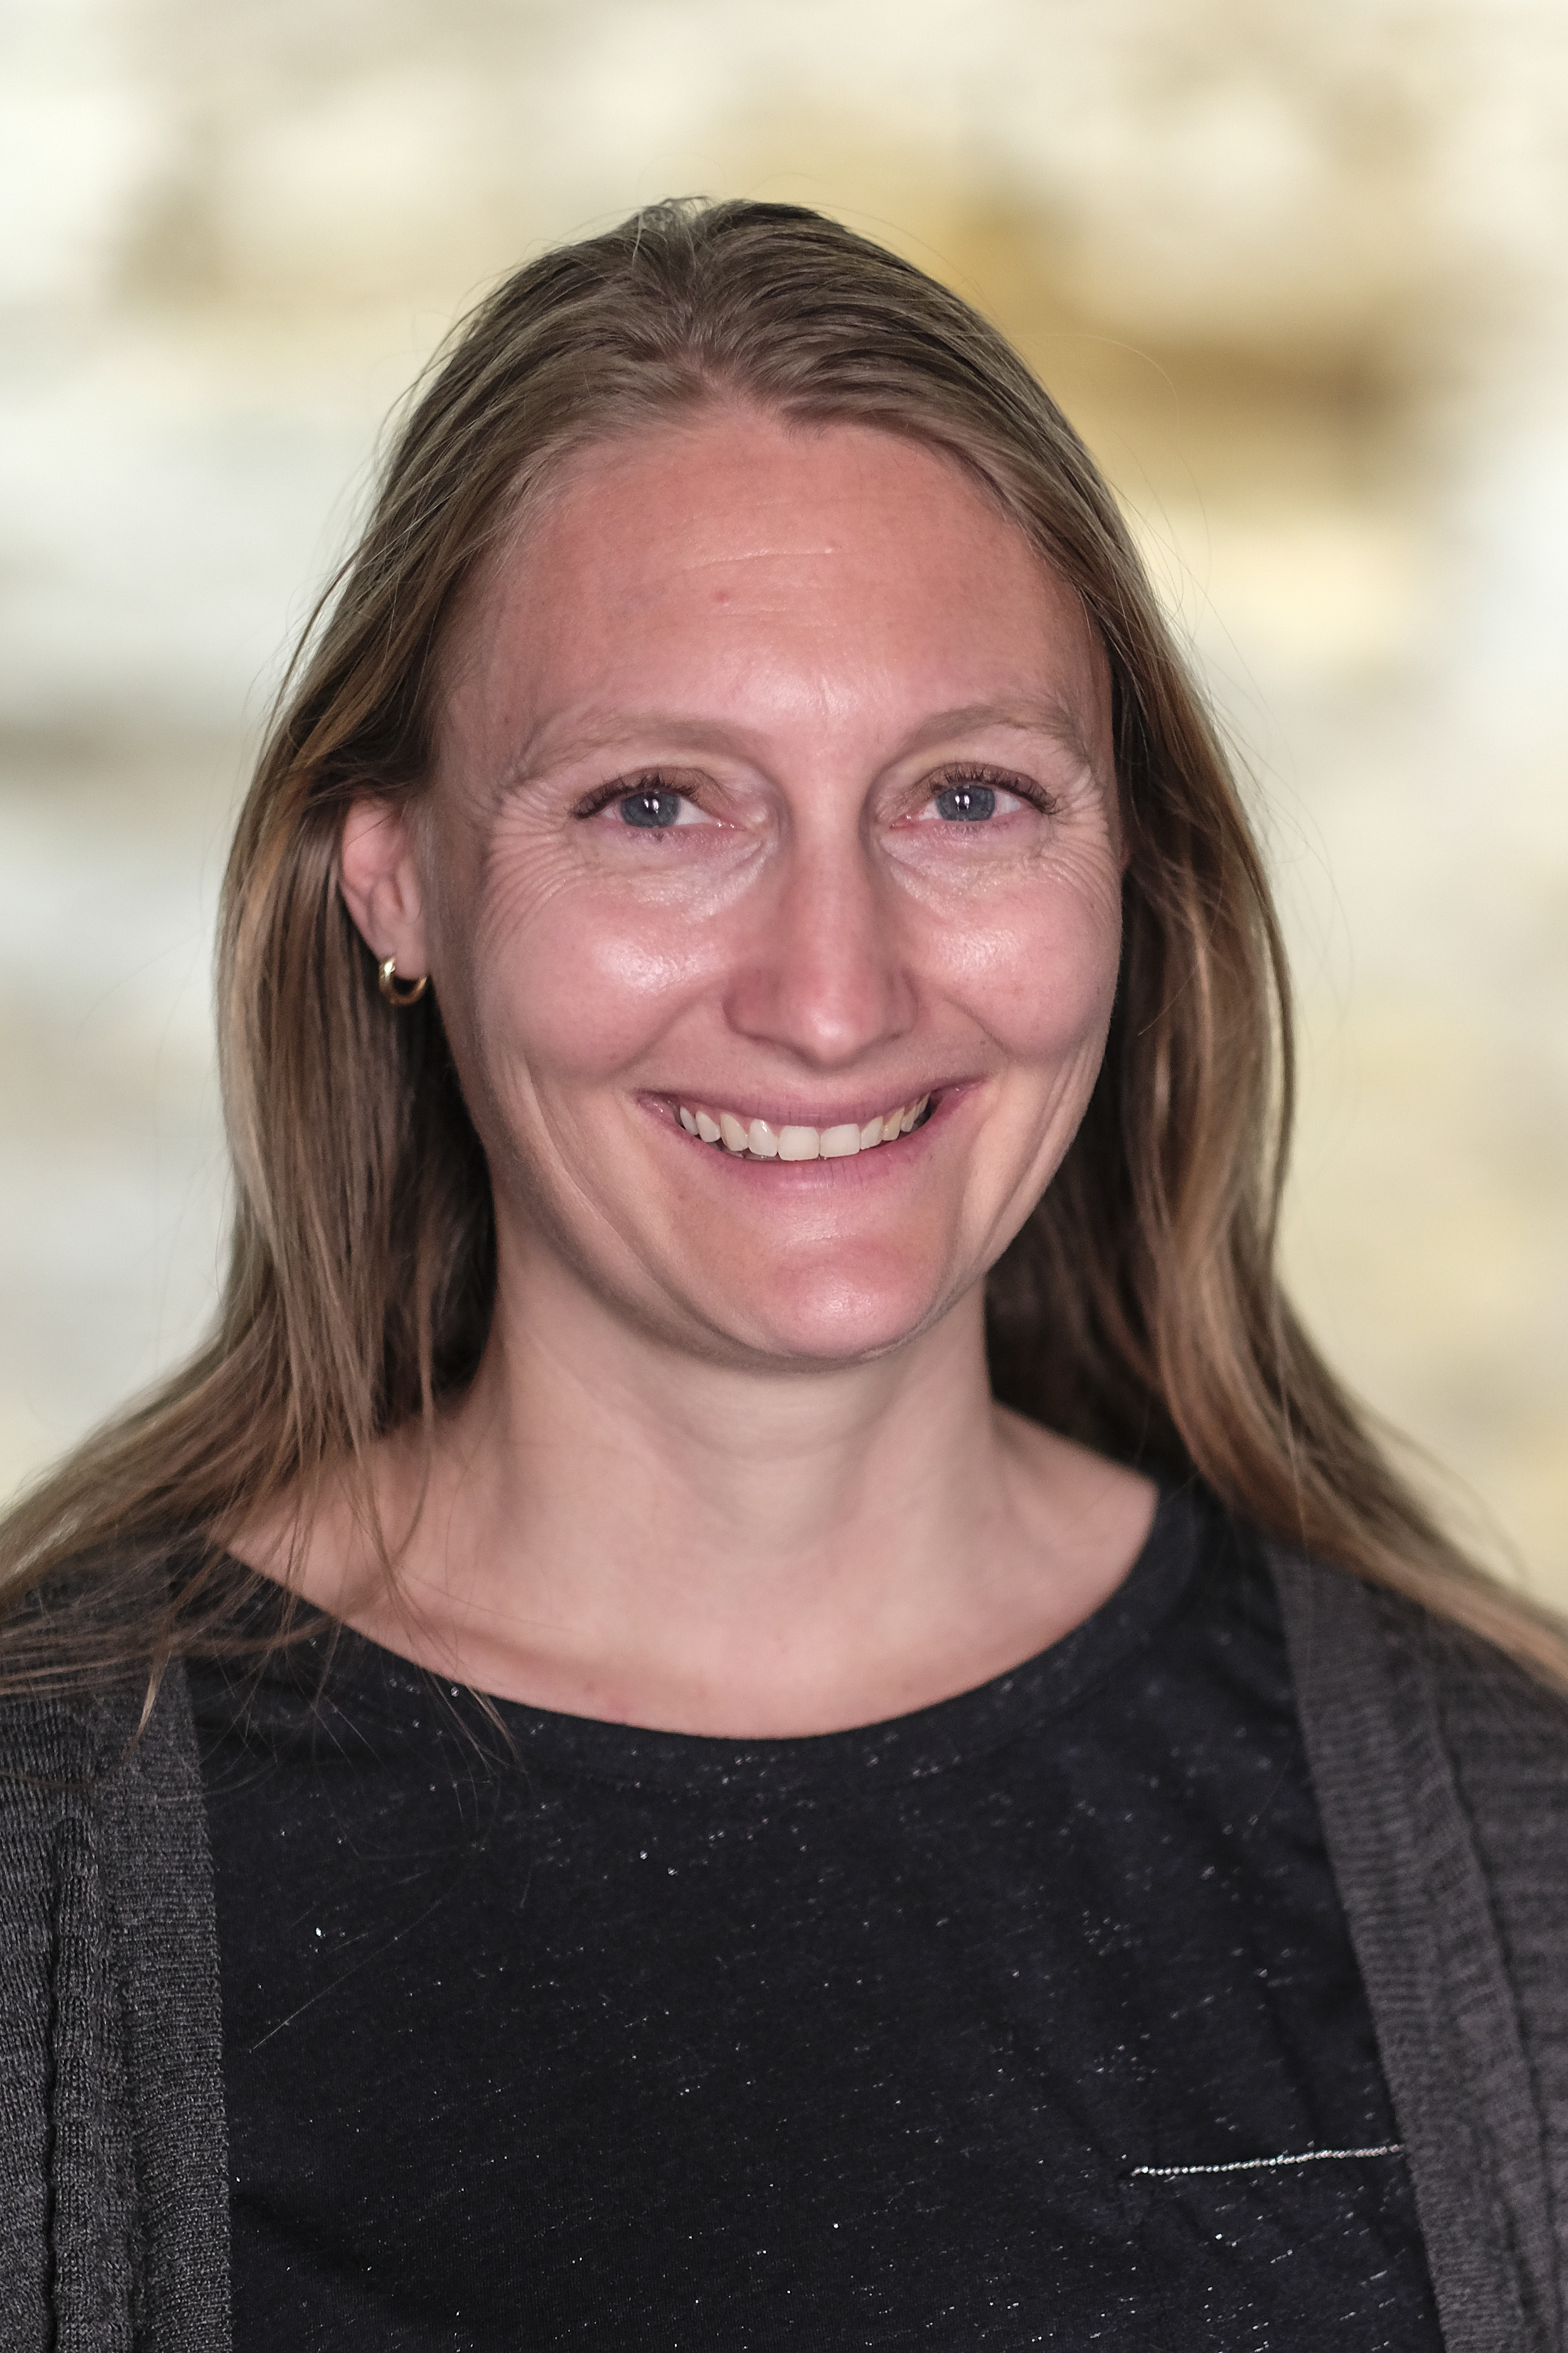
The international office team:
Ina Engelen Sylvia Brandt Suzanne Beckers
General IRO Incoming Exchange Outgoing Exchange
& Alumni

Slide 9
Why UCM?
UCM is an honours college
PBL teaching method
All courses are taught in English
Geographic Location
Quaint city with a burgundy flair
Vibrant student life

Slide 10
Concentrations
Social Sciences | Humanities | Sciences
Economics and Business Administration | History | Applied Mathematics
Sociology | Cultural Studies | Information and Computer Sciences
Political Science | Arts and Literature | Biomedical Sciences
International Relations | Philosophy | Biology
Public Policy |  | Biochemistry
International Law |  | Cognitive Sciences and Neurosciences
Psychology
Statistics

Slide 11
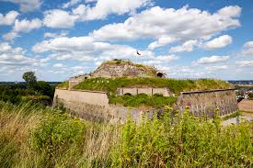
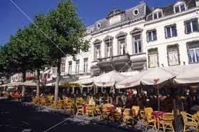
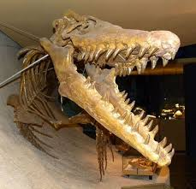
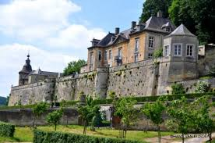
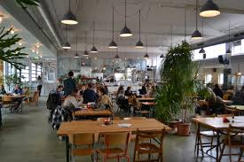
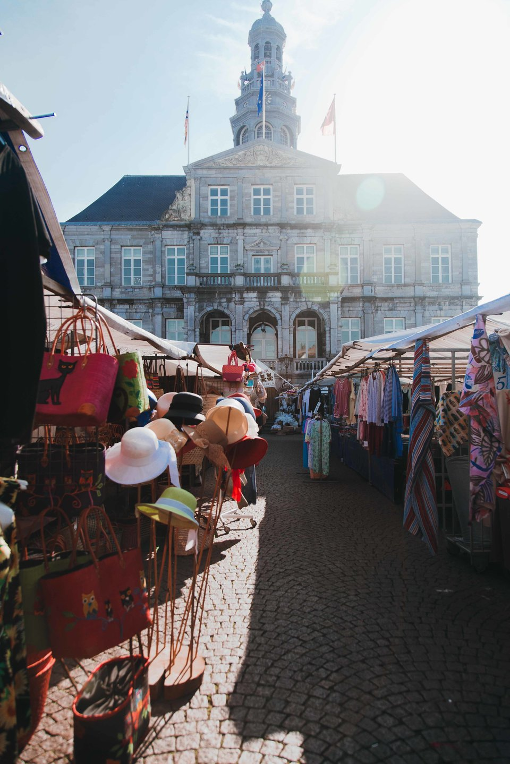
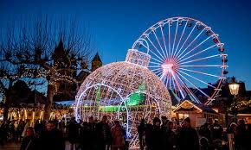
MAASTRICHT IN A NUTSHELL

Slide 12
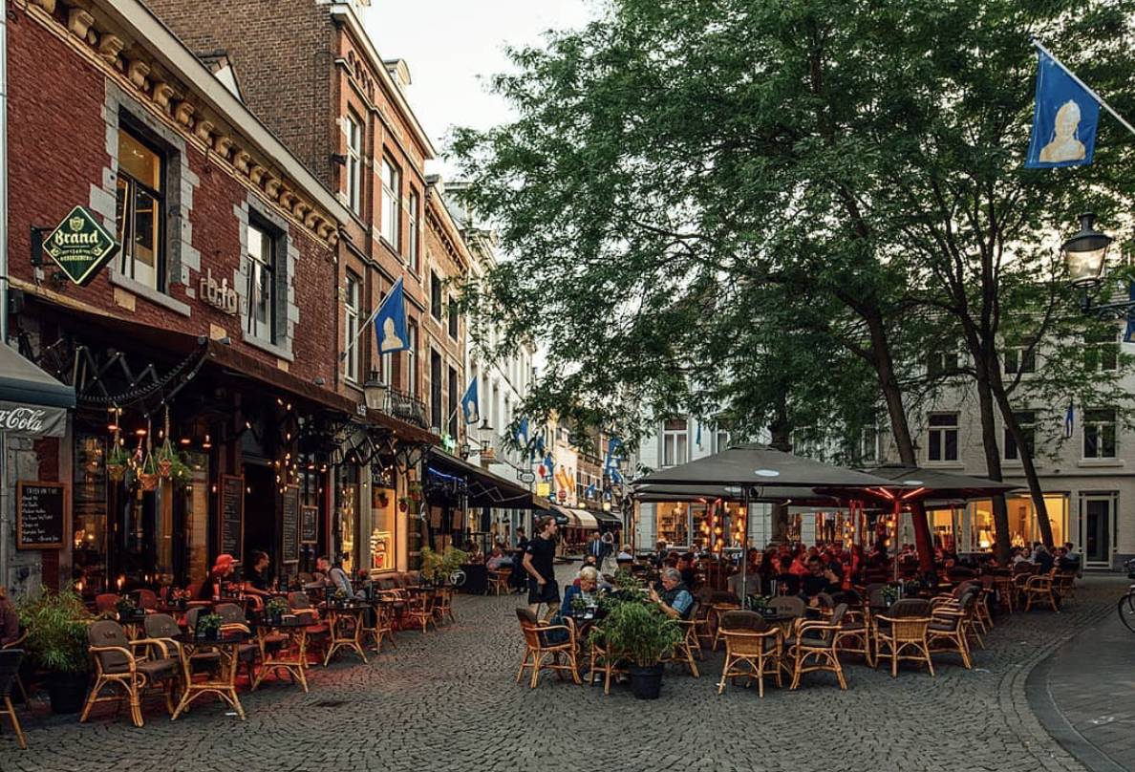

Slide 13
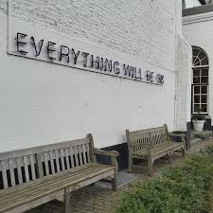
We care for our students
At UCM we like offer students a warm and welcoming environment.
Because of the small scale education
environment we are able to provide
more personal attention to our
students if needed.

Slide 14
Do you still have questions?
Send a short email to:
ucm-iro-incoming@maastrichtuniversity.nl
Your email should containing the following info:
First/Last name
Your email address
Name of your home university
Choose your time slot: 10AM CET or 3PM CET
You will be invited to a small group, video chat session with the international relations office which will be held each Tuesday until the end of the year.

