Slide 1
IT Support by ICTS
Introduction IT services
Raven van den Akker
Roel Bleize
Version 11-6-2023

Slide 2
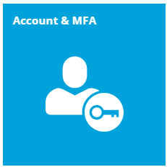
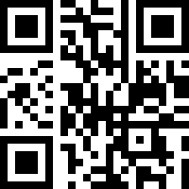
Account & MFA
Manage your UM account via MyAccount on myaccount.maastrichtuniversity.nl
  Check the status of your account
  Change and reset your password
  Unlock your account after too many failed login attempts
  Register an extra alternative email address
Multi Factor Authentication (MFA) is required for most services
  Register at least two authentication methods (e.g. MS Authenticator app and phone)
  Lost or replaced your phone? Request a Temporary Access Pass code via our Self-Service Portal
Scan QR-code for articles and manuals

Slide 3
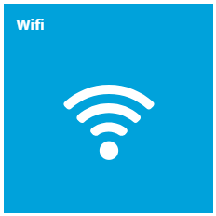
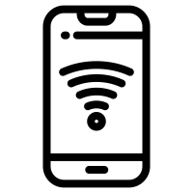
Wifi
Wifi is available in all UM buildings
The UM has two wifi networks to which you can connect:
  UMnet: the UM wide Wifi network
  Eduroam: a worldwide Wifi network offered at most educational institutes and also hosted by the UM
If you connect to these Wifi networks:
  the username is your UM username followed by @unimaas.nl
  e.g. i66778899@unimaas.nl
  the password is your UM password
Scan QR-code for articles and manuals

Slide 4
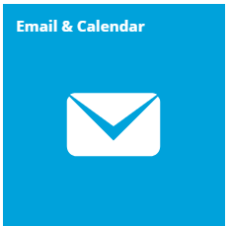

Email & Calendar
Sent and receive email via Outlook Web Access:
mail.maastrichtuniversity.nl
Find UM employees and students in the Outlook address book
Configure your mailbox in an email client (laptop, mobile device)
Your My Timetable can be linked to your personal digital calendar application:
  Microsoft Outlook & Outlook Web Access
  Apple calendar
  Google calendar
  How to setup your My Timetable with your calendar
Scan QR-code for articles and manuals

Slide 5
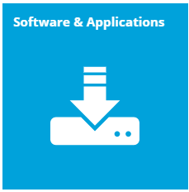
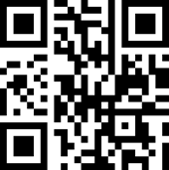
Software & Applications
Student Desktop Anywhere (SDA) is a virtual desktop environment; access your Homedrive and certain software (like SPSS) for free.
Want to use the software on your own device? Download software via the Self-Service Portal*
Get Office 365 Education for free via the Self-Service Portal
Scan QR-code for articles and manuals
*The software is free, however to use most software you need a license code. Purchase a license code with student discount via www.surfspot.nl

Slide 6
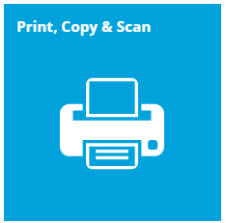
Printing, copy & scan
MyCampusprint by Canon
Multiple ways to print:
  Print portal - print.maastrichtuniversity.nl
  Campus Print iOS and Android app
  UM_Printer on Student Desktop (Anywhere) or install the UM Internet Printer on your own device
Print jobs can be collected at any printer (Follow you queue)
Pay with your UMcard
Scans are free of charge:
  Scan2Home delivers the scan to your Homedrive
  Scan2Mail delivers the scan to your UM mailbox
Visit the Canon shops at the Randwyck and inner city library
Scan QR-code for articles and manuals

Slide 7
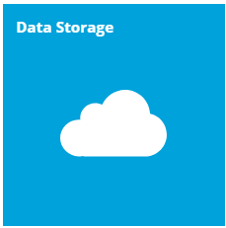
Data Storage
IMPORTANT: Files stored on your laptop cannot
be recovered in case your hard drive crashes!
Scan QR-code for articles and manuals
Network drives | Access UM network drives via Student Desktop (Anywhere): ✔ HOMEDRIVE (I:) for personal files ✔ PROJECTS (L:) for project related files ✔ EDUCATION (N:) for education related files ✔ RESEARCH (P:) for research related files | More information: Storage solutions for UM data
SURFdrive | Store and share your files securely in the cloud ✔ Each user is provided with 500 GB of storage space ✔ Secure file sharing within education and research ✔ Offline synchronization; always have your files at your fingertips ✔ Document sharing with guest users ✔ Optimization for use with smartphone and/or tablet | Request SURFdrive access More information: https://www.surfdrive.nl/en
SURFfilesender | Send and receive files quickly, securely & easily ✔ Send files of up to 1TB ✔ Free for you as a user ✔ Sent via Dutch servers ✔ End-to-end encryption (up to 2 GB) | More information: https://www.surf.nl/en/surffilesender

Slide 8


