Slide 2
PROGRAMMES & PROJECTS
MaastrichtMBA
International executive MBA programme for professionals
Offered in Executive & Blended formats
www.maastrichtmba.com
MBA
EXECUTIVE MASTERS
MANAGEMENT PROGRAMMES
CUSTOMISED PROGRAMMES FOR TEAMS & ORGANISATIONS
INNOVATION PROJECTS

Slide 3
THE HUMAN SIDE
OF BUSINESS
Maastricht University Alumni Day
4 September 2021

Slide 4


Slide 5

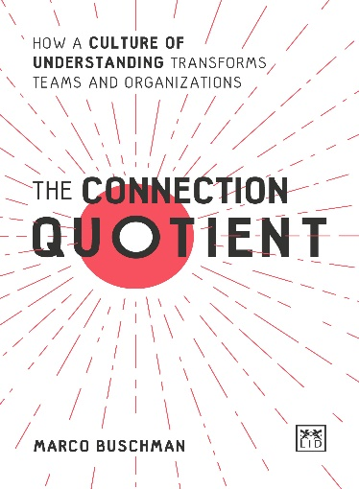

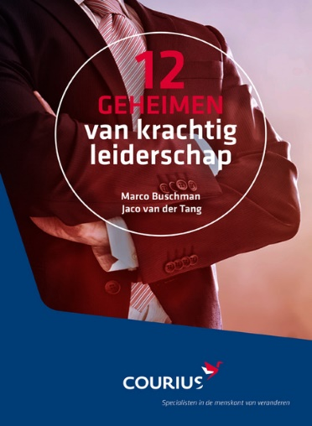
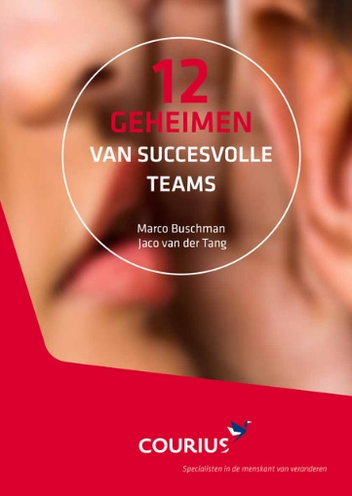


COURIUS – Marco Buschman, MCC
Specialists in the human side of change
Business Coaching, Team-, Leadership- & Organizational Development
National and international, senior consultants with hands-on experience
Human DOING: Managing Partner, Executive & Team Coach, focus on the Connection Quotient (CQ) & Leadership, Facilitator, Speaker, Author
Human BEING: Proud father of 3 kids (Laura, Frank, Erin), Husband (Cindy), Enjoy dancing, Music lover, Meditation, Spiritual interest
Clients: Capgemini, Majid Al Futtaim, AkzoNobel, Shell & many more including small & ambitious companies and independent consultants

Slide 6



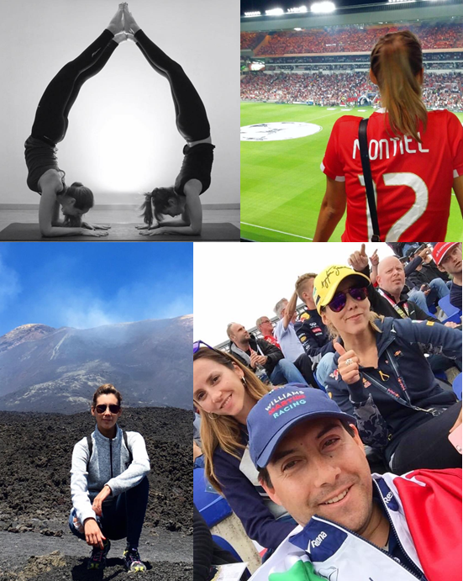






FERNANDA MONTIEL
Assoc. Director Global Trade at Collins Aerospace
The people I love
What I stand for
The things I enjoy
Respect
The boring stuff…
Graduated from International BA in Mexico City
One module of the MBA to go + BCP
NL | ES | EN | FR | IT
Started and closed 2 businesses
15+ years in Compliance, started at Siemens MX
5.5 years at Collins Aerospace

Slide 7


What is/creates connection?
Our birth right & necessity (Australian longitudinal study of aging)
Give and receive trust (Stephen M.R. Covey + David Maister)
Create psychological safe workplace (Google, Project Aristotle)
Being and feeling supported (Gallup: People leave managers)
Experience empathy (Daniel Goleman, EQ)
It creates a foundation for results (Your own day-to-day experience)
…
Do we need to define connection?
We know/experience
when connection
is (not) in place!
How to develop your CQ?

Slide 8
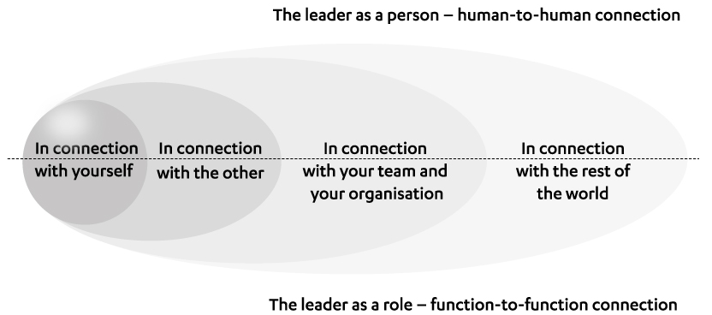
The ever-expanding circles of connection

Slide 9


Functions, Teams & Organizations: 2 lenses
Functional
Organizations, teams & functions exist to produce results
Rational, Business impact
Examples: vision, strategy, year plan, tasks, decisions, etc.
The Leader as a role (Human DOING)
Relational
Organizations, teams & functions are in essence persons
Emotional, Interpersonal
Examples: trust, respect, psychological safe, inclusiveness, etc.
The Leader as a person (Human BEING)

Slide 10
Framework: The Connection Quotient
Relational
Functional

Slide 11
In Connection with Yourself
Fulfilment
Vulnerable
Introspection
Relational
Functional
Successful
Resolute
Reflection

Slide 12

My life, at least the first part ☺

Slide 13
Balance DOING (function) and BEING (person)
DO
HAVE
BE

Slide 14
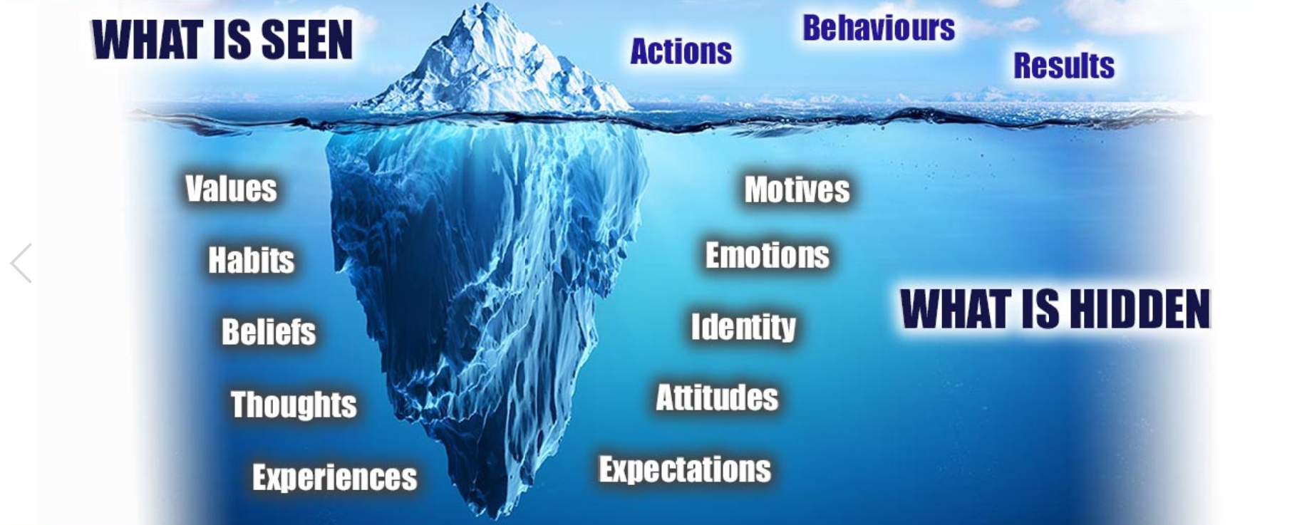
The engine for our behaviour (McClelland)

Slide 15
Balance DOING (function) and BEING (person)
DO
HAVE
BE
BE
HAVE
DO

Slide 16
In Connection with the Other
Relations
Acknowledgement
Dream
Fulfilment
Vulnerable
Introspection
Relational
Functional
Successful
Resolute
Reflection
Goals
Compliment
Ambition

Slide 17
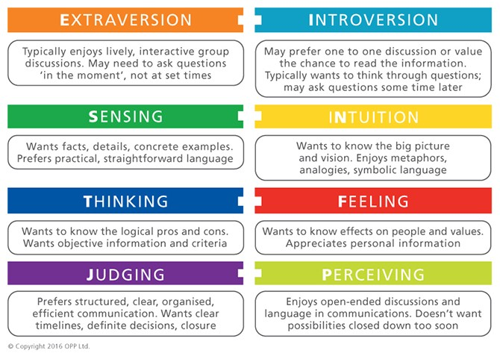
Psychological preferences (Carl Jung)
Where you prefer to focus your attention
The way you prefer to take in information
The way you prefer to make decisions
How you prefer to deal with the outer world

Slide 18
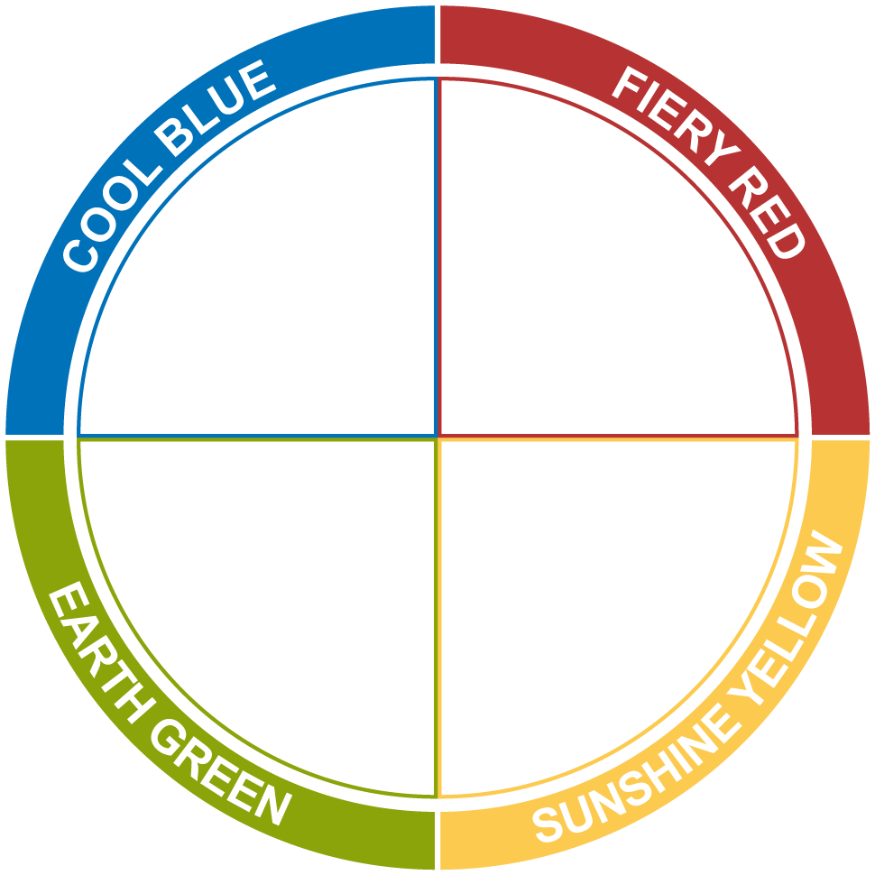
Adapt & Connect
Cool Blue
Fiery Red
Be well prepared and thorough
Be direct and to the point
Do not be flippant on important issues
Do not hesitate or waffle
Do not push them to make quick decisions
Do not tie them down with routine
Be patient and supportive
Be friendly and sociable
Earth Green
Sunshine Yellow

Slide 19

Everyone is right, but partially…
In interaction:
Stay Open & Curious
Raise Questions
Listen to Understand (instead of Reply/Fix)
Look for the Truth (even only small percentage)
Et cetera

Slide 20
In Connection with your Team & Organisation
Relations
Acknowledgement
Dream
Culture
Ethics
Happiness
Fulfilment
Vulnerable
Introspection
Relational
Functional
Successful
Resolute
Reflection
Goals
Compliment
Ambition
Structure
Just do it
Profit

Slide 21
Impact energy
e
PASSION
Commitment +19%
Client Satisfaction + 6%
Performance + 14%
Impact energy on
Emotional exhaustion + 18%
Performance -27%
Employee turnover + 21%
STRESS

Slide 22
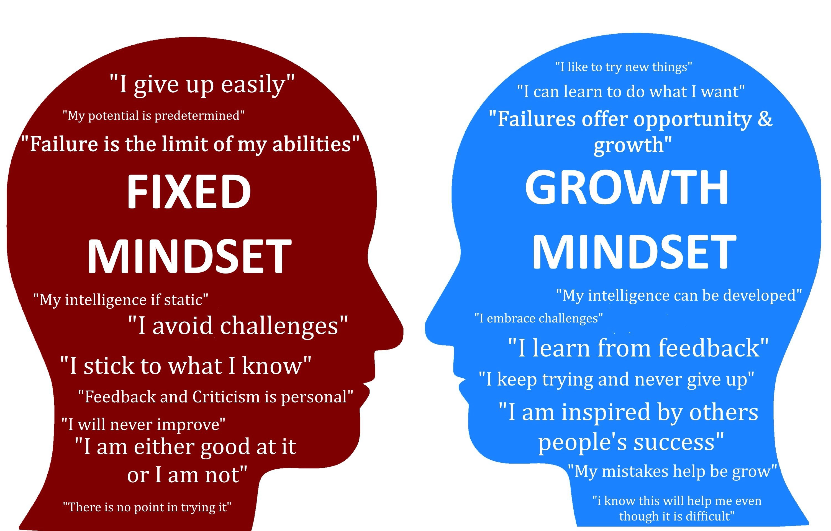
What’s the mindset within your organisation

Slide 23
In Connection with the rest of the world
Relations
Acknowledgement
Dream
Culture
Ethics
Happiness
Society
Circular Economy
Sustainability
Fulfilment
Vulnerable
Introspection
Relational
Functional
Successful
Resolute
Reflection
Goals
Compliment
Ambition
Structure
Just do it
Profit
Employee / Client
Consumption Economy
Raw Materials

Slide 24
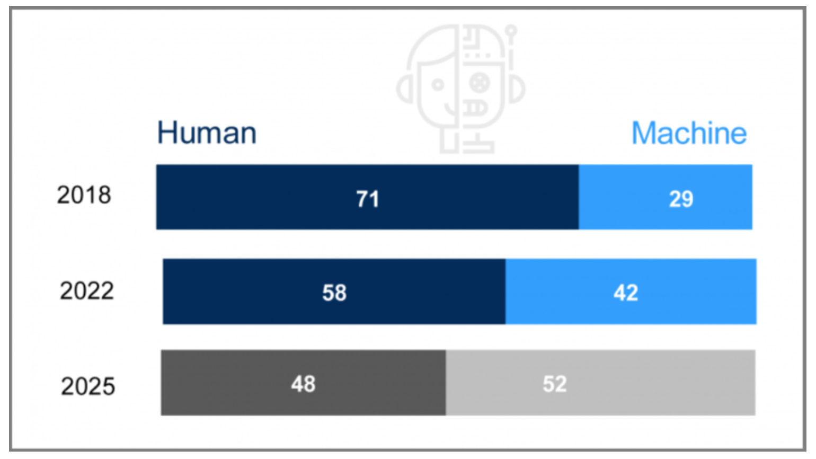
The future of jobs – What’s our added value?
Source: 2018 World Economic Forum, Future of Jobs report

Slide 25
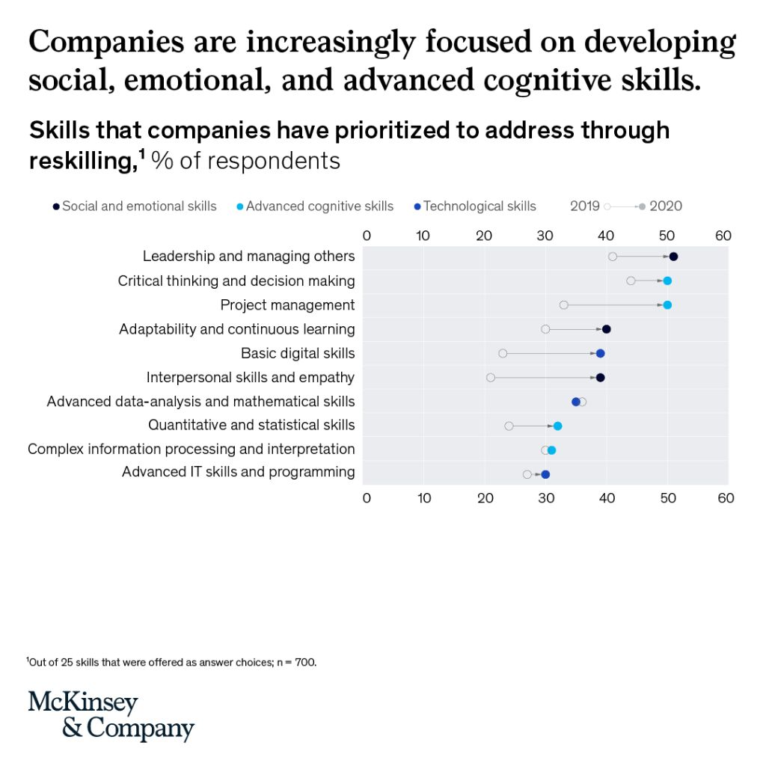
Skills for Navigating the VUCA World

Slide 26
Paradox: importance Functional and Relational
Functional & Relational are equal
Functional & Relational are unequal
1/3 functional - 2/3 relational

Slide 27
Importance of emotion (Daniel Goleman)
All roles
Leadership positions

Slide 28
Research suggests…
Emotional Intelligence accounts for nearly 90 percent of what sets high performers apart from peers with similar technical skills and knowledge. (Harvard Business School)
75% of careers are “derailed” for reasons related to emotional competencies, including the inability to handle interpersonal problems; unsatisfactory team leadership during times of difficulty or conflict; or inability to adapt to change or elicit trust. (Centre for Creative Leadership)
Research conducted with Fortune 500 CEOs by the Stanford Research Institute International and the Carnegie Melon Foundation, found that 75% of long-term job success depends on people skills, while only 25% on technical knowledge. (American Management Association)
A 40-year longitudinal investigation of 450 boys found that IQ had little relation to life success. The most significant predictors were being able to handle frustration, control emotions, get along with other people. (National Library of Medicine)

Slide 29
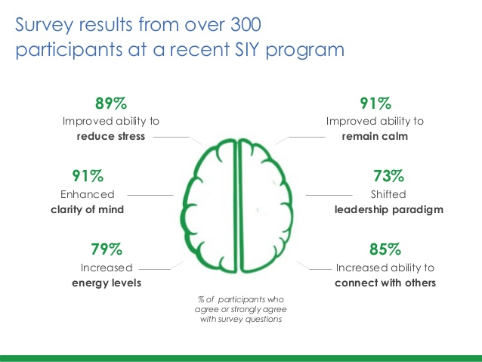
Benefits of building Mindfulness and EI

Slide 30
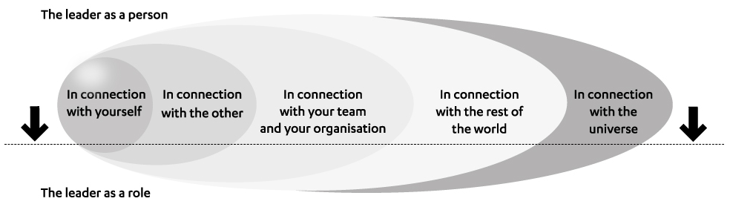
Adjusted framework: The Connection Quotient
Relational
Functional

Slide 31
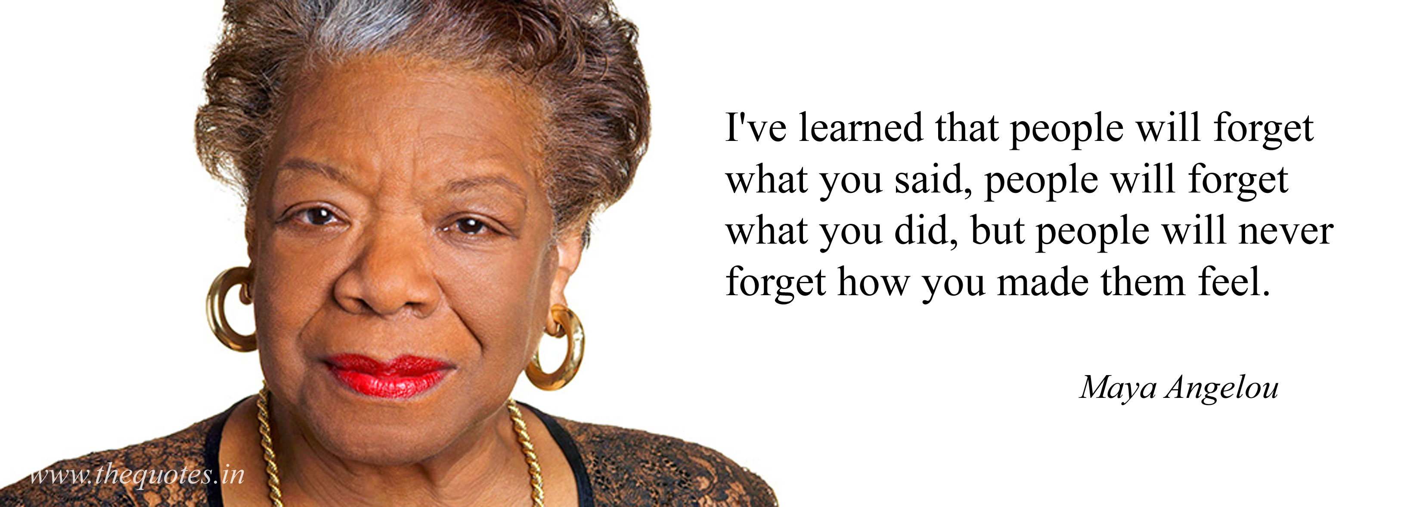
We can ALL be leaders if we choose to be

Slide 32
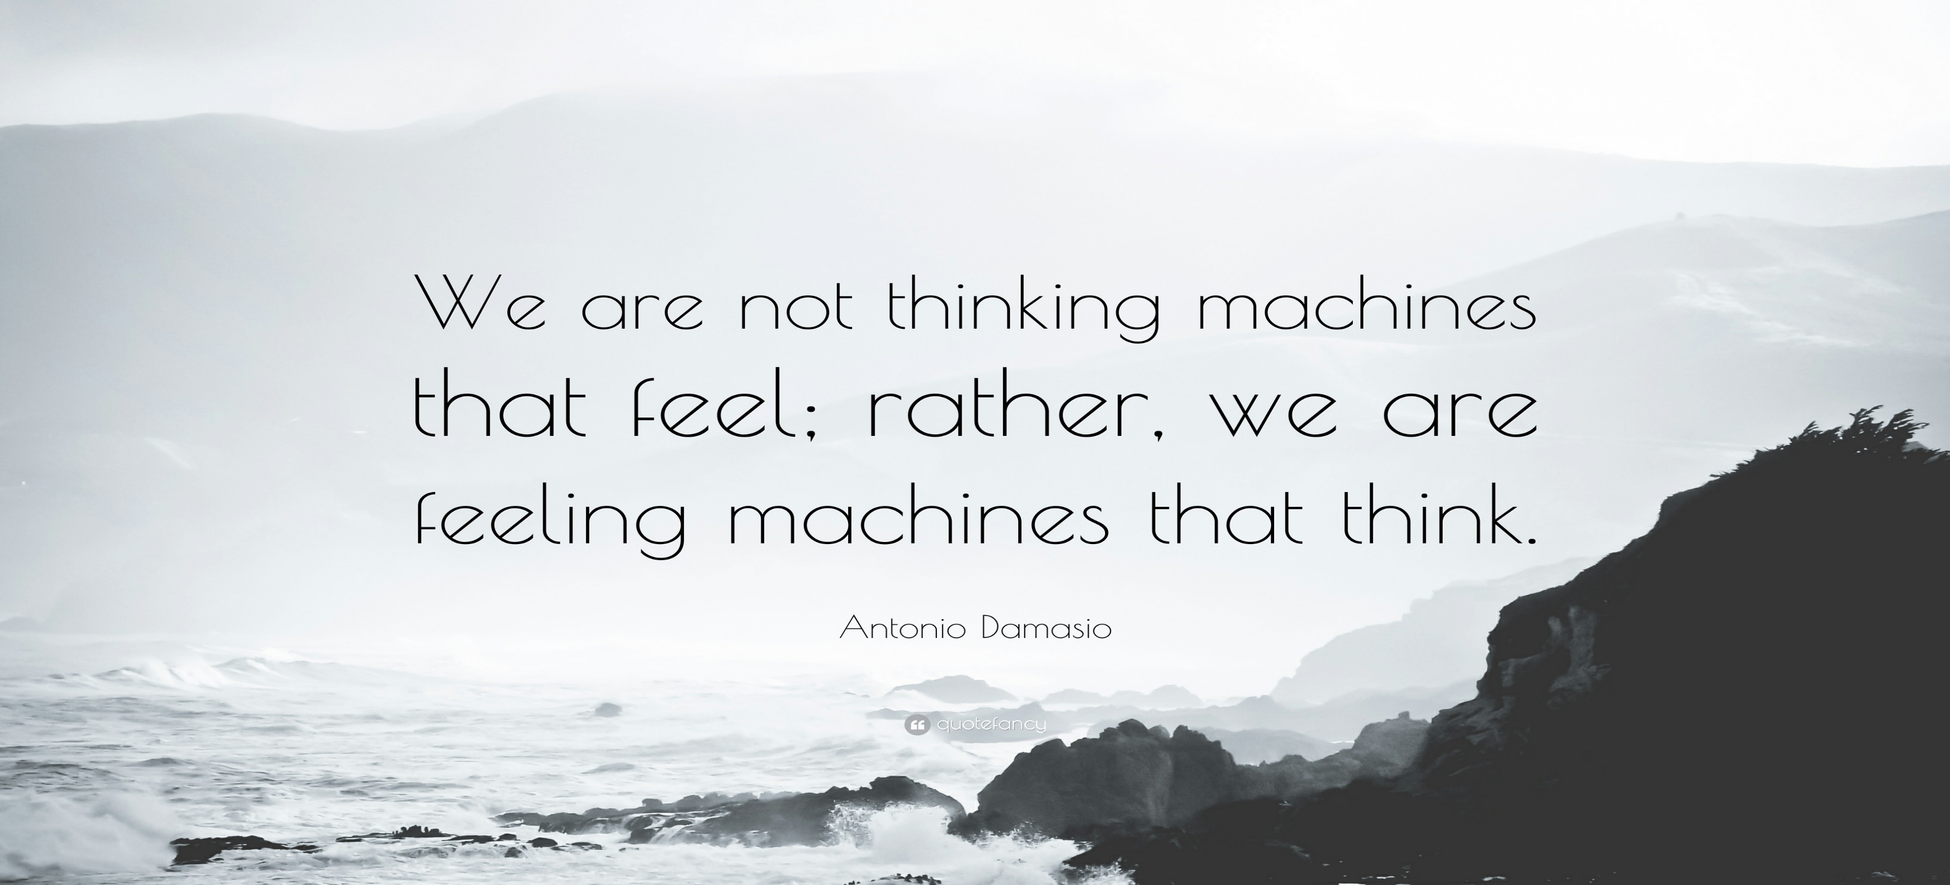
We can ALL be leaders if we choose to BE

Slide 33
Key messages ‘The Human Side of Business’
The Connection Quotient (CQ) – No need for a definition, because everyone knows/feels when it’s (not) in place. And everyone needs/desires it.
The Connection Quotient starts by being in connection with yourself, then with the other, followed by your team, your organization and the world (and maybe even the universe).
You are primairily a person (Human BEING), you have a function (Human DOING).
The paradox: Leader/Employee as Function (focus on result and business impact) and Leader/Employee as Person (focus on relation and interpersonal) are equally important, and they’re not equelly important (1/3 versus 2/3).
Development of your CQ starts by raising questions on your balance and themes between yourself as a function and yourself as a person, looking for answers, then to understand what your answers mean and finally to act on it.

Slide 34
H2 grow your ‘Human Side of Business’
Invest time and attention; reflect on your actions and introspect on your drivers for your behaviour
Focus both on the Human DOING and the Human BEING; follow your attention or the necessity
Ideally start your personal growth; first be able to lead yourself, before leading others
Acknowledge, accept and respect your and other people’s emotions and vulnerability; use these elements
Everyone is different; use the power of diversity and be actively inclusive
Ask for feedback; listen to understand (instead to fix), stay curious, raise questions, learn and act on it
Focus on 1 element; how to eat an elephant… indeed in small bites
Create a timeline and act on it; 5, 4, 3, 2, 1… start
You’re not alone; take an UMIO masterclass or work with a coach/mentor to support your growth

Slide 35

What’s the world you want to contribute to?

Slide 36
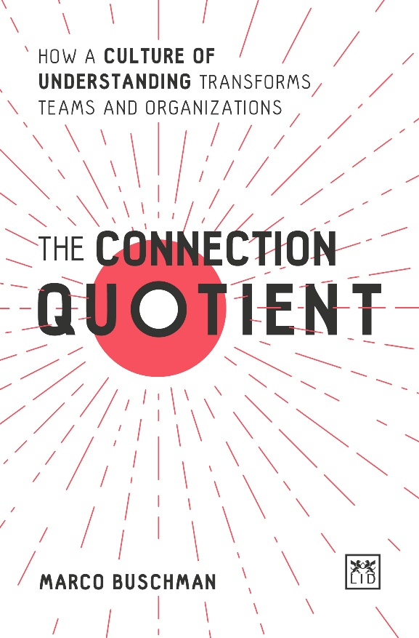
What are your thoughts, questions & remarks?
Marco Buschman
Managing Partner COURIUS
www.courius.com
www.marcobuschman.com
marco@courius.com
LinkedIn: marcobuschman
+31 6 46716141
WWW.UMIO-PRIME.NL

Slide 37
PROGRAMMES & PROJECTS
MaastrichtMBA
International executive MBA programme for professionals
Offered in Executive & Blended formats
www.maastrichtmba.com
MBA
EXECUTIVE MASTERS
MANAGEMENT PROGRAMMES
CUSTOMISED PROGRAMMES FOR TEAMS & ORGANISATIONS
INNOVATION PROJECTS

Slide 38

CONNECT WITH US THROUGH UMIO PRIME! www.umio-prime.nl
UMIO Prime is an engagement platform that helps business professionals and organisations gain the knowhow and network to create a meaningful impact together.
Connect and interact with experts & peers
Articles, videos, (online) events & workshops
Desktop & mobile app
Become a member for free!

