Slide 1
MSc IB Entrepreneurship & Business Development
Maastricht University
School of Business and Economics

Slide 2
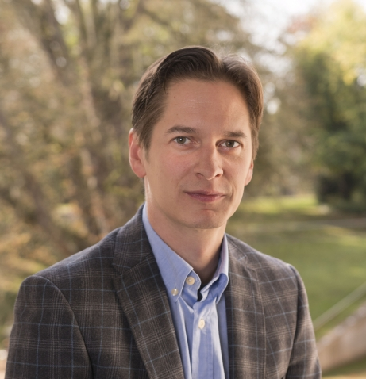
Dr. Yannick Bammens
Program leader

Slide 3
Today’s Agenda
What are we about?
1
Teaching Method
2
Programme Structure
3
Student Profile
4
What does the future hold?
5

Slide 4
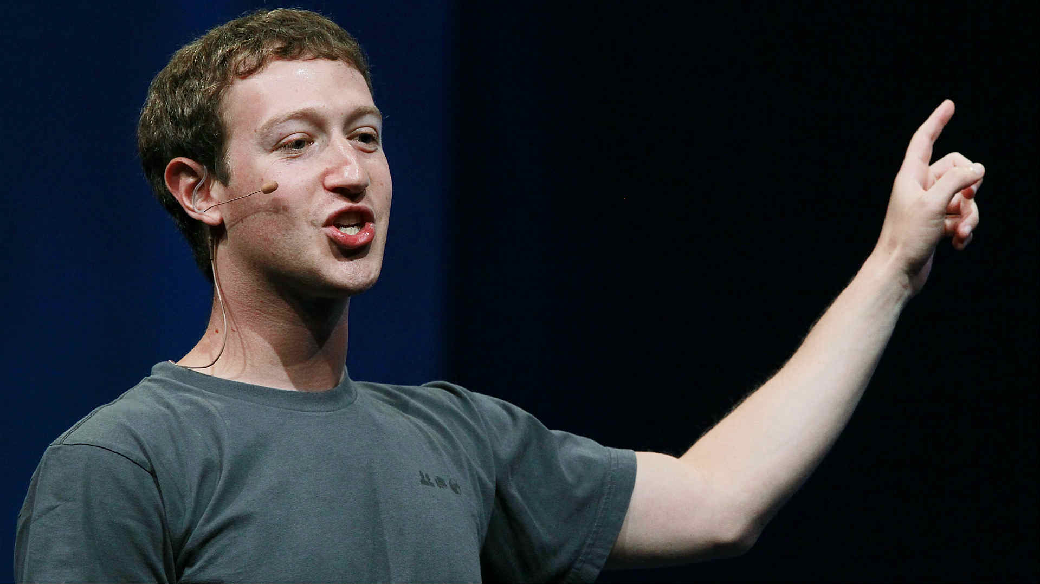
What are we about?

Slide 5


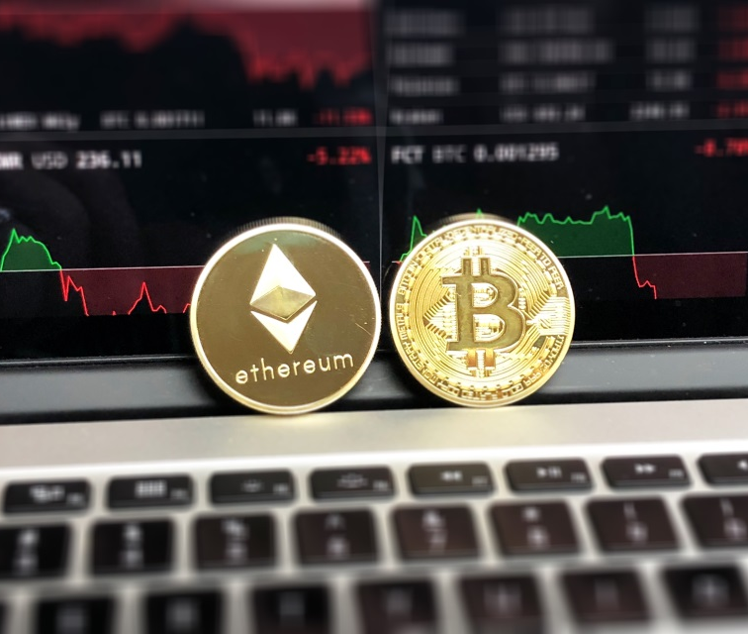
Entrepreneurship

Slide 6
Entrepreneurship
Economic importance
  Engine of renewal and growth

Slide 7
Entrepreneurship
Economic importance
  Engine of renewal and growth
Societal importance
  Plastic waste, air pollution, mobility, …
  Turning problems into opportunities
    Profit: scalable and sustainable

Slide 8
Entrepreneurship
Economic importance
  Engine of renewal and growth
Societal importance
  Plastic waste, air pollution, mobility, …
  Turning problems into opportunities
    Profit: scalable and sustainable
Why now?
  Entrepreneurial eco-system
    Incubators, fin. platforms, entrep. centers,…
  Fast-paced technological developments
    Green tech, AI, blockchain, …
    Tech. start-ups look for business profiles

Slide 9
Entrepreneurship
We offer insight on the entrepreneurial process
  Ideation, business modelling, validation and iteration, business planning, launching and scaling
Newness: how to manage uncertainty
  E.g., effectuation, lean start-up
Smallness: how to operate under resource constraints
  E.g., entrepreneurial bricolage

Slide 10

Business Development
Entrepreneurship: Startup ventures
Business Development: Corporations
  Intrapreneurship
  Business model renewal
  Innovation management
  Corporate venturing

Slide 11

Teaching Method

Slide 12

Academic Knowledge
Learning by Doing
Key topics
  Entrepreneurship & Innovation
  Digitalization & Data Analytics
  Sustainable Development
Small group setting
  Max. 15 students
Active participation
  Presentations
  Case discussions
Course Projects
Business Challenge (elective)
  Business model development
  Business model validation
  Business model pitching

Slide 13

Programme Structure

Slide 14
Structure of the programme (Sept. intake)
period
Entrepreneurship & Business Development
1 Sep-Oct
Strategic Entrepreneurship and Innovation
Data Analytics
2 Oct-Dec
Entrepreneurial Finance
Elective
3 Jan
Master Thesis Proposal
Notes:
ERM: entrep. stages and models that help you navigate these stages (effectuation, lean start up, bricolage), and how research is done on this (thesis)
FFDE: impact of family ownership on strategic choices, and difference with founder firms
EF: different fin. options (bootstrapping, crowdfunding, bank lending, angel investment, VC): pro and con, when which

Slide 15

Strategic Entrepreneurship & Innovation
Insights for entrepreneurs:
  Entrepreneurial frameworks
  Entrepreneurial tools
Insights for corporate entrepreneurs:
  Innovation management
  Corporate venturing

Slide 16


Data Analytics
Quantitative methods for problem-solving and research
Generate insights that improve management decision-making
R programming language for statistical analyses

Slide 17
Structure of the programme (Sept. intake)
period
Entrepreneurship & Business Development
1 Sep-Oct
Strategic Entrepreneurship and Innovation
Data Analytics
2 Oct-Dec
Entrepreneurial Finance
Elective
3 Jan
Master Thesis Proposal
Notes:
ERM: entrep. stages and models that help you navigate these stages (effectuation, lean start up, bricolage), and how research is done on this (thesis)
FFDE: impact of family ownership on strategic choices, and difference with founder firms
EF: different fin. options (bootstrapping, crowdfunding, bank lending, angel investment, VC): pro and con, when which

Slide 18

Entrepreneurial Finance
Mobilizing financial resources
  Bank lending
  Crowdfunding
  Business angels
  Venture capitalists
Across different venture stages

Slide 19

Elective
Choose your own course from a wide range of options
From another MSc IB Program
Or: Multidisciplinary Business Challenge
Broaden your horizon and go the extra mile!

Slide 20
Structure of the programme (Sept. intake)
period
Entrepreneurship & Business Development
4 Feb-Apr
Digital Entrepreneurship
Master Thesis
5 Apr-Jun
Business Innovation and Sustainable Development
6 Jun
Finalizing Master Thesis
Notes:
VBM: develop value prop., how to segment customers, how to set price
MC: when grows beyond founder, incentivize and monitor employees

Slide 21
Broader contextual trends
Digital Entrepreneurship
  Insight in new digital technologies
    E.g., artificial intelligence, robotics, blockchain, quantum computing
  How these new technologies create entrepreneurial opportunities and shape business development strategies
Business Innovation and Sustainable Development
  Insight in ecological and social issues
    E.g., green supply chains, renewable energy, bottom of pyramid poverty and needs
  How these sustainability challenges create entrepreneurial opportunities and shape business development strategies

Slide 22

Student Profile

Slide 23




Entrepreneurial mindset
Analytical doer
“The true entrepreneur is a
doer, not a dreamer”
Nolan Bushnell, founder of Atari
International
Interactive

Slide 24
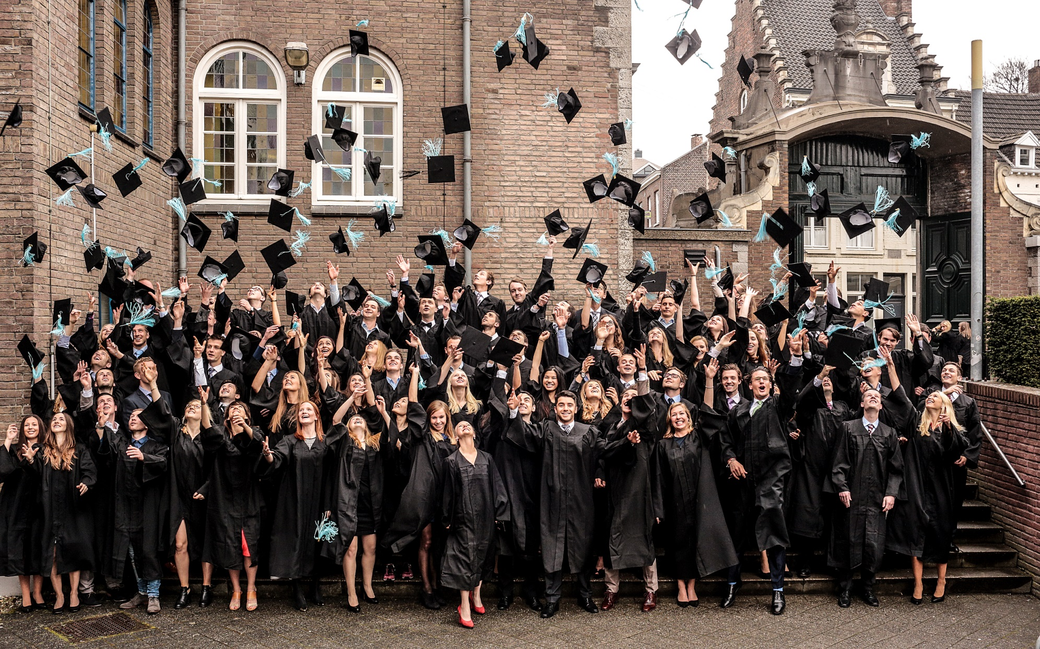
What does the future hold?

Slide 25

Our graduates are employed in over 30 countries
Entrepreneur
New venture manager
Business development manager
Business consultant
Policy, academia, …

Slide 26
Questions?

