Slide 1
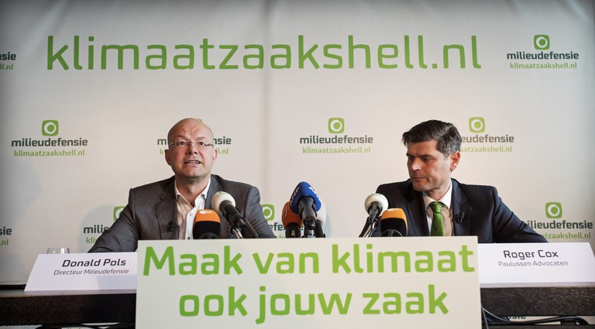
A Democratic Alternative to Address Climate Change

Slide 2
Shell Verdict, May 26 2021
For the first time in history, a judge has held a corporation liable for causing dangerous climate change.
Shell is “obliged to reduce the CO2 emissions of the Shell group’s activities by net 45% at end 2030, relative to 2019” - including that of its customers (the latter a significant best-efforts obligation)
This is comparable to five times the annual CO2 emissions of The Netherlands (Urgenda verdict: reduce 25% of Dutch emissions by 2020)
In principle applicable to all major polluters (legal precedent)

Slide 3
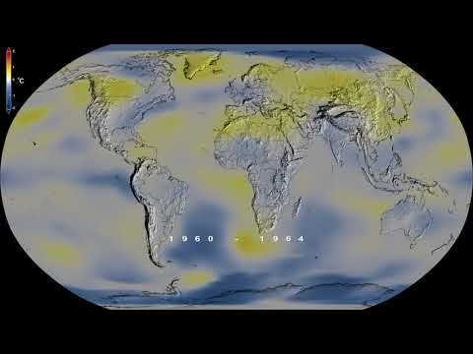
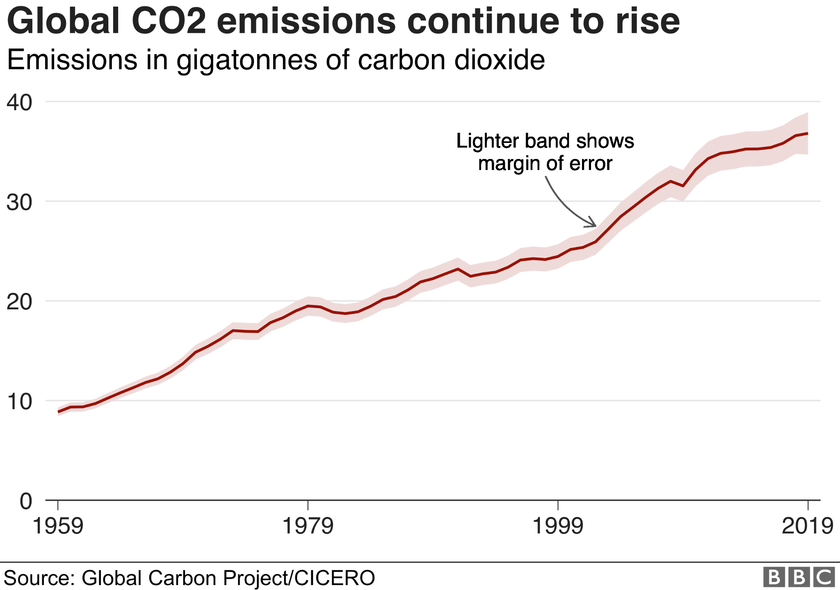
A Need for New Strategies
Notes:
For me the journey started at the failure of the Copenhagen Climate Conference in 2009. After working on a international climate agreement for 9 consecutive years. Was supposed to bring together world leaders. Failed miserably. Interviewed negotaotors, ministers, moved to china to understand sitiation. My conlcusion supriisng and simple. Will share

Slide 4
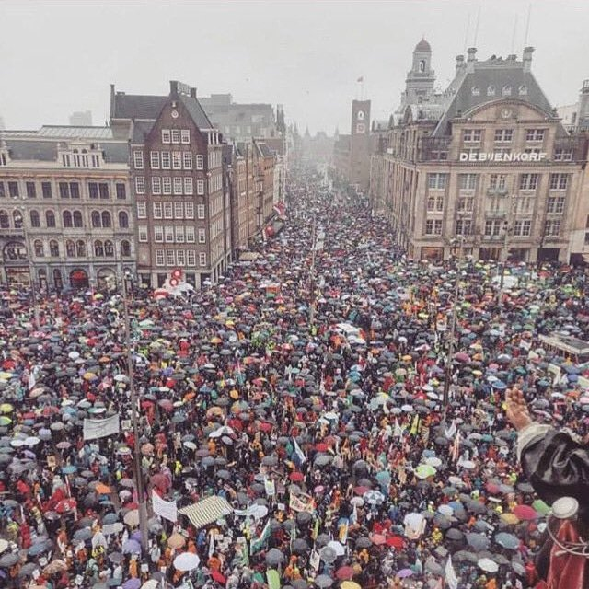
Not Good vs Evil

Slide 5
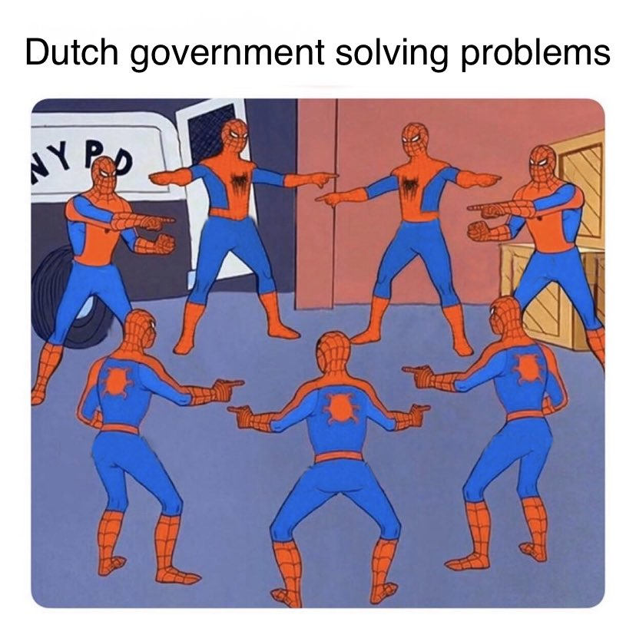
Who is responsible for public goods?

Slide 6
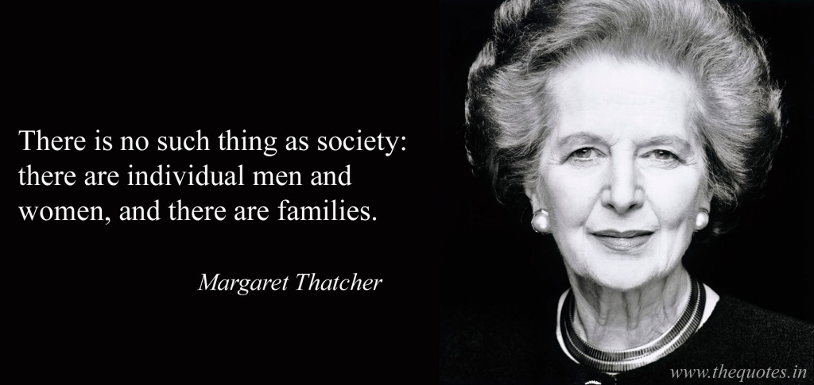

Slide 7
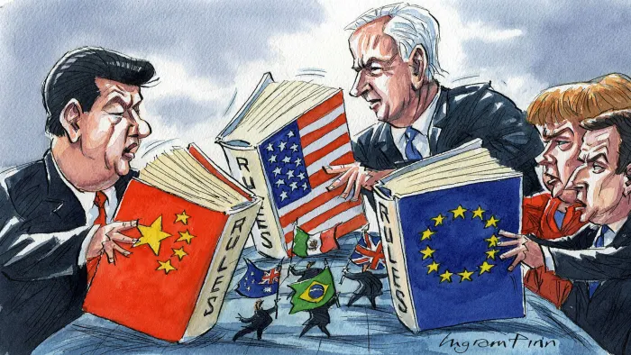
Regulatory frameworks are national

Slide 8
The Economy has Globalised

Slide 9
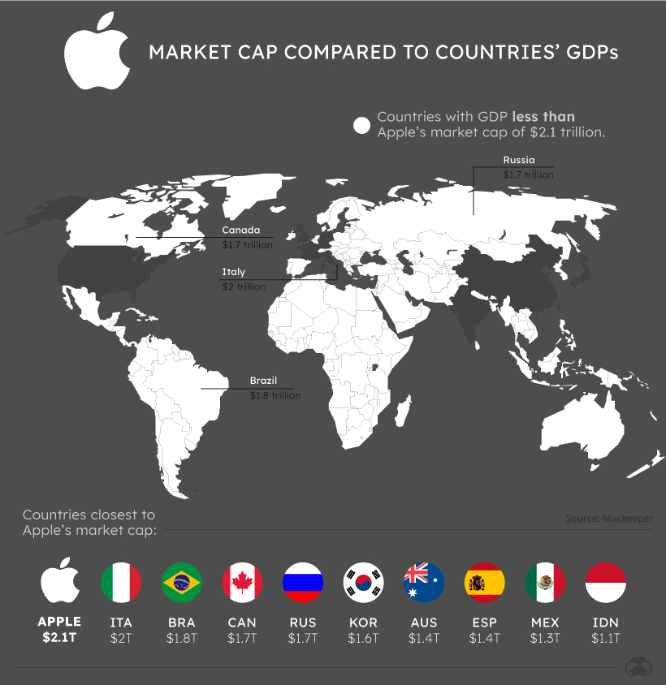
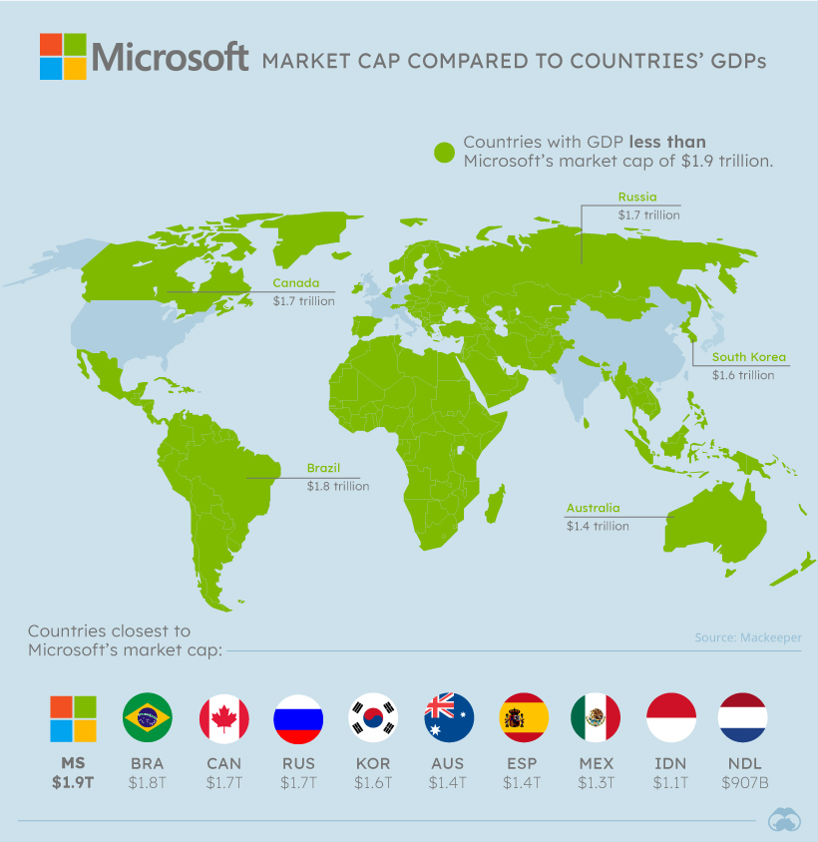
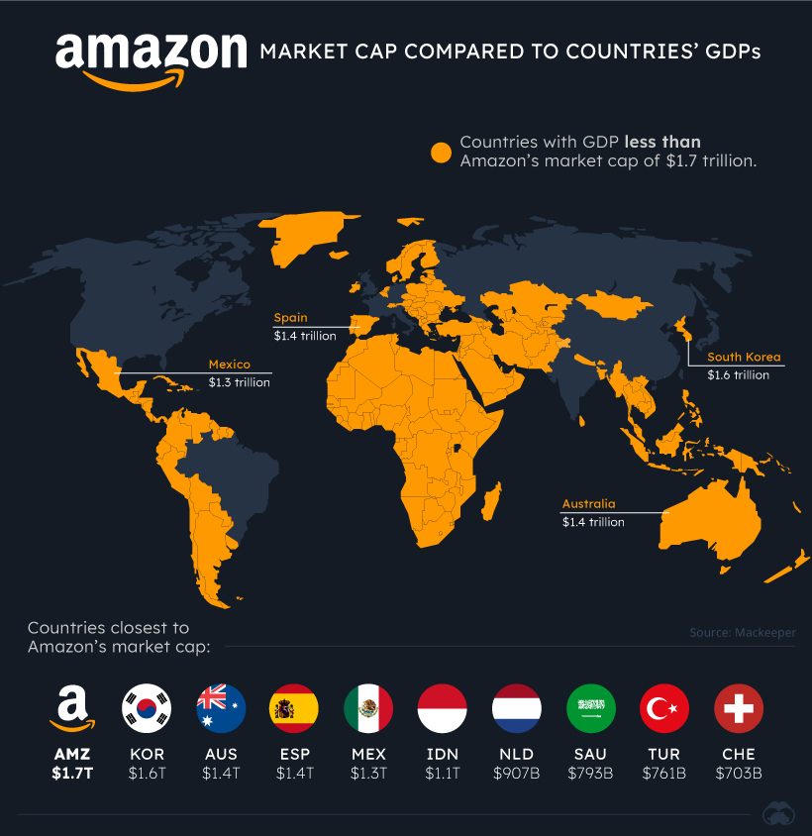
Growth of corporations more powerful than countries
Apple, Amazon Wealthier than More than 90% of the World’s Countries

Slide 10
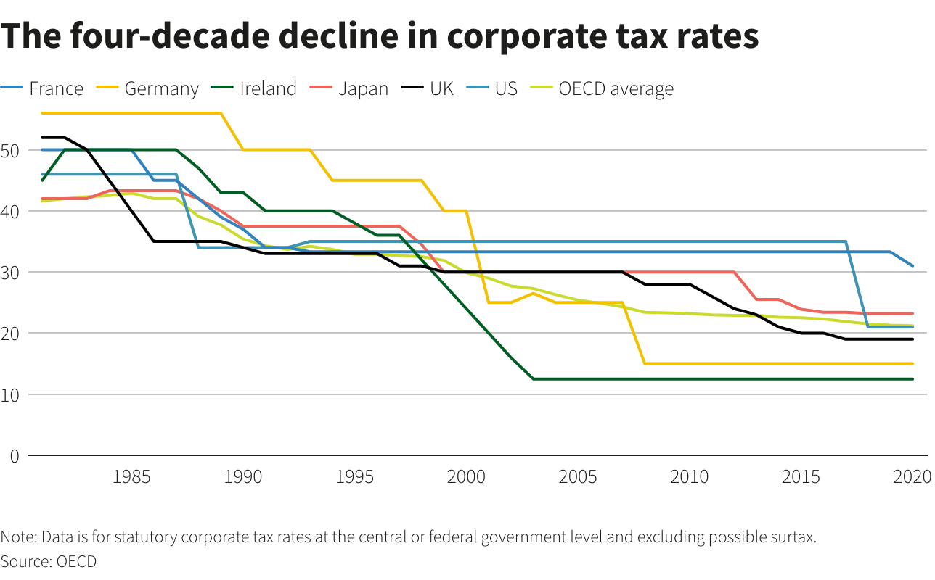
Translates into “Regulatory Gap”
Notes:
Taxation as an illustration of being exempt of regulation.

Slide 11
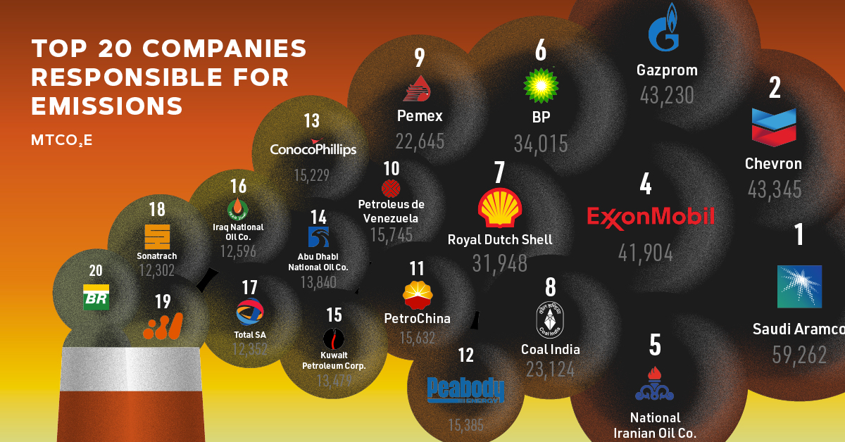
35%
Between 1965-2017, the top 20 companies have contributed 35% of cumulative global emissions.
Notes:
Companies outside of remit of Paris and national policies

Slide 12
Everyone in society responsible including Multinationals (Shell)
Degree of influence on the problem
Degree of awareness of the problem
Degree of influence on the solution

Slide 13
Options for accountability
Self-regulation
International regulation
National regulation

Slide 14
Court Decision based on Duty of Care

Slide 15
Impact: the ‘ripple effect’
Shell implements court order (annual investments $24-29 billion)
Other major polluters implement climate policy to avoid litigation
Other NGOs start lawsuits
Governments create level playing field for example (e.g. EU Border Tax Correction)

Slide 16
Holding multinationals accountable

