Slide 1
Welcome to Maastricht University
School of Business and Economics
Msc. IB/Sustainable Finance

Slide 2
Contact:
Dr. Jeroen Derwall
Finance Department
j.derwall@maastrichtuniversity.nl
www.maastrichtuniversity.nl/SBE (official site)

Slide 3
Imagine the following
You have always felt an interest in being involved with finance in your later career…
…investment manager or pension fund
…or more generally for a financial services firm…
…or perhaps in a company or property investment firm
But you want to learn more about finance than a standard Finance track has to offer
…you are also interested in the concept of sustainability, and the role it can play in financial markets and decision making
Notes:
pbl

Slide 4
Sustainable Finance: Our “definition”
Understanding how sustainability/society affects (better) financial decision making
&
how financial decision making can have real positive societal impact
Finance plus sustainability: Integration in Financial Analysis
Notes:
Highlight that the tracks is intended for those who want to learn about finance AND sustainability, not about those who think that there is more than finance and that social issues are alsi important

Slide 5
SF student will be valuable asset for…
Mainstream financial institutions who want to understand how they can make smarter financial decisions and enhance returns for their clients by considering sustainability risks and opportunities
Financial institutions who aim to generate explicit social impact through investments, alongside financial returns (Impact Investors)
Companies who want to understand how they can improve their long-term competitiveness and financial performance by integrating society and environmental goals in their strategy, management, reporting, marketing and financial decisions

Slide 6
Various sectors are working on it...but each in a different way
Notes:
This is now known as sector-specific materiality. Each company is looking for genuine strategic sustainability challenges that affects the business case or investment case.

Slide 7
Topics: traditional finance with sustainability Examples....
Course / Topic | Topics in traditional Finance track | Topics also in Sustainable Finance
Investments & capital market | Performance measurement Investor preferences Asset allocation: stocks, bonds, real estate Institutional investors | Measure financial and social return on investment Do investors’ have ’social’ preferences affecting security prices and product development? Can specific investors promote sustainability?
Real estate finance | Real estate markets & securities Real estate diversification | Sustainability benchmarking Valuation of green real estate & REITs
Corporate finance, governance, & valuation | Discounted cash flow model (DCF) Optimal capital structure Optimal compensation & corporate ownership structure Key drivers of shareholder value | Integrate sustainability in DCF valuation and value-driver analysis? What is a sustainability-enhancing corporate ownership structure? Stakeholder theory of capital structure

Slide 8
Sustainable Finance examples
We ask all typical finance questions and then go one step further:
(How) does a company’s value change if it invests in sustainability initiatives? (Valuation, capital budgeting)
Can institutional investors use shareholder activism tactics to improve the sustainability policies and practices of firms they invested in?
(How) can asset managers make better stock investment decisions by considering environmental management and corporate governance standards of companies? (Portfolio management)
How can we benchmark real estate investments on environmental impact and assess the business case of green commercial property?

Slide 9
IB/Sustainable Finance in brief
Block
Sustainable Finance
1
(sept)
Sustainable Finance, Management, and Strategy
Financial Research Methods
2
Institutional Investors
Elective Block 2
3
Skills Training: Writing a Master’s Thesis
4
Sustainable and Responsible Investments
Writing the Master’s Thesis
5
Real Estate Finance
6
Completing the Master’s Thesis
Details of this programme could change; before applying, please check www.maastrichtuniversity.nl/sbe for the latest information.
Notes:
Standard structure of each SBE msc programme: 5 obligatory fixed courses + 1 elective + 1 skills training+ 1 msc thesis
1 year, twice a year (in February this matrix turned around)
- 4 courses in Semester I and 2 courses in semester II to enable you to write the msc thesis

Slide 10
IB/Sustainable Finance in brief
Block
Sustainable Finance
4
(feb)
Sustainable and Responsible Investments
Financial Research Methods
5
Real Estate Finance
Elective Block 5
6
Skills Training: Writing a Master’s Thesis
1
Sustainable Finance,
Management & Strategy
Writing the Master’s Thesis
2
Institutional investors
3
Completing the Master’s Thesis
Details of this programme could change; before applying, please check www.maastrichtuniversity.nl/sbe for the latest information.
Notes:
Standard structure of each SBE msc programme: 5 obligatory fixed courses + 1 elective + 1 skills training+ 1 msc thesis
1 year, twice a year (in February this matrix turned around)
- 4 courses in Semester I and 2 courses in semester II to enable you to write the msc thesis

Slide 11
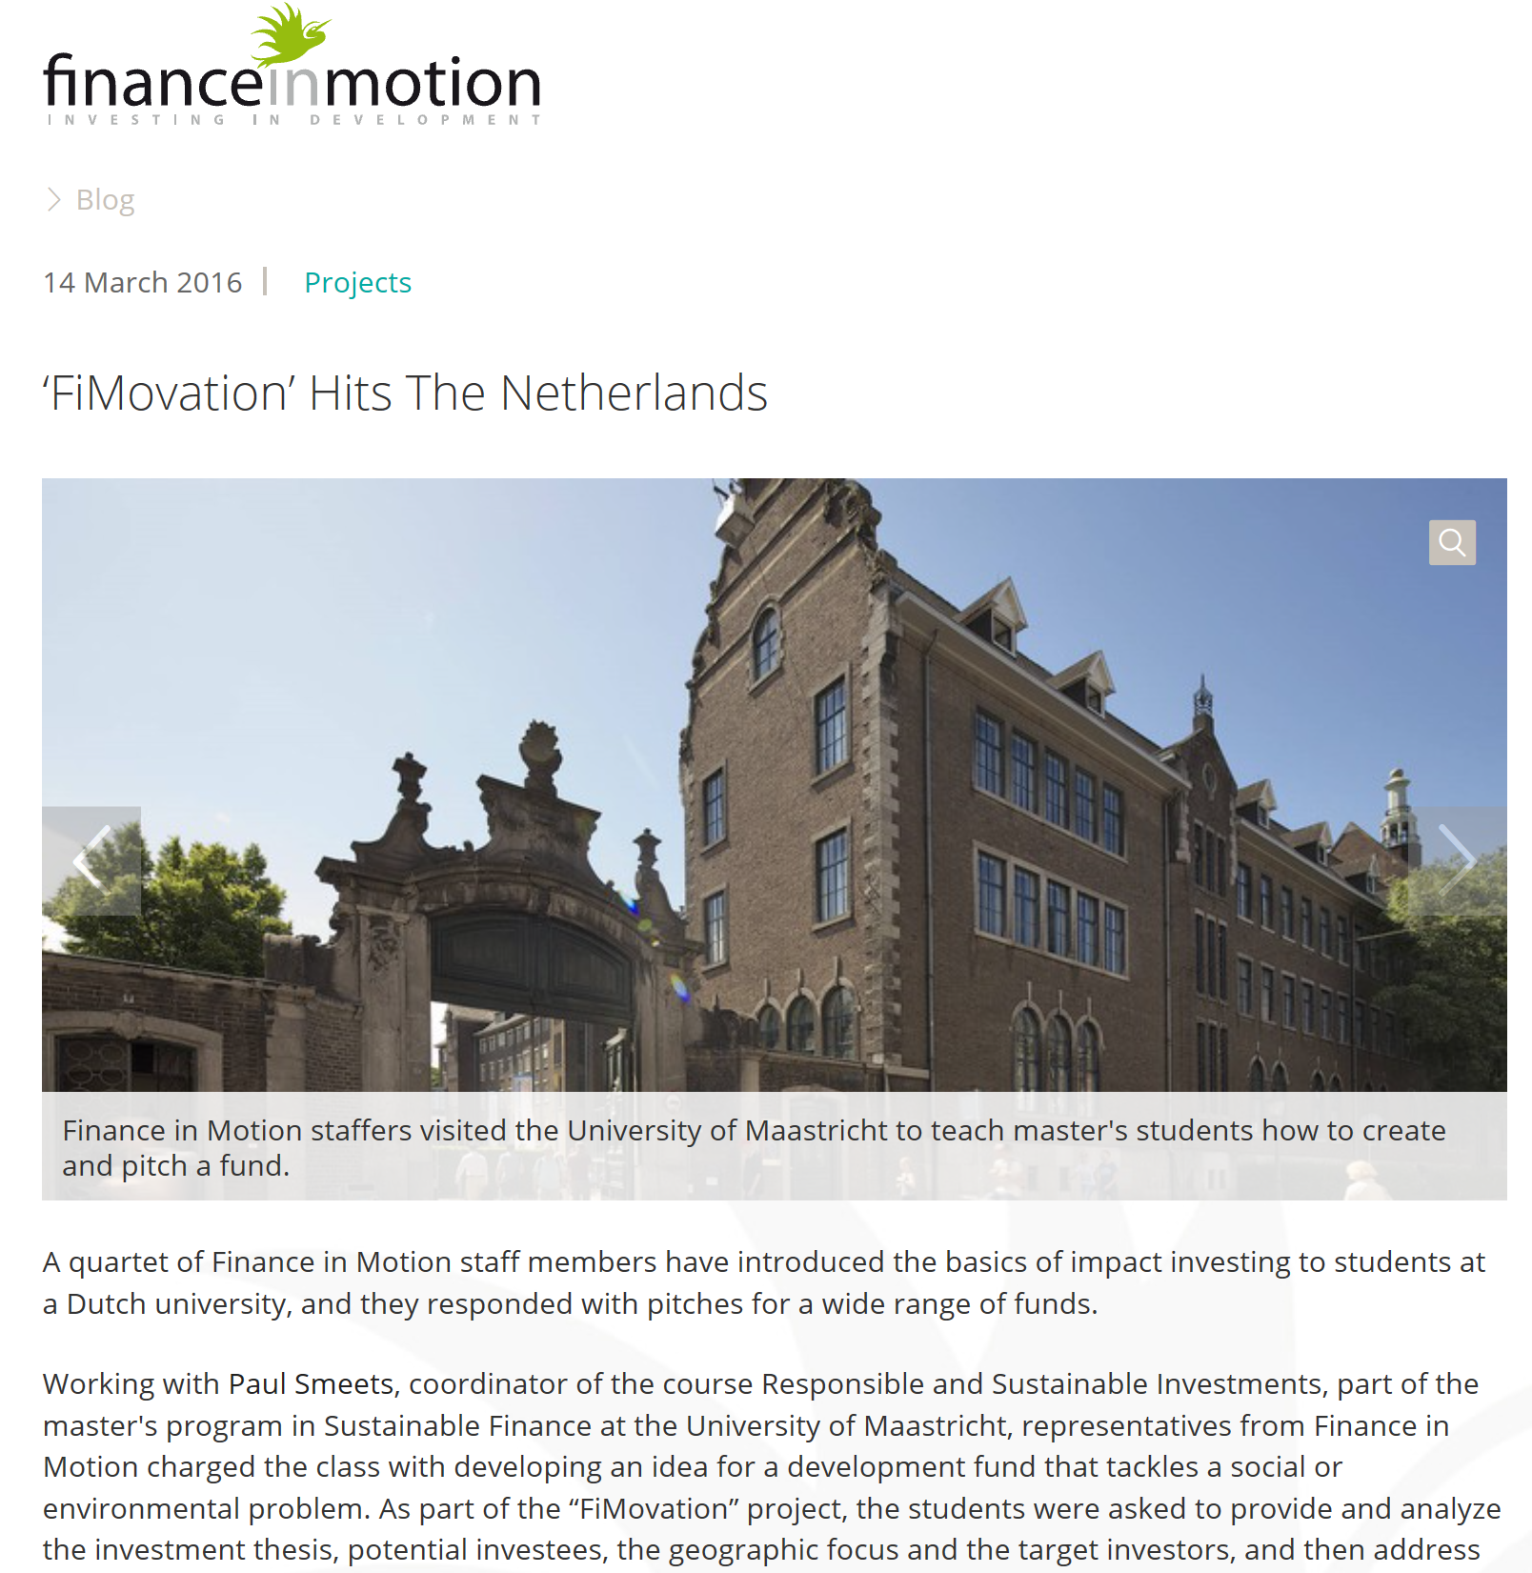
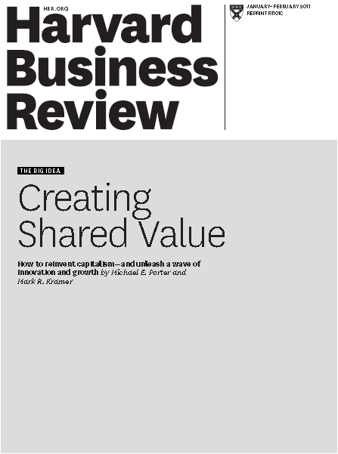
Confronting theory and literature with practice

Slide 12
Sustainable Finance at UM SBE Source of knowledge creation
UM SBE: frontrunner in sustainable finance research
European Centre for Corporate Engagement (ECCE)
Global Real Estate Sustainability Benchmark (GRESB)
Academics and practitioners teach theory and applications
Notes:
..but IS is no rocket science
Managerial/strategic: not purely theoretical/academic level but with an eye towards practice
Also highlight that link to practice means they have valuable networks (student like to here that some practitioners got student into a good job after they wrote a very good thesis). You can also mentioned initiatives like GRESB, ECCE, etc.

Slide 13
Career perspectives Extra baggage on the job market
This year’s graduates: some example
Consulting: PwC, E&Y, Finance Ideas, GRESB
Asset Management: DB / Deutsche Wealth, Arabesque, Actiam
Companies: DSM, Mars, Boels
Development Finance: Finance in Motion
Banks: ING
Insurance companies: Achmea
Academic: PhD program
London, Zurich, Frankfurt, Amsterdam, …
Frequently approached on linkedin by companies because of their study profile

Slide 14
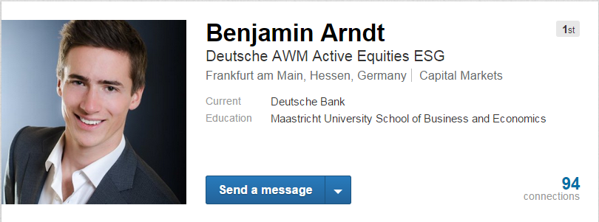
Career perspectives Extra baggage on the job market

Slide 15
Career perspectives Extra baggage on the job market

Slide 16
More on teaching approach
Problem-based learning
Real company cases
Real financial problems
Your own data collection and statistical analysis
“Science meets practice”
Blended learning (some courses)
Preparatory e-learning material to make in-class teaching most efficient
Also practitioners speak or introduce their case

Slide 17
Study abroad and internship
Abroad: under conditions possible as extra-curricular activity
Study point requirements before allowed to do so under Master program
Administrative fee
Internship with Master’s thesis: possible part-time
Full-time: you must have first obtained all credits needed to graduate

Slide 18
Enrollment & requirements
In general GMAT/GRE required
Exceptions may apply
Certain “hogescholen” (Fontys, Zuyd)
“Continuing” SBE students
Students with Bachelor from NVAO accredited University
NHTV with academic minor and recommendation from School
Details: http://www.maastrichtuniversity.nl/web/Faculties/SBE/TargetGroup/Education/MastersProgrammes/RequiredDocuments1.htm

Slide 19
Differences with other UM Master’s
IB/Finance (Strategic Corporate Finance)
is more strategic corporate finance oriented
Sustainability not explicit on the agenda
Sustainable Finance: mainly investor and markets focused but offers a core corporate sustainability course that is essential in linking sustainability to finance
Marketing-Finance
focuses more on marketing aspects of financial products
focuses more on marketing’s contribution to financial outcomes
Sustainable Finance: finance-focused track but does cover marketing implications of investors’ preferences for sustainable companies, markets and products

Slide 20
Further information:
Official Msc. IB/Sustainable Finance
www.maastrichtuniversity.nl/sbe
European Centre for Corporate Engagement (ECCE)
www.corporate-engagement.com
Email : j.derwall@maastrichtuniversity.nl
Or visit us at the information market in the Mensa

