Slide 1
MSc International Business – Supply Chain Management Delivering value through the supply chain
Janjaap Semeijn
Professor of Supply Chain Management
Coordinator MSc. IB, track Supply Chain Management

Slide 4
Specialisation Structure (1st Semester)
Block
IB/Supply Chain Management
1
Purchasing Management
Supply Chain Strategy
2
Retailing and the Supply Chain
Supply Chain Research Methods
3
Skills Training:
Thesis Skills

Slide 5
Specialisation Structure (2nd Semester)
Block
IB/Supply Chain Management
4
Supply Chain Operations
Writing the Master’s Thesis
5
Supply Chain Metrics
6
Completing the Master’s Thesis

Slide 6
Purchasing Management
Understand the strategic relevance of purchasing
Learn about suppliers and competitive advantage
Organise the purchasing function
Block
IB/Supply Chain Management
1
Purchasing Management

Slide 7
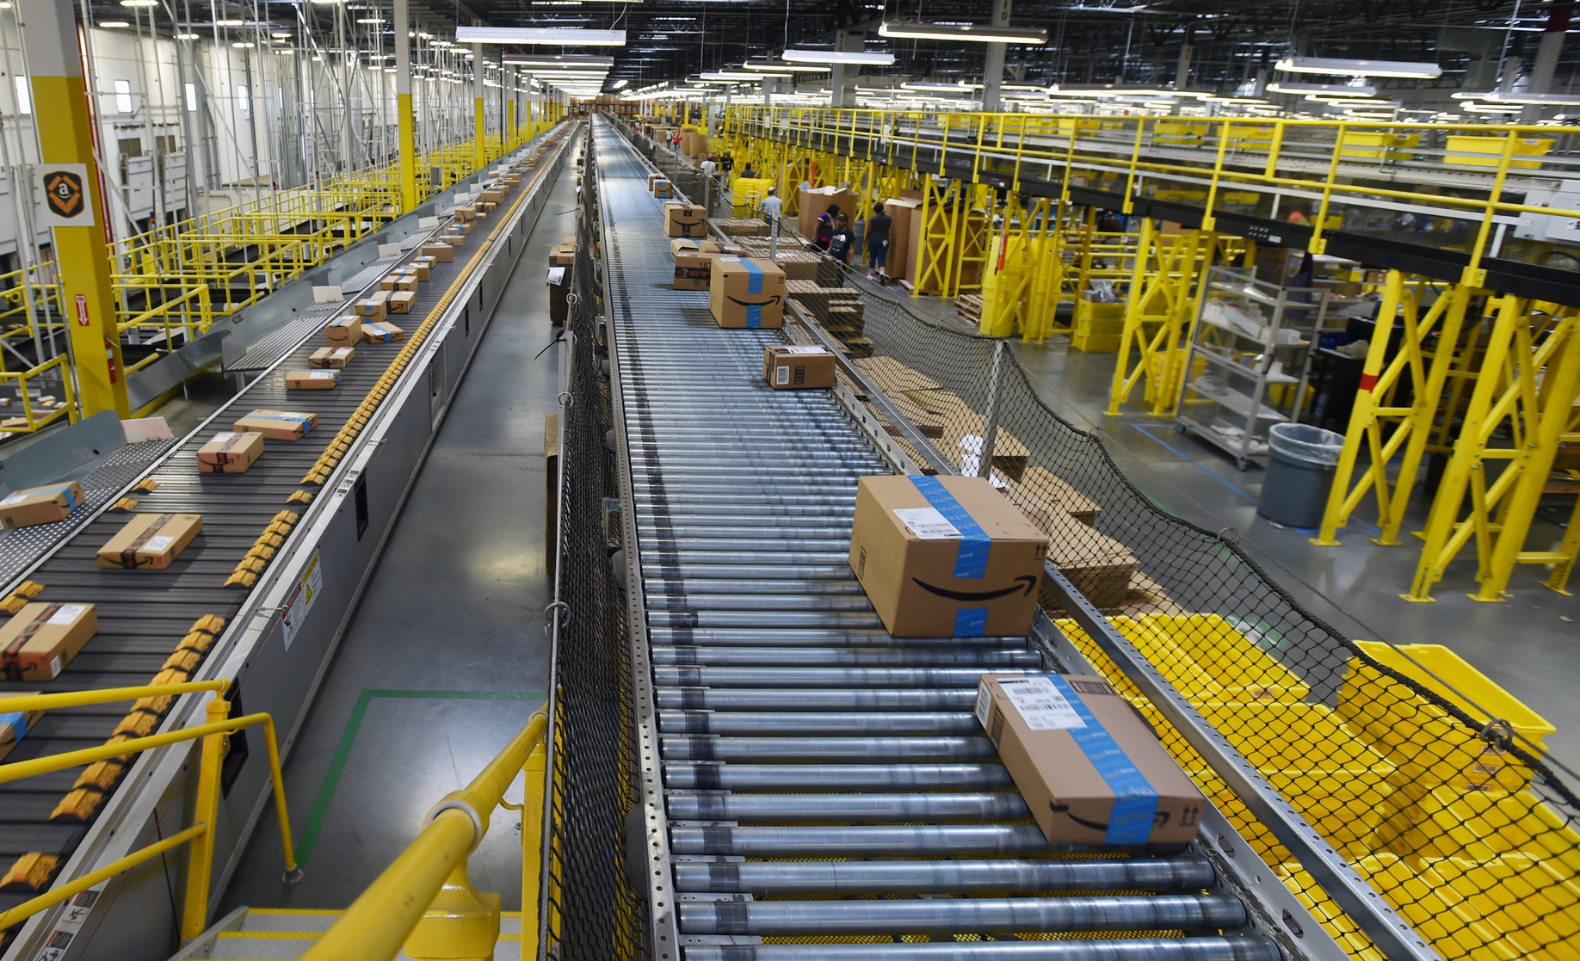
Supply Chain Strategy
Get introduced to the discipline and the programme
Take a holistic view of the supply chain
Take a strategic view of the supply chain
Block
IB/Supply Chain Management
1
Supply Chain Strategy

Slide 8
Retailing and Distribution
Learn about store location choice
Understand assortment and inventory management
Learn about shelf space allocation
Understand pricing and price promotion
Block
IB/Supply Chain Management
2
Retailing and the Supply Chain

Slide 9
Supply Chain Research Methods
Get introduced to the role of research in supply chain management
Learn about methods for optimising the supply chain
Block
IB/Supply Chain Managment
2
Supply Chain Research Methods

Slide 10
Thesis Skills
Acquire a deeper understanding of a topic relevant to supply chain management professionals
Academically formulate this topic as preparation for entry on the job market
Block
IB/Supply Chain Management
3
Skills Training:
Thesis Skills

Slide 11
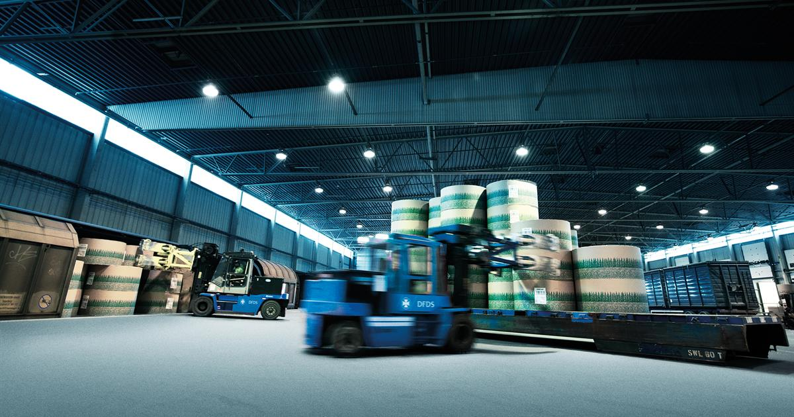
Supply Chain Operations
Use quantitative models for decision-making
Design and assess efficient product processes
Block
IB/Supply Chain Management
4
Supply Chain Operations

Slide 12
Supply Chain Metrics
Understand the performance of supply chain systems
Learn about evaluation criteria (metrics)
Control supply chain performance
Block
IB/Supply Chain Management
5
Supply Chain Metrics

Slide 13
Master’s Thesis
In-depth study of a supply chain management problem
- Academic relevance
- Managerial relevance
Block
IB/Supply Chain Management
4
Writing the Master’s Thesis
5
6
Completing the Master’s Thesis

Slide 14
Is IB/Supply Chain Management right for you?
“When studying firms, I like to find out everything from the first
supplier to the final customer.”
“I believe that how and where firms buy their products
and services has a large impact on firm performance.”
“One has to understand how supply networks work to become
successful in business.”
“Data analysis is necessary to support decisions in a
supply chain.”
“Integrating real-life cases and interaction with
companies is critical for understanding how firms work with each other.”

Slide 15
Why MSc IB/SCM at SBE?
Business Partnerships
Job offers
Internships
Thesis topics
Company contact
Connecting you to a network of knowledge and opportunities
Providing better access to business
Preparing you for a future career

Slide 16
What are your career prospects?

Slide 17
Careers of our alumni
352 graduates
Employed in 11 countries
Supply Chain Manager
Consultant
Market Analyst
Project Manager
MSc graduates SBE IB Track Supply Chain Management period 2004-2015

Slide 18
For questions please visit the information market in the Mensa

Slide 19
maastrichtuniversity.nl/sbe See you in Maastricht!

