Slide 1
MSc Human Decision Science

Slide 2
What is the MSc in Human Decision Science?
New programme started September 2012
Centers around the human decision making process
Takes an interdisciplinary perspective.
Economics: formal modeling (1st block of courses)
Psychology: experimental evidence (2nd block of courses)
Integrates the two approaches (integration workshop)
Applications to specific fields (elective courses\thesis)

Slide 3
Block
MSc Human Decision Science, Programme Structure
1
Cognitive Psychology & Cognitive Experiments
Integration Workshop
Theory of Individual & Strategic Decisions
2
Social Psychology & Decision Making
Negotiation & Allocation
3
Research Skills: Writing a Master’s Thesis
4
Elective course
Elective course
5
Master’s Thesis
6

Slide 4
Block
Programme Structure
1
Cognitive Psychology & Cognitive Experiments
Integration Workshop
Theory of Individual & Strategic Decisions
2
Social Psychology & Decision Making
Negotiation & Allocation
How do rational people behave in a given decision problem?
Decision Theory
Game Theory
3
Research Skills: Writing a Master’s Thesis
4
Elective course
Elective course
5
Master’s Thesis
6

Slide 5
Block
Programme Structure
1
Cognitive Psychology & Cognitive Experiments
Integration Workshop
Theory of Individual & Strategic Decisions
2
Social Psychology & Decision Making
Negotiation & Allocation
How to design the decision problem so that rational people behave in the desired way?
Mechanism design
Market design
Bargaining
3
Research Skills: Writing a Master’s Thesis
4
Elective course
Elective course
5
Master’s Thesis
6

Slide 6
Block
Programme Structure
1
Cognitive Psychology & Cognitive Experiments
Integration Workshop
Theory of Individual & Strategic Decisions
2
Social Psychology & Decision Making
Negotiation & Allocation
Which are the cognitive processes that people engage when making decisions?
Heuristics and biases
Self-control and intertemporal choice
Emotions
3
Research Skills: Writing a Master’s Thesis
4
Elective course
Elective course
5
Master’s Thesis
6

Slide 7
Block
Programme Structure
1
Cognitive Psychology & Cognition Experiments
Integration Workshop
Theory of Individual & Strategic Decisions
2
Social Psychology & Interaction Experiments
Negotiation & Allocation
How do social influences affect decision-making?
Fairness and justice
Intentions and regret
Morality
Group decision-making
3
Research Skills: Writing a Master’s Thesis
4
Elective course
Elective course
5
Master’s Thesis
6

Slide 8
Block
Programme Structure
1
Cognitive Psychology & Cognitive Experiments
Integration Workshop
Theory of Individual & Strategic Decisions
2
Social Psychology & Interaction Experiments
Negotiation & Allocation
3
Research Skills: Writing a Master’s Thesis
4
How can we use knowledge from the two
disciplines simultaneously to approach
theoretical and real-life problems.
Study nudging examples
Discuss actual cases/projects
Guest lectures
Elective course
Elective course
5
Master’s Thesis
6

Slide 9
Block
Programme Structure
1
Cognitive Psychology & Cognitive Experiments
Integration Workshop
Theory of Individual & Strategic Decisions
2
Social Psychology & Interaction Experiments
Negotiation & Allocation
3
Research Skills: Writing a Master’s Thesis
4
Elective course
Elective course
5
Master’s Thesis
Fields: Accounting & Controlling, ICT Management, Entrepreneurship, Finance, Management and Organization, Marketing, Strategy and Innovation, Supply Chain Management, Human Resource Management, Behavioral Economics, Public Economics, Sustainable Development, Mediation …
6

Slide 10
In-depth study of a problem:
Topic: Fundamental problem of decision making or problem from the application field
Approach: Theoretical / empirical / experimental
Originality: Some research needed
Basis: Thesis can be done externally but internal supervisor is required
Interships/Projects: Established relations / Individual arrangements (last year 4 TIP/22 registered students)
Block
Programme Structure
1
Cognitive Psychology & Cognition Experiments
Integration Workshop
Theory of Individual & Strategic Decisions
2
Social Psychology & Interaction Experiments
Negotiation & Allocation
3
Research Skills: Writing a Master’s Thesis
4
Elective course
Elective course
5
Master’s Thesis
6

Slide 11
Is Human Decision Science right for you?
You are a good fit for us, if you are:
interested in both Economics and Psychology
analytical and critical
NOT afraid of mathematical models and abstract thinking
We are a good fit for you, if you want to:
understand how human decisions are made
learn how to explain and predict decisions
use your knowledge to design better public or private policies

Slide 12
Careers of our alumni
MSc – Human Decision Science
67 graduates
Employed in 14 countries
Consultant
Financial Analyst
Project Manager
Business Developer
MSc graduates SBE Human Decision Science period 2004-2015

Slide 13
What are your career prospects?
There is no job profile “Human Decision Scientist” yet.
But demand is growing e.g. http://www.be-recruit.com/.
Specific examples:
Policy Advising (Behavioural Insights Team)
Marketing / Human Resources
Strategic Planning / Managing
PhD programs (Behavioral Economics, Psychology,…)

Slide 14
Positions of graduates
Research Officer (NERA Economic Consulting)
Consulting Analyst (Deloitte)
Market Research Associate (WBA Research)
Business Developer (Avazu Inc.)
Consumer Marketing Manager (Philips)
Young Professional (KPMG)
Software Engineer (Vodafone NL)
Rijkstrainee (Dutch Ministry of Education, Cultural Affairs and Science)
Acquisition & Develop. Intern (Porsche A.G.)
Evidence-Based Coach (Self-employed)
PhD student (Princeton Univ.; Maastricht Univ.; Univ. of Stirling;…)

Slide 15
Facts up to now
Keuzegids Ranking (2nd-4th / 12 programs in Psychology over the last years)
From the applications we roughly rejected 25% (mostly because of missing quantitative pre-knowledge)
On average 20-30 students / year
Roughly half male, half female
Roughly half from Psychology half from Business or Economics
Roughly half from inside, half from outside
Roughly 40-45% Dutch, 25-30% Germans, 15-20% other EU, 10-15% non-EU
2-3 dropouts / year

Slide 16
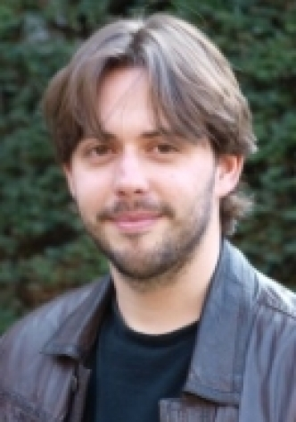
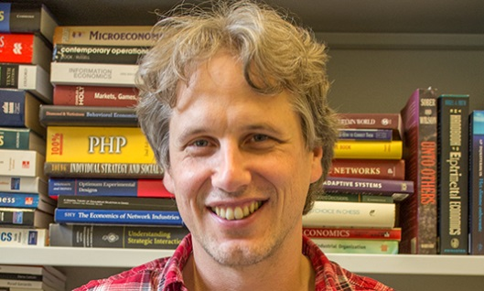
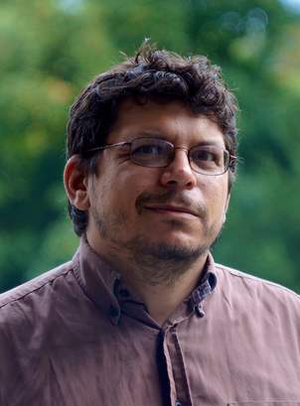
Human Decision Science team
Martin Strobel (SBE)
Philippe Verduyn (FPN)
Suzanne van Gils (FPN)
Elias Tsakas (SBE)
Notes:
Elias: Greek, MSc Mathematics, PhD Economics (Game Theory/Decision Theory)
Sjir: Dutch (Limburgs), MSc International Management, MSc Applied Cognitive Psychology, PhD Business
Burak: Turkish: MSc Economics, PhD in Economics (Matching)
Suzanne: Dutch, MSc Social Psychology, PhD in Management (Ethical Leadership)
Martin: German, MSc in Computer Science, PhD in Economics (Experimental Economics)

Slide 17
Further questions
About application / admissions?
Phone: +31 43 388 36 28
E-mail: masteradmissions-sbe@MaastrichtUniversity.nl
Application deadline: 1 June (EU), 1 May (non-EU)
GMAT at the latest 2 weeks before application deadline
About the content of the programme?
http://code.unimaas.nl
http://www.maastrichtuniversity.nl/web/Faculties/SBE/TargetGroup/Education/Master/HumanDecisionScience.htm
E-mail: master-sbe@MaastrichtUniversity.nl
E-mail: e.tsakas@MaastrichtUniversity.nl or
m.strobel@MaastrichtUniversity.nl

Slide 18
Human Decision Science Graphical Summary
http://facebook.com/MscHumanDecisionScience

Slide 19
Neuroeconomics
Research Master in Cognitive and Clinical Neuroscience

Slide 20
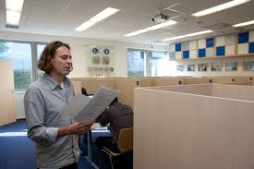
More Information? Questions?
Write an email to the coordinator of the RM specialisation Neuroeconomics:
Arno Riedl
a.riedl@maastrichtuniversity.nl
Visit the RM website via www.neuroeconomics.nl
Notes:
Social Neuroscience:
How biological systems implement social processes and behavior. Humans are a social species and create social organizations of all kinds.

