Slide 1
MSc Sustainability Science, Policy, and Society
Maastricht University, School of Business and Economics
Ron Cörvers

Slide 2
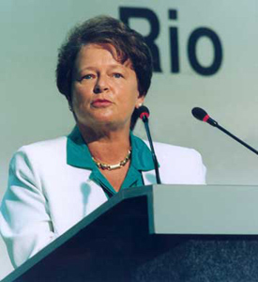

Slide 3
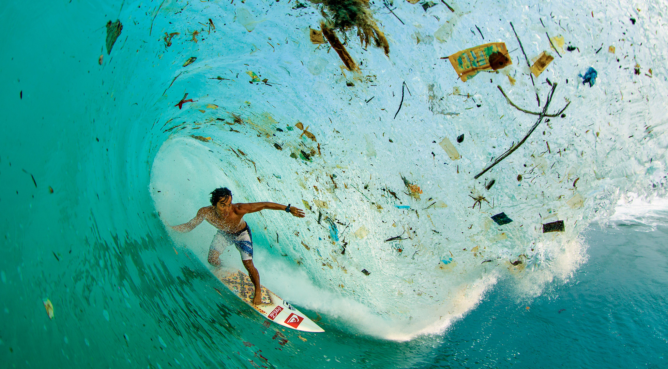

Slide 4
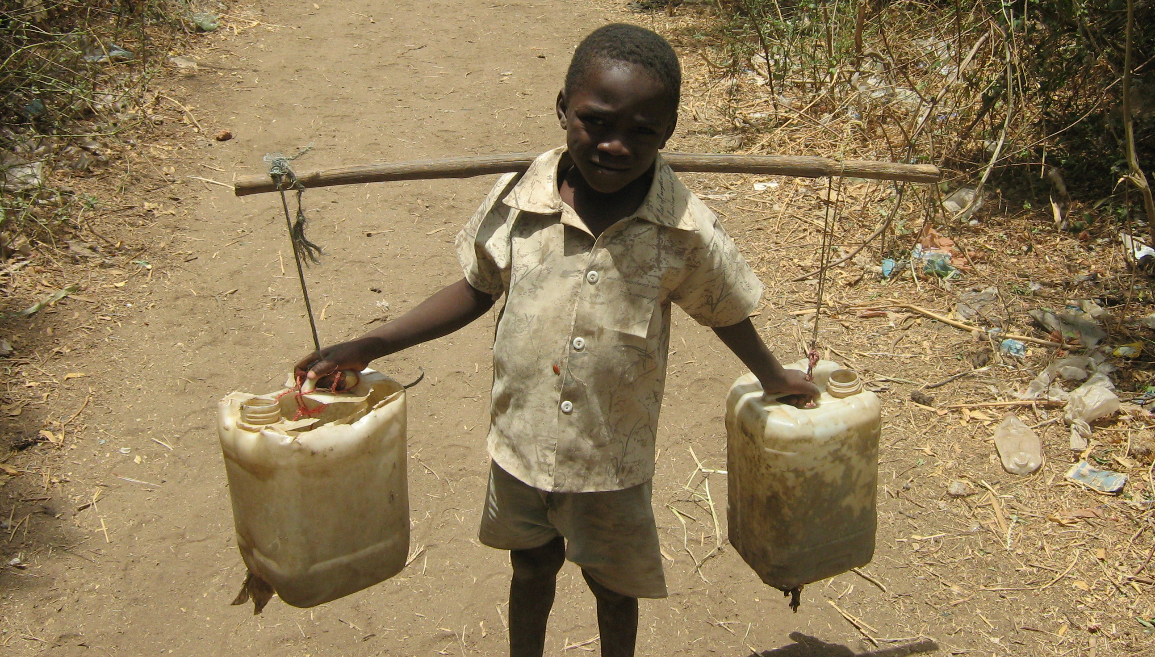

Slide 5
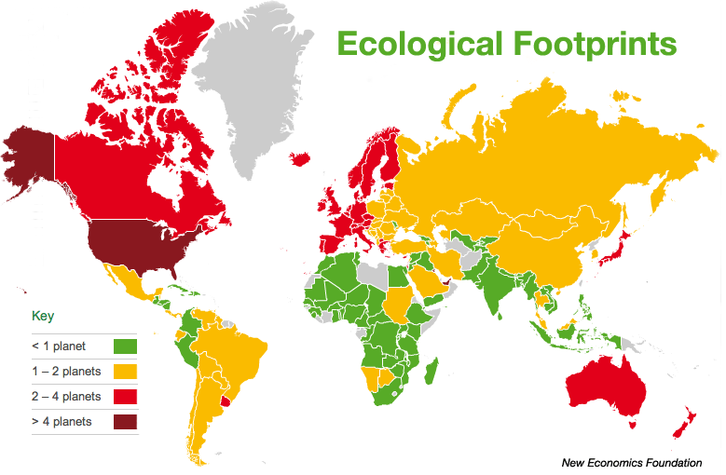

Slide 6
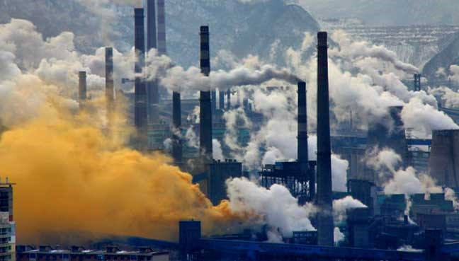
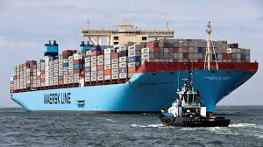
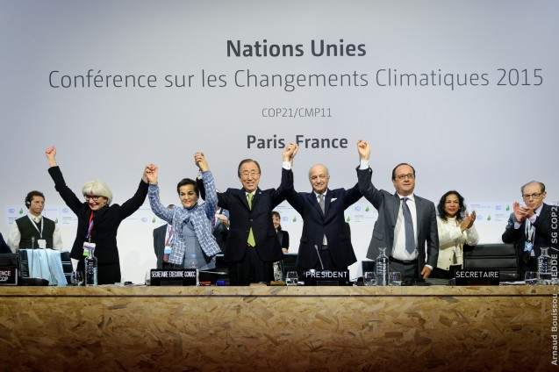
Worldwide interdependencies
Ecological interdependencies (ecosystem services, life support systems, nature, etc.)
Economic interdependencies (global markets, international trade, supply/value chains, etc.)
Political interdependencies (nation states, EU, UN, WTO, NATO, etc.)

Slide 7
‘Global North’
Environment
Development
‘Global South’

Slide 8
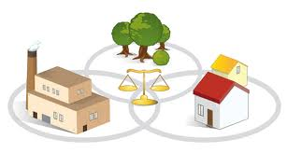
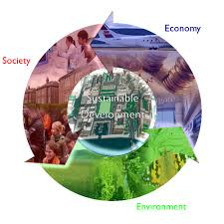
Sustainable Development =
Complex & Normative
→ Integrative approaches

Slide 9
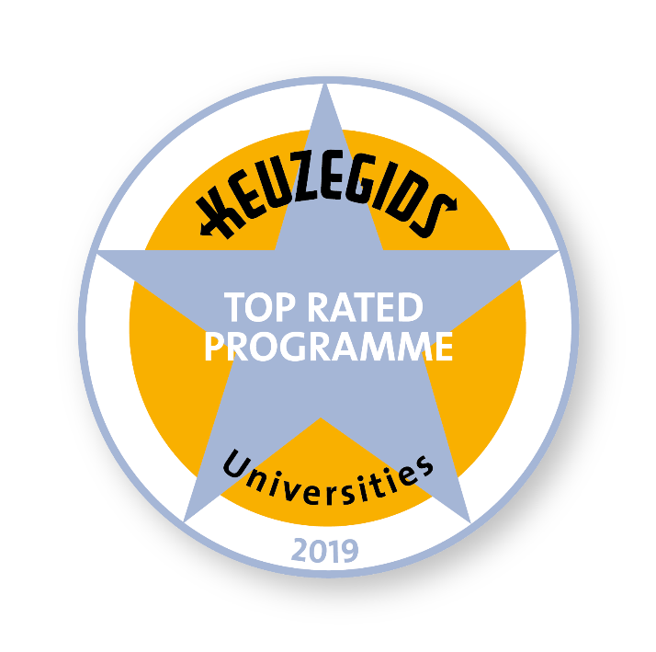
MSc Sustainability Science, Policy, and Society

Slide 10
Courses & Curriculum (60 ECTS)
Problem Based Learning & Academic skills (1)
Sustainable Development (5)
Sustainability Science (5)
Governance for Sustainable Development (5)
Innovation for Sustainable Development (5)
Sustainability, Law and the Environment (5)
Methodology for Sustainability Assessment (5)
Sustainability Assessment Skills (4)
Integrated Sustainability Project (5)
Research Approaches and Methods (2)
Thesis Research Proposal (3)
Master Thesis (15)

Slide 11
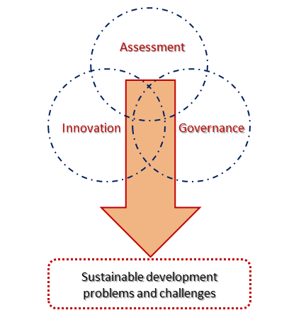
Focus and Scope

Slide 12
Integrated Sustainability Project (ISP)
In ISP, students work in small teams on real-world sustainability problems commissioned by external stakeholders and conduct an assessment, which include an integrated analysis of the problem, identification and assessment of solution options, and formulation of recommendations for the client
Overview ISP’s 2012-2018
https://www.maastrichtuniversity.nl/education/master/master-science-sustainability-science-policy/why-this-programme

Slide 14
Serious game
In the serious game Conquest for Paradise, students (and staff) experience the complexity of the energy transition in a global context from the perspective of various stakeholders and the impact of their decisions
https://www.youtube.com/watch?v=AaAex3YTfLY

Slide 15
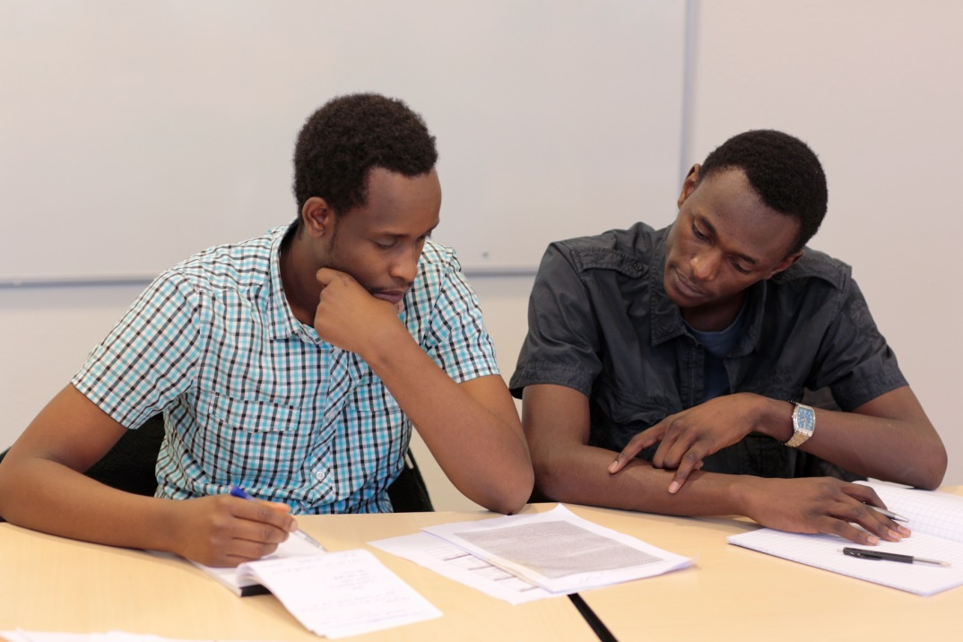
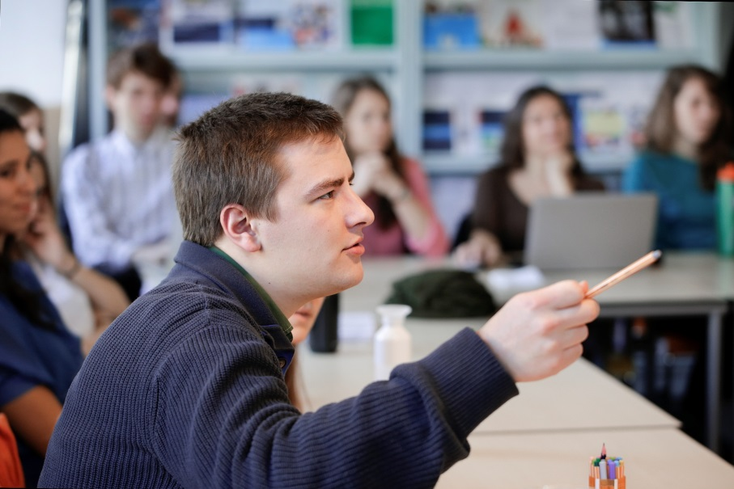
Teaching & Learning activities
1-year programme fully taught in English
Problem-based Learning (PBL)
International, multidisciplinary student group
Small-scale teaching and learning
Thematic courses focusing on sustainable development
Research project for real clients (Integrated Sustainability Project)
Weekly 10-12 hrs classes, 28-30 hrs group work & individual

Slide 16
International, multidisciplinary classroom
Academic year | Total number of students | NL Dutch students | Other European students | Non European students
2011/12 | 10 | 3 | 6 | 1
2012/13 | 22 | 6 | 12 | 4
2013/14 | 18 | 1 | 11 | 6
2014/15 | 13 | 2 | 7 | 4
2015/16 | 37 | 9 | 23 | 5
2016/17 | 44 | 8 | 27 | 9
2017/18 | 46 | 13 | 26 | 7
2018/19 | 49 | 9 | 31 | 9
2019/20 | 75 | 12 | 50 | 13
Total | 314 | 63 | 193 | 58
 | 100% | 20% | 61,5% | 18,5%

Slide 17
Examples employers
Amnesty International
Columbus Earth Center
Cradle2Cradle Innovation Institute Europe
CSR Europe
Deutsche Gesellschaft für Internationale Zusammenarbeit
Ernst & Young
European Environment Agency
General Electric
Green Trust
KPMG
Siemens
Tata Consultancy Services
Universities (Aalborg, Charleston, UM, etc.)
WWF European policy office
Etc.
Career prospective
Sustainability professional, e.g.
advisor
analyst
consultant
lecturer
manager
policymaker
researcher
trainer
PhD candidate
etc.

Slide 18
Questions?
http://www.maastrichtuniversity.nl/masterssp

