Slide 1
MSc IB Sustainable Finance
Maastricht University, School of Business and Economics

Slide 2
Sustainable Finance Quiz 1
How much water is used to produce 1 hamburger?
About 20 litres
About 2000 litres
About 4000 litres
Notes:
P

Slide 3
Sustainable Finance Quiz 1
How much water is used to produce 1 hamburger?
About 20 litres
About 2000 litres
About 4000 litres
Notes:
P

Slide 4
Sustainable Finance Quiz 2
Which day in 2019 was ‘Earth Overshoot Day’
The day of the year we have already used up the planet’s annual capacity to generate natural resources?
19 June
2 July
29 July
Notes:
P

Slide 5
Sustainable Finance Quiz 2
Which day in 2019 was ‘Earth Overshoot Day’
The day of the year we have already used up the planet’s annual capacity to generate natural resources?
19 June
2 July
29 July
Notes:
P

Slide 6
Sustainable Finance Quiz 3
If all coal, oil, and gas companies on the stock market would burn their existing reserves…
…their emissions would cause the Earth to warm up by…
More than 2 degrees Celsius
1.5 degrees Celsius
1 degree Celsius
Notes:
P

Slide 7
Sustainable Finance Quiz 3
If all coal, oil, and gas companies on the stock market would burn their existing reserves…
…their emissions would cause the Earth to warm up by…
More than 2 degrees Celsius
1.5 degrees Celsius
1 degree Celsius
Notes:
P

Slide 8
Sustainable Finance Quiz 4
Worldwide, 30-year-old men have spent 10 years in school on average, how many years have women of the same age spent in school?
9 years
6 years
3 years
Notes:
P

Slide 9
Sustainable Finance Quiz 4
Worldwide, 30-year-old men have spent 10 years in school on average, how many years have women of the same age spent in school?
9 years
6 years
3 years
Notes:
P

Slide 10
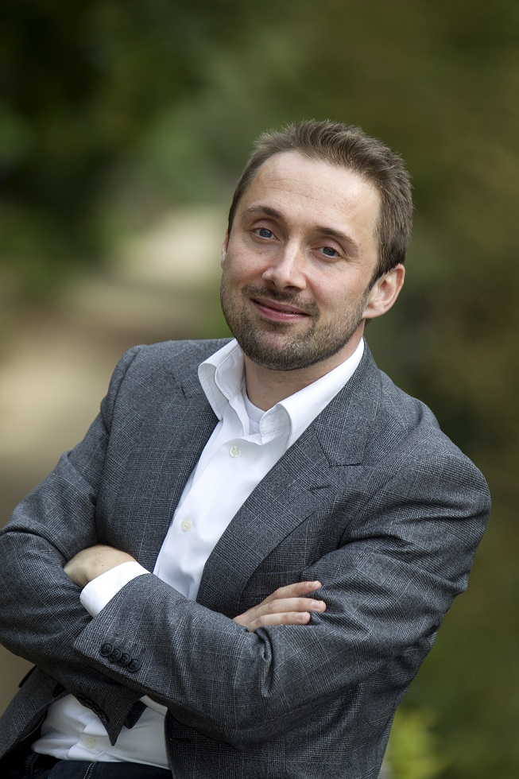
Who are we?
Dr. Jeroen Derwall IB/Sustainable Finance Program Leader j.derwall@maastrichtuniversity.nl

Slide 11
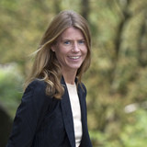
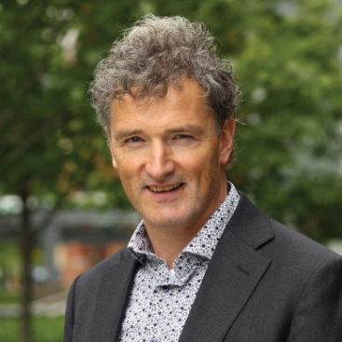
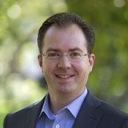
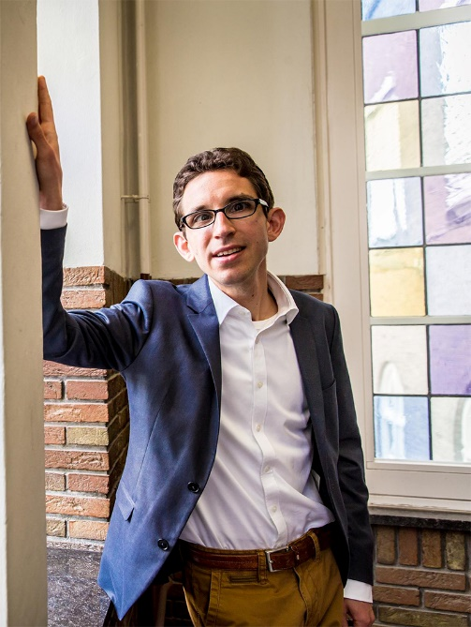
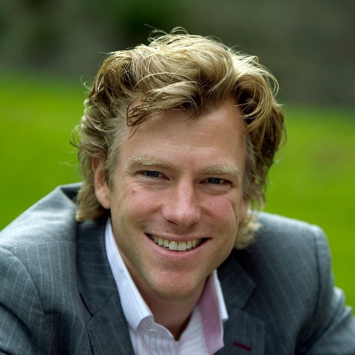

Slide 12
Today’s Agenda
Who are you?
1
What is sustainable finance?
2
Our programme
3
What does the future hold?
4

Slide 13
Who are you?

Slide 14
Who are you…
You have always felt an interest in being involved with Finance in your later career…
…e.g., a financial services firm or consultant, investment manager or pension fund…
…or perhaps in a company
or property investment firm
But you want to learn more about finance than a standard Finance track has to offer
…you are also interested in the concept of sustainability…
…and the role it can play in financial markets and decision making
Notes:
M and A
Let them make up their mind!
Does it suit you?

Slide 15
What is Sustainable Finance?

Slide 17
How sustainability/society affects (better) financial decision-making
How financial decision making can have real positive societal impact

Slide 18
Corporate & Investor Perspective
Sustainability can be a competitive advantage?
What are material sustainability challenges facing a firm?
How to integrate sustainability in financial models and investments?
Financial returns of sustainable investments in for example stock, bond, and property markets..
Sustainable Finance
How sustainability/society affects (better) financial decision making
How sustainability/society affects (better) financial decision-making

Slide 19
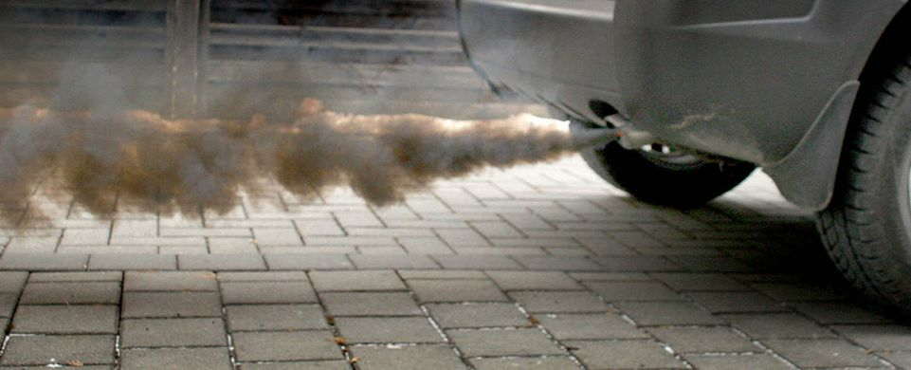
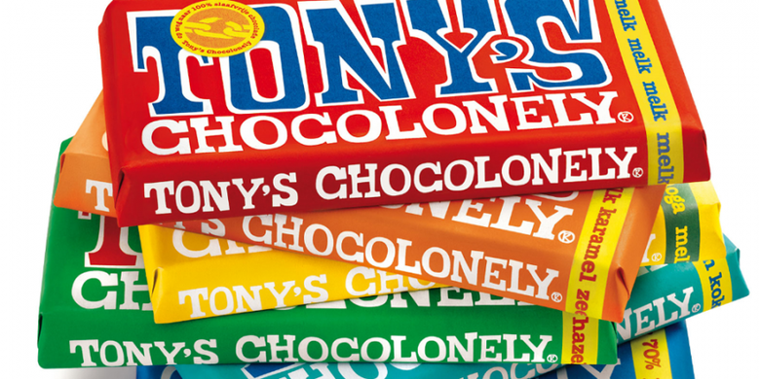
Sustainable Finance
How sustainability/society affects (better) financial decision making
How sustainability/society affects (better) financial decision making

Slide 20
Social and Philanthropic Perspective
What is Sustainability?
How can investors fill the funding gap to reach the United Nations Sustainable Development Goals?
What are effective interventions?
How can we measure social and environmental return?
How sustainability/society affects (better) financial decision making
How financial decision making can have real positive societal impact
How financial decision making can have real positive societal impact
Notes:
Paul

Slide 21
Our Programme

Slide 22
IB/Sustainable Finance in brief
Block
Sustainable Finance
1
(sept)
Sustainable Finance, Management, and Strategy
Data Analytics
2
Institutional Investors
Elective Block 2
3
Skills Training: Writing a Master’s Thesis
4
(feb)
Sustainable and Responsible Investments
Writing the Master’s Thesis
5
Real Estate Finance
6
Completing the Master’s Thesis
Notes:
Moni
Standard structure of each SBE msc programme: 5 obligatory fixed courses + 1 elective + 1 skills training+ 1 msc thesis
1 year, twice a year (in February this matrix turned around)
4 courses in Semester I and 2 courses in semester II to enable you to write the msc thesis

Slide 23
Data Analytics
Quantitative methods for problem-solving and research in Sustainable Finance
Generate insights that improve management decision-making
R language for statistical analyses

Slide 24
Elective
Choose your own course from a wide range of options
From another MSc IB Program
Or: Multidisciplinary Business Challenge
Broaden your horizon and go the extra mile!

Slide 25
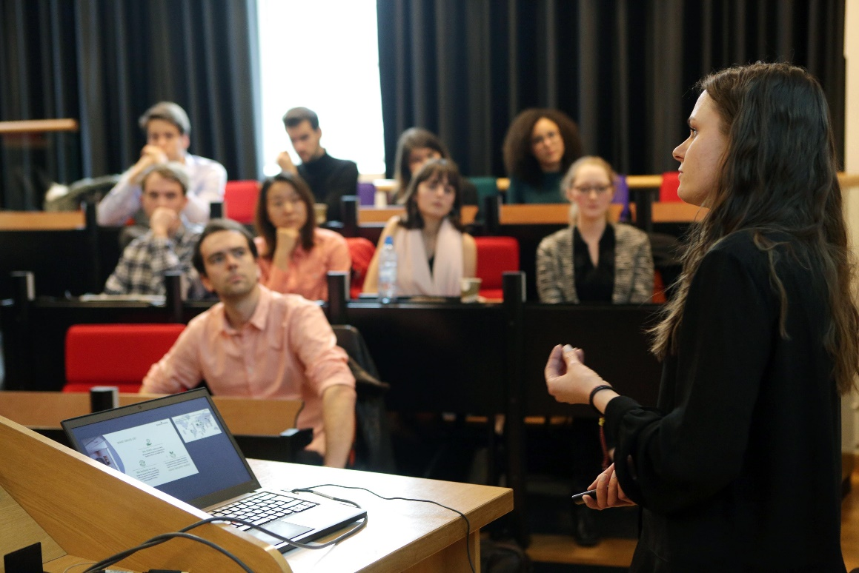
Teaching Approach
Problem Based Learning
Real company cases and financial problems
Blended learning: E-learning materials
Guest Lectures from practitioners
Community building and trips
Notes:
Alex

Slide 26
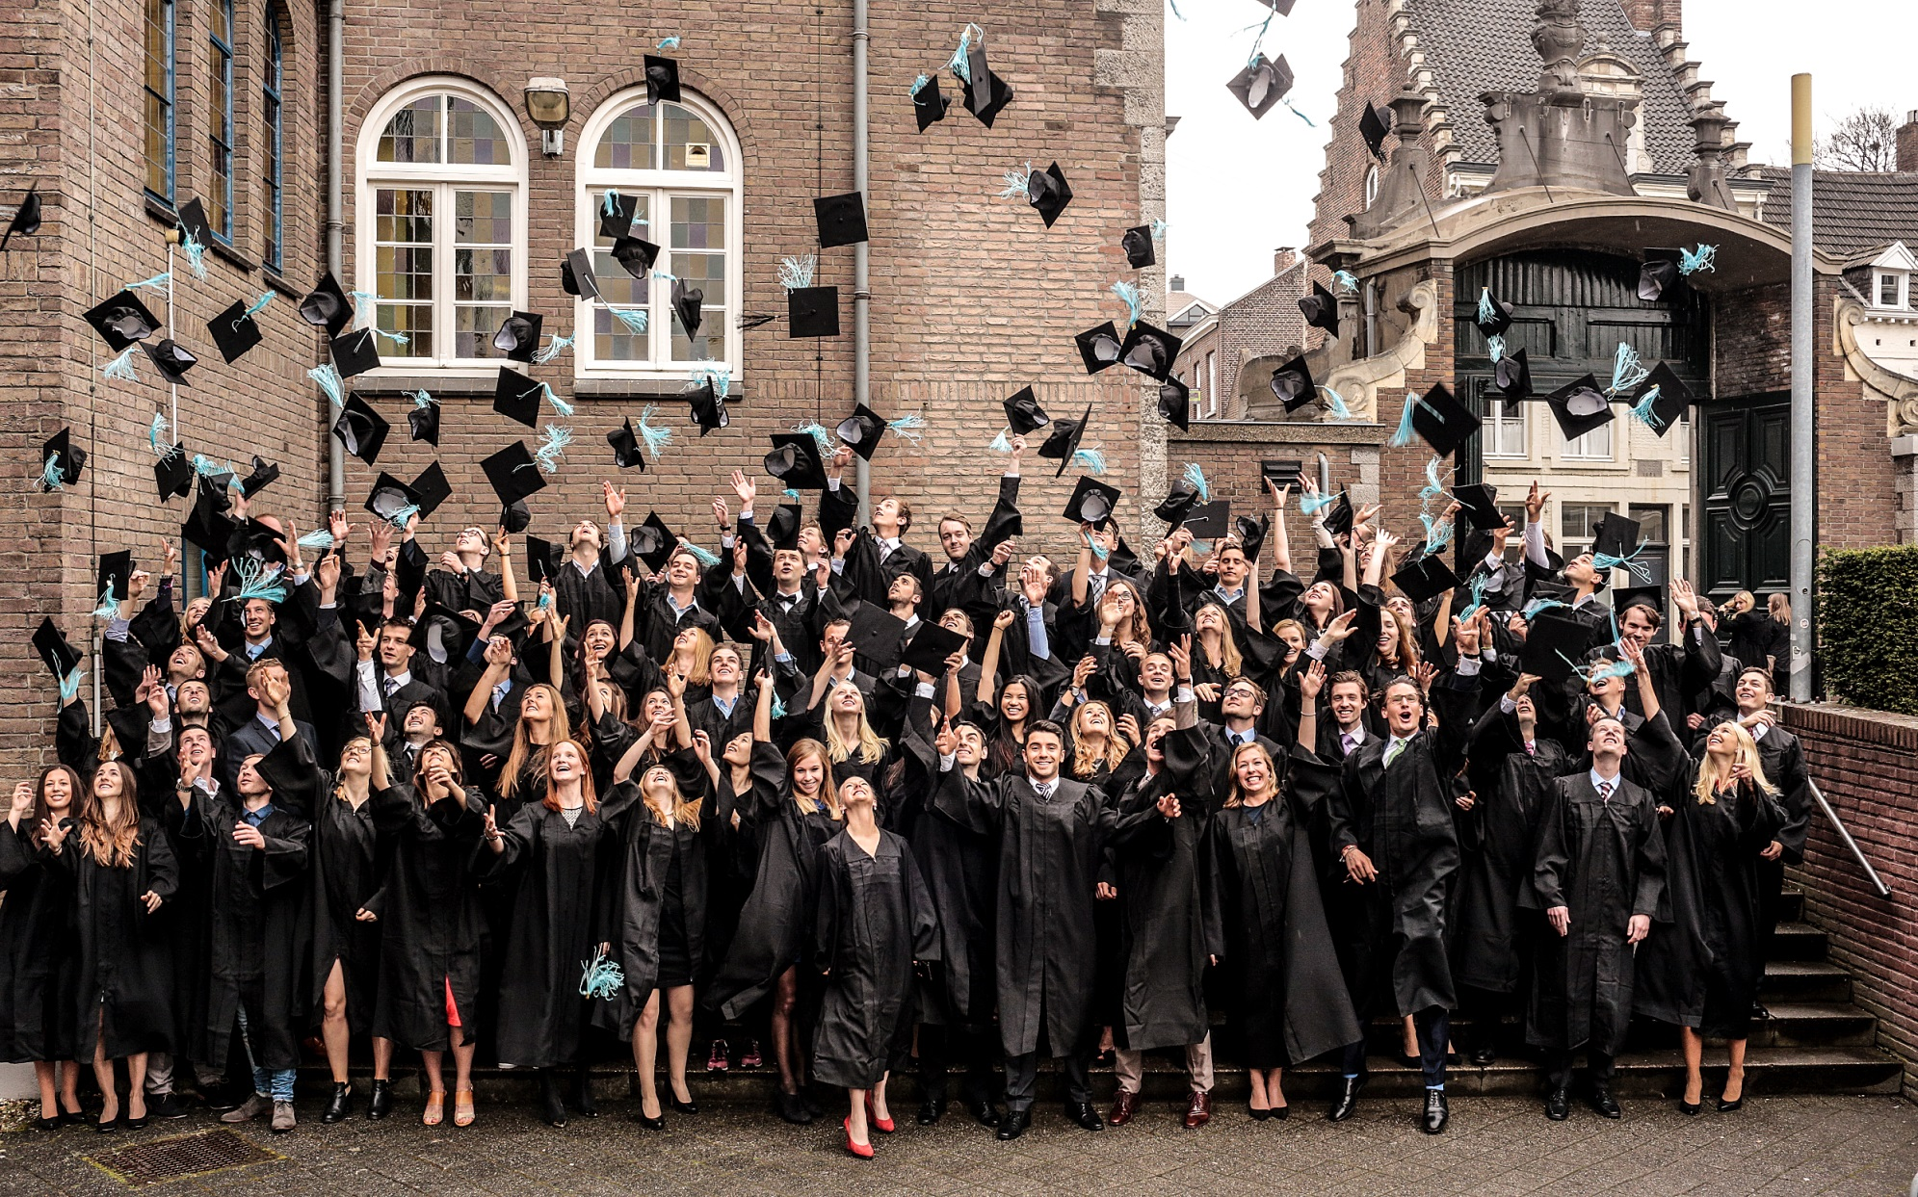
What does the future hold?

Slide 27
Consulting
Asset Management
Companies
Academic
Insurance companies
Banks
Development/Impact Finance

Slide 28
Questions?
Visit us at the information market in the Mensa

