Slide 1
Double Degree and Network Programmes
Maastricht University, School of Business and Economics

Slide 2
Double Degree
Two Master’s degrees from two universities in considerably less time
Experience a different culture, business environment and teaching style
Only pay tuition fee at MU plus administrative fee

Slide 3
Where can you go?

Slide 4
Lisbon, Portugal
Universidade Nova de Lisboa

Slide 6
Brisbane, Australia
Queensland University of Technology

Slide 7
Louvain-la-Neuve, Belgium
Université Catholique de Louvain

Slide 8
What can you do?

Slide 9
One Double Degree Programme
International Business
Specialisation Organisation: Management, Change and Consultancy
Specialisation Strategy and Innovation
Duration of Programme
1,5 academic year (three semesters)

Slide 10
One Double Degree Programme
International Business
Specialisation Strategic Marketing
Duration of Programme
Option to finalize your studies in 1 academic year (two semesters);
Or 1,5 academic year (three semesters)

Slide 11
One Double Degree Programme
Economics
Duration of Programme
2 Years

Slide 12
International Triangle Programme (ITP): International Business
Specialisation Organisation Management, Change and Consultancy
ITP:
Three semesters
Corporate Experience
Administrative fee € 1.000

Slide 13
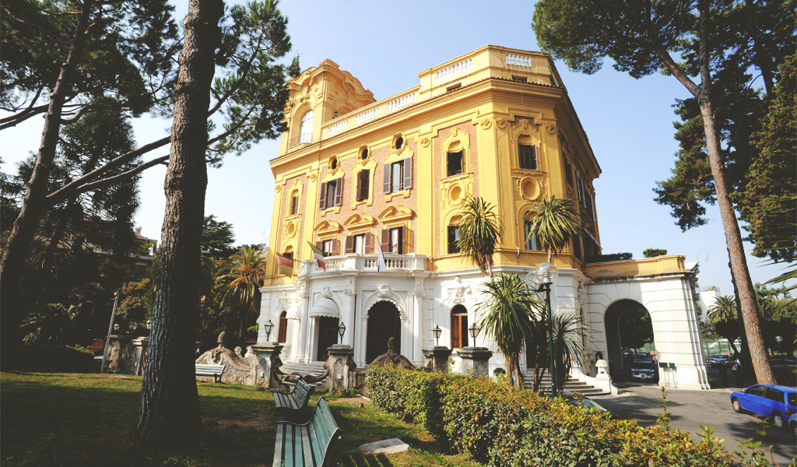
New Programme
LUISS in Rome
International Business, Specialisation Strategic Corporate Finance
Aimed start September 2020

Slide 14
Questions?
Visit us at the information market
today until 4 PM!
Or email:
DoubleDegree-sbe@MaastrichtUniversity.nl

