Slide 1
Applications & Admissions
Maastricht University, School of Business and Economics

Slide 2
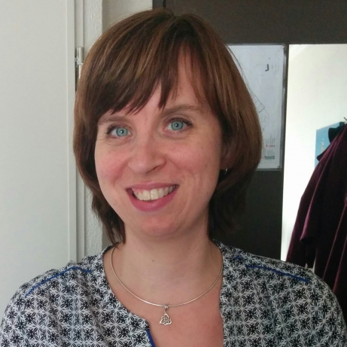
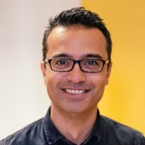
Today’s Team

Slide 3
Today’s Agenda
Getting Started
1
Required Documents
2
GMAT or Exemption
3
Deadlines
4

Slide 4


Getting Started
Submit request for Registration Master
Receive login data for MyUM
Upload the required documents via the My UM-portal

Slide 5
University of Applied Sciences: BUA/ZUYD
HBO + academic minor Zuyd /ICT programme/SBM NHTV
Bachelor’s degree and/or transcripts (incl. GPA).
Statement from your HBO institute indicating that you finished the academic minor/SBM-programme (or for BISS: Minor ICT).
Recommendation from your HBO-institute OR (if you don’t have this yet) add a Word-document in which you indicate that you are following the minor.
Valid passport and portrait picture.

Slide 6
University of Applied Sciences: External pre-master
Only for Dutch relevant pre-master’s programmes (list on website);
Bachelor’s degree and/or transcripts (incl. GPA);
Statement from the university at which your are taking/took the pre-master indicating that you finished this pre-master’s programme successfully;
If you have not finished the pre-master’s programme yet: proof of registration for pre-master/statement from the university;
Valid passport and portrait picture.

Slide 7
University of Applied Sciences: SBE’s pre-master
For graduates from Dutch, Belgian and German institutes (list with eligible programmes on the website).
Separate application via Studielink for pre-master’s programme (no master’s application yet)
Bachelor’s degree and/or transcripts on the institutes’ letterhead+stamps/signatures (certified);
Valid passport and portrait picture.
Upon successful completion of the pre-master’s programme (1 semester), admission to the MSc programme is guaranteed.

Slide 8
University of Applied Sciences: SBE’s pre-master’s programmes
For which master’s programmes do we have pre-master’s programmes?
MSc Global Supply Chain Management and Change;
MSc International Business (all specialisations);
MSc Learning and Development in Organisations.

Slide 9
Other universities
Bachelor’s degree and/or transcripts;
Motivation essay;
Curriculum Vitae;
Letters of reference (only required for research master’s programmes);
Description of the Statistics courses you followed during your Bachelor’s programme ( for MSc IB, MSc BISS, MSc GSCM&C, MSc ESEM );
GMAT/GRE score report or for specific groups a portfolio with proof of academic capabilities (more details in a later slide);
TOEFL/IELTS score (only for non-EU citizens whose mother tongue is not English): possible exemption if the entire bachelor’s programme was in English;
Valid passport and portrait picture.

Slide 10
Possible GMAT exemption
NVAO-accredited relevant programmes: no GMAT required;
Other Dutch/Flemish programmes: either GMAT or proof of academic capabilities;
AACSB / EQUIS: extended file = file + proof of academic capabilities;
BSc students who followed and passed four specific SBE courses, list available via SBE Admissions : no GMAT required;
GMAT-exemption: your file will be presented to the Board of Admission they will assess whether you can start the programme

Slide 11
Proof of academic capabilities
Quantitative skills
  Basic mathematical and statistical skills;
  Ability to reason quantitatively and solve quantitative problems.
Verbal skills
  Ability to read and comprehend written material;
  Reason and evaluate arguments;
  Use of correct standard written English.
Analytical writing skills
  Ability to explore the complexities of an issue or opinion;
  Ability to formulate an appropriate and constructive critique of a specific conclusion based on a specific line of thinking.

Slide 12
Proof of academic capabilities: Examples
Mandatory: List of courses in a relevant field;
Pre-master’s programmes at other institutions;
Project reports;
Assignments;
Bachelor’s thesis;
Reports made during your professional career;
GMAT or GRE score…

Slide 13

GMAT Preparation
Study suggestions and free online testing material
from GMAC. More information via www.mba.com
Discount of 10% (when mentioning code: UMGMAT2019) on GMAT preparation courses provided by The Mindful GMAT Foundation. More information via www.mindfulgmat.org

Slide 14

Ready-Set-Go!
September: all Master’s programmes
February:
  MSc International Business
  MSc Financial Economics
  MSc Fiscal Economics
  Pre-Master’s programmes

Slide 15
Application Deadlines
September
February
Non-EU applicants
1 May
1 November
EU applicants
Non-EU applicants with Dutch residence permit
1 June
15 December

Slide 16

Additional Questions
www.maastrichtuniversity.nl/education/master
Contact us: masteradmissions-sbe@maastrichtuniversity.nl
General questions about registration, payment, etc.:
study@maastrichtuniversity.nl
or call: 0031-3885388
About grants and scholarships:
www.maastrichtuniversity.nl/support/your-studies-begin/um-scholarships

Slide 17
Questions?

