Slide 1
MSc IB Strategic Marketing
Maastricht University, School of Business and Economics

Slide 2
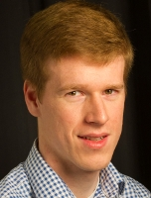
Dr. Niels Holtrop Programme Leader Strategic Marketing

Slide 3
Today’s Agenda
Today’s Marketing challenges
1
Student Profile
2
Our Programme
3
What does the future hold?
4

Slide 4
Today’s Marketing Challenges

Slide 5
What is Marketing?
Marketing is the activity, set of institutions, and processes for creating, communicating, delivering, and exchanging offerings that have value for customers, clients, partners, and society at large.

Slide 6
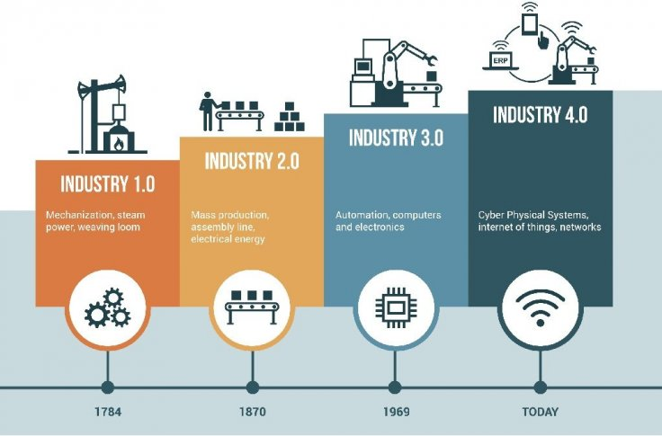

Slide 7
1. Disruptive changes in consumption
Robotics
Digital Business Models
IoT, Smart Home
From ownership to access

Slide 8
2. Communication Channels
Formerly Mass Media Advertising.
Today Social Media, Mobile Marketing.
→ Risks & Opportunities?

Slide 9
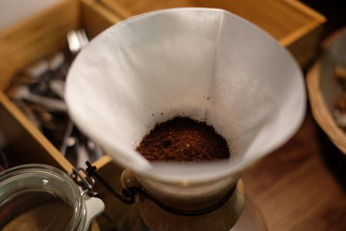
3. From commodity to experience
Formerly Commodities and products
Today Addition of services, focus on experience
→ What are relevant services and experiences customers need and want?
Niels
Different & Unique
Specific
Diversity
Service
Experience
Customer Need
Product
Undifferentiated
Commodity
Generic
Low
Market Value
High

Slide 10
4. From gut feeling to informed decisions
Formerly Gut feeling and experience
Today Data-driven decisions, accountable
→ Take advantage of the exponential increase in data availability
→ Use data to inform decision-making
throughout the marketing process

Slide 11
Student Profile

Slide 12
Statistics are alright!
I am a pro-active thinker!
Able to look at old problems in a new way (think outside the box)
Flexible, able to change perspectives
Strong Interpersonal Skills

Slide 13
Our Programme

Slide 14
What today’s Marketing Managers need…
COMPETENCIES
OUR COURSES
Connect with your customers
Understand the customer
Understanding complex service relationships
Provide value
Consumer Psychology
Service Management
Innovate products, services and processes
Marketing Strategy and Innovation
Elective
Be accountable
Data-driven decisions
Measure and improve performance
Data Analytics
Digital Marketing

Slide 15
Block
MSc IB/Strategic Marketing
1
Marketing Strategy and Innovation
Data Analytics
2
Consumer
Psychology
Elective
3
Skills: Master Thesis

Slide 16
Block
MSc IB/Strategic Marketing
4
Service Management
5
Writing the Master’s Thesis
Digital Marketing
6
Completing Master’s Thesis

Slide 17
Marketing Strategy and Innovation
Understanding:
Principles of marketing strategy
Detection of business opportunities, innovation-oriented culture
Interaction of marketing with, e.g., Operations, R&D, HR, and Information systems
Applying:
Real-life assignments: development / launch of novel idea
Guest lectures, hackathon

Slide 18
Data Analytics
Quantitative methods for problem-solving and research in Strategic Marketing
Generate insights that improve management decision-making
R language for statistical analyses

Slide 19
Elective
Choose your own course from a wide range of options
From another MSc IB Program
Or: Multidisciplinary Business Challenge
Broaden your horizon and go the extra mile!

Slide 20
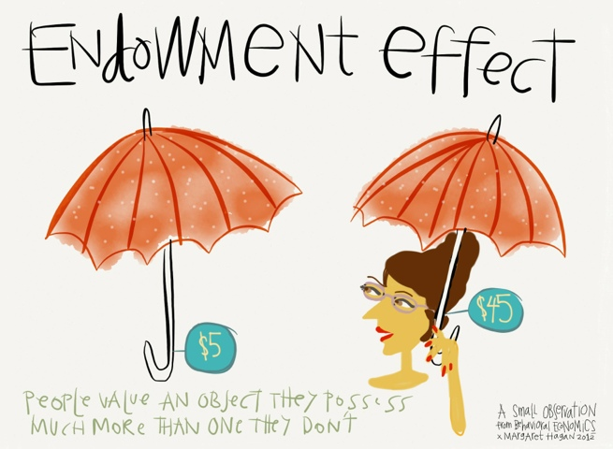
Consumer Psychology
Understanding consumers:
Why do consumers often act “irrational”?
Role of emotions, social norms, expectations, context
How to conduct research in the area of consumer behavior?

Slide 21
Skill: Writing a Master’s Thesis
Information on Master’s thesis
Develop high quality research proposal
Receive first feedback from supervisor
Develop your own idea
Join one of our research projects
Do TIP (Thesis and Internship Project)

Slide 22
Service Management
Managing service relationships
Complex service systems
Practicing service design
Emphasizing transformative services
Real-life case from the services sector

Slide 23
Digital Marketing
Assess the strategic impact of digitalization on marketing activities
Quantify & measure effectiveness of digital marketing decisions
Hands-on experience in marketing modelling, real life company data
Which channels are most valuable?
What content works best?

Slide 24
A programme with a clear focus
Strengthening managerial and analytical skills
A healthy mix of academic rigor and real-life applications
Award-winning professors and tutors, researchers that publish in the top journals.
International setting
What we offer
In a nutshell…

Slide 25
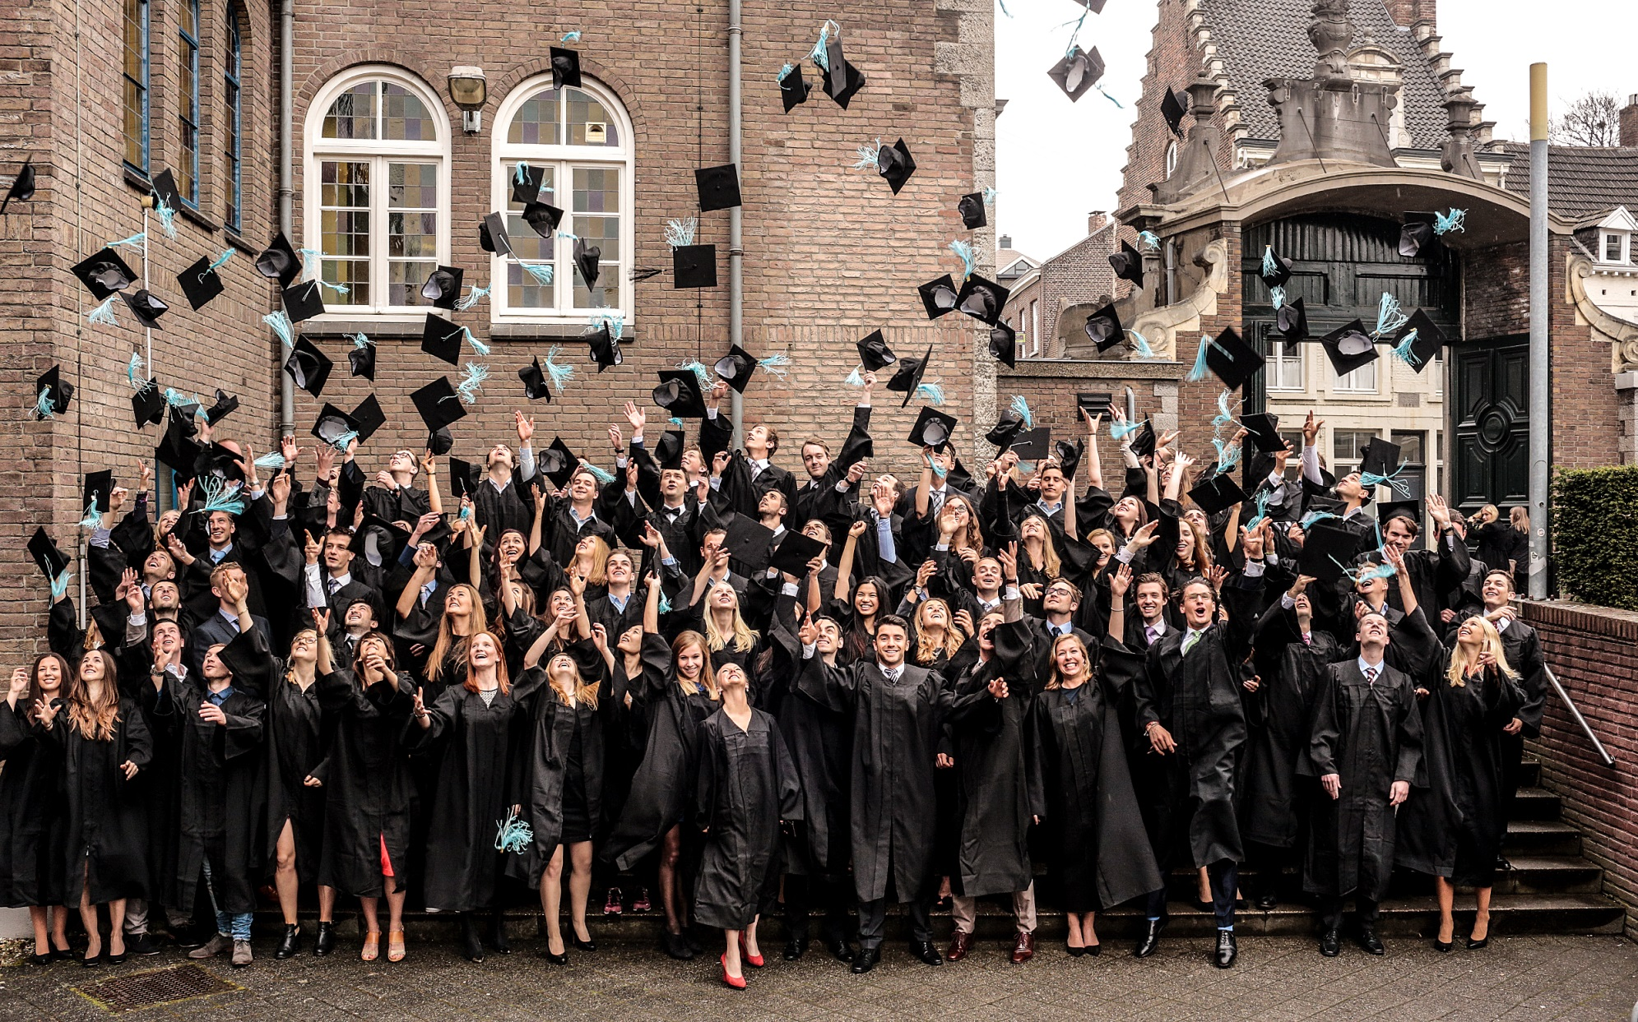
What does the future hold?

Slide 26
Alumni Careers
Management Consultant at Apple
Brand Manager at Unilever
Marketing Researcher at Nielsen
Community Manager at Vodafone
Account Strategist at Google
Communication Manager at Facebook
Policy advisor at the Ministry of Health, Welfare and Sports
Project manager at ING
Customer Service expert at Philips Healthcare

Slide 27
Statistics

Slide 28
Questions?
Contact:
Gsbe-sbe@maastrichtuniversity.nl
Or visit us at the information market in the Mensa

