Slide 1
MSc IB Strategy and Innovation
Maastricht University, School of Business and Economics
Progress through innovation

Slide 2
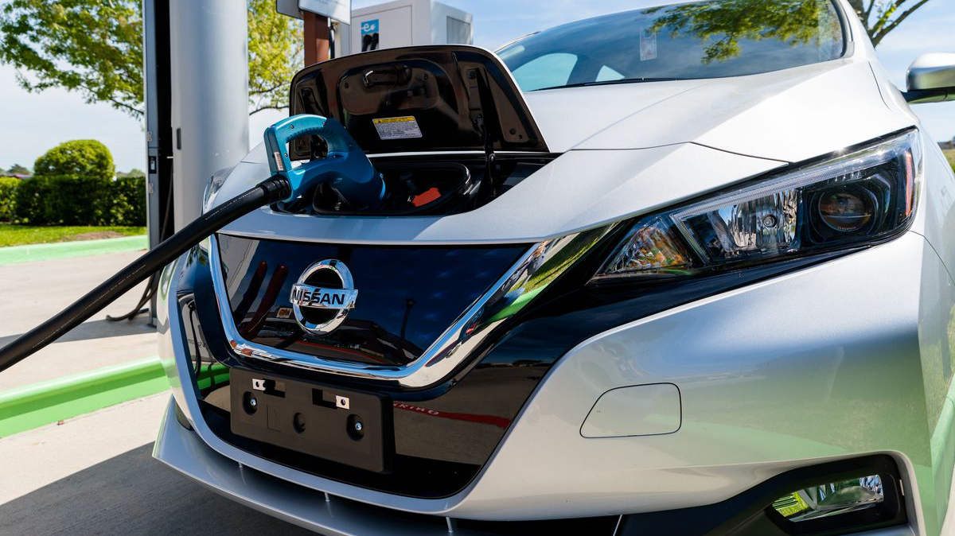
Notes:
State some interesting facts about electric cars. When were first invented? What strategy was used to bring this to the market? These questions that are discussed in this master. This is a great example of the interface of strategy and innovation. (come back to the brilliant strategy of how it was done in the end)

Slide 3
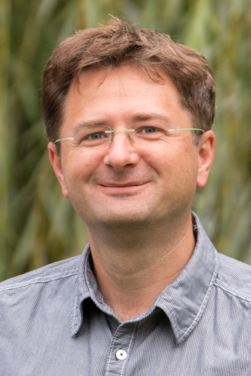
Today’s Team

Slide 4
Today’s Agenda
What are we about?
1
Course Content
2
Variation in the track
3
What does the future hold?
5
Student Profile
4

Slide 5
What are we about?

Slide 6
Strategy
Ideas
Impact
Innovation

Slide 7
We promote
Critical Thinking
Creative processes
Self-Organization
Balance of Theory & Practice

Slide 8
Course Content

Slide 9
Block
Strategy & Innovation
1
Strategic Entrepreneurship and Innovation
Data Analytics
2
International Competitive Analysis and Strategy
Elective
3
Skills Training: Writing a Master’s Thesis
4
Knowledge, Innovation, and Technological Change
Writing the Master’s Thesis
5
Business Innovation and Sustainable Development
6
Completing the Master’s Thesis

Slide 10
Data Analytics
Quantitative methods for problem-solving and research in Strategy & Innovation
Generate insights that improve management decision-making
R language for statistical analyses

Slide 11
Elective
Choose your own course from a wide range of options
From another MSc IB Program
BroadeOr: Multidisciplinary Business Challenge
n your horizon and go the extra mile!

Slide 12
International Competitive Analysis and Strategy
Strategy
Focus
Strategy & Impact
Student skills
Analysis: Apply economics with statistics to strategy in a real world team strategy project
Ideas
Impact
Innovation

Slide 13
Strategic Entrepreneurship and Innovation
Strategy
Focus
Ideas, Innovation & Impact
Student skills
Consulting team project
Creativity and design workshop
Ideas
Impact
Innovation

Slide 14
Knowledge, Innovation and Technological Change
Strategy
Focus
Strategy & Innovation
Student skills
Individual project of analyzing the network strategy of a company
Ideas
Impact
Innovation

Slide 15
Business Innovation and Sustainable Development
Strategy
Focus
Innovation & Impact
Student skills
Team project – Case study of real world company/ industry on how they integrate sustainability in business strategy
Ideas
Impact
Innovation

Slide 16
Variations in the Track

Slide 17
Your Choice
Choose from 40 + electives
Combine this degree with other degrees
Business research master
Notes:
Name fields of electives

Slide 18
Student Profile

Slide 19
Notes:
Analytical – want to engage in academic discussions

Slide 20
Notes:
Team player – enjoys and is good at working in teams

Slide 21
Notes:
Pro-active – Active and motivated to work

Slide 22
Notes:
Creative - innovation

Slide 23
What does the future hold?

Slide 24
Alumni Careers
About 1,000 graduates
Employed in 23 countries
Consultant, incl. in-house
Business Analyst
Manager (Project; Logistics; Industry; Performance; Strategy)
AkzoNobel; ASML; RWE; Detecon; Ernst & Young; OC&C; PNO Consultants; InterFinanz; Simon-Kucher
MSc graduates SBE IB Track Strategy and Innovation period 2004-2015

Slide 25
Questions?
Visit us at the information market in the Mensa

