Slide 1
MSc IB Supply Chain Management
Maastricht University, School of Business and Economics
Creating value through the supply chain

Slide 2
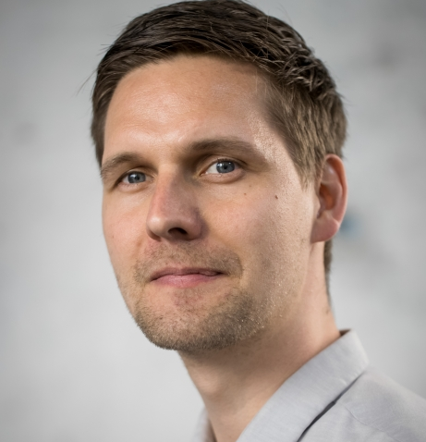
Robert Suurmond
Assistant Professor of Purchasing and Supply Chain Management Program Leader MSc. IB, track Supply Chain Management

Slide 4
Today’s Agenda
What are we about?
1
Our Programme
2
Student Profile
3
What does the future hold?
4

Slide 5
What are we about?

Slide 7
Our Program

Slide 8
New Revised Program

Slide 9
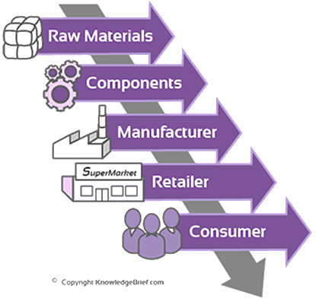
Block
Programme Overview
(September)
1
Strategies & Technologies
Data Analytics
2
SC Operations Management
Elective
3
Skills: Thesis
Skills: Thesis
4
Strategic Sourcing
Writing the Master’s Thesis
5
Int. Contracting & Relationships
6
Completing the Master’s Thesis

Slide 10
Student Profile

Slide 11
Student Profile
30% SBE Bachelor
50% Female Students
70% International Students
30% Outside Europe
Icons used with permission from © Flaticon

Slide 12
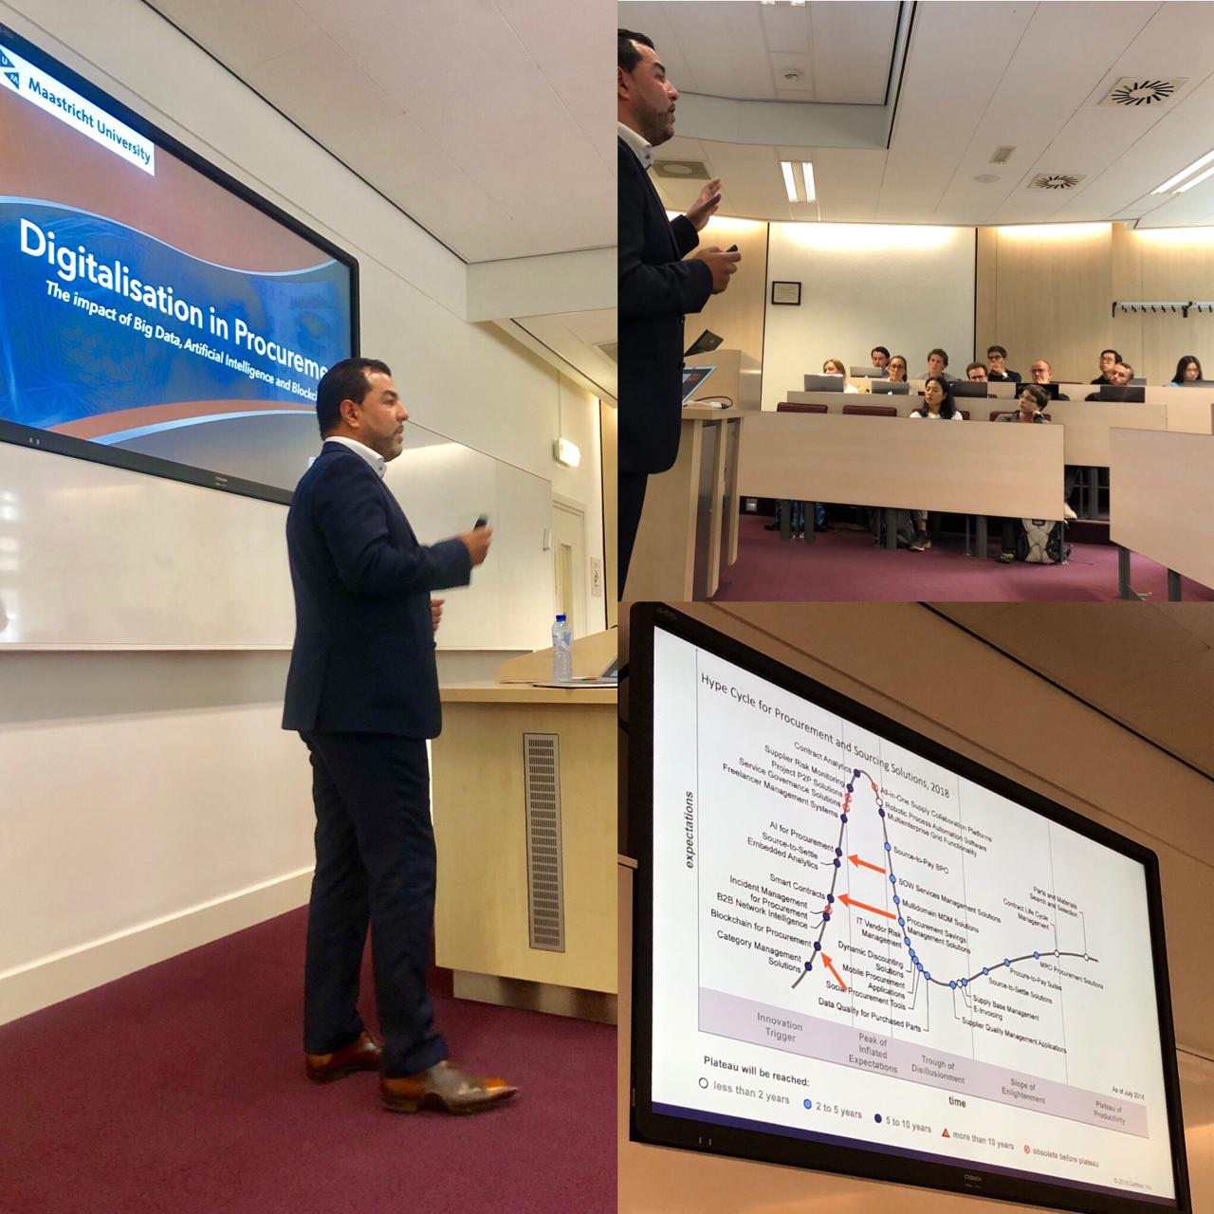
Impressions
Small Classes
Real
Companies
Deep Community

Slide 13
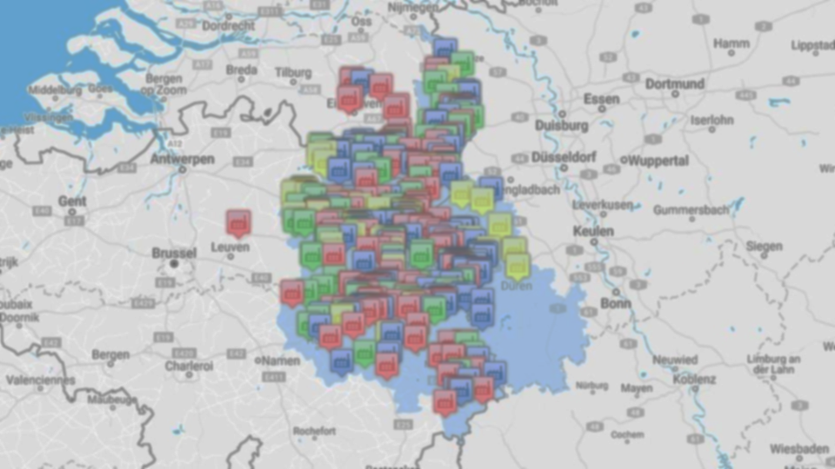
International Business
Supply Chain Management
Maastricht University
Notes:
Productive from Day one
Hands on mentality
Unique educational experience

Slide 14
“Integrating real-life cases and interaction with
companies is critical for understanding how firms work with each other.”
“I believe that how and where firms buy their products
and services has a large impact on firm performance.”
“When studying firms, I like to find out everything from the first
supplier to the final customer.”
“Data analysis is necessary to support decisions in a
supply chain.”
“One has to understand how supply networks work to become
successful in business.”
Notes:
Change the picture or move the

Slide 15
Why MSc IB/SCM at SBE?
Productive from Day 1
Hands on Mentality
Unique Educational Experience
Problem-based Learning
Business Partnerships
Job offers
Internships / TIP
Thesis topics
Company contact
Notes:
Productive from Day one
Hands on mentality
Unique educational experience

Slide 16
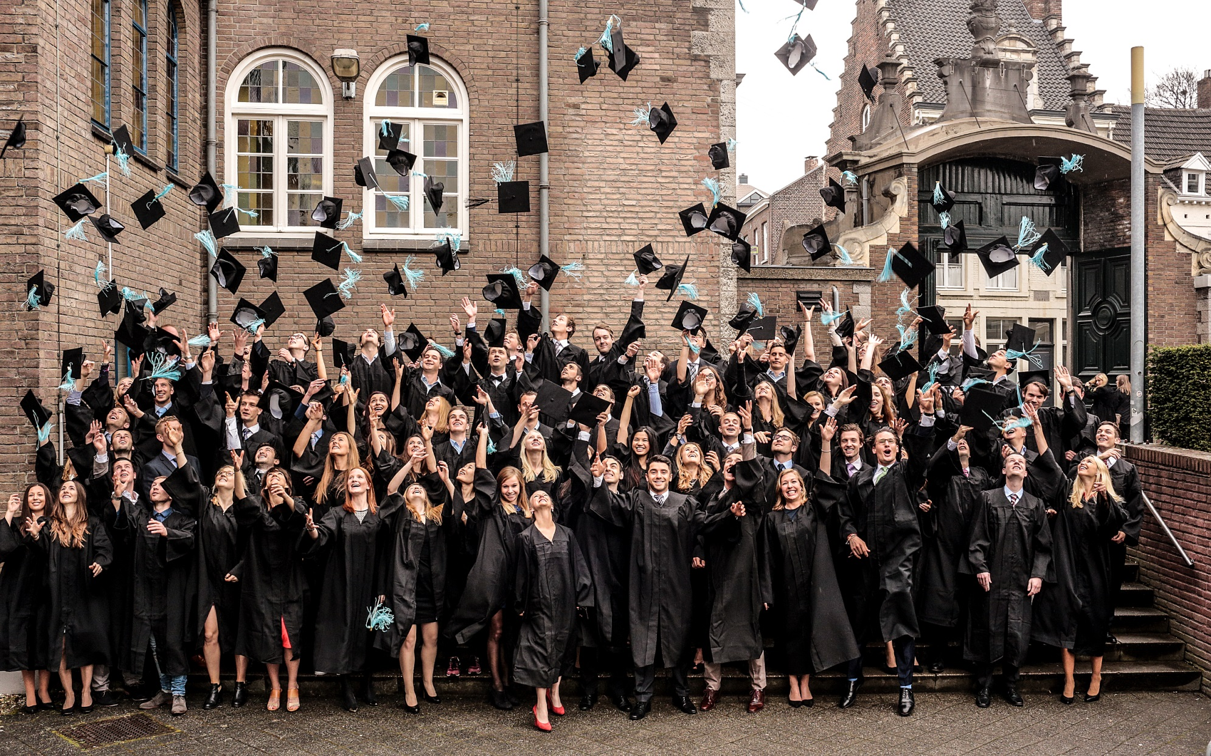
What does the future hold?

Slide 17
Graduates
352 graduates in 5 years
Function
Supply Chain Manager
Companies
Employed in 11 countries
Consultant
Market Analyst
Project Manager
Notes:
Check data Graduates, add logo accenture

Slide 18
Questions?
Visit us at the information market in the Mensa
r.suurmond@maastrichtuniversity.nl
@RobertSuurmond

Slide 19
1st Semester
Block
IB/Supply Chain Management
1
Supply Chain Strategies & Technologies
Data Analytics
2
Supply Chain Operations Management
Elective
3
Skills Training:
Thesis Skills
Skills Training: Thesis Skills

Slide 20
2nd Semester
Block
IB/Supply Chain Management
4
Strategic Sourcing
Writing the Master’s Thesis
5
International Contracting and Relationships
6
Completing the Master’s Thesis

Slide 21
Courses

Slide 22
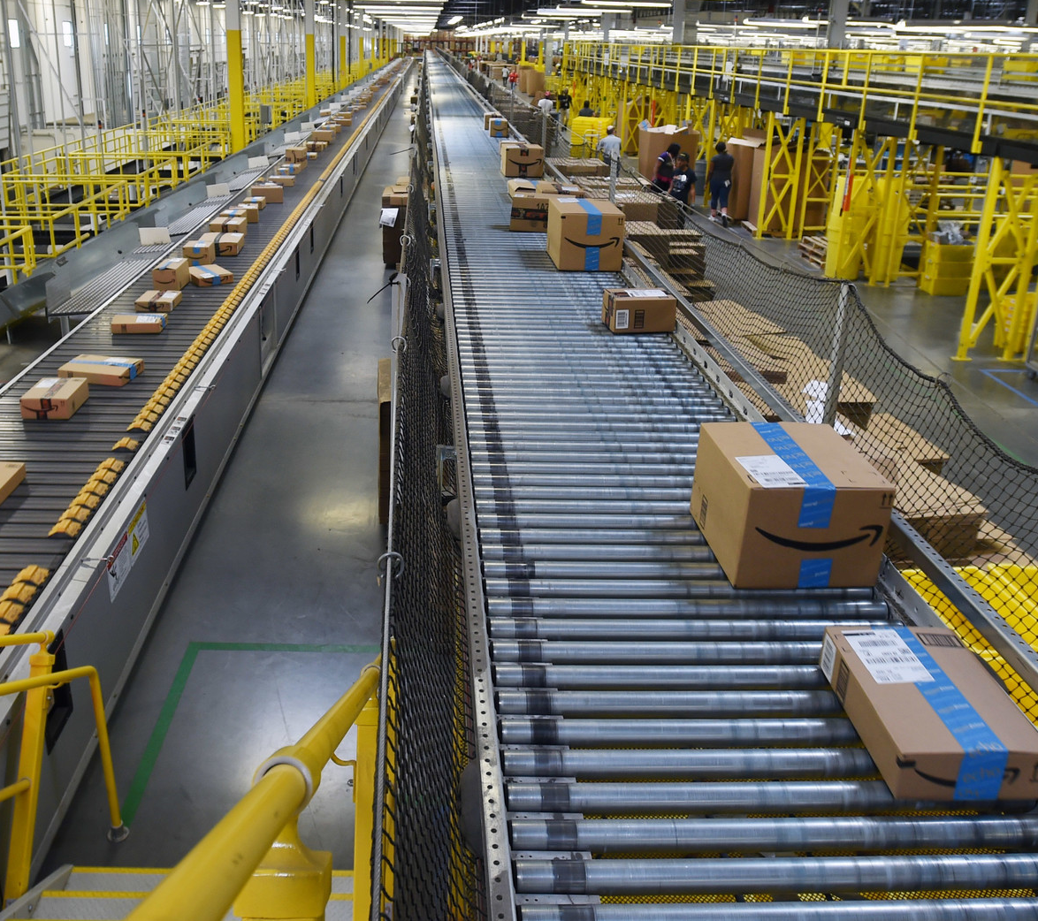
Supply Chain Strategies & Technologies
Get introduced to the discipline and the programme
Take a holistic view of the supply chain
Take a strategic view of the supply chain
Block
IB/Supply Chain Management
1
Supply Chain Strategies & Technologies

Slide 23
Data Analytics
Quantitative Methods for problem-solving and research in SCM
Multiple Regression, Linear Programming, Structural Equation Modelling
Programming Language R
Block
IB/Supply Chain Managment
1
Data Analytics
Notes:
Switch courses block 2

Slide 24
Supply Chain Operations Management
Design and assess efficient product processes
Use quantitative models for decision-making
Block
IB/Supply Chain Management
2
Supply Chain Operations
Notes:
Production, bottles , big factory, Flora Holland

Slide 25
Elective
Choose your own course from a wide range of options
From another MSc IB Program
Broaden your horizon and go the extra mile
Block
IB/Supply Chain Management
2
Elective

Slide 26
Thesis Skills
Acquire a deeper understanding of a topic relevant to supply chain management professionals
Academically formulate this topic as preparation for entry on the job market
Block
IB/Supply Chain Management
3
Skills Training:
Thesis Skills
Notes:
Move a bit the computer or change

Slide 27
Strategic Sourcing
Understand the strategic relevance of purchasing
Learn about suppliers and competitive advantage
Organise the purchasing function
Block
IB/Supply Chain Management
4
Strategic Sourcing
Notes:
Switch block 1 courses

Slide 28
International Contracting &
Relationships
Understand and manage transactions in global supply chains
Negotiation, trading, supply risk and disruption
Multiple levels: country, industry, organization
Block
IB/Supply Chain Management
5
Int. Contracting & Relationships
Notes:
Symbols for KPI? Dollar/ Time money?

Slide 29
Writing Master’s Thesis
In-depth study of a supply chain management problem
- Academic relevance
- Managerial relevance
Block
IB/Supply Chain Management
4
Writing the Master’s Thesis
5
Notes:
Completing the master thesis → happy slide

Slide 30
6
Completing the Master’s Thesis

