Slide 1
MSc IB Organisation: Management, Change and Consultancy
Maastricht University, School of Business and Economics
Developing your leadership abilities
Dr. Hannes Guenter
Associate Professor of Organizational Behavior

Slide 2



















What is this thing called organisation?

Slide 3
Why should you choose Organisation: Management, Change and Consultancy?
If you are eager to learn...
How to lead and manage an organisation
How to analyse organisational processes
How to sharpen your critical thinking skills and develop your leadership abilities
Know how to provide solutions to increase organisational effectiveness
Work in the field of consultancy, human resources, general management

Slide 4





Slide 5
The track structure
Block
Organisation: Management, Change, and Consultancy
1
Organizational Change and Consultancy
Data Analytics
2
Organizational Learning
Elective
3
MSc Thesis Skill
4
Leadership
Writing the Master’s Thesis
5
Managers@Work
6
Completing the Master’s Thesis

Slide 6


Leadership
Leadership is a specialized role and a social influence process
Leadership is not a one-way street but an interactive process between leaders and followers
There is no leader without a follower
“The first follower is actually an underestimated form of leadership”
Derek Silvers

Slide 7

Leadership
Understand leadership theory and learn about the evolution in leadership thinking
Explore practice of leadership: for example, by studying practitioner-oriented articles
How to lead yourself (so you can lead others): Self-assess and develop your leadership capacities
Critical thinking and reflection are important pillars in this course

Slide 8

Data Analytics
Quantitative methods for problem-solving and research
Generate insights that improve management decision-making
R language for statistical analyses

Slide 9
Managers@Work
The actual practice of management means mastering complexity, uncertainty and performance
Managerial practice is a dynamic mix of craft, art and science
Managers need to deal with information, people and tasks
They are responsible for the future of business and society, including sustainability
Students will interview and shadow real managers and meet/talk with them at a managers’ forum

Slide 10
Managers@Work
Evidence-based management (“what works”) is a dominant methodology, not just for the course but also for managerial practice
Evidence-based: basing one’s judgment on business facts & figures, best practices, rely on research and on professional experience from within and outside the firm
Evidence-based is more easily said than done - all depends however on the quality of the evidence and the quality of the manager’s judgement and decision-making

Slide 11
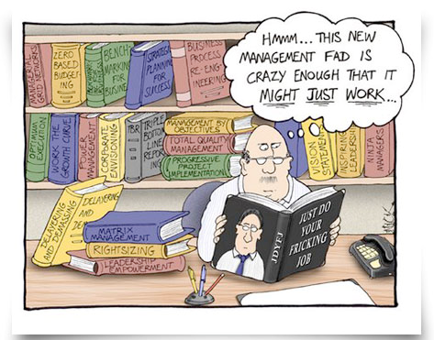
Managers@Work

Slide 12
Electives
Choose your own course from a wide range of options
From another MSc IB Program
Or: Multidisciplinary Business Challenge
Broaden your horizon and go the extra mile!

Slide 13
Skills Training: Writing the Masters’ Thesis
Understand the basic requirements of a Master’s thesis
Learn how to get from a broad research interest (e.g., top management teams) to a specific research model to be tested empirically
Learn about research design, data collection (e.g., questionnaire study), and statistics
Two-week period with expert lectures and meetings with MSc thesis supervisor

Slide 14



Organisational Change and Consultancy
Organisational Change
Learn about the benefits and risks of change
How to lead change?
How to reduce resistance to change?
Consultancy
Understand the role of management consultants
Discuss the effects of consultants and how this depends on the relationship with the client

Slide 15


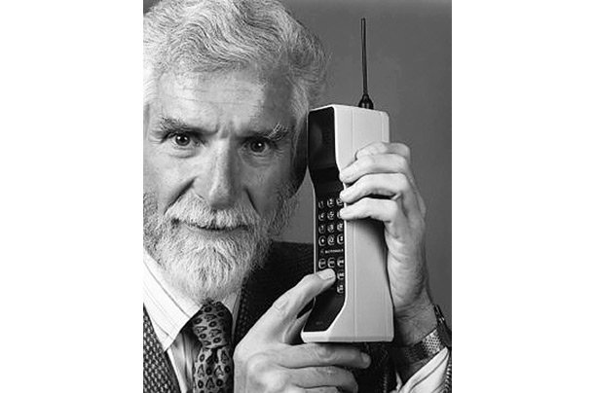

Organisational Learning
“This is one small step for man, one giant leap for mankind.”

Slide 16

Designing Learning in(to) Organisations
HRM & Design
Training
Selection
“Processes”
(Physical) Environment
Multi-level
Individual
Interpersonal
Leadership
Teams
Culture
Structure

Slide 17

Writing the Master’s Thesis
In-depth scientific study of an organisational problem
Academic relevance
Managerial relevance
Relevance to you
Thesis completed over the course of seven months

Slide 18

Is IB Organisation: Management, Change and Consultancy right for you?
Be eager to learn what it takes to become a good manager and leader
Be curious about why and how people behave the way they do in organisations, and how to influence behaviour at the workplace
Be interested in developing your analytical skills

Slide 19
The track structure
Block
Organisation: Management, Change, and Consultancy
1
Organisational Change and Consultancy
Data Analytics
2
Organisational Learning
Elective
3
MSc Thesis Skill
4
Leadership
Writing the Master’s Thesis
5
Managers@Work
6
Completing the Master’s Thesis

Slide 20


Data Analytics
Quantitative methods for problem-solving and research
Generate insights that improve management decision-making
R language for statistical analyses

Slide 21

Elective
Choose your own course from a wide range of options
From another MSc IB Program
Or: Multidisciplinary Business Challenge
Broaden your horizon and go the extra mile!

Slide 22

Careers of our alumni
MSc IB Organisation
693 graduates
Employed in 32 countries
HR Manager
Project Manager
Management Consultant
Recruitment Coordinator
MSc graduates SBE IB Organisation period 2004-2018

Slide 23
Questions?
Go to: www.maastrichtuniversity.nl/sbe
E-mail: h.guenther@maastrichtuniversity.nl
Or visit us at the information market in the Mensa

