Slide 1
MSc IB Marketing-Finance
Maastricht University, School of Business and Economics

Slide 2
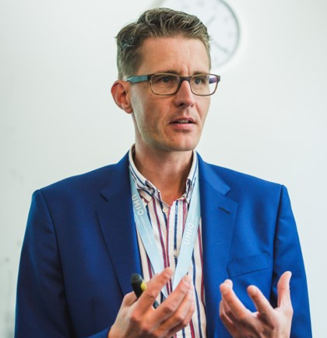
Dr. Thomas Post Assistant Professor of Finance

Slide 3
Today’s Agenda
Why Markting-Finance?
1
Our programme
2
Courses
3
What does the future hold?
4

Slide 4
Why Marketing-Finance?
You think saving something extra for retirement makes sense?
Ok, let’s try to do it!

Slide 5
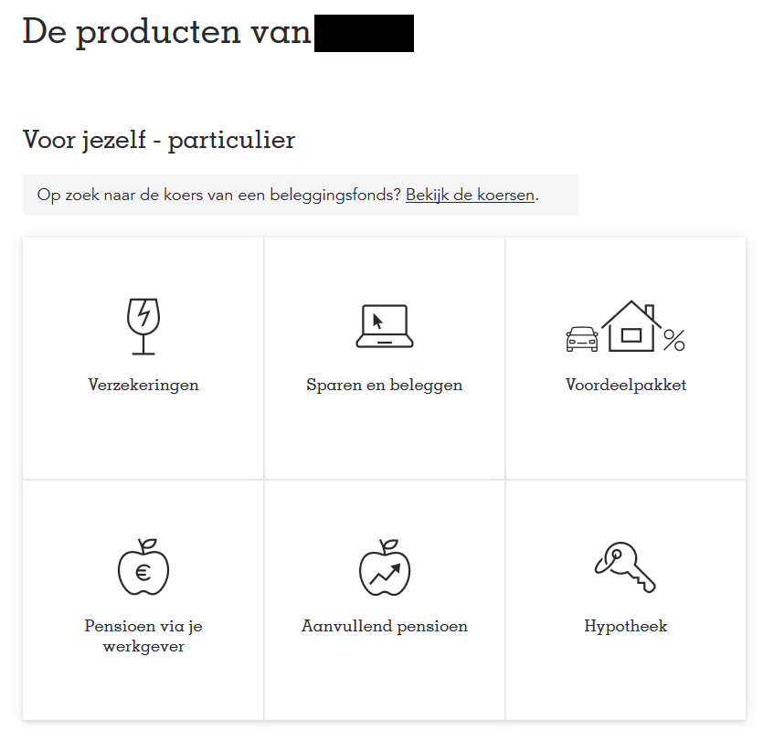

Slide 6
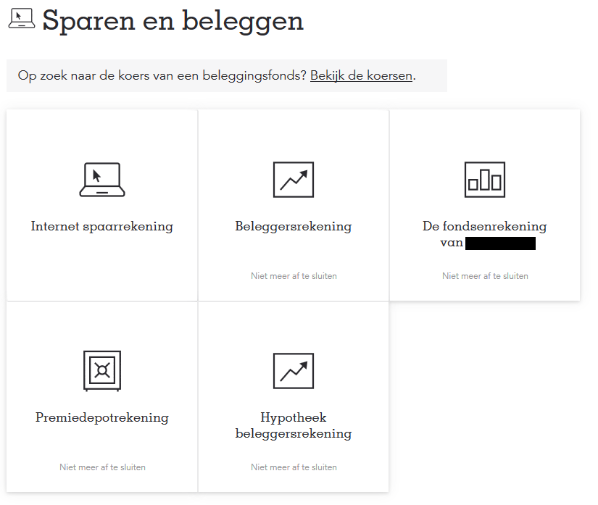

Slide 8
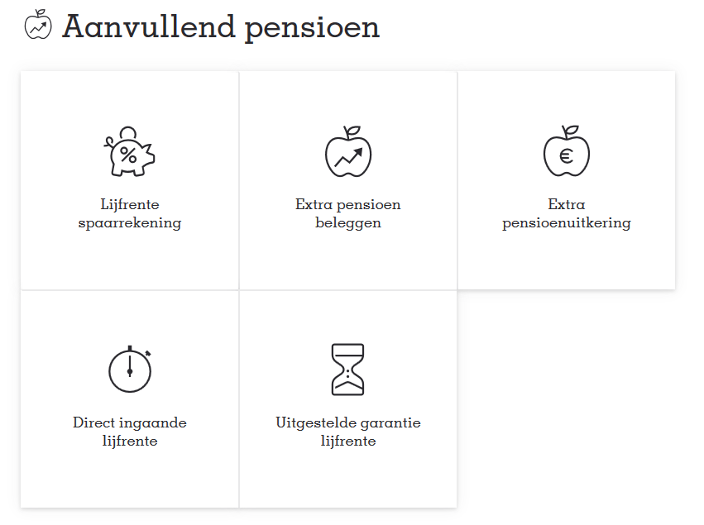

Slide 9
What does Finance Theory (and professionals) often assume about how people make decisions?

Slide 10
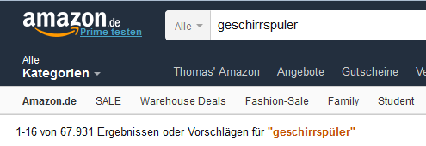
How do (most) real people make decisions?

Slide 11
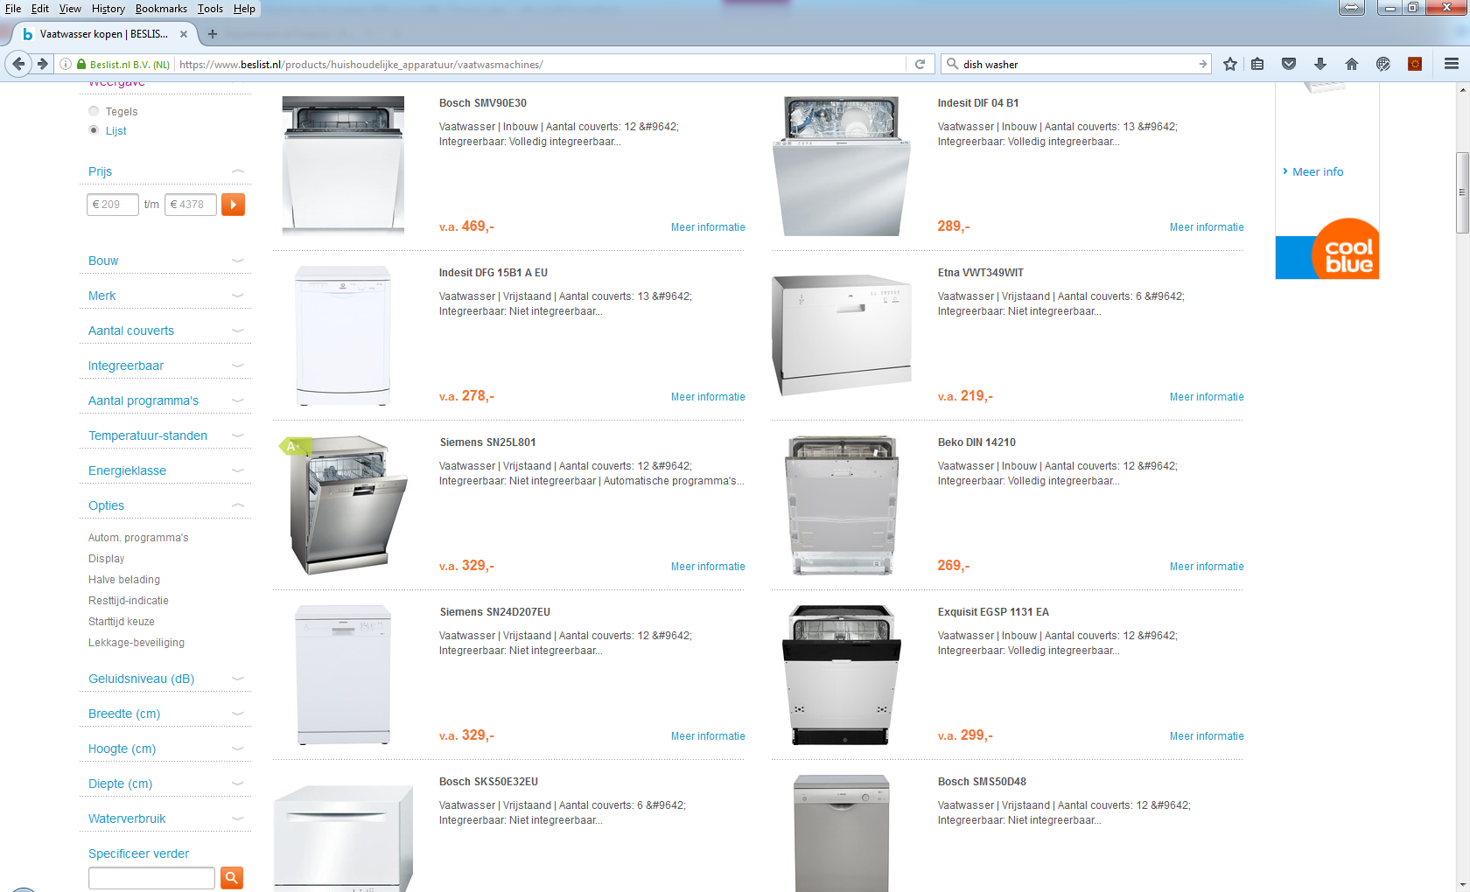

Slide 12
Why is a Marketing-Finance programme necessary?
Companies need linking-pins between Marketing and Finance departments
There is a communication gap between
Marketing and Finance professionals
Financial products’ design and development require an interdisciplinary Marketing-Finance approach
What is technically possible?
What does the consumer/investor want?
But also: Marketing needs to become accountable
What is the effect of marketing actions on financial performance?

Slide 13
Our Programme

Slide 14
The Marketing-Finance Programme
Develops professionals who are able to bridge and link Marketing and Finance;
Teaches you an understanding of Finance, Marketing, Consumer Psychology and their interrelations;
And, how to integrate them in an environment that aims at maximizing financial performance as well as customer value

Slide 15
Start September
Block
Marketing - Finance
1
Shareholder Value & Market Based Assets
Data Analytics
2
Consumer Psychology
Elective
3
MSc Thesis Skill
4
Behavioral Finance
Writing the Master’s Thesis
5
Financial Product Development: A Marketing-Finance Approach
6
Completing the Master’s Thesis

Slide 16
Start
February
Block
Marketing - Finance
4
Behavioral Finance
Data Analytics
5
Financial Product Development: A Marketing-Finance Approach
Elective
6
MSc Thesis Skill
1
Shareholder Value & Market Based Assets
Writing the Master’s Thesis
2
Consumer Psychology
3
Completing the Master’s Thesis

Slide 17
Courses

Slide 18
Shareholder Value and Market-Based Assets
Foundation of the marketing-finance interface
Learn how market-based assets drive shareholder value
Market-based assets include:
Customer relationships
Channel relationships
Partner relationships
Dr. Peiran Jiao

Slide 19
Consumer Psychology
One important market-based asset is the customer
Course aims to provide advanced knowledge and under-standing of (sometimes irrational) customer behavior
Dr. Anouk Festjens

Slide 20
Elective
Choose your own course from a wide range of options
From another MSc IB Program
Or: Multidisciplinary Business Challenge
Broaden your horizon and go the extra mile!

Slide 21
Data Analytics
Quantitative methods for problem-solving and research in Marketing & Finance
Generate insights that improve management decision-making
R language for statistical analyses
Dr. Mark Graus

Slide 22
Behavioral Finance
How psychology affects financial markets and investor and corporate decision-making
What for?
Debiasing
Financial product development
Marketing of financial services
Financial advice and consulting
Dr. Thomas Post

Slide 23
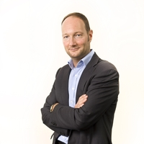
Financial Product Development:
A Marketing-Finance Approach
Learn to create successful financial products
Based on real world problems and cases
And both finance and marketing knowledge
Finance tells you what is technically feasible
Marketing tells you what consumers want
Prof. Joost Pennings

Slide 24
Writing the Master’s Thesis
You engage in innovative and highly relevant thesis topics
Brings all the knowledge together to develop an exiting academic and practical contribution
Numerous possibilities to interact with the business world in writing your thesis
Current graduates have written theses at Deutsche Bank, APG, Deloitte, Procter & Gamble, ING ...

Slide 25
What does the future hold?

Slide 26
Career Prospects
Types of Organisations
You will be the one that
Creates innovative, successful (financial) products
Links marketing actions to the financial bottom line
Help firms understanding consumer financial decision-making
Financial Services and Banking
Marketing Research and Strategy
Management Consulting
MF will makes you a generalist rather than a specialist

Slide 27
The Marketing-Finance Interface: a unique programme at Maastricht University
Started: September 2008
Unique: first in Europe
Industry driven
Business realism
Excellent job prospects

Slide 28
Questions?
Dr. Thomas Post
t.post@maastrichtuniversity.nl
Watch our video
https://www.youtube.com/watch?v=erJdkhZPo70
Or visit us at the information market in the Mensa

