Slide 1
MSc IB Information Management & Business Intelligence (IMBI)
Maastricht University, School of Business and Economics

Slide 2
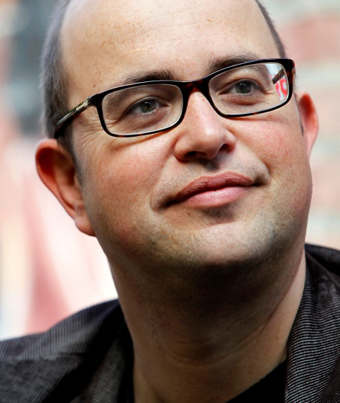
Dr. Mark Vluggen
Senior lecturer information management
Director of bachelor programmes at SBE
Vice-chair department Accounting & Information Management
E-mail: m.vluggen@maastrichtuniversity.nl
Education
Master: Cases in MIS (EBC4038)
Postgraduate: EMFC (Maastricht), EMMA (Paramaribo, Suriname)
Research
Enterprise resource planning (ERP), Online reviews, Technology Acceptance
Member editorial board International Journal of Accounting Information Systems
Track co-chair at European Conference on Information Systems

Slide 3
Today’s Agenda
Student Profile
4
IT & Business
1
Why this programme?
2
Our programme
3
What does the future hold?
5

Slide 4
IT & Business

Slide 5
Information Technology as a Fashion
Enterprise resource planning
Data warehousing
Social media
Cloud computing
Green computing
Big data & Data analytics
The Internet of Things
Blockchain technology

Slide 6
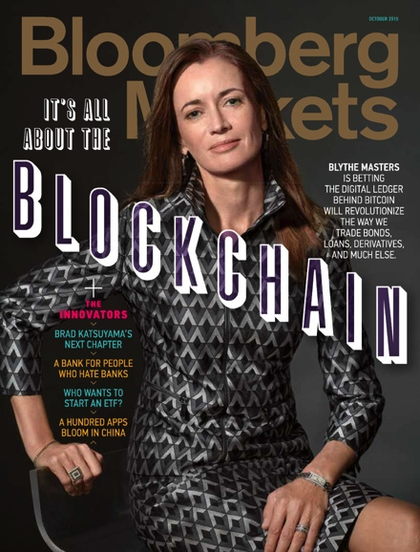
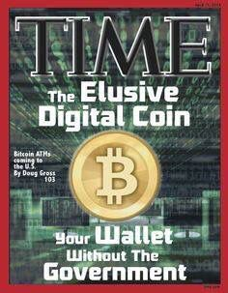
Blockchain in the media

Slide 7
IT Predictions
“I think there is a world market for maybe five computers.”
(Thomas Watson, chairman of IBM, 1943)
“There is no reason anyone would want a computer in their home."
(Ken Olson, founder of Digital Equipment Corp., 1977)
“I predict the Internet will soon go spectacularly supernova and in 1996 catastrophically collapse.”
(Robert Metcalfe, founder of 3Com, 1995).
“I see little commercial potential for the Internet for at least ten years.”
(Bill Gates, founder of Microsoft, 1994)

Slide 8
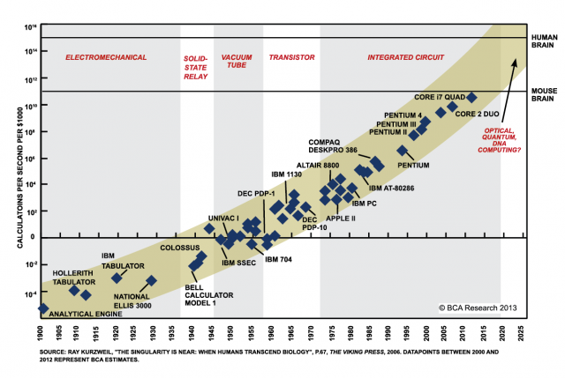
Moore’s Law

Slide 9
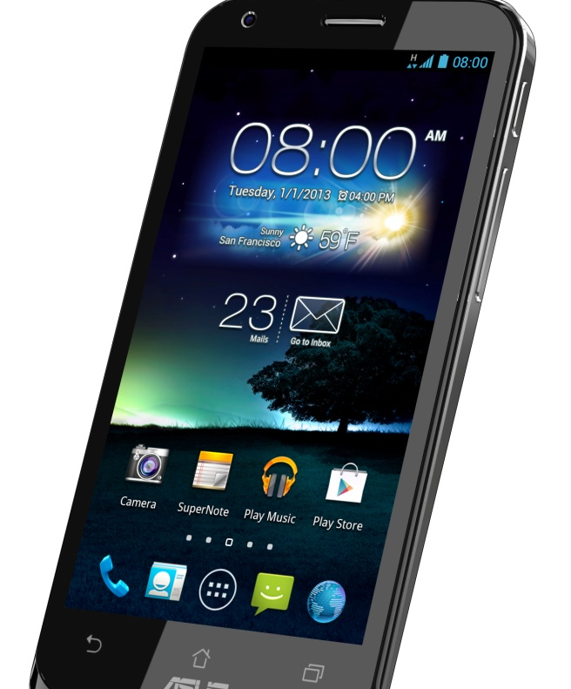
Mainframe (80’s) versus smartphone

Slide 10
Ease of Use
C:\>DIR C:\DOS\M*.EXE

Slide 11
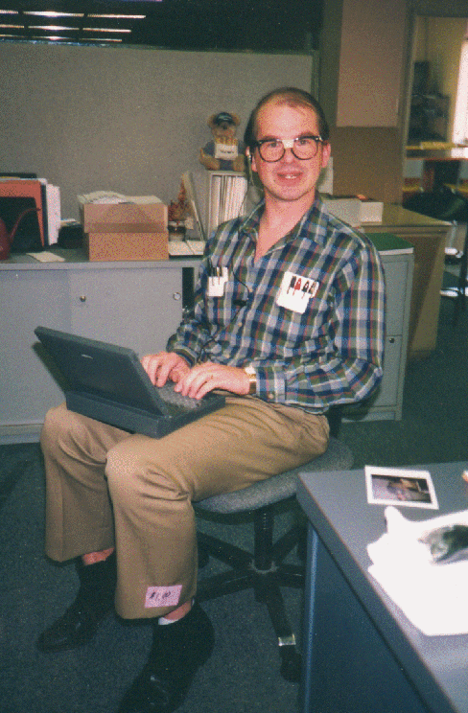
IT and Business: A Problematic Relationship

Slide 12
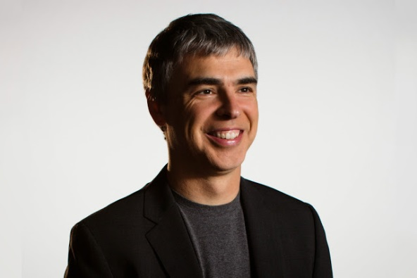
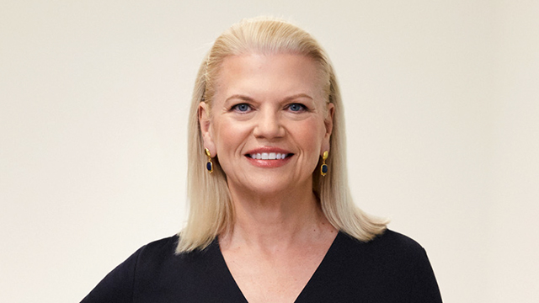
Some “Geeks”

Slide 13
Get Involved… or accept the consequences
IT investments not aligned with business strategy
Prioritization of IT projects missing
Lack of standardisation in IT-applications
No return on IT investments
‘Blaming & shaming’

Slide 14
Why this Master?

Slide 15
Why should you choose Information Management & Business Intelligence?
Business today cannot function efficiently and effectively without information systems
Business today needs efficient and fully automated decision-making tools
There are unlimited possibilities for information systems & data analytics in organisations

Slide 16
Information Management vs Computer Science
 | IM | CS
Focus | Organization | Software
Objective | More efficient or effective business | Reliable computer program
Core Task | Determine business requirements for information systems | Deliver information systems to meet defined requirements
Theoretical vs. Applied | Balanced | Applied
Typical Starting Job Title | Business Systems Analyst | Application Programmer
University Home | Business Schools | Science College, Technical Universities

Slide 17
Our Programme

Slide 18
Information Management
The Cost of IT: Managing an IT Budget
The Value of IT: How to Measure It?
Setting Investment Priorities
Innovation: Emerging Technologies (e.g. internet of things, cloud computing, gamification)
Project management
Change management issues
The Runaway Project
Vendor Partnering (e.g. cloud computing, outsourcing)
Managing Outsourcing Contracts
Managing the Applications Portfolio

Slide 19
Business intelligence / data analytics
1970s: Decision Support Systems (DSS)
Executive information systems (EIS), online analytical processing (OLAP), dashboards/scorecards
1990s: New term: Business Intelligence (BI) (coined by Gartner): “a broad category of applications, technologies, and processes for gathering, storing, accessing and analyzing data to help business users make better decisions”
Current era: Data analytics
Umbrella term similar to BI
The ”getting data out” part of BI
The development of algorithms (e.g. machine learning, neural networks)
BI versus data analytics:
BI: Business Users determine what question to ask, then IT structures the data to answer that question.
Example of BI tasks: Monthly sales reports, Profitability analysis, Customer surveys
Data analytics: IT delivers a platform to enable creative discovery, then Business Explores what questions could be asked
Example of data analytics tasks: Sentiment analysis, analysis of clickstream patterns

Slide 20
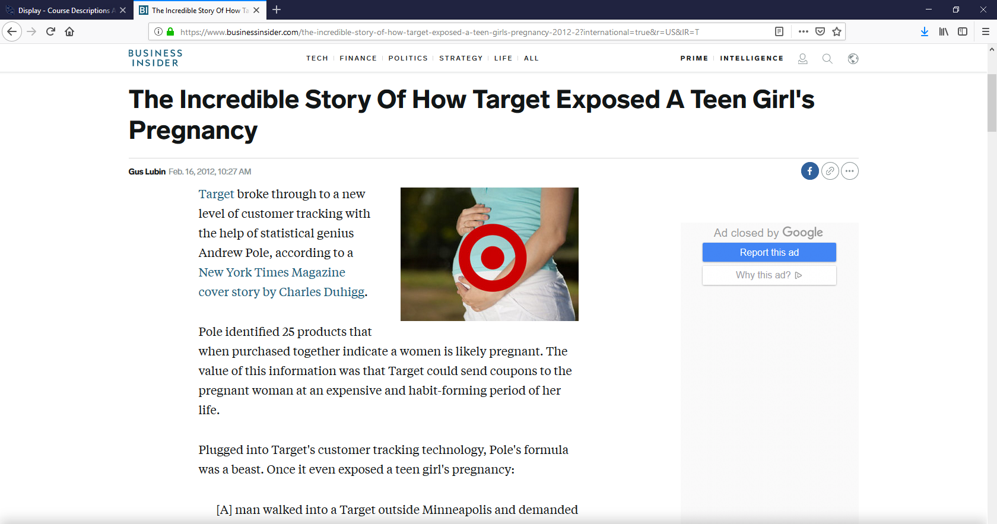
Ethical issues

Slide 21
What is the specialisation structure? (Start: SEPT)
Block
IB/IMBI
1
Data Management
Data Analytics
Data Analytics
2
Cases in MIS
Elective
3
Skills Training:
Writing a Master’s Thesis
Data Analytics

Slide 22
What is the specialisation structure? (Start: SEPT)
Block
IB/IMBI
4
Business Process Management
Writing the Master’s Thesis
5
Business Intelligence Case Studies
6
Completing the Master’s Thesis

Slide 23
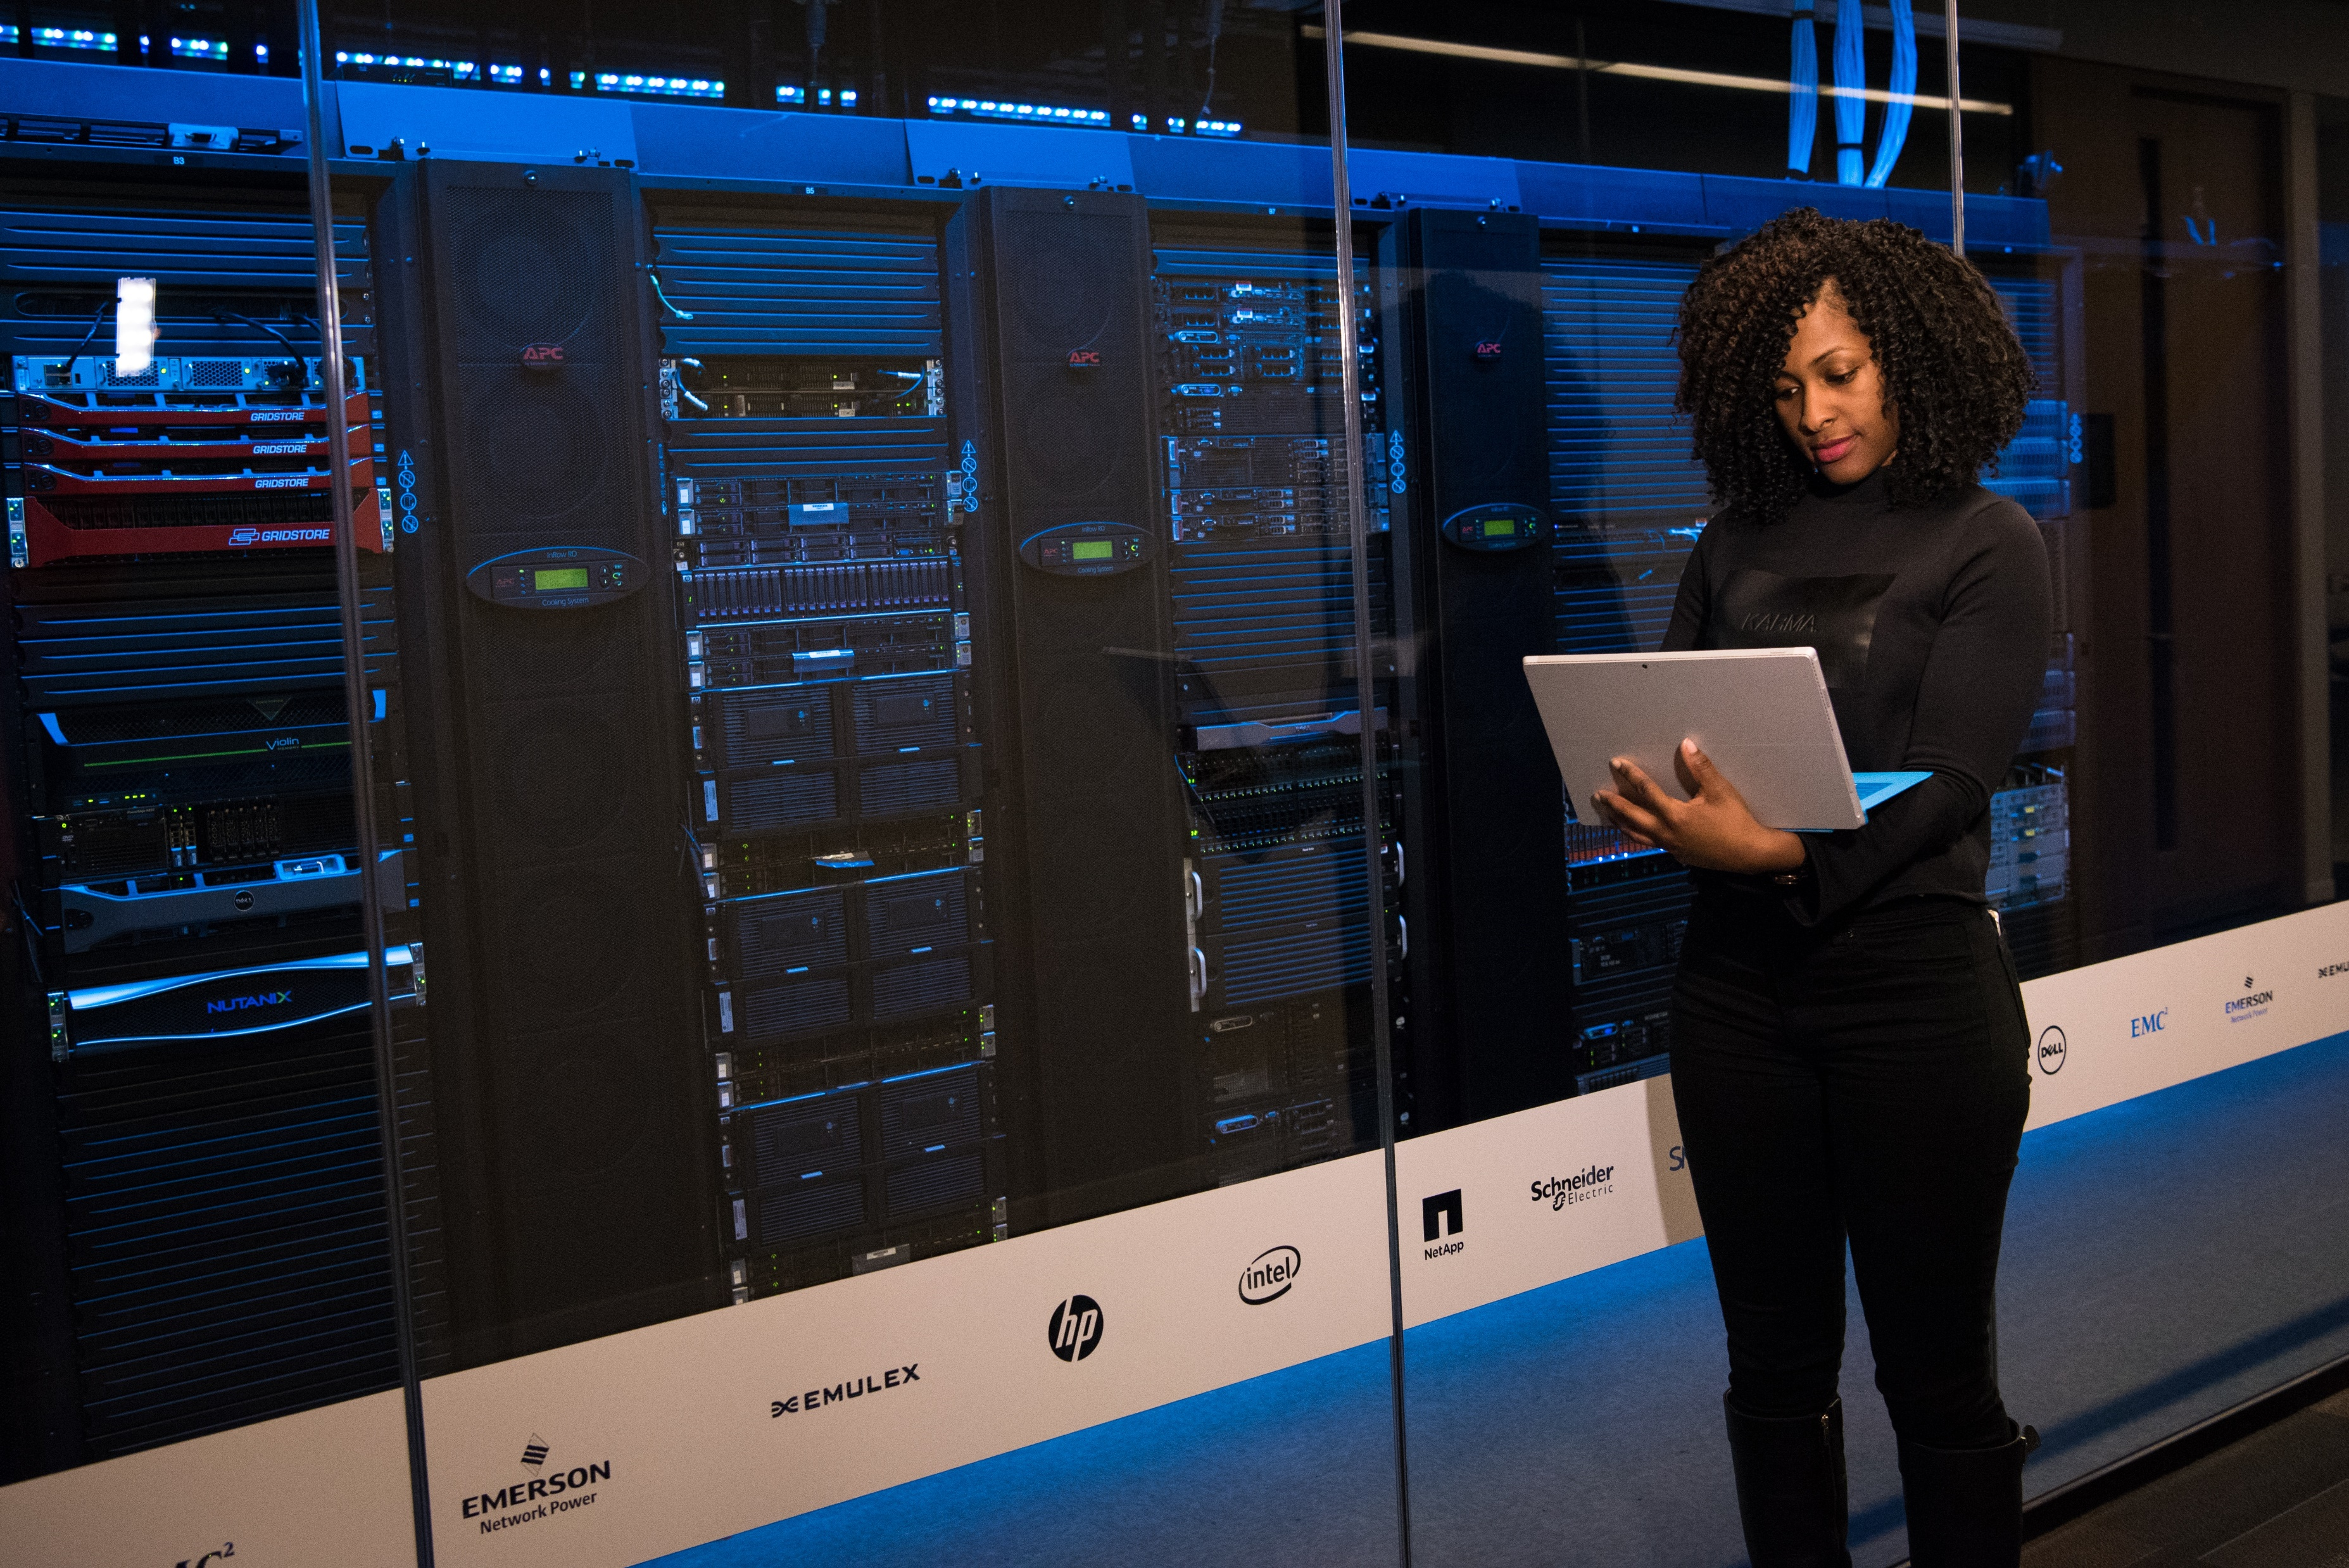
Data Management
Data Modelling and SQL
Relational databases (first part of the course)
New developments (e.g. Hadoop, MapReduce, second half of the course)
Gain hands-on skills plus theoretical background
Block
IB/IMBI
1
Data Management

Slide 24
Data Analytics
Quantitative methods for problem-solving and research
Generate insights that improve management decision-making
R language for statistical analyses
Block
IB/IMBI
1
Data Analytics
Notes:
Learn modern forecasting techniques and the basics of time series analysis
Learn how to turn a business problems into a mathematical model and how to solve the model using available software (R language for statistical analyses)

Slide 25
Cases in Management Information Systems
Discuss how businesses can use information systems to improve their performance
Use company cases and academic literature
Block
IB/IMBI
2
Cases in Management Information Systems

Slide 26
Elective
Choose your own course from a wide range of options
From another MSc IB Program
Or: Multidisciplinary Business Challenge
Broaden your horizon and go the extra mile
Block
IB/IMBI
2
Elective

Slide 27
Writing the Master’s thesis
Understand the basic requirements of a master’s thesis
Develop a high quality research proposal for a master’s thesis
Apply for thesis supervision
Block
IB/IMBI
3
Skills Training: Writing a Master’s Thesis

Slide 28
Business Process Management
Identify the different phases in the management of business processes
Model complex business processes with BPMN
Learn to communicate with domain experts and IT specialists on business processes
Qualitatively and quantitatively analyze business processes and identify process improvement actions
Block
IB/IMBI
4
Business Process Management

Slide 29
Business Intelligence Case Studies
Learn how to tackle real-life business problems, e.g.,
Capacity planning in a hospital
Implementing quality control in a hotel
Customer segmentation at a bank
Block
IB/IMBI
5
Business Intelligence Case Studies

Slide 30
Master’s Thesis
In-depth study of an IM/BI problem
- Academic relevance
- Managerial relevance
- Case study/internship possibilities
Scientific study
Block
IB/IMBI
4
Writing the Master’s Thesis
5
6
Completing the Master’s Thesis

Slide 31
Student Profile

Slide 32
Have an affinity for quantitative reasoning, IT and its potential for organisations
Have the desire to study and work in an international environment
Be able to think in a logical and structured way
* Programming / technical / sophisticated mathematical skills are not necessary

Slide 33
What does the future hold?

Slide 34
Job Prospects are Excellent
Typical starting positions of IM students
IT Consultant (e.g. Accenture, IBM Consulting, PwC)
Data analyst (e.g. Henkel)
Systems Analyst (e.g Shell, ING Bank, Cisco Systems)
Project Manager (e.g. ABN AMRO)
IT vendors (e.g. SAP, Google)
Startup (e.g. SpamExperts, i2 Solutions)
Further down the career path
Manager of the IT function in an organisation
Chief Information (Knowledge) Officer

Slide 35
Questions?
E-mail: m.vluggen@maastrichtuniversity.nl
Or visit us at the information market in the Mensa

