Slide 1
MSc Global Supply Chain Management and Change
Maastricht University, School of Business and Economics
Campus Venlo

Slide 2
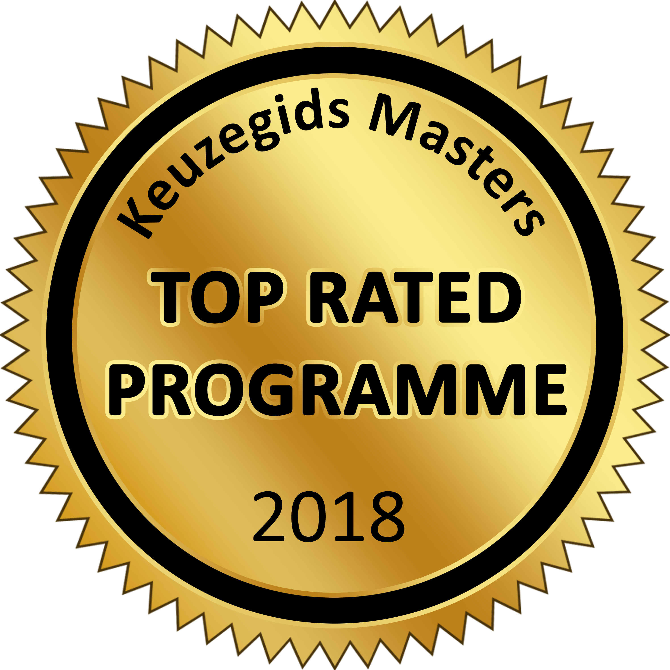
MSc Global Supply Chain Management and Change
Innovative entrepreneurship in the worldwide supply chain
Tjark Vredeveld
Associate Professor of Operations Research
Previous coordinator MSc GSCMC

Slide 3
Why Global Supply Chain Management and Change?
Supply chain management is of strategic importance
- Globalisation
- Outsourcing
- Customisation
- Shorter product life cycles
SCM = major competitive weapon in 21st century
Entrepreneurship and innovation are needed to respond to change

Slide 4
Why Global Supply Chain Management and Change?
Venlo campus
- Venlo is the logistics and supply chain
“hot spot” in the Netherlands
- Venlo is home to world class companies and educational institutions
- Venlo region is famous for its entrepreneurial spirit

Slide 5
Why Global Supply Chain Management and Change?
Multidisciplinary programme
- Supply chain management
- Innovation
- Entrepreneurship
Close collaboration with leading local/regional companies such as CAROZ, Ewals (e-logistics), Seacon, Flex, Océ/Canon, Xerox, KLG

Slide 6
What will you learn?
Maintain an overview of every link in the supply chain
Carry out effective supply chain planning
Deal effectively with suppliers, buyers and customers
Understand global business issues
Identify areas of improvement and drive change processes
Work in and manage (international) teams

Slide 7
What is the programme structure? (1)
Block
Global Supply Chain Management & Change
1
Methods and Methodology
Supply Chain Operations
2
Supply Chain Relationships
Entrepreneurship and Innovation
3
Skills Training:
Research Design and Methodology for a Thesis

Slide 8
What is the programme structure? (2)
Block
Global Supply Chain Management & Change
4
ICT Systems and Services
Business and Supply Chain Strategy
5
Skills Training:
Project and Change Management
Writing the Master’s Thesis
6
Completing the Master’s Thesis
NB. The details of this programme could change; before applying, please check www.maastrichtuniversity.nl/sbe for the latest information.

Slide 9
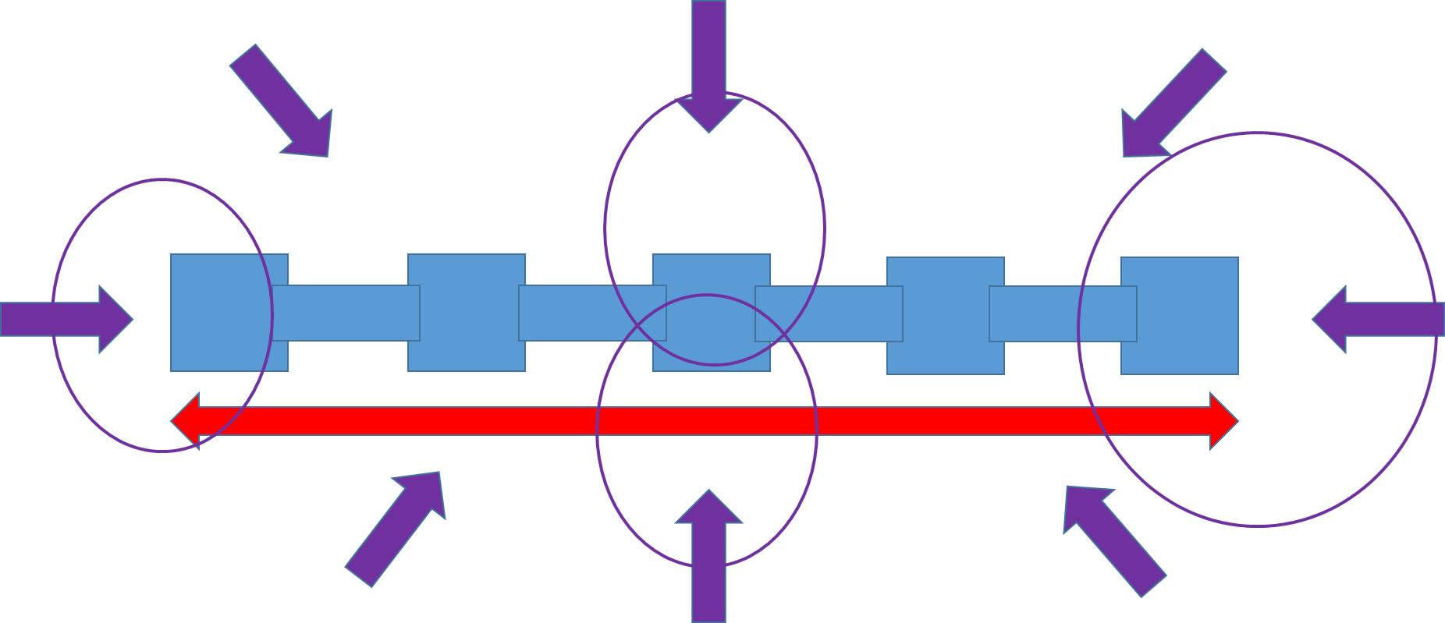

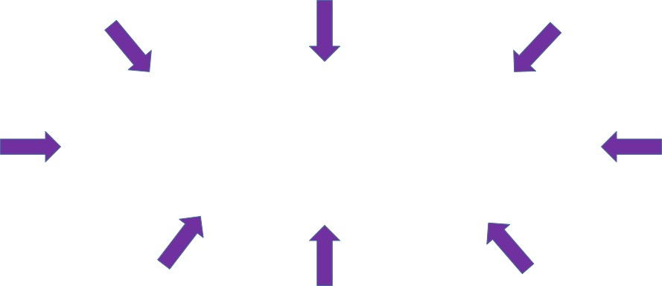
What is the programme structure? (3)
Methods & Methodology
Supply Chain Operations
Project and Change Management
Supply Chain Relationships
Supply Chain Operations
ICT Systems and Services
Business and Supply Chain Strategy
Entrepreneurship and Innovation
Project and Change Management

Slide 10
Is Global Supply Chain Management and Change right for you?
Internationally minded and open to new ideas
Seeing the opportunities of change rather that the threats
Analytical with a desire to see theory in practice
Ready to acquire knowledge, skills, attitude, ambition and confidence to take on the challenge

Slide 11
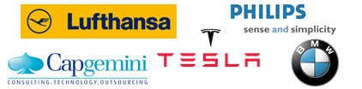
Careers of our alumni
MSc – Global Supply Chain Management & Change
93 graduates
Employed in 15 countries
Business Analyst
Consultant
Logistics Engineer
Supply Chain Analyst
MSc graduates SBE Global Supply Chain Management & Change period 2004-2015
Notes:
Ceva weg, lufthansa in, KPMG eruit, TESLA in

Slide 12
Further questions?
www.maastrichtuniversity.nl/gscmc
Contact: Gscmc-info@maastrichtuniversity.nl
Or visit us at the information market in the Mensa
Or visit us on our Open Day in Venlo on Saturday 4 April

Slide 13
Methods and Methodology
Develop the concepts and knowledge required for scientific research in supply chain management
Block
Global Supply Chain Management & Change
1
Methods and Methodology

Slide 14
Supply Chain Operations
Learn about the design, management and improvement of the primary supply chain processes
Block
Global Supply Chain Management & Change
1
Supply Chain Operations

Slide 15
Supply Chain Relationships
Learn about management of relationships between supply chain partners to jointly advance supply chain performance
Block
Global Supply Chain Management & Change
2
Supply Chain Relationships

Slide 16
Entrepreneurship and Innovation
Learn about theory and methods to sense and leverage change opportunities within a firm or by starting a new one
Block
Global Supply Chain Management & Change
2
Entrepreneurship and Innovation

Slide 17
Research Design and Methodology for a Thesis
Learn about different research methodologies that can be applied when doing the research for a thesis.
Learn about the important issues to take into account when making a research design for your thesis.
Block
Global Supply Chain Management & Change
3
Skills Training:
Research Design and Methodology for a Thesis

Slide 18
ICT Systems and Services
Perform an in-depth study of ICT systems and services, the two main drivers of supply chain change and value creation
Block
Global Supply Chain Management & Change
4
ICT systems and Services

Slide 19
Business and Supply Chain Strategy
Gain a strategic perspective on industry dynamics and change, at supply chain level and at corporate level
Block
Global Supply Chain Management & Change
4
Business and Supply Chain Strategy

Slide 20
Project and Change Management
Do practical case work on making strategic innovation happen in a multinational
Block
Global Supply Chain Management & Change
5
Skills Training:
Project and Change Management

Slide 21
Master’s Thesis
Do scientific research and contribute to academic knowledge in some area related to Global SCM and/or innovation
Block
Global Supply Chain Management & Change
5
Writing a Master’s Thesis
6
Completing the Master’s Thesis

