Slide 1
MSc Econometrics and Operations Research
Maastricht University, School of Business and Economics

Slide 2
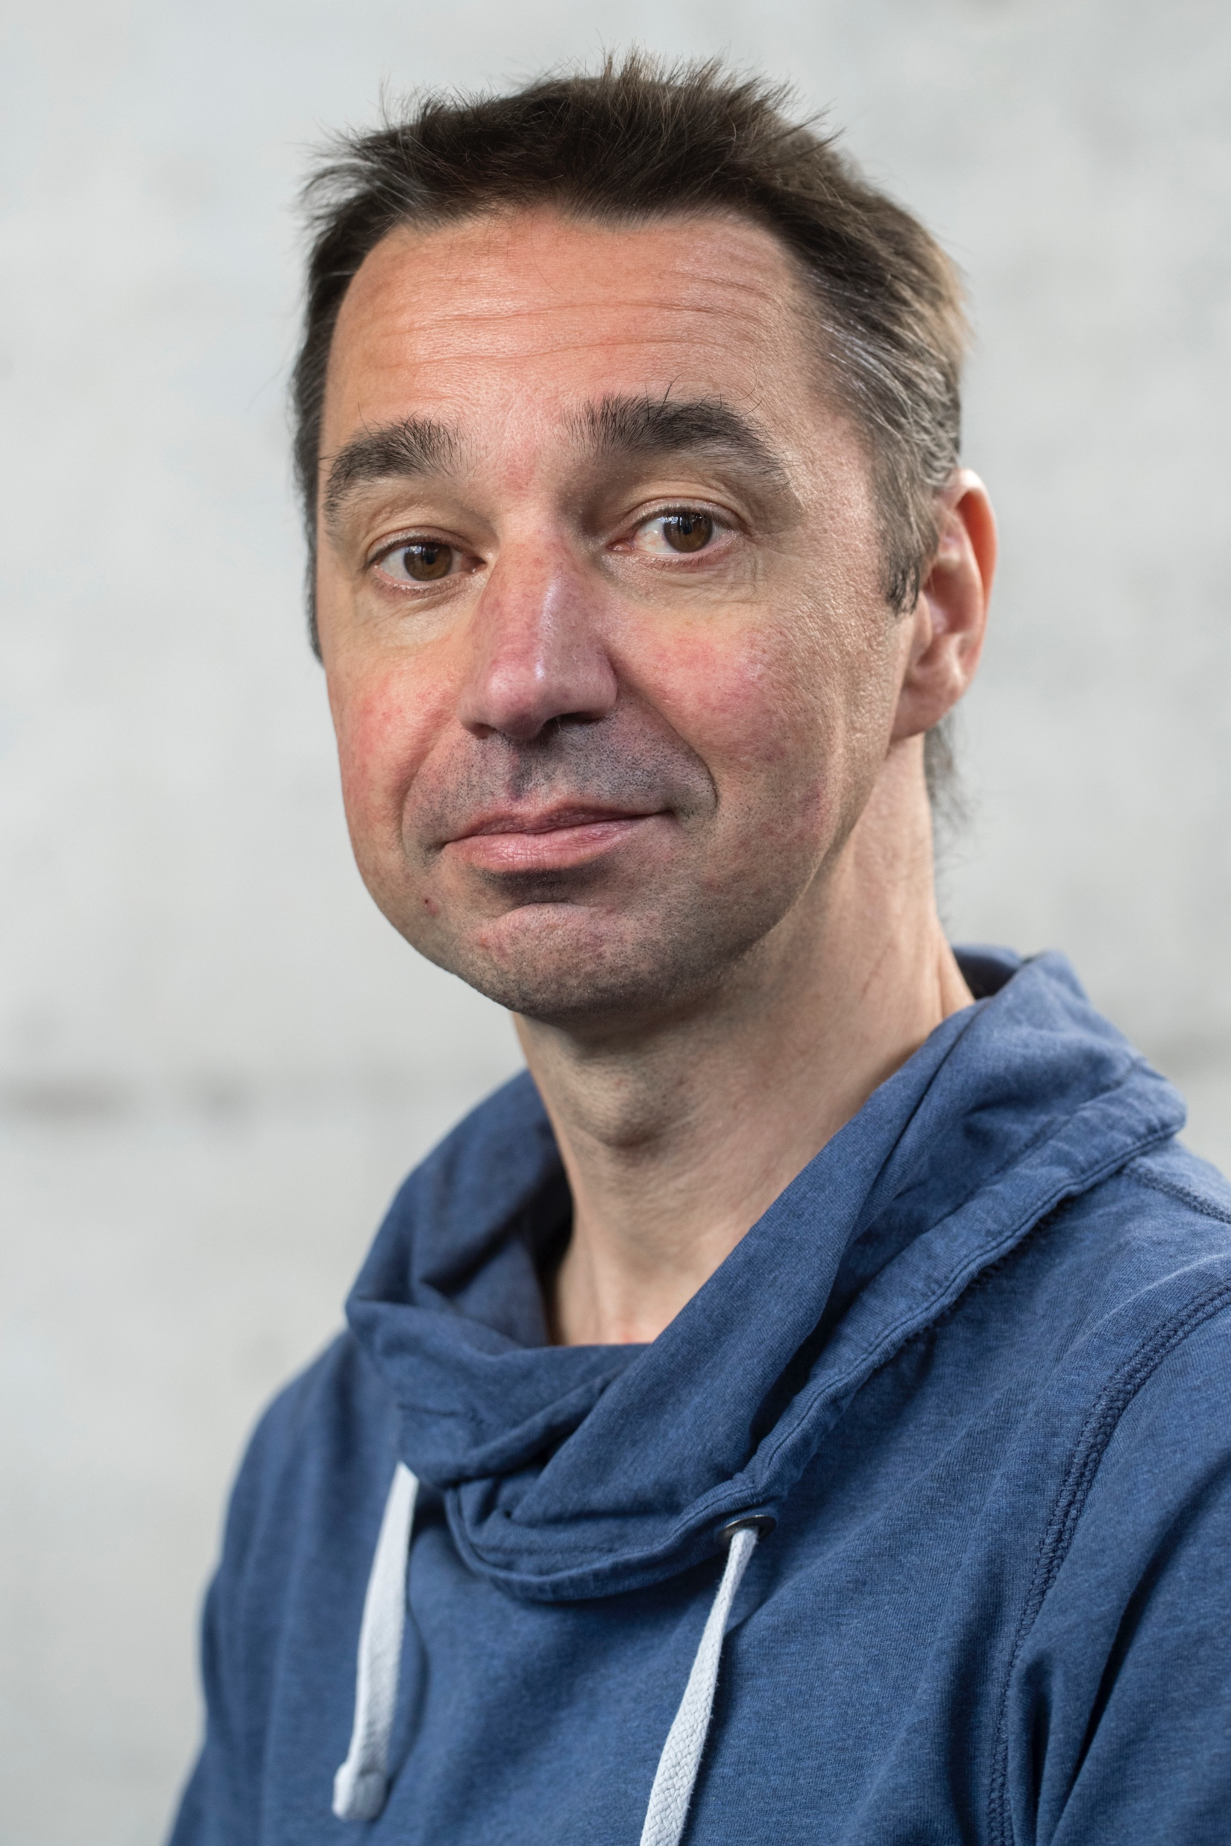
Dr. Dries Vermeulen

Slide 3
Today’s Agenda
Why this MSc?
1
Our programme
2
Specialisations
3
Student Profile
4
What does the future hold?
5

Slide 5
Why this MSc?

Slide 6
Why Econometrics and Operations Research?
Applying mathematics and statistics to economics and business
High quality courses
Small group teaching
Excellent career perspectives
Use of dedicated software
Close links to the corporate world

Slide 7
What will you learn?
Improve economic decisions in business and the public sector
Apply, improve and develop models based on mathematics and statistics
Implement the models using existing or newly developed computer software
Instantiate the computer models with data and interpret the results
Control for robustness and sensitivity of the model

Slide 8
Our Programme

Slide 9
Block
Econometrics and Operations Research
1
Stochastic Processes
Game Theory and Optimisation
2
Choice course
Choice course
3
Skills Training

Slide 10
Block
Econometrics and Operations Research
4
Choice course
Writing the Master’s Thesis
5
Choice course
6
Completing the Master’s Thesis

Slide 11
The list of E&OR core courses
Time Series Methods and Dynamic Econometrics
Life Insurance I
Life Insurance II
Mathematical Finance
Econometrics Methods for Cross-Sectional and Panel Data
Empirical Analysis of Financial Markets
Social Choice Theory
Industrial Economics
Equilibrium Theory and Financial Markets
Algorithms and Optimisation
Modelling and Solver Technology
Operations Research Applications
High-Dimensional Econometric Methods for Big Data
Machine Learning
Capita Selecta Quantitative Economics

Slide 12
Free Electives (at most 1 out of 4 choice courses)
Open Macroeconomics in a Global Society
Supply Chain Operations
Risk Management

Slide 13
Study profiles

Slide 14
Study profiles
Actuarial Sciences
Econometrics
Mathematical Economics
Operations Research
Data Science

Slide 15
1. Actuarial Sciences
Applying mathematics and statistics to assess risks in insurance and finance
Stochastic Processes
Time Series Methods and Dynamic Econometrics
Life Insurance I
Life Insurance II
Mathematical Finance
Topics in Computational Actuarial Methods
Writing a Master’s Thesis
Core Courses
Skill Courses

Slide 16
2. Econometrics
Analysis and testing of economic relationships
Stochastic Processes
Time Series Methods and Dynamic Econometrics
Econometrics Methods for Cross-Sectional and Panel Data
Empirical Analysis of Financial Markets
Topics in Computational Econometrics
Writing a Master’s Thesis
Core Courses
Skill Courses

Slide 17
3. Mathematical Economics
Modelling strategic behaviour
Game Theory and Optimisation
Social Choice Theory
Industrial Economics
Equilibrium Theory and Financial Markets
Topics in Computational Econometrics
Writing a Master’s Thesis
Core Courses
Skill Courses

Slide 18
4. Operations Research
Optimisation of business processes
Game Theory and Optimisation
Algorithms and Optimisation
Modelling and Solver Technology
Operations Research Applications
Operations Research Software
Writing a Master’s Thesis
Core Courses
Skill Courses

Slide 19
5. Data Science
Analysis of large data sets
Game Theory and Optimisation
Time Series Methods and Dynamic Econometrics
High-Dimensional Econometric Methods for Big Data
Machine Learning
Operations Research Software
Writing a Master’s Thesis
(and\or Algorithms and Optimisation)
Core Courses
Skill Courses

Slide 20
Master’s Thesis
Study a practical or theoretical problem within the track of your choice
Combine your master’s thesis with an internship – this is strongly recommended!
Support offered via the TIP program

Slide 21
Research Master: 2 years
Includes more experience in doing research (both fundamental and executive)
Prepares for a PhD
Operations Research variant:
Part of the Business Research Master
Year 1 is very similar to the OR variant of Ect&OR master (master’s thesis is replaced by two electives, last skill is replaced by a hands-on research project).
Year 2 deepens OR knowledge with courses of the Dutch network LNMB in Utrecht. Master’s thesis is 30 ECTS and can be fullfilled through an internship.

Slide 22
Research Master: 2 years
Econometrics/Mathematical Economics research variant:
Part of the 2 years METEOR Research MSc in Economic and Financial Research.
Year 1 is very similar to the Ect/MathEcon variant of Ect&OR master (master’s thesis is replaced by two core courses of the research master and the last skill is replaced by a hands-on research project).
Year 2 is made out of the specialisation courses and electives from the EFR programme. The fourth semester is devoted to a 30 ECTS master’s thesis.

Slide 23
Student Profile

Slide 24
Is Econometrics and Operations
Research right for you?
Have a solid knowledge in bachelor’s level
subjects which are fundamental for your
choice of subjects in the master’s programme

Slide 25
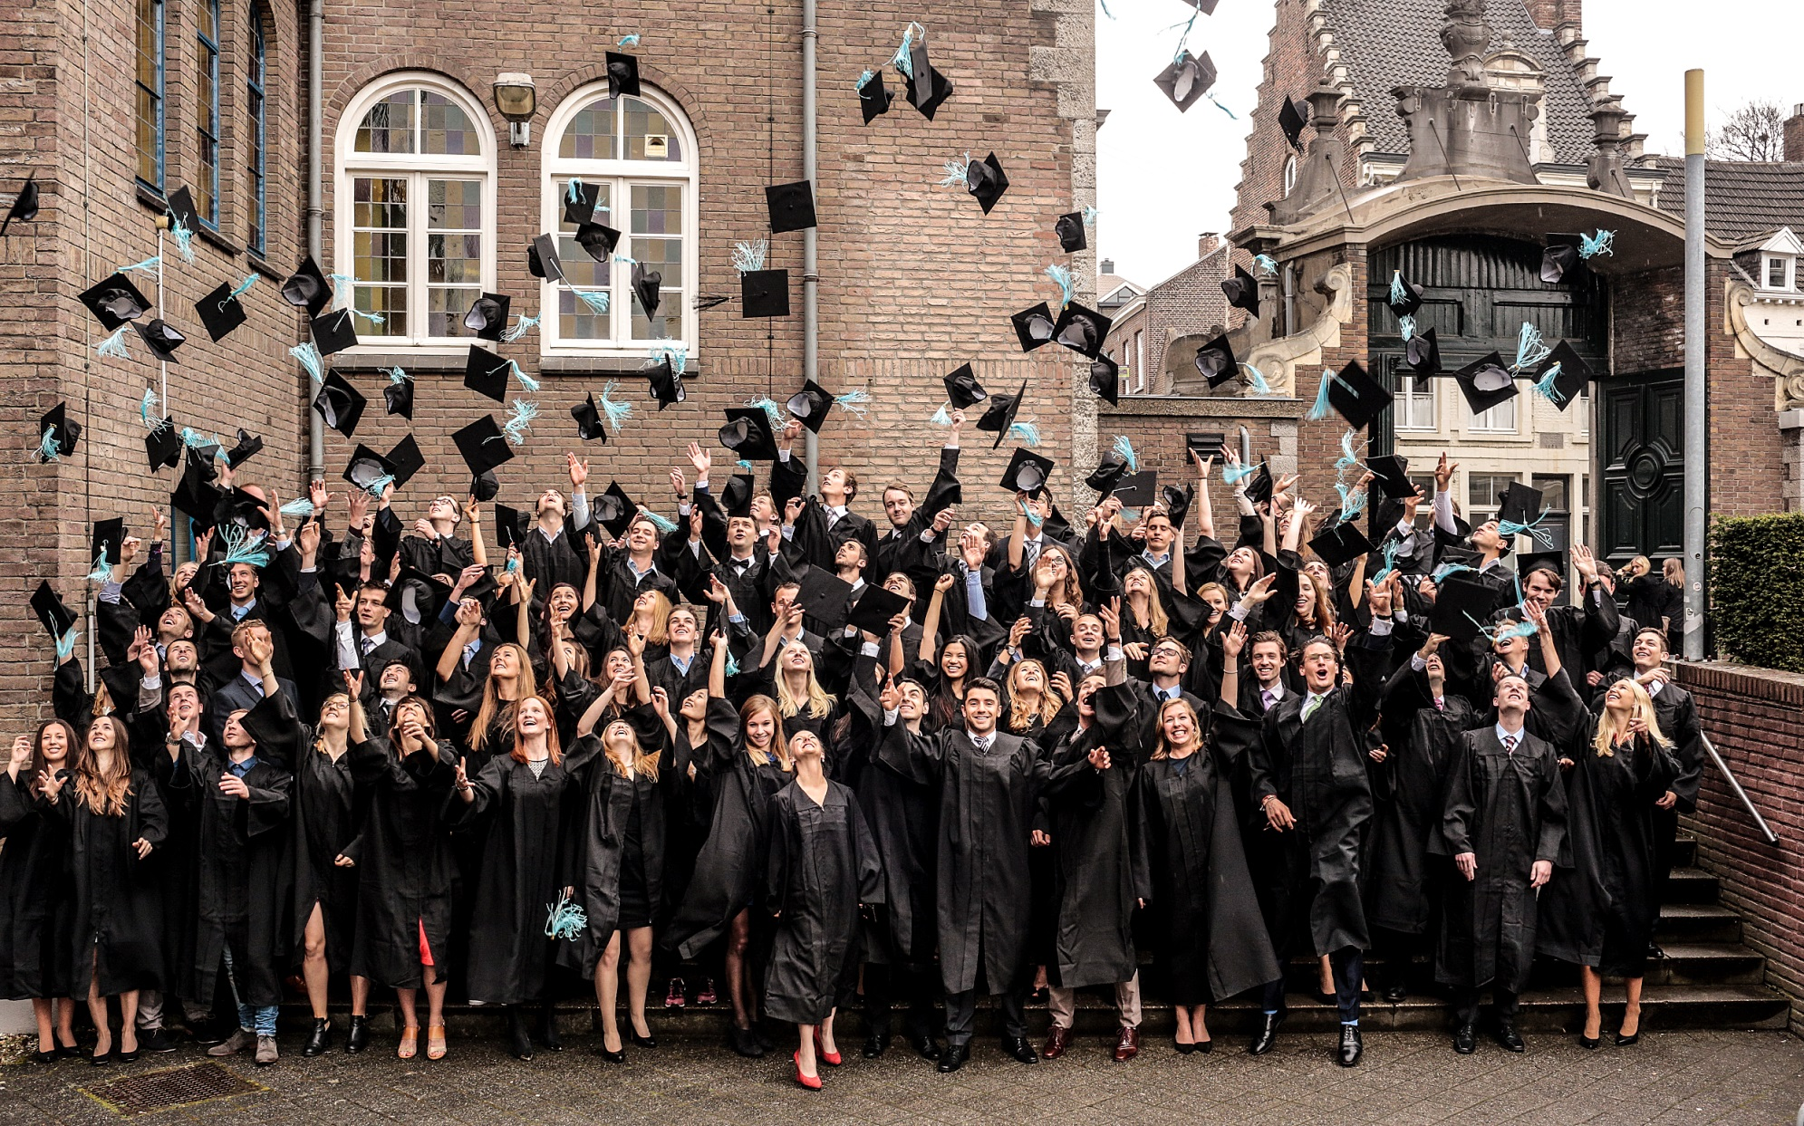
What does the future hold?

Slide 26
Alumni Careers
Actuarial Science
Econometrics
Mathematical Economics
Graduates
Employed in 4 countries
Graduates
Employed in 14 countries
Graduates
employed in 3 countries
Actuary
Consultant
Investment Manager
Product Controller
Business Intelligence Analyst
Econometrician
Consultant
Risk Analyst
Analytical Consultant
Research Analyst
Risk Advisor
Sales Analyst

Slide 27
Alumni Careers
Operations Research
Data Science
Graduates
employed in 3 countries
Graduates
employed in 13 countries
Business Consultant
Software Engineer
Trading Innovation Manager
Technical Consultant
Actuary
Analytical Consultant
Data Scientist
Financial Advisor

Slide 28
Questions?
Visit us at the information market in the Mensa

