Slide 1
MSc Economic & Financial Research
Maastricht University, School of Business and Economics

Slide 2
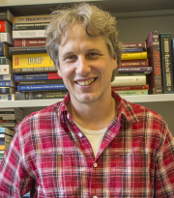
Martin Strobel

Slide 3
Today’s Agenda
What are we about?
1
Our Programme
2
Learning Environment
3
Student Profile
4
What does the future hold?
5

Slide 4

“Give me six hours to chop down a tree and I will spend the first four sharpening the axe.”
Abraham Lincoln
What are we about?

Slide 5

Research Master’s Programme
Two-year Master’s degree programme
Strong focus on research and science-related skills
Provides you with the appropriate toolbox to tackle a PhD

Slide 6

Our Programme

Slide 7
Year 1
Period
Courses
1
Mathematical Research Tools
Empirical
Econometrics 1
2
Microeconomics 1
Macroeconomics
3
Computational Econometrics
World of Research
4
Microeconomics 2
Financial Markets
5
Empirical
Econometrics 2
Research Strategy
6
Experimental Economic Methods

Slide 8
Year 2
Period
Courses
1
Elective Course
Elective Course
2
Elective Course
Elective Course
3
Presentation Skills
4
Master’s Thesis
5
6

Slide 9
Electives Year 2 (Some examples)
Behavioural Economics (EFR)
Industrial Organisation and Public Economics
Capita Selecta Economic and Financial Research
Equilibrium Theory and Financial Markets
High-Dimensional Econometric Methods for Big Data
18 others at the SBE and many more outside!

Slide 10
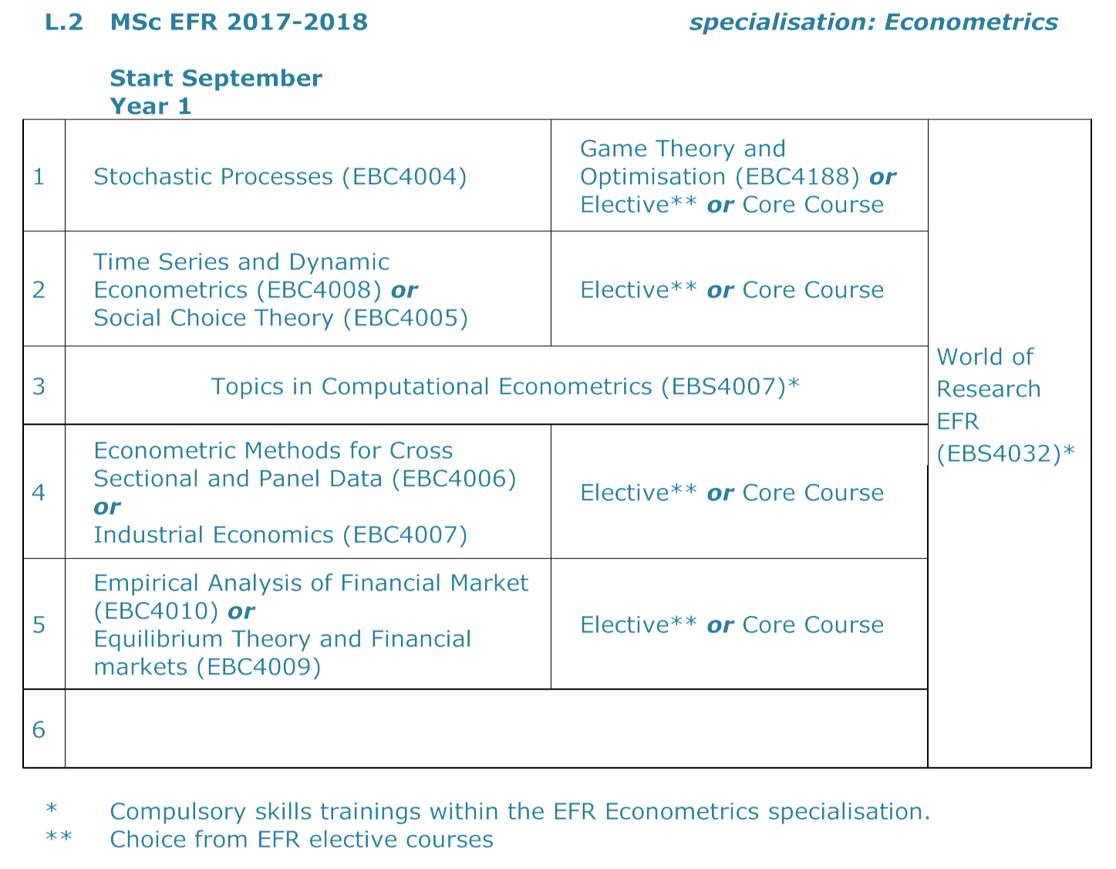
Special Econometrics Track

Slide 11

Academic Environment

Slide 12

Academic Environment
Seminar series in our research areas
GSBE sponsored workshops and conferences (free of charge)
Courses at other faculties or other universities possible

Slide 13



Excellent Research Facilities

Slide 14

Financial Issues
Teaching assistantship in the first year
Research assistantships in the second year
PhD positions (competitive)

Slide 15

Student Profile

Slide 16



Curious & Academic Minds
Not afraid of using analytical techniques, tools and math
Want to keep good options for a PhD

Slide 17

What does the future hold?

Slide 18

Career Options
Academia (PhD at SBE or elsewhere)
Research-related positions in private industry (banks and consulting)
Policy-oriented positions governments and governmental institutes (oversight authorities and think tanks)

Slide 19
Questions?
For contact:
gsbe-sbe@maastrichtuniversity.nl
Or visit us at the information market in the Mensa

