Slide 1
MSc Economics
Maastricht University
School of Business and Economics

Slide 2
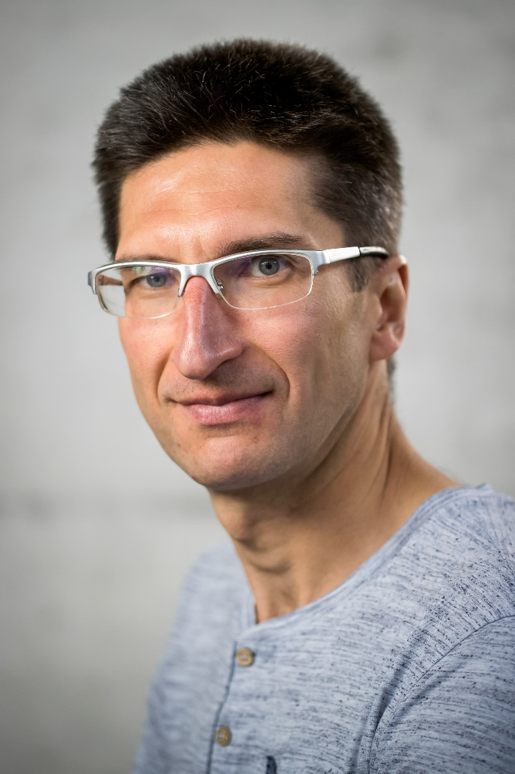
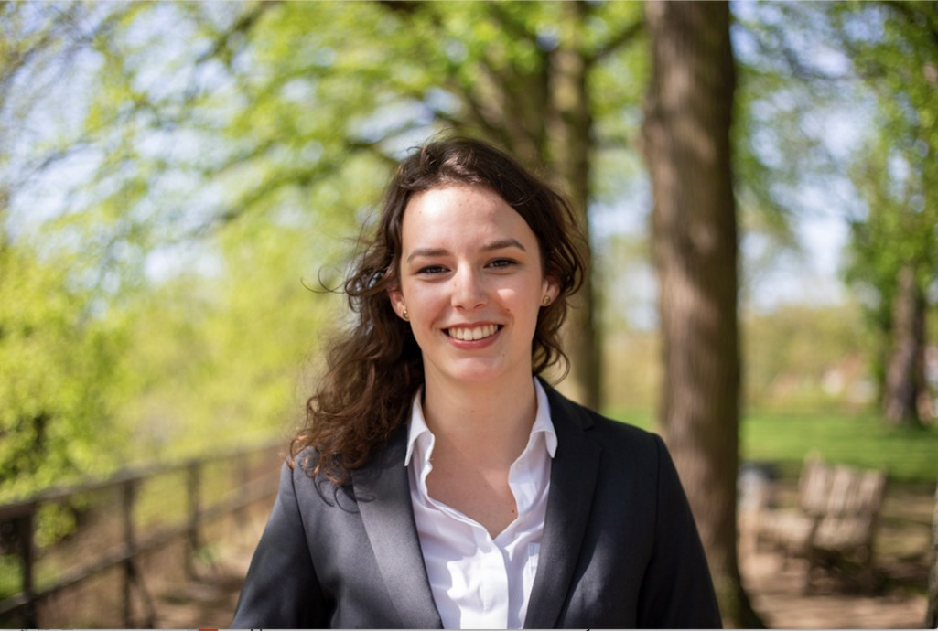
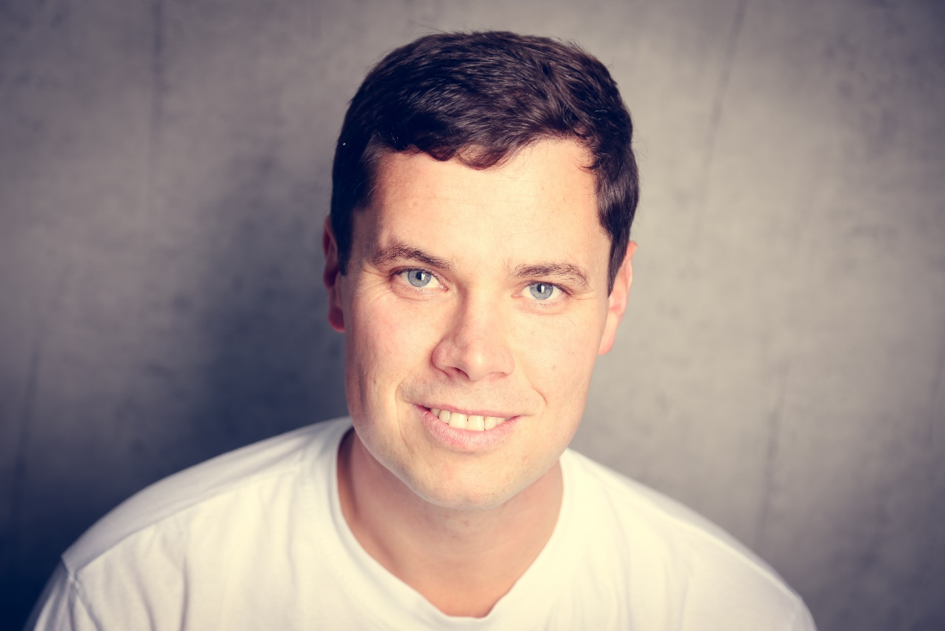
Today’s Team
Arkadi Predtetchinski & Steffen Künn
Program leaders
Evie Graus & Marnix Vermeer
Students

Slide 3
Today’s Agenda
What are we about?
1
Our program
2
Preparation for the job market
3
Teaching environment
4
What does the future hold?
5
Students’ perspective
6

Slide 4
What are we about?

Slide 5
Why Economics?

Slide 6
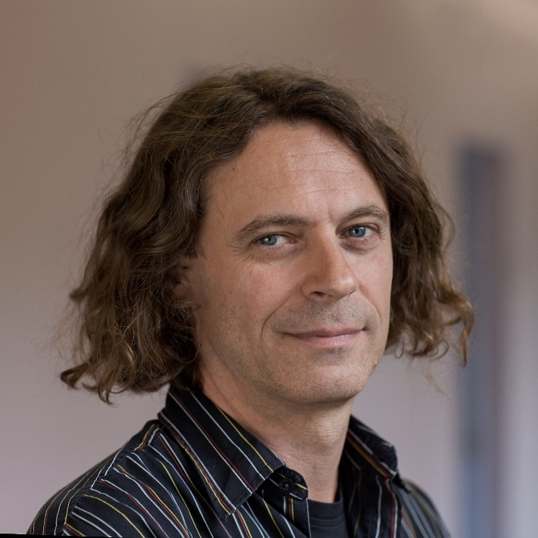
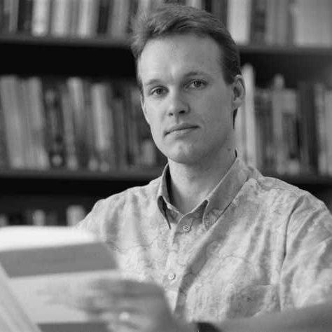
Successful in research
Economentop 40 in 2018
Highly ranked Econ department
Tilburg University Top 100 Worldwide Economics Schools Research Ranking
IDEAS/REPEC Top 10% Economic Institutions
Arno Riedl
Jean-Jacques Herings

Slide 7
High quality, up to date courses
Project
Strong abilities based on solid economic principles
Individual competence development

Slide 8
Our Program

Slide 9
2

Slide 10
Global challenges and macroeconomic policy
Fiscal and monetary policies, the role of trade, economic growth
Jobs in economic policy, finance or insurance

Slide 11
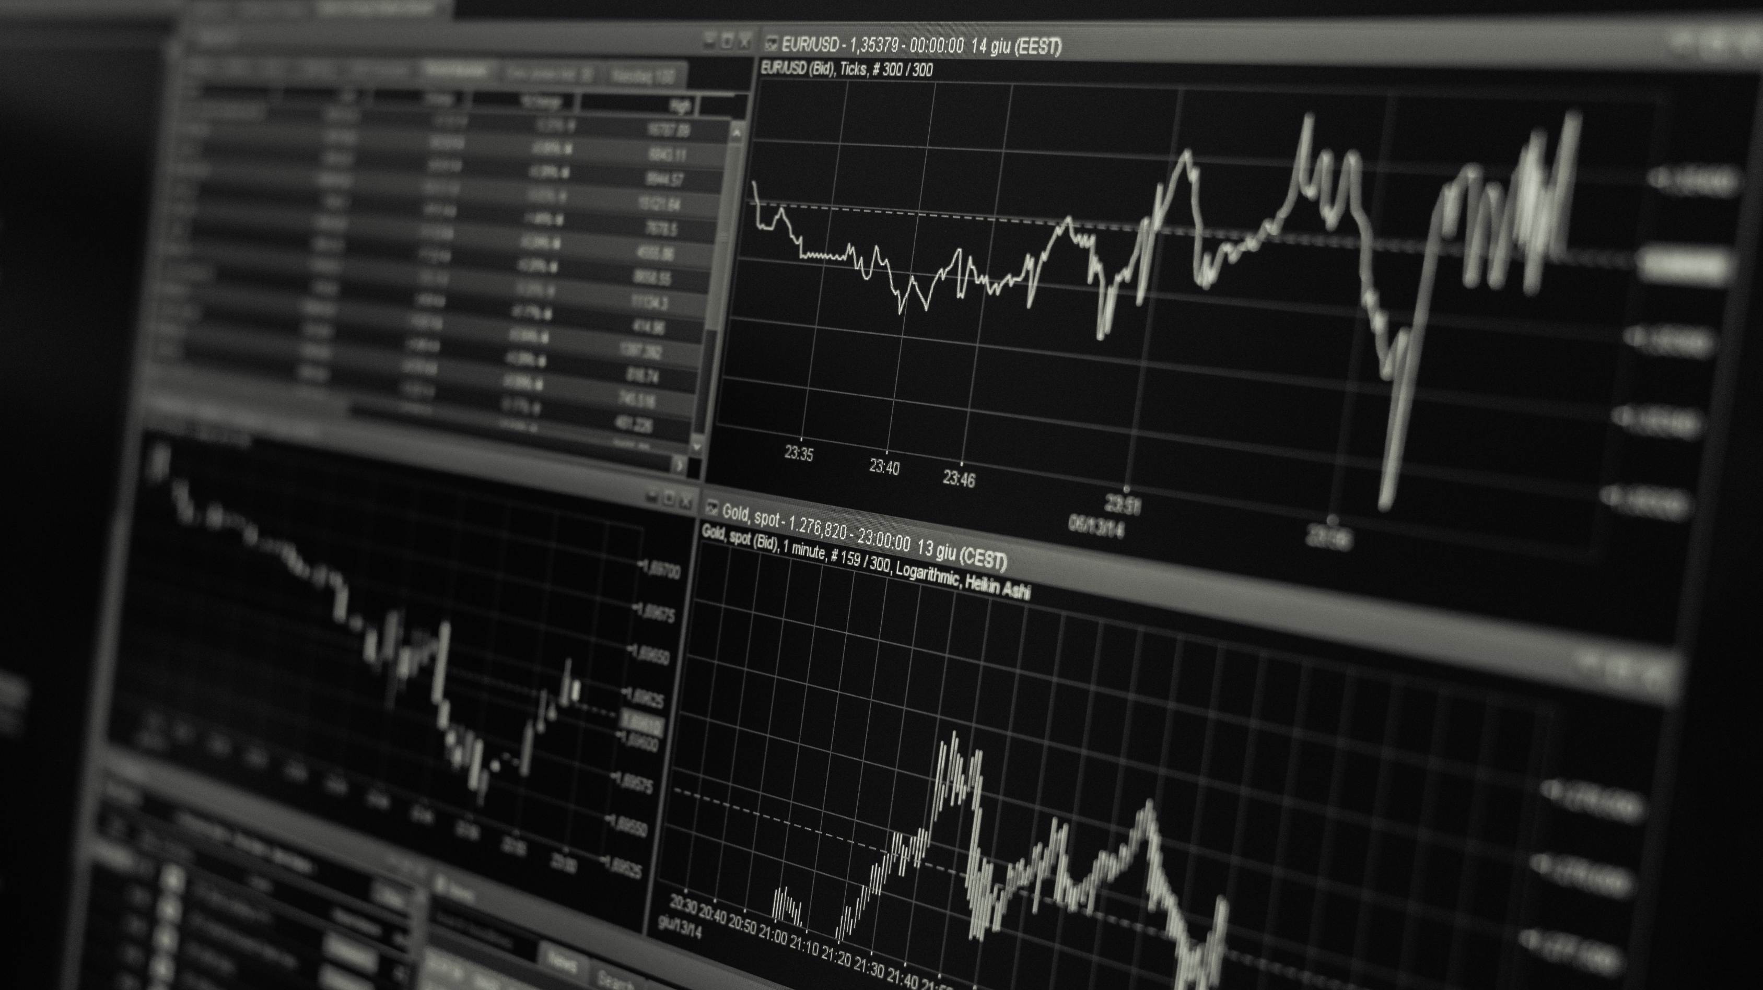
Market regulation and design
Market regulation, competition policy, auction design, market design
Jobs in economic consultancy, audit firms, market regulation authorities

Slide 12
Education and Labour Economics
Human capital development in educational institutions and labour markets
Jobs as policy officers and consultants, public institutions, researcher

Slide 13
Preparation for the job market

Slide 14
Project
Individual Competence Development
Guest lectures and study trips
Thesis Internship Program (TIP)

Slide 15
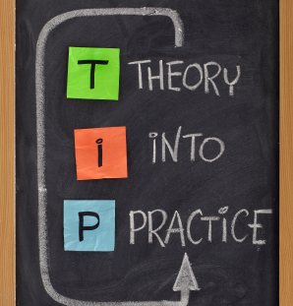
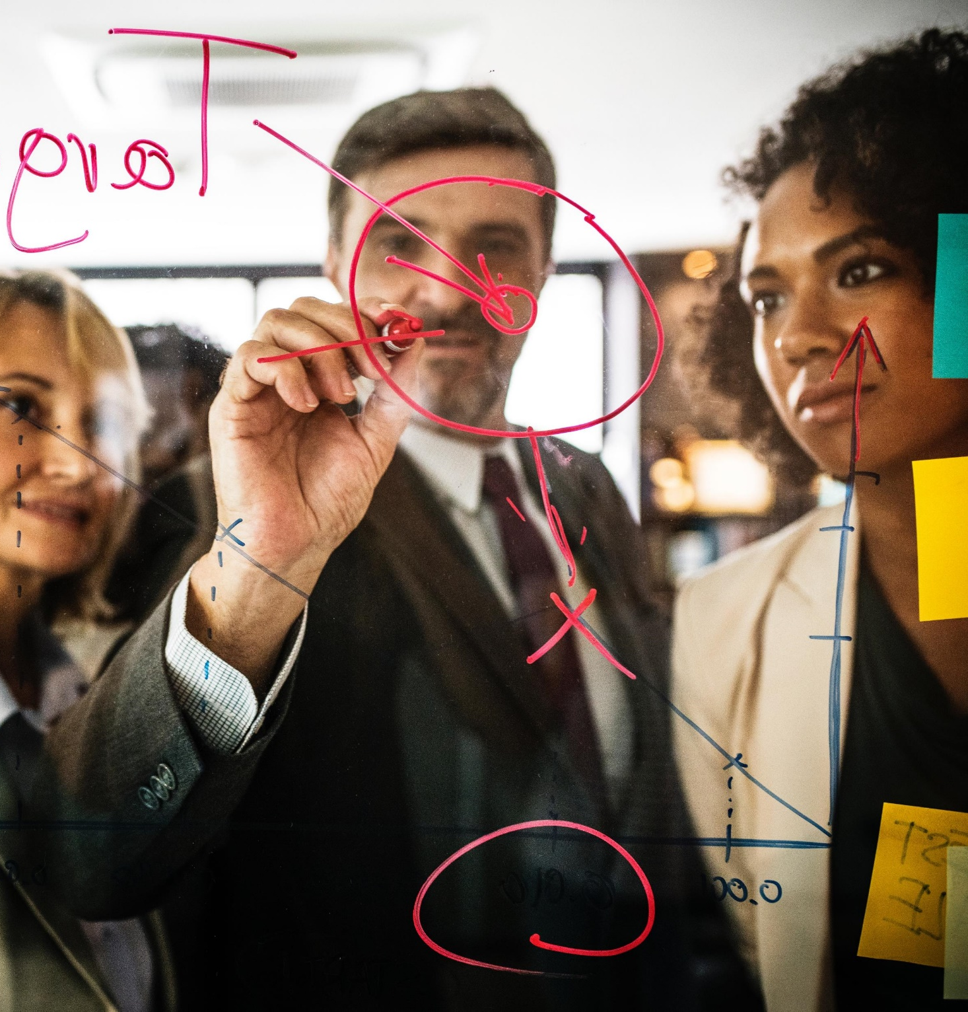
Project

Slide 16
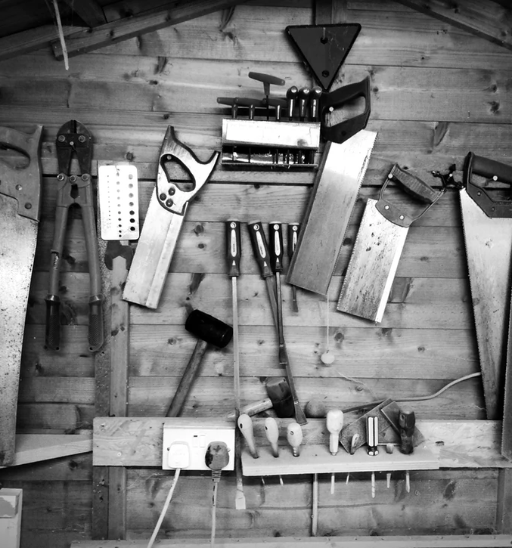
Individual Competence Development

Slide 17
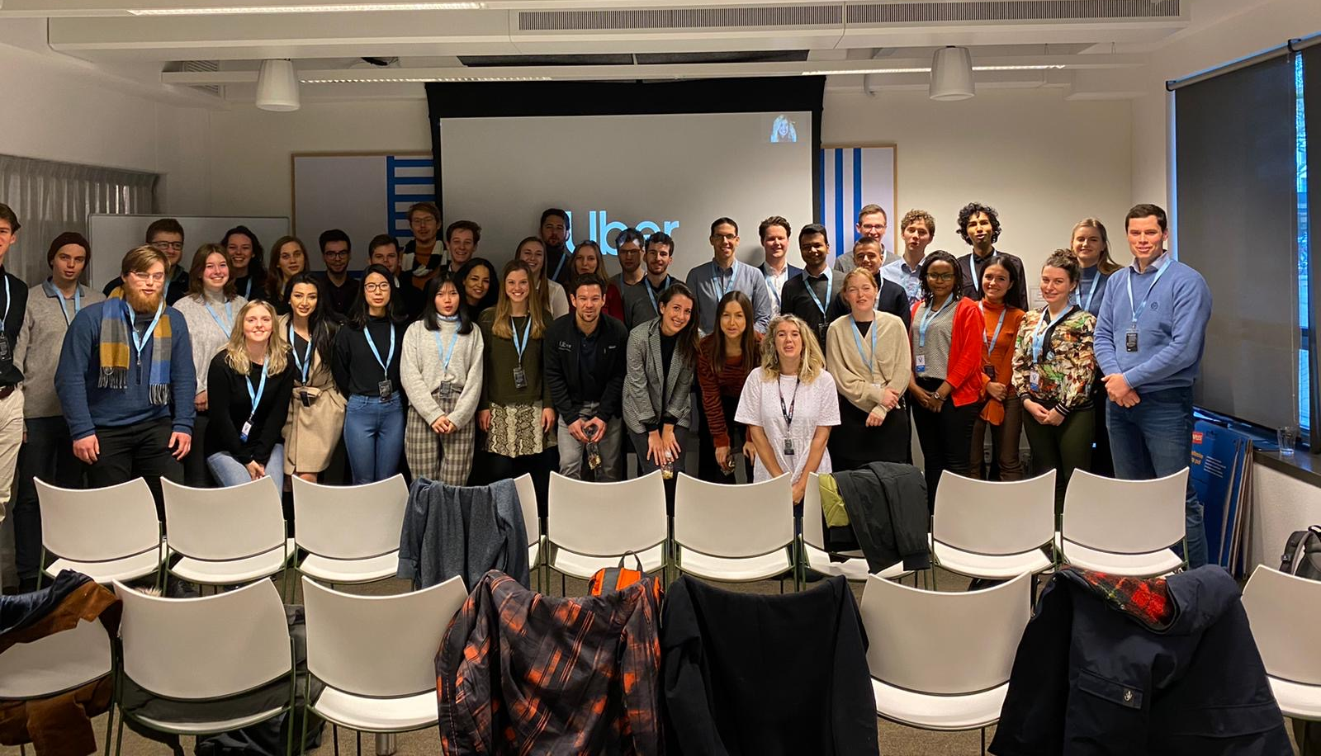
Study trips
Explore job opportunities!

Slide 18
Thesis Internship Program
Apply academic theory to a real-world business case.
Learn professional skills at a company.
Enhance your network and experience.
Kick-start your career even before graduating.

Slide 19
Teaching Environment

Slide 20
Problem-based learning
Strong Community Building
Small-scale
Active learning
Interesting discussions
Strong connection with students
Individual attention from teachers

Slide 21
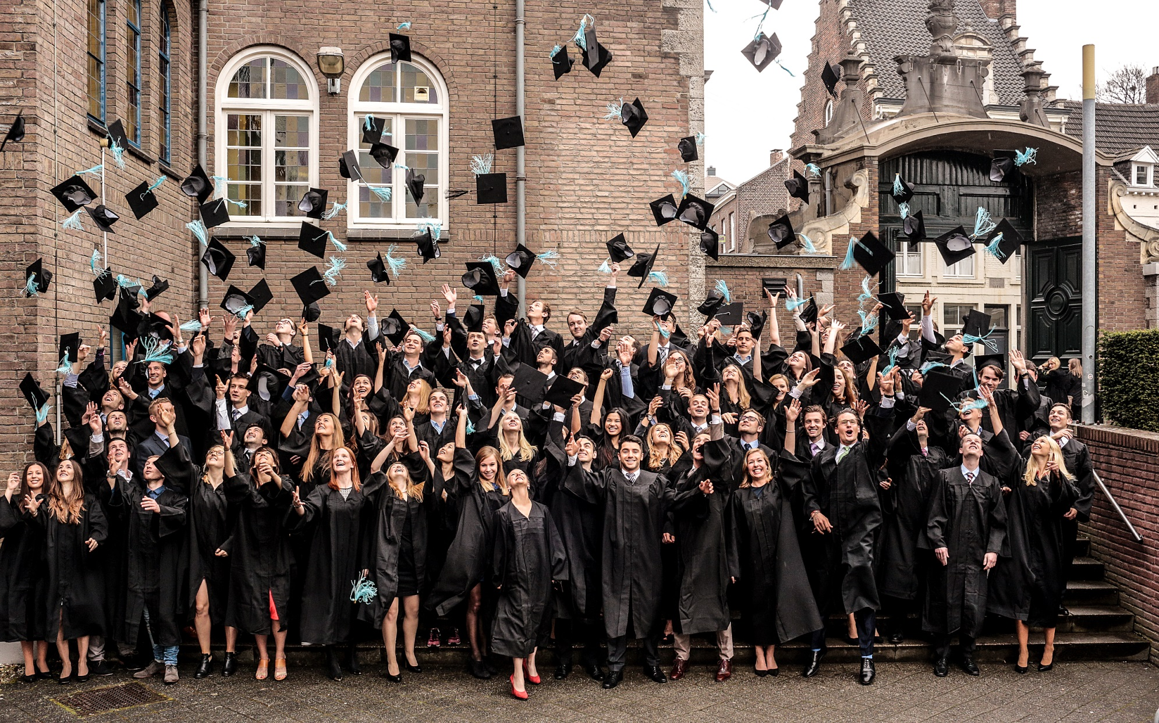
What does the future hold?

Slide 22
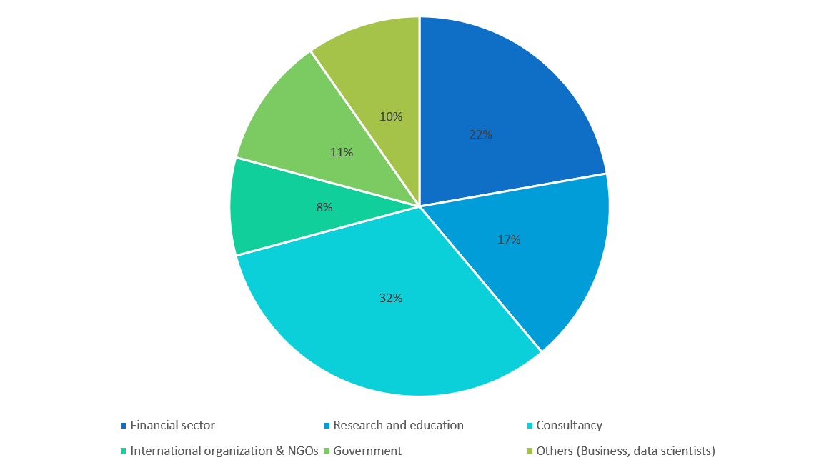

Slide 26
Questions?

Slide 27
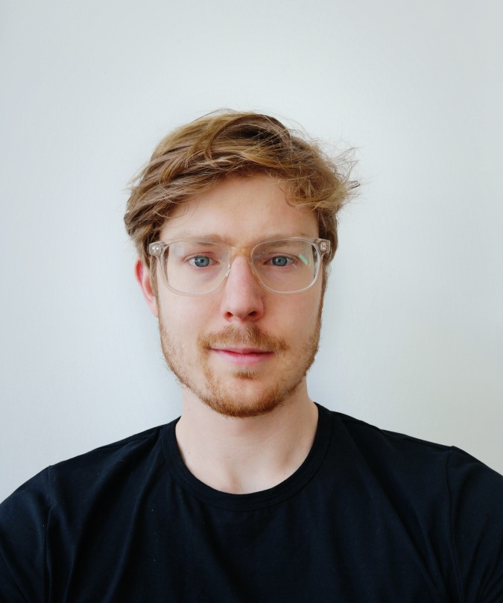
A student's perspective

Slide 28
28

Slide 29
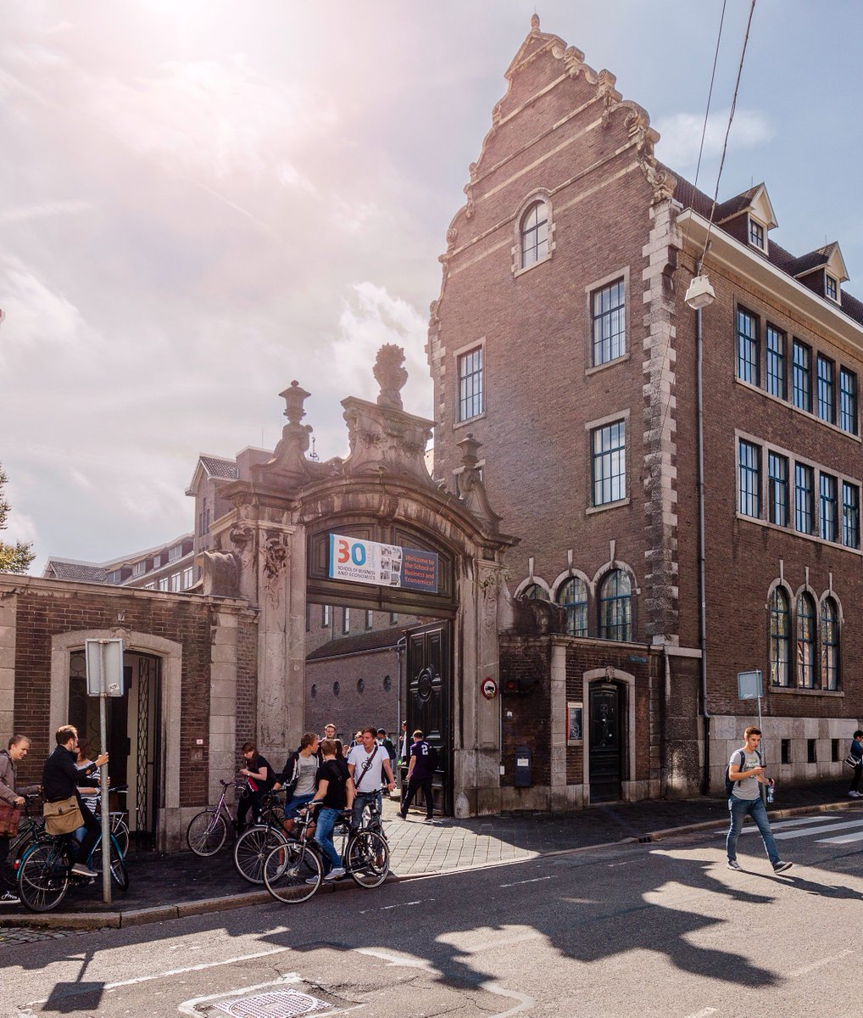
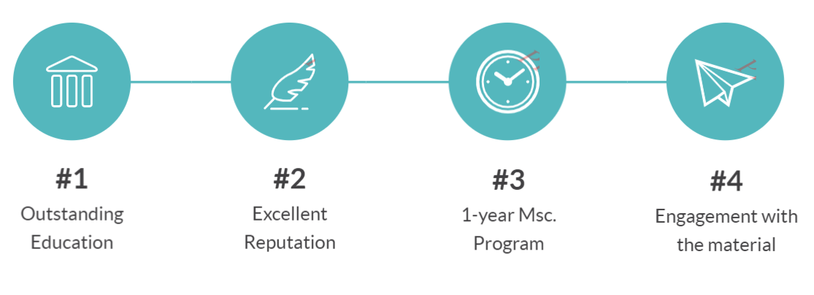

Slide 30
My experience so far
The university
The city
The community
30

Slide 31
My experience with Problem Based Learning
Learning by applying rather than memorizing.
Interesting discussions & creative thinking.
Lots of engagement and room for questions.
Complex problem solving required.

Slide 32
The Thesis Internship Program
Combining academic excellence with real world experience
Joint supervision
32

Slide 33
Double Degree Program
Two Masters: European Economics & Economics.
Université catholique de Louvain & Maastricht University
Joint supervision
33

Slide 34
Questions?

