Slide 1

MSc Business Research
Maastricht University, School of Business and Economics

Slide 2
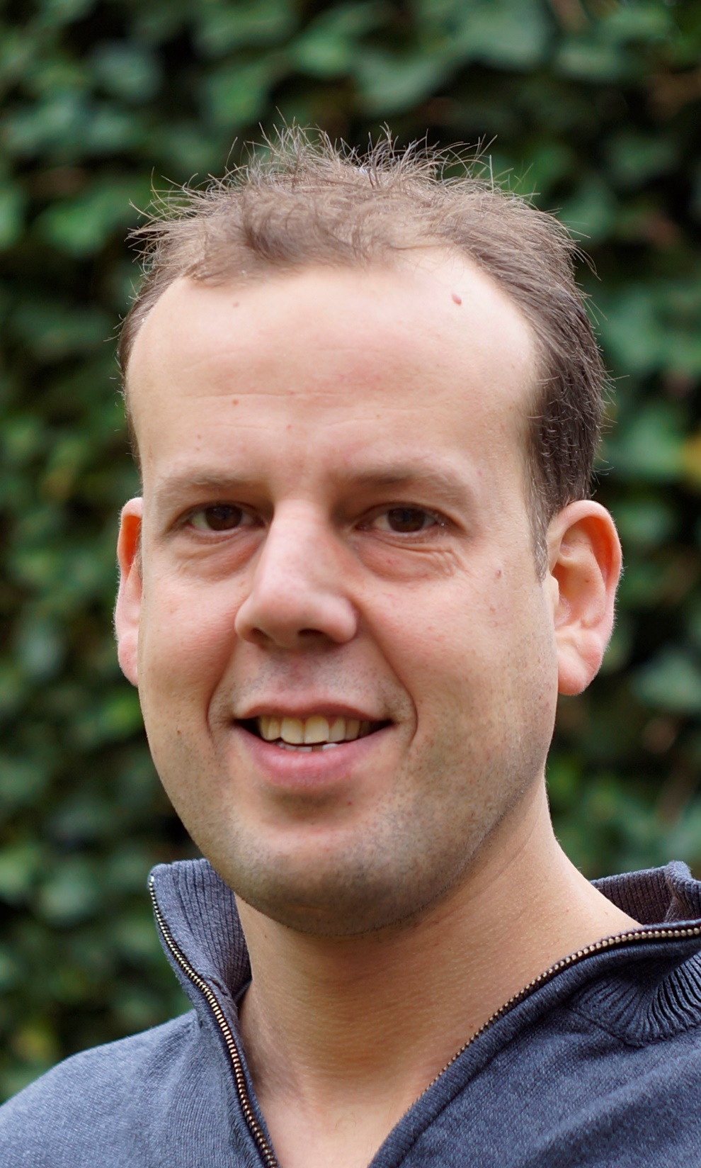
Dr. Iwan Bos

Slide 3
Today’s Agenda
Why this programme?
1
Our programme
2
What sets us apart?
3
Student Profile
4
What does the future hold?
5

Slide 4

Why this Programme?

Slide 5
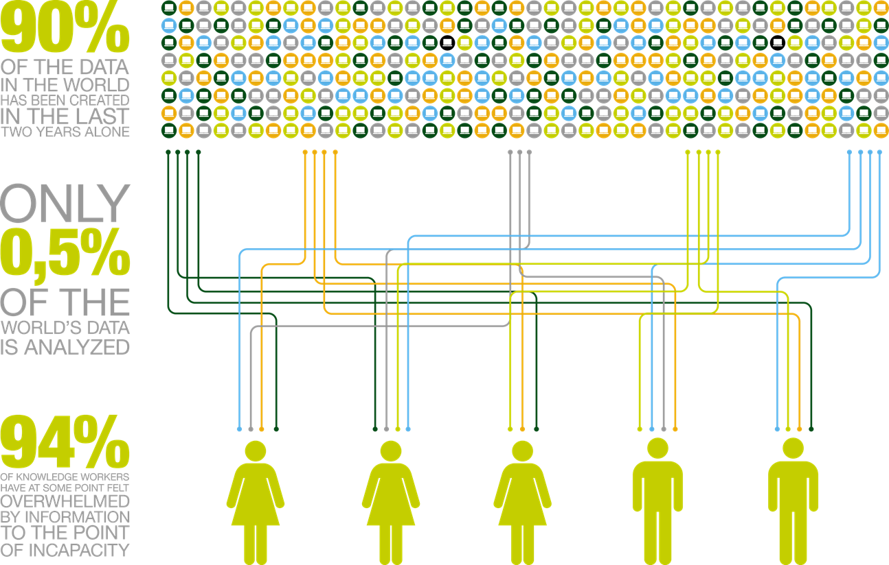

Slide 6
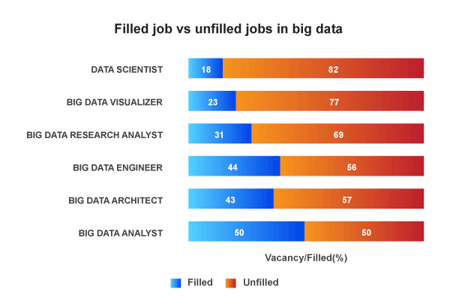

Slide 7
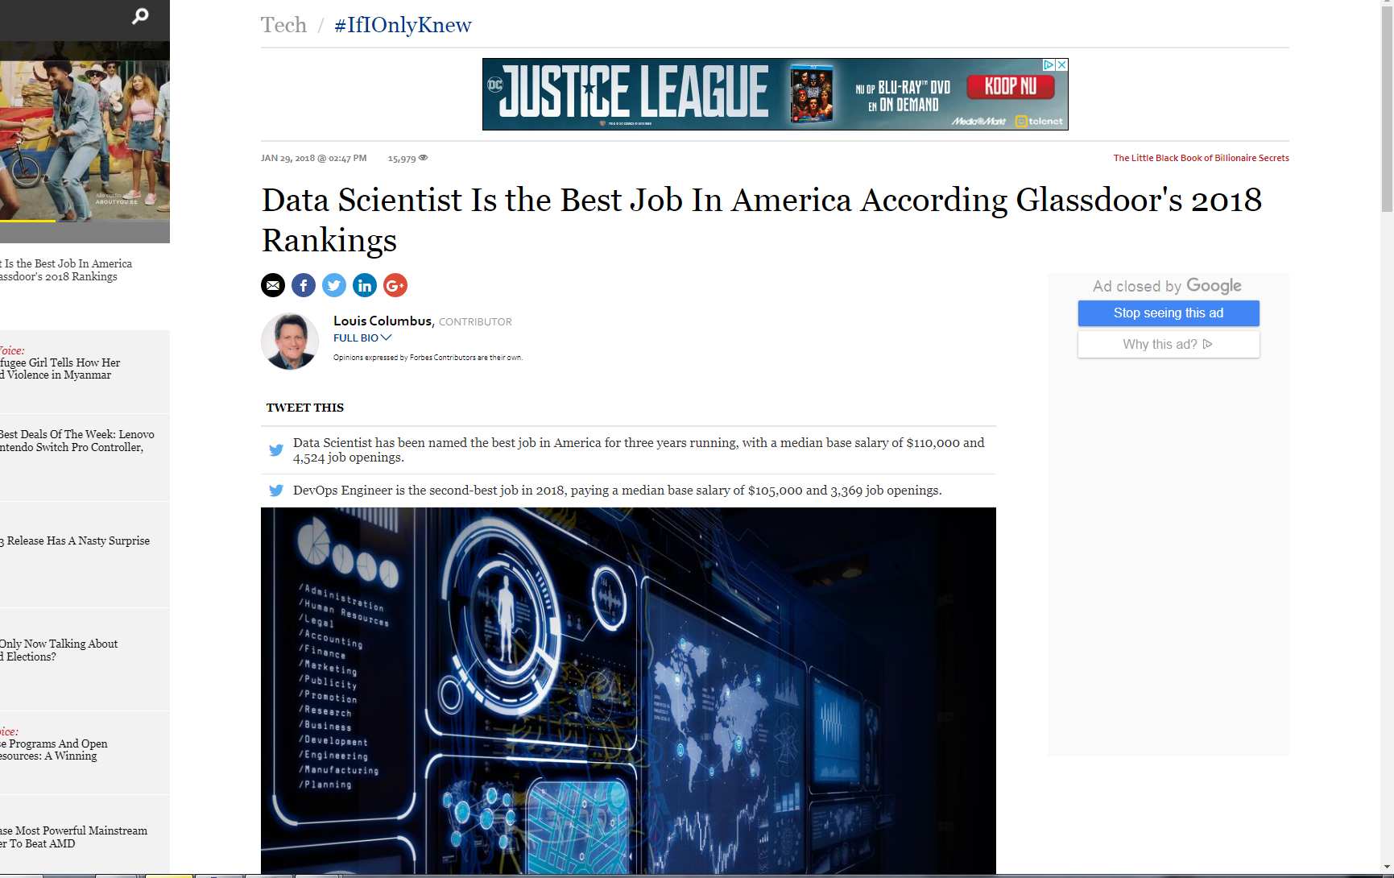

Slide 8

Knowledge Gap
IT&DATA knowledge
BUSINESS
knowledge

Slide 9

Our Program

Slide 10
Block
Business Research
Year 1
1+2
Disciplinary Business
Courses
Data Analytics
4+5
3+6
Skills Training

Slide 11
Block
Business Research
Year 1
1+2
Disciplinary Business
courses
Accountancy
Controlling
Entrepreneurship
Business Intelligence
Marketing-Finance
Org., Change & Consultancy
Corporate Finance
Marketing
Strategy & Innovation
Supply Chain Management
Sustainable Finance
1 Empirical Analysis I
2 Empirical Analysis II
4+5
4 Data Analytics in Practice
5 Business Research Strategy
3+6
Skills Training
3: Data Analysis Skills (MLE)
6: World of Research (Academic Writing)

Slide 12
Block
Business Research
Year 1
e.g. Marketing
1+2
1 IB Course (Relationship Marketing)
2 IB Elective (Return on Marketing)
1 Empirical Analysis I
2 Empirical Analysis II
4+5
4 IB Course
(Value-Based Marketing)
5 IB Course
(Innovation Management)
4 Data Analytics in Practice
5 Business Research Strategy
3+6
Skills Trainings:
Data Analysis Skills
World of Research

Slide 13
Block
Business Research
Year 2
1+2
Disciplinary Specialization Courses
Free electives / Methodology / THESIS
4+5
THESIS
Free electives / Methodology / THESIS
3+6
Skills Training:
Presentation Skills (3)
and THESIS (6)

Slide 14
Block
Business Research
Year 2
e.g. Marketing
1+2
Specialisation
1 and 2
(e.g., Services Marketing, Advanced Consumer Behavior)
Free electives / Methodology / THESIS
4+5
THESIS
Free electives / Methodology / THESIS
3+6
Skills Training:
Presentation Skills (3)
and THESIS (6)

Slide 15

What sets us apart?

Slide 16

What is the difference with a regular IB Master?
An Advanced 2-year Master’s programme
The business content is similar, but the programme includes additional advanced data science and research training

Slide 17

Additional Advantages
Top Rated Programme (Keuzegids MSc ranking 2019);
Student assistentship in the second year;
Extended MSc thesis, internship possible (TIP);
Small, selective, programme;
flexible, individual study plans
close student community
close relation to staff
Preparation for a Ph.D.

Slide 18

Student Profile

Slide 19



Passion for one of the International Business (IB) fields that we offer
Affinity with Statistics and Data
Curiosity and an Academic Mindset

Slide 20
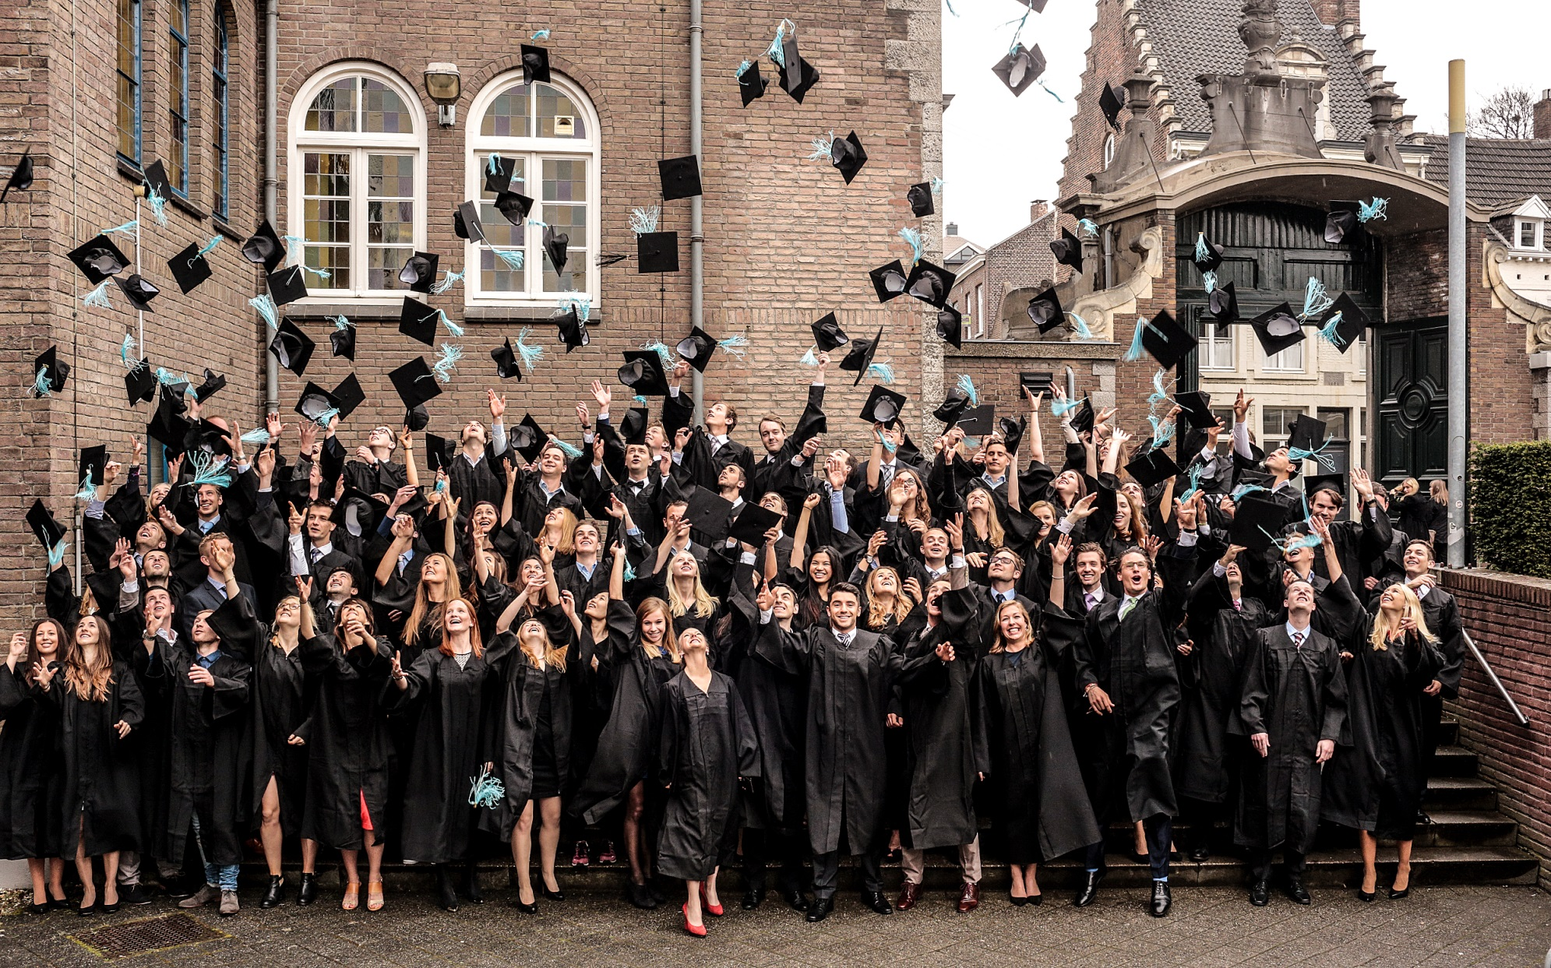
What does the future hold?

Slide 21
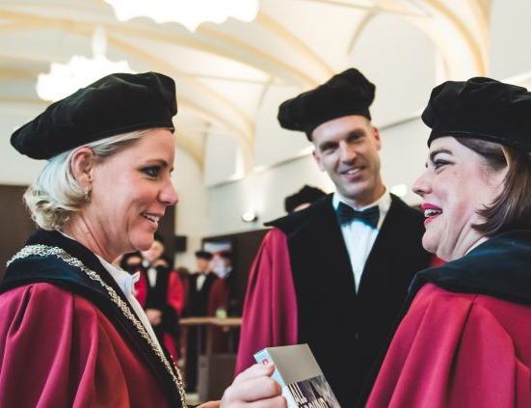
After completion of this Research Master?
Part of our graduates stay at SBE to obtain a Ph.D.
Part of our graduates go to the private sector (mainly large consultancies)
A few do a Ph.D. project in other places

Slide 22
Questions?
Contact:
gsbe-sbe@maastrichtuniversity.nl
i.bos@maastrichtuniversity.nl

