Slide 1
MSc IB Accounting and Business Information Technology (Fulltime) Accounting and Control (Parttime)
Maastricht University, School of Business and Economics

Slide 2
Today’s Agenda
What are we about?
1
Our programme
2
Student Profile
3
What does the future hold?
4

Slide 3
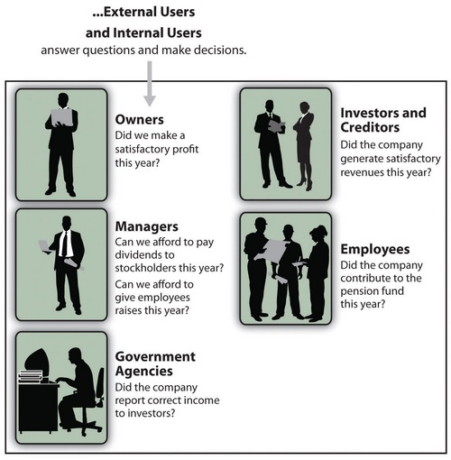
What are we about?

Slide 4
Why Accounting and Business Information Technology?
Accounting is the language of business
Become an expert in audit, assurance, corporate governance and controlling
Manage, prepare, analyze & interpret information
Find out how to prevent and detect fraud
Understand investors and providers of financial information
Communicate with stakeholders

Slide 5
Why Accounting and Business Information Technology at UM?
Practical training, development of directly applicable skills
Good preparation for postmaster programmes (to become a registered auditor (RA))
Good understanding of businesses
Excellent job perspectives
Leading in accounting research on the European continent
Strong ties with the (audit) profession
Leading among European peers in commissioned research for e.g. the European Commission

Slide 6
Our Programme

Slide 7
Block
Accounting and Business Information Technology
1
Assurance Services and Audit Analytics
Data Analytics
2
Financial Statement Analysis and Valuation
Elective
3
Skills Training:
Writing a Master’s Thesis

Slide 8
Block
Accounting and Business Information Technology
1
Assurance Services and Audit Analytics
Assurance Services and Audit Analytics
Data Analytics
2
Financial Statement Analysis and Valuation
Elective
Deepen insight on the audit process with emphasis on the use of data analytics and digital auditing, prepare for entry-level assurance work in professional accounting firms
Develop understanding of different types of assurance services, auditor behaviour, and functioning and regulation of the assurance services market
Assignments, discussion of academic research, real-life cases aimed at training practical skills
Workshop with Big4 firm on Data Analytics
3
Skills Training:
Writing a Master’s Thesis

Slide 9
Block
Accounting and Business Information Technology
1
Assurance Services and Audit Analytics
Data Analytics
Data Analytics
2
Financial Statement Analysis and Valuation
Elective
Quantitative methods for problem-solving and research in Accounting and Business Information Technology
Generate insights that improve management decision-making
3
Skills Training:
Writing a Master’s Thesis

Slide 10
Block
Accounting and Business Information Technology
1
Assurance Services and Audit Analytics
Data Analytics
2
Financial Statement Analysis and Valuation
Financial Statement Analysis and Valuation
Elective
Identifying Earnings Management and Accounting Fraud
Business Analysis and Valuation using Financial Statements
3
Skills Training:
Writing a Master’s Thesis

Slide 11
Block
Accounting and Business Information Technology
1
Assurance Services and Audit Analytics
Data Analytics
2
Financial Statement Analysis and Valuation
Elective
Elective
Choose your own course from a wide range of options
From another MSc IB Program
Or: Multidisciplinary Business Challenge
Broaden your horizon and go the extra mile!
3
Skills Training:
Writing a Master’s Thesis

Slide 12
Block
Accounting and Business Information Technology
1
Assurance Services and Audit Analytics
Data Analytics
Understand the basic requirements of a master’s thesis
Develop a high quality research proposal for a master’s thesis
Apply for thesis supervision
2
Financial Statement Analysis and Valuation
Elective
3
Skills Training:
Writing a Master’s Thesis
Skills Training:
Writing a Master’s Thesis

Slide 13
Block
Accounting and Business Information Technology
4
Advanced Financial Accounting
Writing the Master’s Thesis
5
Risk, Control, and Compliance
6
Completing the Master’s Thesis

Slide 14
Block
Accounting and Business Information Technology
4
Advanced Financial Accounting
Writing the Master’s Thesis
Preparation of consolidated financial statements in accordance with IFRS
The application of accounting methods in multinational organizations
Accounting for long-term assets and financial investments
Data analytics on the basis of accounting information
5
Risk, Control, and Compliance
Management Control
6
Completing the Master’s Thesis

Slide 15
Block
Accounting and Business Information Technology
4
Advanced Financial Accounting
Writing the Master’s Thesis
Learn about the importance of risk assessment and internal control in modern business
Discuss frameworks of internal control and how they can prevent fraud
See how control systems need to differ for different types of organizations
Apply this knowledge to real-life cases, and design optimal control systems
5
Risk, Control, and Compliance
6
Completing the Master’s Thesis

Slide 16
Block
Accounting and Business Information Technology
4
Financial Accounting
Writing the Master’s Thesis
In-depth study of an accounting problem
- Academic relevance
- Managerial relevance
- Relevance to you
Scientific study
5
Management Control
6
Completing the Master’s Thesis

Slide 17
What is the track structure? (1)
Block
Accounting & Control year 1 (parttime)
1
Assurance Services
2
Financial Statement Analysis and Valuation
3
4
Advanced Financial Accounting
5
Risk, Control & Compliance
6
* Courses are offered on Fridays.

Slide 18
What is the track structure? (1)
Block
Accounting & Control year 2 (parttime)
1
Data Analytics
2
Performance Management & Strategy Execution
3
MSc Thesis Skill
4
MSc Thesis
5
6
* Courses are offered on Fridays.

Slide 19
Student Profile

Slide 20
Be an enthusiastic team player
Have a high level of achievement
Be a critical thinker
See beyond the numbers
Have a common-sense understanding of the way organisations work

Slide 21
What does the future hold?

Slide 22
Career Prospect
(External) Auditor
Manager Internal Audit
Fraud consultant/investigator
Financial / Business Analyst
Reporting Analyst / Manager Reporting and Consolidation
IFRS Consultant

Slide 23
Alumni IB Accountancy Track
First half year
Second half year
Graduated
2 years ago
Mostly Theoretical
Opportunity:
Internship
Combine
Theory, Practice & Research

Slide 24
M.Sc. International Business –
Accounting and Business Information Technology
or Accounting and Control
& Managerial Decision-Making and Control
Postgraduate Programmes:
Registeraccountant (RA)
Registercontroller (RC)
International Executive Master of Auditing Program (IEMA)
International Executive Master of Finance & Control (iEMFC)
Qualified Member of the Chartered Institute of Management Accountants (CIMA)

Slide 25
Questions?
www.maastrichtuniversity.nl/sbe

