Slide 1
Introduction Honours Programme FHML
Juanita Vernooy & Theo de Kok - Coordinators
May 26, 2025
Maastrichtzaal 18:30 – 20:30

Slide 2
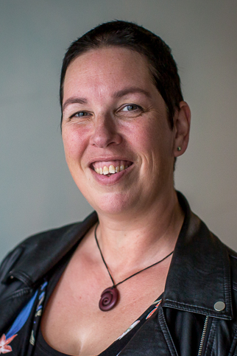
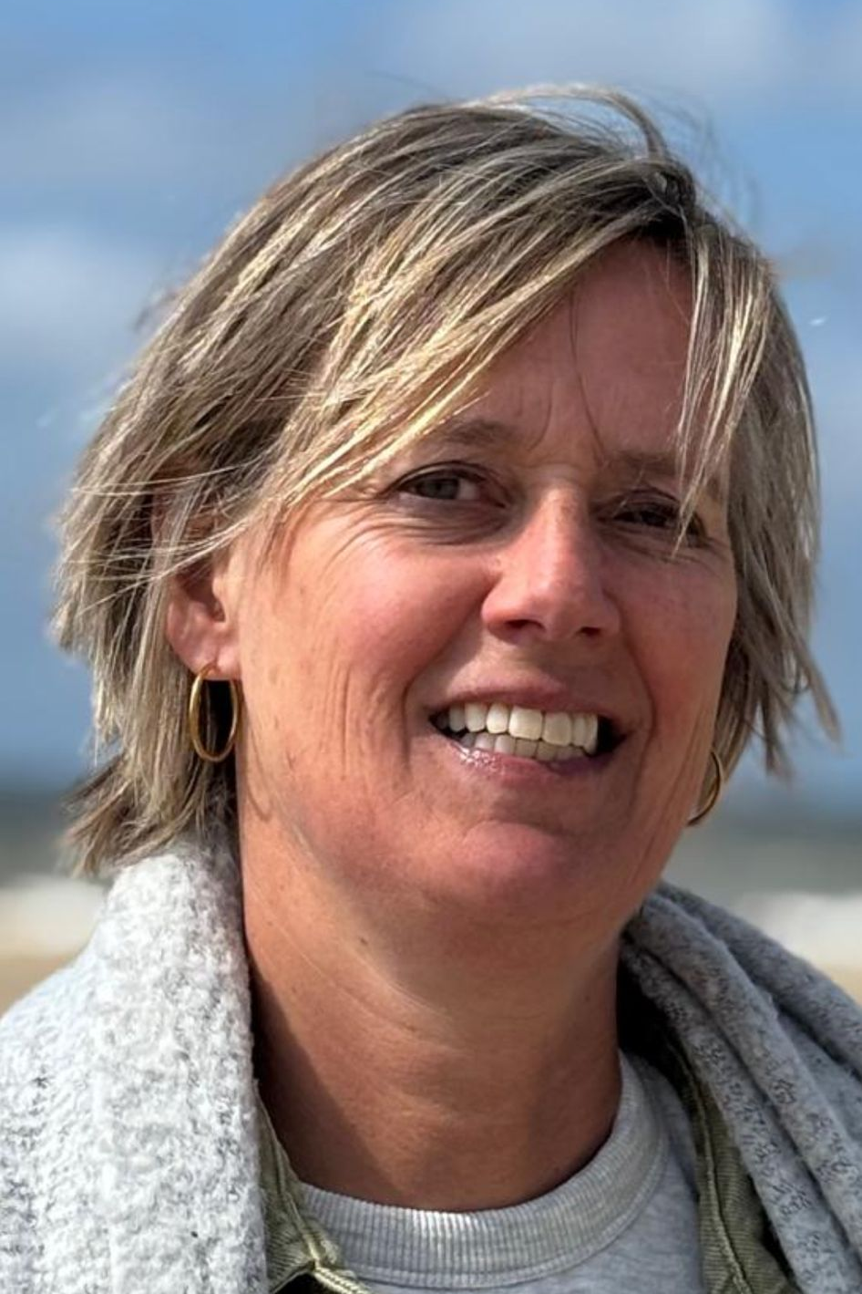
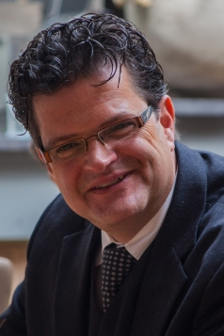
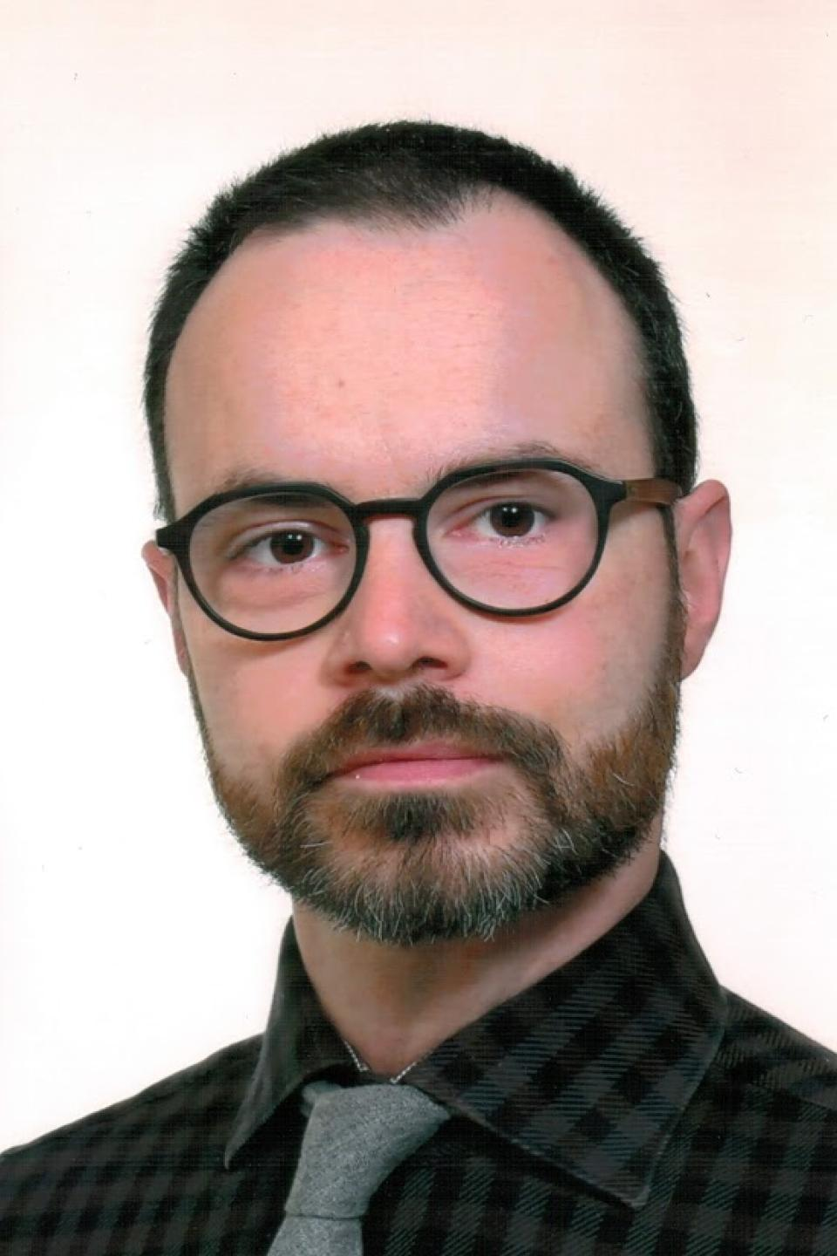
Information for potential participants
May 26th, 2025
18.30 – 20.30 hours
Maastrichtzaal
Juanita Vernooy Theo de Kok
Chair Co-chair
Ingrid Mesterom Bart Penders
Secretary Co-chair

Slide 3
Agenda
18.30 Theo de Kok Welcome
General overview Honours Programme at FHML
Competency development
18.55 Juanita Vernooy FHML Honours Programme 2025:
Selected projects | Elective courses | Application
19.15 MAAHS Presentation
19.30 Honours+ Presentation
19.40 Questions from the audience
20.15 Closure

Slide 4
Agenda
18.30 Theo de Kok Welcome
General overview Honours Programme at FHML
Competency development
18.55 Juanita Vernooy FHML Honours Programme 2025:
Selected projects | Elective courses | Application
19.15 MAAHS Presentation
19.30 Honours+ Presentation
19.40 Questions from the audience
20.15 Closure

Slide 5
FHML Honours in three words
Cohort 2018-2020
Cohort 2019-2021
CHALLENGING
TEAMWORK
…. and FUN !
Cohort 2022-2024
Cohort 2023-2025

Slide 6
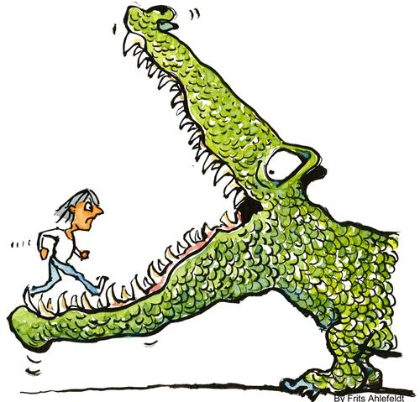
Objectives of the Honours Programme
To challenge you and all other students of FHML
To step out of your confort zone
To get involved with students from other disciplines
To work on a CV that stands out of the ordinary
To take control over your own research project
To work on a personalized set of competencies

Slide 7
General features of the Honours Programme
Open for students from ALL programmes within FHML
Project based approach:
opportunities for initiative, creativity, networking, no easy going learning
Relevant and real-life outcomes
Personalized tasks and compentency development
Budget responsibilities
Specific endproduct is not necessarily a report
3. Elective Courses and lectures:
Addressing historical, ethical and philosophical issues
Academic skills and competencies

Slide 8
Structure & study load FHML-HP
Starting mid September 2025, ending early April 2027
15 EC = 420 hours during 18 months (equivalent)
Two elements: Project (9 EC) & Courses (6 EC)
Regular project meetings with or without your coach; mostly outside regular study hours
Dedicated time slot once a month Wednesday 16.00-18.00 hours

Slide 9
Projects and competences in practice
What happens if I am admitted to the Honours Programme?
We have 11 different types of projects
You apply for a project – Top 3
You will identify your own strong and weaker competencies
Your profile will be matched against the project
You will define with your coach a “learning-working” agreement
Everybody has a personalized work plan
Everybody will be tailor-made graded

Slide 10
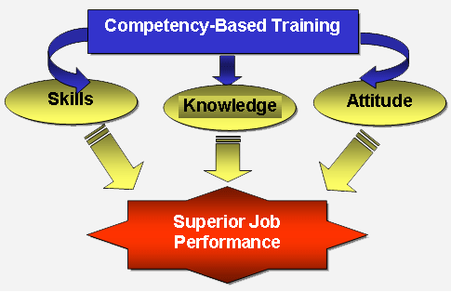
What are competencies?
Combination of Knowledge, Skills and Attitudes
Being proactive, optimistic, motivating, problems solving, critical to others, constructive ….

Slide 11
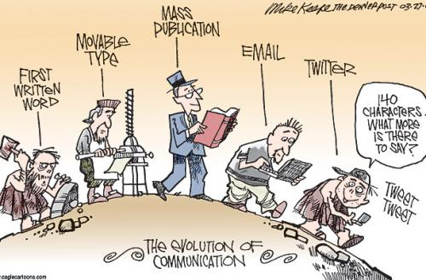
Competencies within the Honours Programme
Competence map with 3 main categories:
Project-based and result-oriented collaboration
Research and analytical competencies
Communicative competencies
Each category has 3-4 subcategories with specific criteria

Slide 12
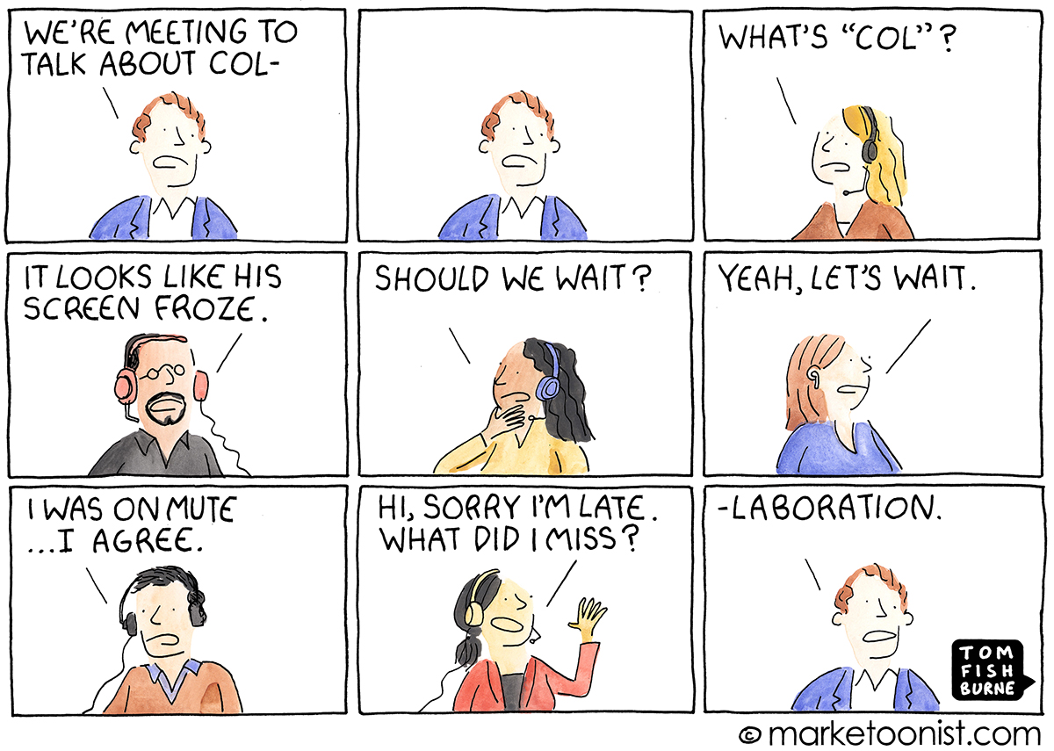
Example category 1: Collaboration
1.1 Cooperating
Definition:
Contributing with other persons or groups to a joint result, even when there is no direct personal interest in doing so.

Slide 13
Example category 1: Collaboration
1.1 Cooperating
Definition:
Contributing with other persons or groups to a joint result,
even when there is no direct personal interest in doing so.
Evaluation criteria:
- Shares information and experiences with others
- Offers colleagues help when they need it
- Contributes ideas, proposals and other input designed to achieve a group result
- Responds actively and constructively to the ideas of others
- Adapts to the group and its goals when a joint result is needed
- Bridges people’s differences and their different viewpoints

Slide 14
The ‘Learning-Working’ agreement
Everyone makes a selection of 3-4 competencies to work on
This will determine how the project work will be evaluated
Feedback on the competencies at given time points
Feedback from the coach as well as project group members

Slide 15
Agenda
18.30 Theo de Kok Welcome
General overview Honours Programme at FHML
Competency development
18.55 Juanita Vernooy FHML Honours Programme 2025:
Selected projects | Elective courses | Application
19.15 MAAHS Presentation
19.30 Honours+ Presentation
19.40 Questions from the audience
20.15 Closure

Slide 16
FHML Honours Projects 2025
6-8 students under the supervision of a project coach (FHML staff member)
Projects on innovative topics with impact in the domain of health care, life sciences or medicine
Mostly connected to an External client or Commissioner:
a company or an institution involved in health care
Procedural change: Today we announce all projects!

Slide 17
11 Honours Projects 2025
1. Dr. Rianne Fijten (Dept. Radiation Oncology - Division Clinical Data Science)
External client: Maastro
Trust and Explainability in AI for Healthcare: From Design Principles to Practical Application
2. Dr. Simone van Breda & Dr. Julian Krauskopf (Dept. Translational Genomics)
External client: MiFood
The Cross-Kingdom miRNA Project
3. Dr. Veerle Melotte (Dept. Pathology)
External Client: Brightlands Maastricht Health Campus
Colorectal Cancer Neuroscience: From Benchside Discoveries to Bedside Impact
4. Prof. Bert Smeets (Dept. Translational Genomics)
External client: Ride4Kids.nl
Recharging the batteries: Towards a treatment for mitochondrial disease

Slide 18
11 Honours Projects 2025
5. Dr. Agnes Meershoek (Dept. Health, Ethics and Society)
External client: SAM.nl & Hogeschool Zuyd
(Mental) health, work and participation: how to address health in labour participation support
6. Dr. Joost Lumens (Dept. Biomedical Engineering)
External client: Heart and Vascular Center MUMC+
Digital Twin Technology in Clinical Cardiology: From Research Tool to Patient Care Innovation
7. Dr. Virginie Joris (Dept. Cell Biology-Inspired Tissue Engineering, MERLN)
External client: Care4Bones.org
Osteogenesis Imperfecta: Better understanding for better management
8. Dr. Athina Vidaki (Dept. Genetics & Cell Biology)
External Client: Netherlands Forensic Institute
Implementation of individual repeatomics in forensic and clinical settings

Slide 19
11 Honours Projects 2025
9. Dr. Bart Spronck & Dr. Cédric Neutel (Dept. Biomedical Engineering)
External client: Tegengif.nl
Exposure of vulnerable citizens to “Forever chemicals”: Assessing PFAS pollution in the hospital
10. Dr. Sébastien Foulquier & Dr. Sven Hildebrand (Depts Pharmacology-Toxicology & Cognitive Neuroscience)
External client: Neurology Department, MUMC+
Clearing vascular dementia
11. Prof. Frits Franssen (Dept. Respiratory Medicine)
External Client: Respiratory Medicine Department, MUMC+
Lung Health Maastricht-2

Slide 20
Project 2. The Cross-Kingdom miRNA Project
Project coach: Dr. Simone van Breda & Dr. Julian Krauskopf
Commissioner: MiFood
Research question:
Can plant-derived miRNAs be detected in human blood after the consumption of specific fruits and vegetables and do these miRNAs influence molecular processes relevant to human health?
Rationale:
miRNAs are small, non-coding RNA molecules found in most forms of life that play essential roles in biological processes and disease development
MiFood promotes healthier lifestyles and longevity by simplifying the integration of vegetables-fruit-rich foods into daily routines
Plant-derived miRNAs can withstand digestion and enter the human bloodstream, sparking the intriguing hypothesis that plant miRNAs can influence human gene expression.

Slide 21
Project 2. The Cross-Kingdom miRNA Project
Assignment:
• Dietary intervention study, including development smoothie recipes rich in specific plant miRNAs, participant coordination and data collection.
• Hands-on laboratory experience, including blood collection, plasma separation, miRNA isolation and molecular analyses.
• Bioinformatics, exploring pilot sequencing data from existing datasets to identify plant- derived miRNAs and possible cross-kingdom regulation.
• Scientific communication, writing a review article summarizing current knowledge and controversies in the field.
Outcome:
Several impactful deliverables depending on the chosen focus!
Sample collection and processing and quantification of plant-derived miRNAs.
Standard Operating Procedures (SOPs) for sample handling and analysis.
Co-authorship scientific review summarizing current evidence and perspectives on the role of plant-derived miRNAs in human biology.

Slide 22
Project 11. Lung Health Maastricht - Part 2
Project coach: Prof. dr. Frits Franssen (Dept. Respiratory Medicine)
Commissioner: MUMC+
Research question:
What is the burden of respiratory symptoms, COPD and its risk factors in the city of Maastricht (different districts and neighbourhoods) and how to create public and political awareness for this disease?
Rationale:
In July 2020, Maastricht signed the Clean Air Treaty, which aims to improve air quality and improve population by 50% in 2030.
Ambient air pollution is continuously measured in Maastricht.
Association between ambient air pollution, respiratory symptoms and (pre-)COPD in Maastricht and its districts and neighbourhoods remains unexplored.

Slide 23
Project 11. Lung Health Maastricht - Part 2
Assignment
Build on the work of Honours 2023-2025.
Develop recruitment strategies covering Maastricht’s different districts and neighbourhoods of Maastricht.
Budget responsibility: crowdfunding, sponsorship and/or collaborations.
Run clinical study: recruit participants, perform assessments, collect data, analyses, draft scientific manuscript.
Create communication and implementation strategy for a healthy lungs campaign for the city to generate impact.
Outcome
Raise awareness for the prevalence, personal and societal burden of COPD and its risk factors amongst stakeholders: general population, patients, local authorities, healthcare professionals/ organisations, environmental organizations.
Create impact by (scientific) publications and presentations for stakeholders.
A healthy lungs campaign for the city of Maastricht.

Slide 24
The calendar of the Honours Programme
Divided in four periods:
Three weeks of introduction Oct 2025
Project and Elective Courses Nov 2025 – Jan 2027
Finishing off project Jan 2027 – Mar 2027 (report, presentation, article, etc)
Closing Ceremony: presenting results Apr 2027
Extra opportunity:
- Start UM Honours+ Nov 2025
- Finish UM Honours+ May 2026

Slide 25
Elective Honours Courses (6 EC - 140 hours)
Objectives:
Expanding your intellectual horizon
Out of your comfort zone
Gaining specific academic skills
Study load:
You need to obtain (at least) 6 EC: 1 EC = 28 study hours
1 EC: Mandatory course Discover your Competencies
4 EC: You can choose from a panel of Electives Honours Courses
1 EC: Attend 5 scientific lectures to obtain 5 Lecture Points
Participating in UM-wide Honours+ Programme means exemption from 3 EC Elective courses

Slide 26
Examples of Elective Honours Courses (1)
Entering the world of the Scientists (2 EC)
- in collaboration with FASOS
Reading books in History and Philosophy of HML (2 EC)
- reading & in depth discussion about a specific topic
Science for Society (1 EC)
- organizing a discussion evening for general public about a specific topic
Qualitative Research (1 EC)
- ins and outs about qualitative research

Slide 27
Examples of elective Honours Courses (2)
Scientific Reporting and Communicating (1 EC)
- how to use word, excel, powerpoint in scientific context
Scientific writing (1 EC)
- how to write & submit a scientific publication
Basic Introduction into Clinical Research (1 EC)
- ins and outs of submitting an METC application
SELF (1 EC)
- lecture series about Lifestyle and Food
Nominate an external course (max. 1 EC)
- send a request to the coordinators and receive credits

Slide 28
Selection procedure
The Honours Programme is open for all FHML students and students of Midwifery Education and Studies
>> nominal study results
2. Students are admitted only if they:
can participate fully in the first three months of the programme and
can participate in the year 2025-2026 for at least 9 months* and
can participate in the final stage of the project in 2027
3. The coordinators of the Honours Programme are responsible for the selection of candidates
* Exceptions like a Minor abroad can be discussed

Slide 29
How to apply?
All students (except Midwifery*) send the application to
askfhml@maastrichtuniversity.nl or use the askfhml contact form
2. Enclose the following items:
Motivation letter (max 1.5 A4)
Curriculum vitae incl. skills
Transcript of the results of your 1st year of study
Contact details incl. Student ID-number & mobile phone number
* Students of the University of Midwifery Education and Studies can apply via: honoursfhml@maastrichtuniversity.nl

Slide 30
How to apply?
3. Deadline for application is Friday 20th of June 2025 at 23:59h
Provisional admittance will be announced in the 2nd week of July 2025
Final admittance or rejection will be announced at the end of August 2025 after receiving the results of the Board of Examiners

Slide 31
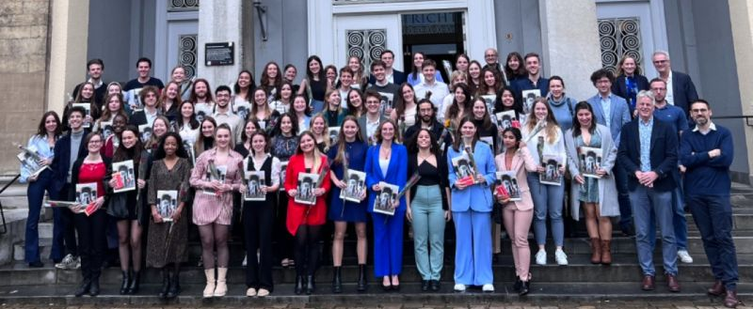
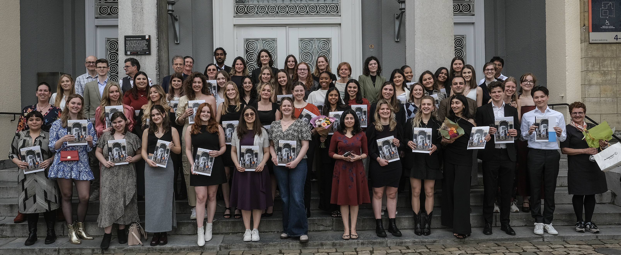
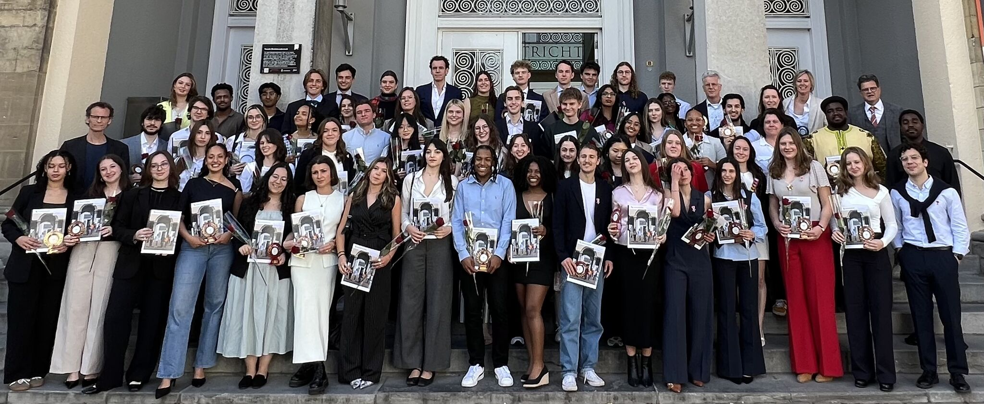
We challenge … YOU … just like
Cohort 2021-2023
Cohort 2022-2024
Cohort 2023-2025
… to join us!

Slide 32
Agenda
18.30 Theo de Kok Welcome
General overview Honours Programme at FHML
Competency development
18.55 Juanita Vernooy FHML Honours Programme 2025:
Selected projects | Elective courses | Application
19.15 MAAHS Presentation
19.30 Honours+ Presentation
19.40 Questions from the audience
20.15 Closure

Slide 33
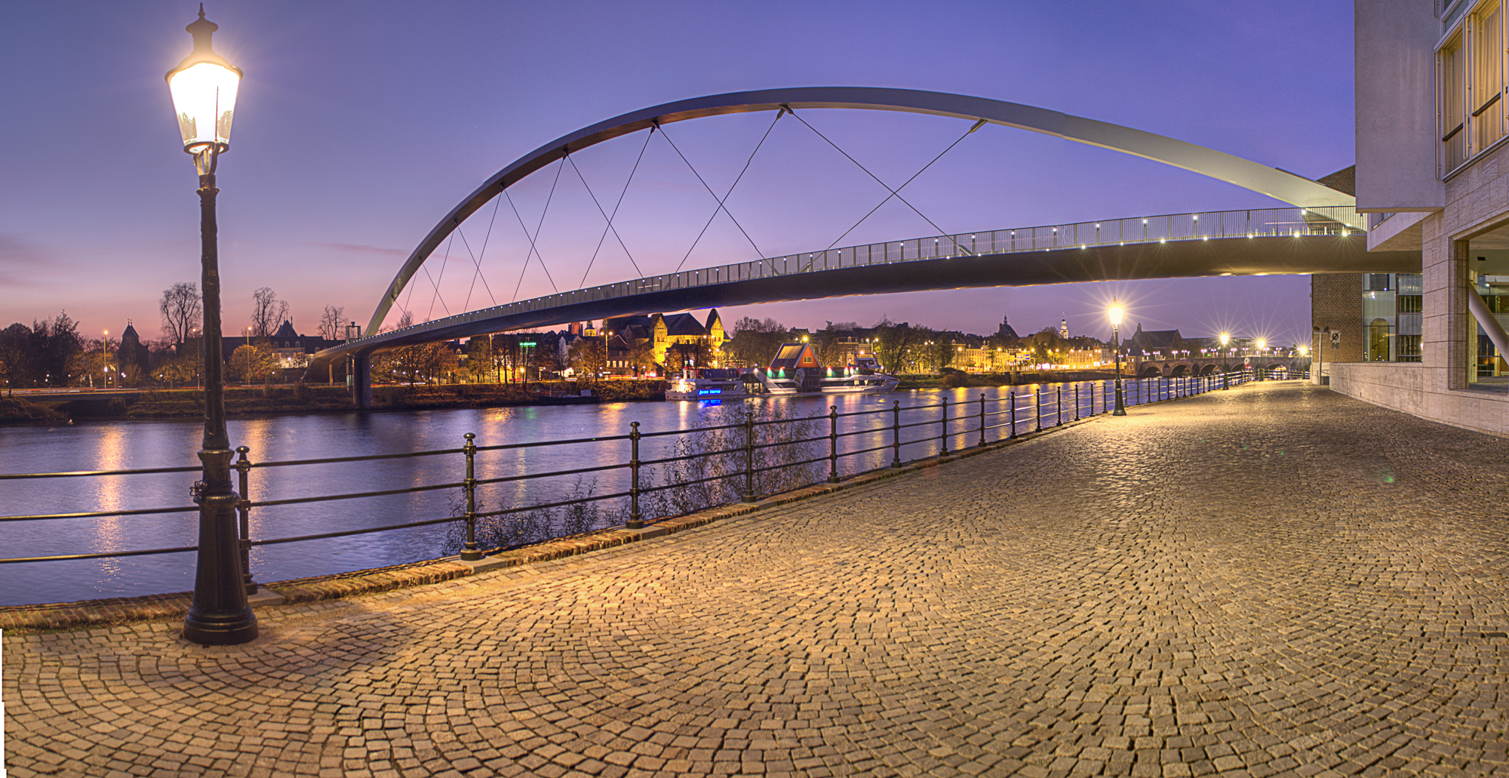
MAAHS
Maastricht Association of Alumni and Honours Students
You become a member!
Organizing fun and educational activities for all honours and alumni students:
Introduction period
Labtour
Pubquiz
Events
Graduation
… and much more!
E-mail: Maahs-fhml@maastrichtuniversity.nl
Facebook: MAAHSFHML
Notes:
Hello everyone and welcome to this info evening in the name of MA(A)HS! My name is Riva, I am on the board of MA(A)HS and I will give you a short introduction of who we are and what we do.

Slide 34
Agenda
18.30 Theo de Kok Welcome
General overview Honours Programme at FHML
Competency development
18.55 Juanita Vernooy FHML Honours Programme 2025:
Selected projects | Elective courses | Application
19.15 MAAHS Presentation
19.30 Honours+ Presentation
https://www.youtube.com/watch?v=GpH5SUo4d0U
19.40 Questions from the audience
20.15 Closure

Slide 35
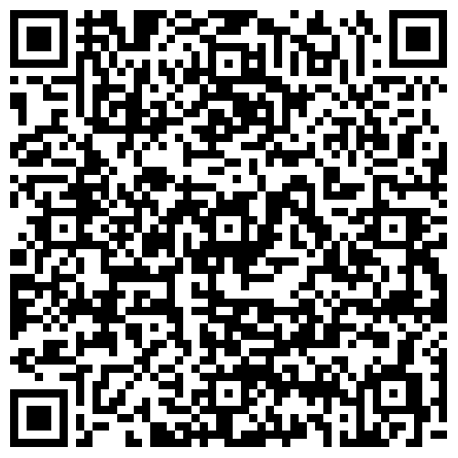
Agenda
18.30 Theo de Kok Welcome
General overview Honours Programme at FHML
Competency development
18.55 Juanita Vernooy FHML Honours Programme 2025:
Selected projects | Elective courses | Application
19.15 MAAHS Presentation
19.30 Honours+ Presentation
19.40 Questions from the audience
20.15 Closure

