Slide 1

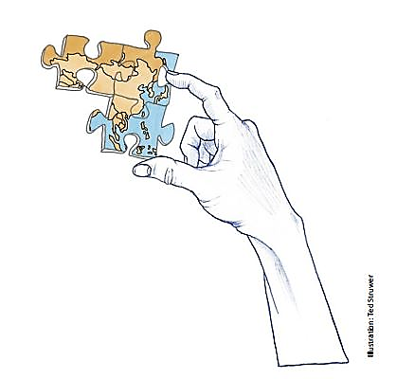
Global Citizenship Education
Student Projects
2020-2021

Slide 2
Hackathon – About us
WHAT?
* Tuberculosis - an infectious disease that affects the lungs
Common symptoms: malaise, fever, weight loss, coughing, night sweats and fatigue
WHO?
Risk groups: homeless, drug and alcohol addicted and HIV-infected people
Common in low to middle class income countries, rarely in Western countries
WHY?
2018: 10 million new cases and 1.5 million deaths, leading in worldwide death cause
THE PROBLEM?
Antibiotic resistance, especially in Pakistan, Sub-Saharan Africa, India and South Africa
Few new research - drug makers are unwilling/ unable to fund development costs

Slide 3
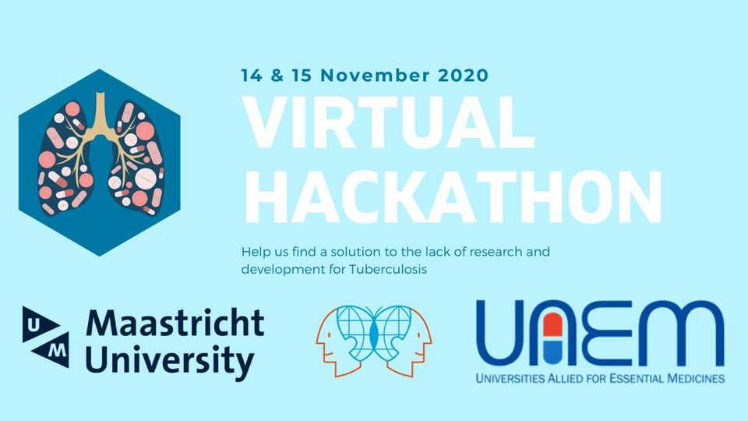
Hackathon – Final Outcomes
Aim: Come up with ideas to make Tuberculosis drugs more available and affordable
Hackathon - young talents generate fresh solutions to challenges by brainstorming
Participants compete within multi-disciplinary teams and pitch their final ideas to a jury
A workshop on pitching – aims to improve
the presentation skills
A 2-day virtual event
Team building activities
A yoga session to support creativity
Rewards for the best ideas

Slide 4



ReDonate – About us
We are a student run organization out of Maastricht.
We provide microfinancing in the developing world.
How we do this?
SMALL DONATIONS
€5 gets you a large coffee in
the Netherlands.
But €5 can stretch much
further in other places.
SMALL LOANS
Giving loans allows us to re-use your donation to help more people. Over and over again.
BIG IMPACT
Thanks to you, ReDonate can help people all around the world. Have a look at our projects.
https://redonate.org/

Slide 5
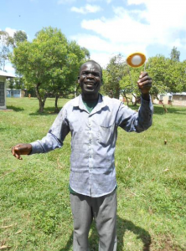
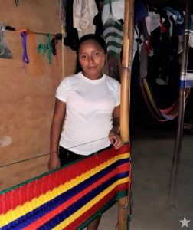
ReDonate – Projects Investment
Protus from Kenya
1.050$
Protus represents his lending group of 13 farmers. With the loan, Protus and the other farmers had the opportunity to buy maize seeds, fertilizers and solar light. In total they plant 12,5 acres of land.
Maribel from El Salvador
600$
Maribel has a small shop selling weaved products. The loan helped her to strengthen her inventory and increase her business. She managed to employ workers and pays fair wages. The living conditions of her family have steadily improved.
https://redonate.org/

Slide 6



ReDonate: Our Final Outcomes & Future
Grew from 2 people to 9 people
Microfinanced 10 projects
Will improve marketing: clarify the concept of ReDonate
Will do more networking: become more embedded in UM network
https://redonate.org/

Slide 7
Study Connect – About us
Aim: Study financing for EU students in the Netherlands
The application conditions for Studiefinanciering are outlined on the DUO website
You must:
Be an EU/EEA national
Be properly registered in the Netherlands
Work in the Netherlands
Have a valid working contract that starts at the first of a new month
Have an income from this particular job
Work at least 56 hours a month
https//56hourrule.nl/

Slide 8
Study Connect – Our Outcomes
The 56-hour criteria is contradicting EU law: Our Survey: Over 170 respondents in 2 weeks
93.6%
Want issues related to the 56 hour rule to be pursued
85.5%
Receiving Studiefinanciering would benefit, help or remove an existing financial burden/obstacle to attaining their studies
79.2%
Do not think that they could balance 56h/month of employment parallel to their studies
Would apply for Studiefinanciering if the 56 hour criteria would be replaced by just a general requirement of employment
56h/month of employment could hinder their study success or increase the chances of a study delay
https//56hourrule.nl/

Slide 9


Study Connect Our Future Perspectives
More about us: 56hourrule.nl

Slide 10
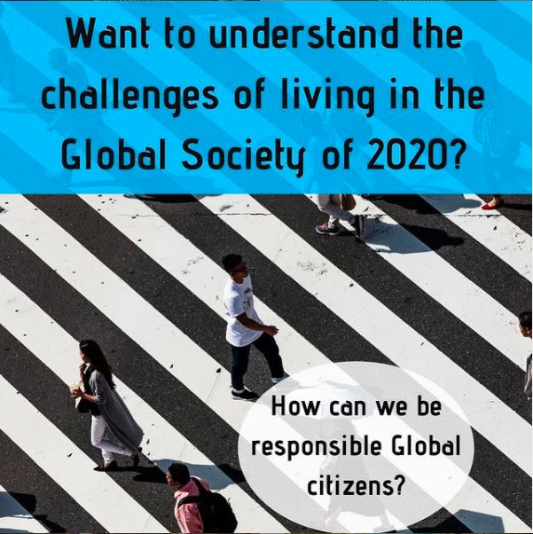
Interdisciplinary Social Justice - About us
“ How has globalization impacted these studies?
Is it even possible to be socially responsible in this new, changed world? “
We provide extracurricular courses that complements your studies
Module 1: 5 sessions in November 2020
3 different domains: Health, Politics & Philosophy
https://www.instagram.com/maastrichtforclimate/

Slide 11
Interdisciplinary Social Justice
Results Module 1
https://www.instagram.com/maastrichtforclimate/

Slide 12
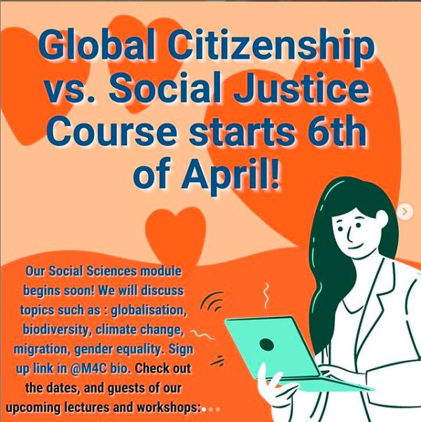
Interdisciplinary Social Justice
Our Future: Module 2 Social Sciences
7 expert sessions:
Acting as a global citizen: lifestyle vs activism
Indigenous and Religious Views on Animals and Nature
Migration, climate, refugees
Individual empowerment and global challenges
Cultural diversity as the glue for global social cohesion
“Why nature is our best professor“
Gendered Language in Recruitment: Why It Matters
https://www.instagram.com/maastrichtforclimate/

Slide 13

Young Global Thinker: About us
YGT is an international organization founded by students of UM and several German Universities during the pandemic
>> Our goal is to connect and empower young people around the globe by means of an online community
What does youth empowerment entail?
Community – To make people feel at home and find support.
Personal Development – Access to information, new skill and experiences.
Creation – A space for people to start initiatives
Do you want to stay in touch? Web: www.youngglobalthinker.org
Follow us! Instagram: @youngglobalthinker
Email: contact@youngglobalthinker.or

Slide 14
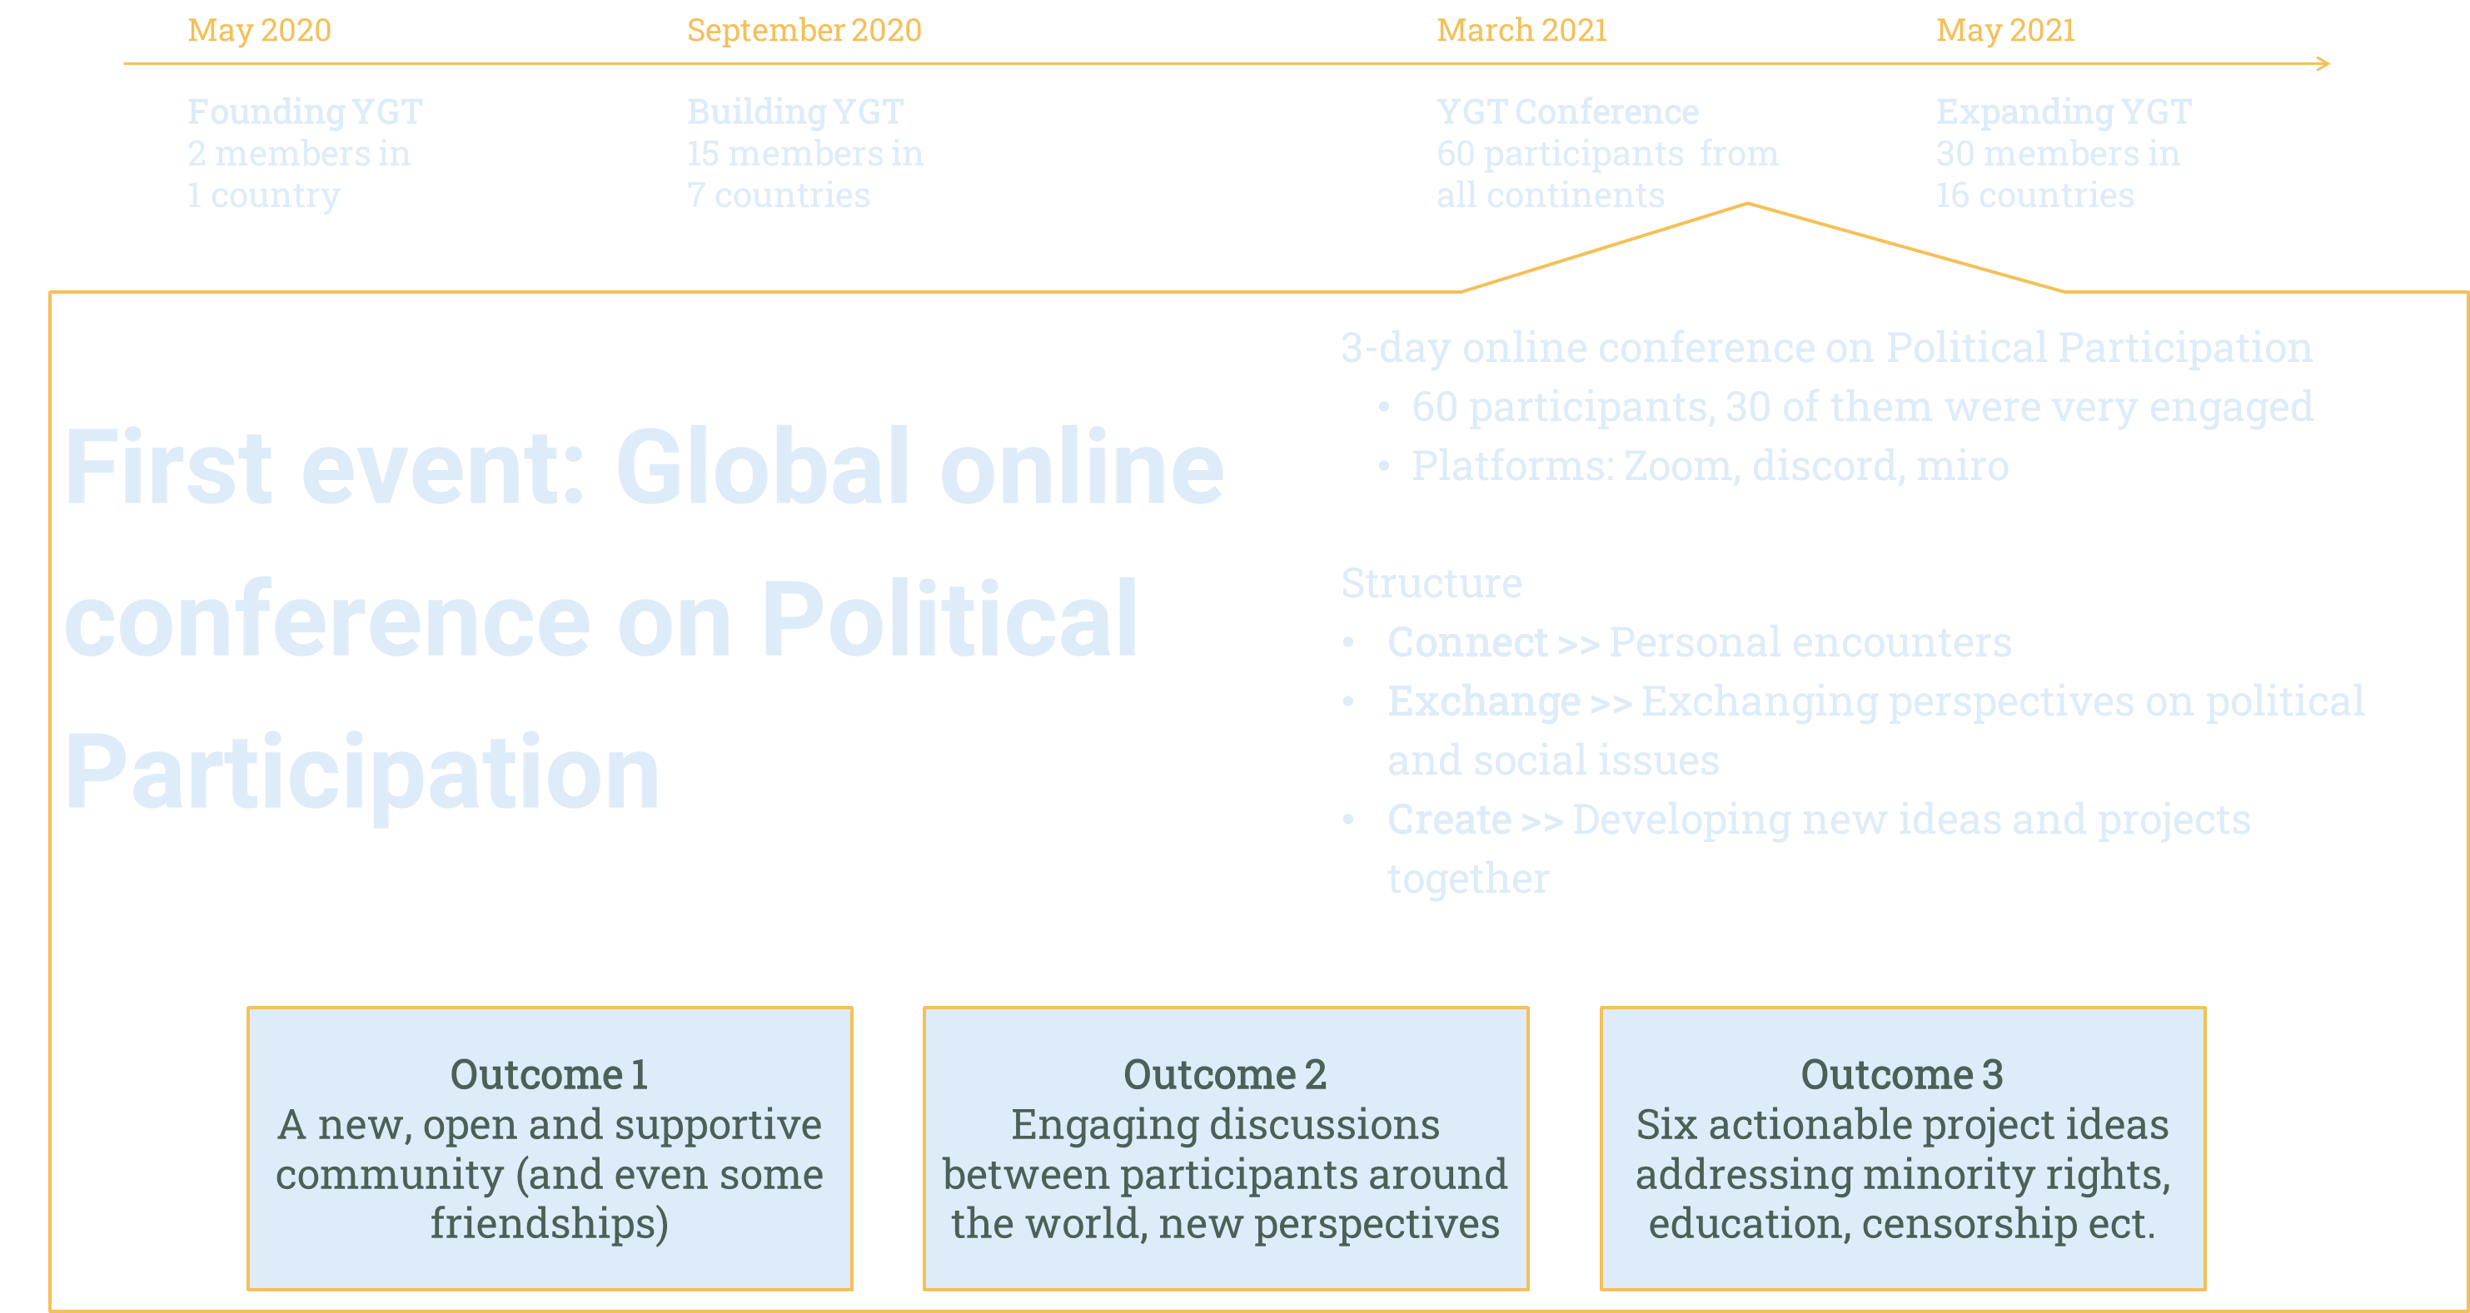

Slide 15

Young Global Thinker: Past & Future
How did it go?
What’s next?
Our team was too small for such a big event:
Most members were overworked
We did not have the capacity to plan further ahead
We need to foster/ keep up the community spirit more actively on discord and through events
>> We are proud of what we’ve accomplished and are excited to continue!
Next Events:
Community building “Cultural Night”
Skills workshop “How to deal with fake news?”
Expand YGT community on Discord
Settle legal status
Increasing outreach via social media
Do you want to stay in touch? Web: www.youngglobalthinker.org
Follow us! Instagram: @youngglobalthinker
Email: contact@youngglobalthinker.or

