Slide 1
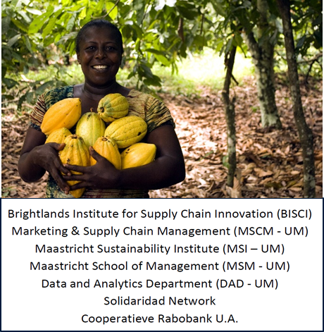
Fair and Smart Data (FSD) – the Currency for Global Sustainability
Fair and Smart Data – webinar 08.12.21
Create a Better World on a Liveable Planet
Ron Cörvers
r.corvers@maastrichtuniversity.nl

Slide 2
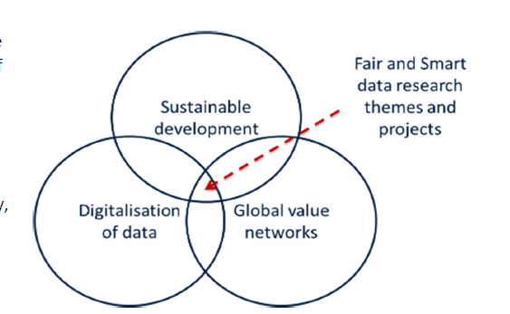
FSD spearhead
School of Business and Economics, Maastricht University 2021
Challenge-driven transdisciplinary (action-) research
To innovate global value networks through new forms of data-governance, shared value creation, and fair distribution of value
Work on real-world cases in the pursuit of sustainable development for all, in particular to improve living conditions and livelihood assets of smallholder farmers in the Global South

Slide 3
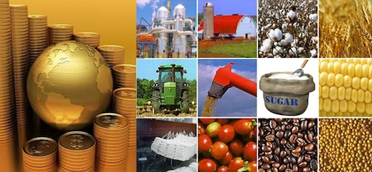
Smallholder farmers
farm size < 2 ha
450-500 million small farms (85% of the world’s farms)
these farms support partly or completely ca 2.2 billion people
economic, social, and environmental problems and challenges
fluctuations in (global) market prices, access to markets/capital, economic situation farm, poverty, etc.
level of organization/education, access to information/expertise, bargaining power in value chains, etc.
climate change, soil degradation, use of pesticides and fertilizer, changes in ecosystems, biodiversity loss, etc.
lowest value receiver in
global commodities chains

Slide 4
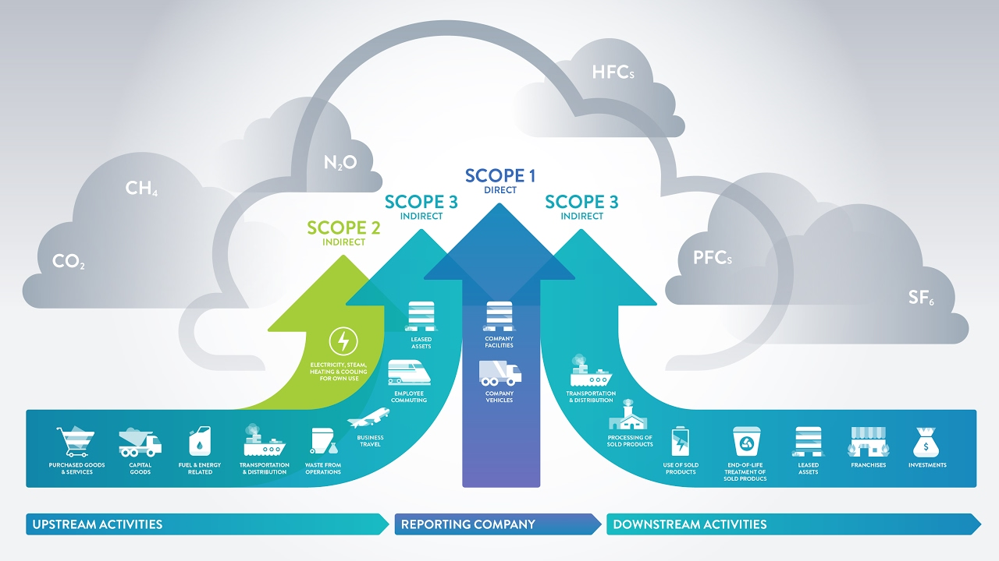
Data-technologies & new business models
in the world of smallholder farmers data does not play a major role
other actors in the supply chain collect data for their own purposes
data-technologies and new business models to improve social and environmental sustainability, next to economic prosperity
carbon markets for smallholder farmers by using agroforestry practices and enabling data-technologies (e.g. Rabobank’s ACORN)
scope-3 GHG emissions
and value of CO2 data

Slide 5
bold and refreshing point of view …
Notes:
RC

Slide 6
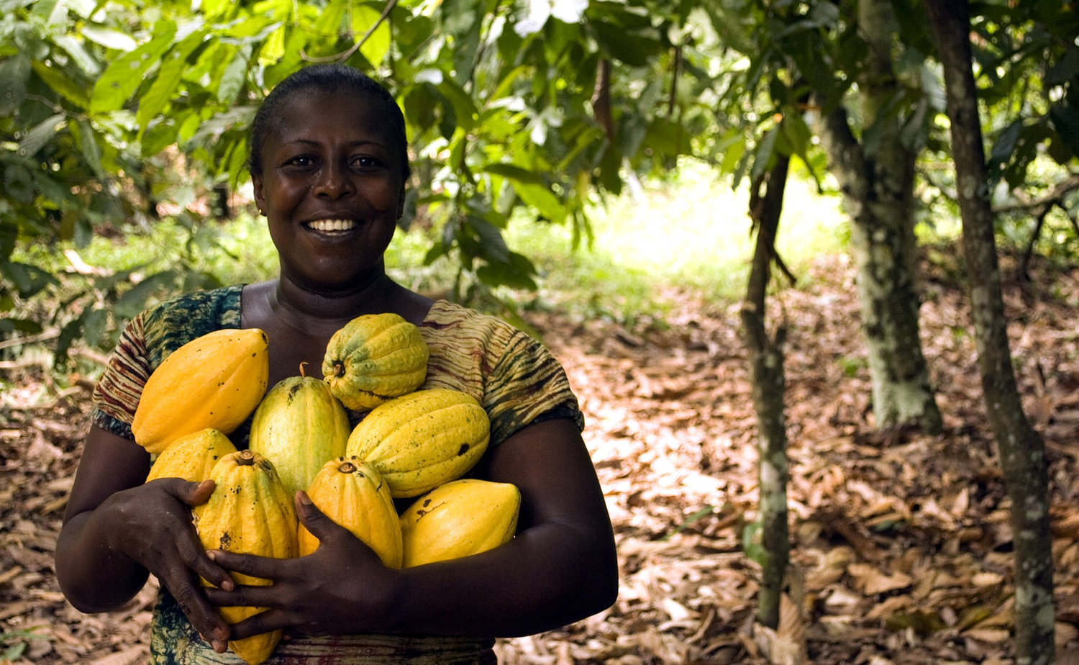
Fair and Smart Data – vision & mission https://www.maastrichtuniversity.nl/research/fair-and-smart-data-currency-global-sustainability
smallholder farmers are at the bottom of the value chain and receive the lowest value
data-technologies & new business models as drivers
to create fair value (returns) for smallholder farmers
improve living conditions and livelihood assets
working on sustainable development for all

Slide 7
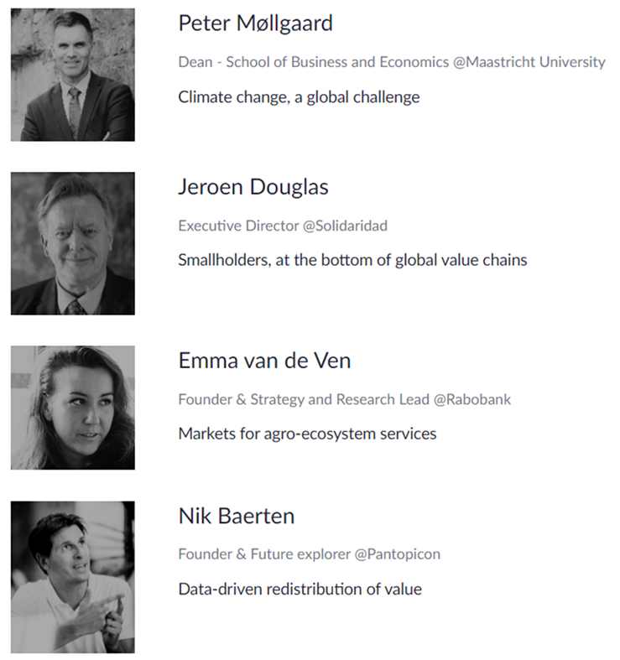
Today’s speakers (09:10-10:30)

Slide 8
Today’s workshops (10:45-12:30)
How to engage smallholder farmers in sustainable farming & land-use practices?
How to deliver value to smallholder farmers by implementing sustainable practices?
What is the role of multinationals in promoting sustainable practices at smallholder farmer's level?

Slide 9
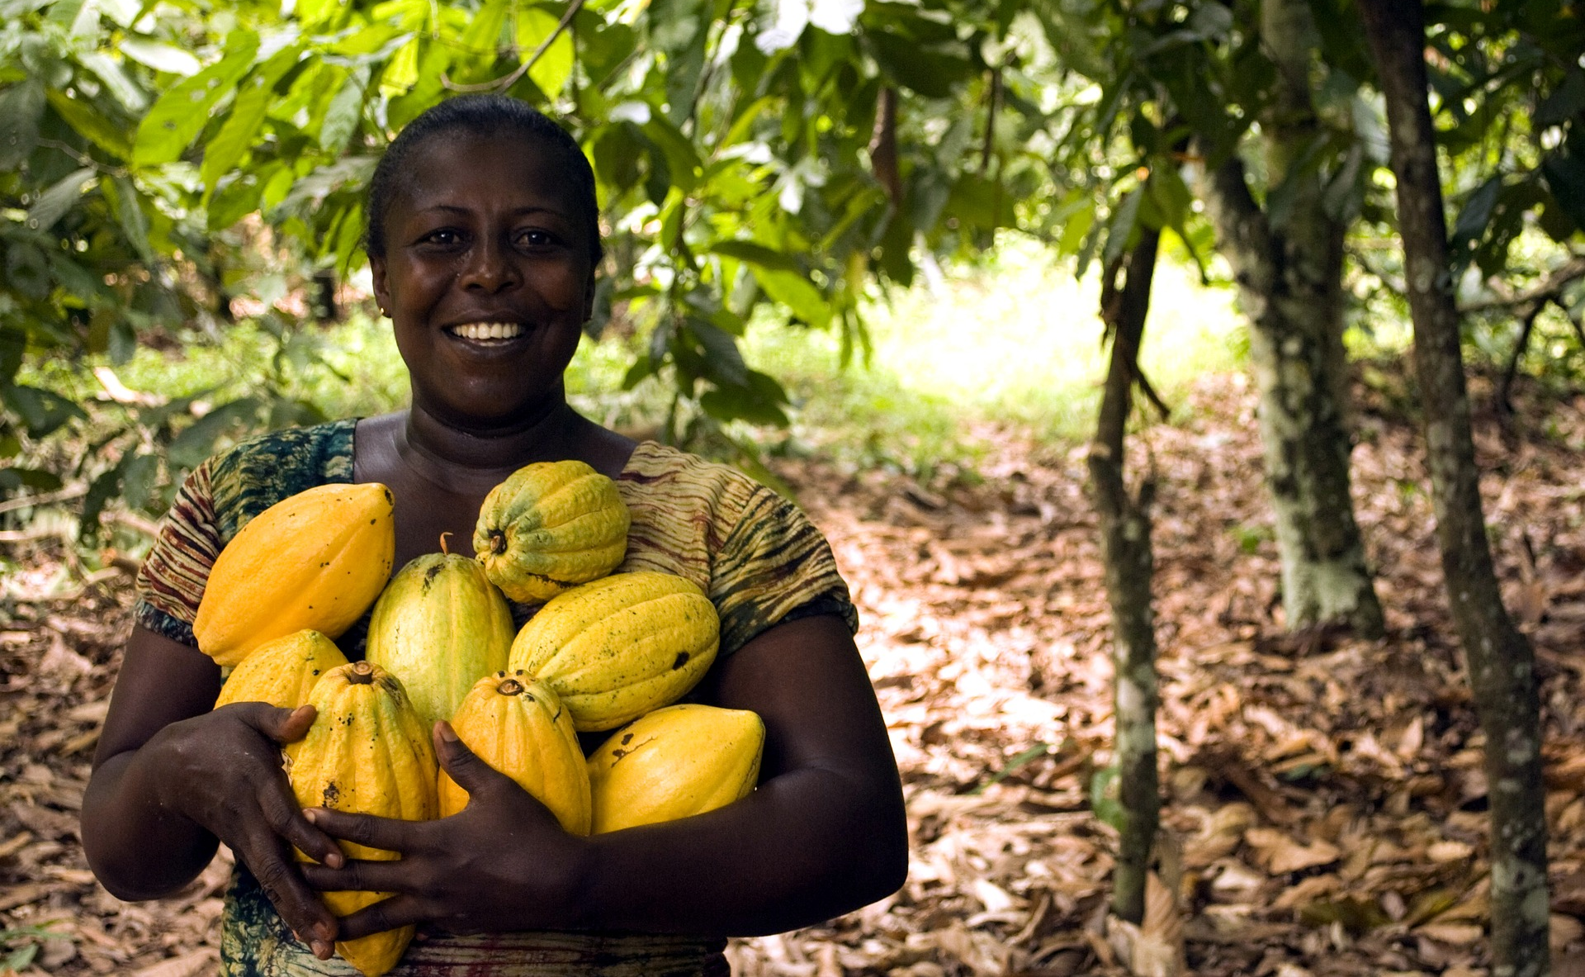
Together for Fair and Smart data!
The FSD research agenda is geared towards 3 interrelated themes:
1. Smallholders: studying the value distribution in global supply chains of agricultural commodities, with a focus on smallholders in the Global South
2. Agro-ecosystems: studying the payments for agro-ecosystem practices, with a combined focus on food production, carbon farming, and biodiversity
3. Digitalisation: studying the digitalisation of farming-related (carbon) practices, with an emphasis on the empowerment of smallholders
https://www.maastrichtuniversity.nl/research/fair-and-smart-data-currency-global-sustainability

