Slide 1
Learning Task Experience Day Medicine

Slide 2
Case
During an intense workout session, you notice that your heart starts beating faster and that your leg muscles begin to ache. You start remembering your biology lesson about the heart and blood pressure.

Slide 3
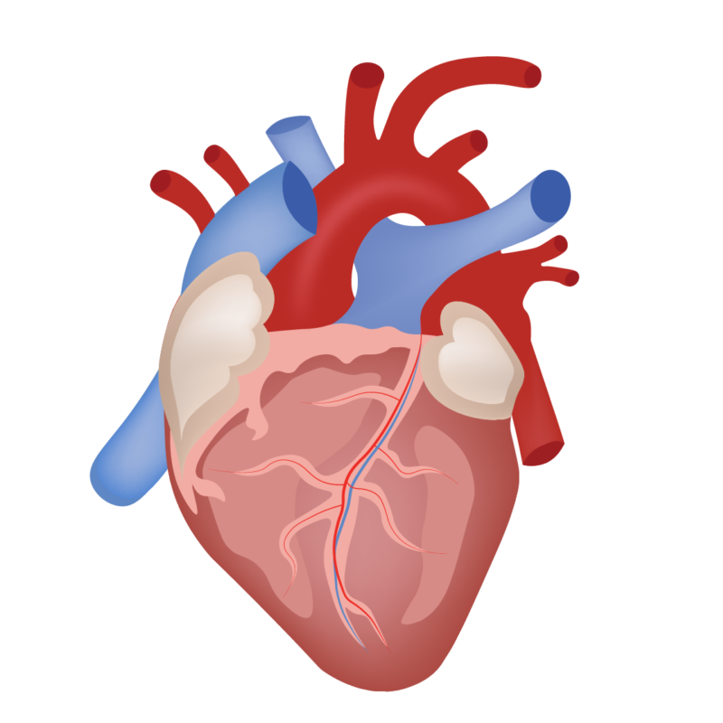
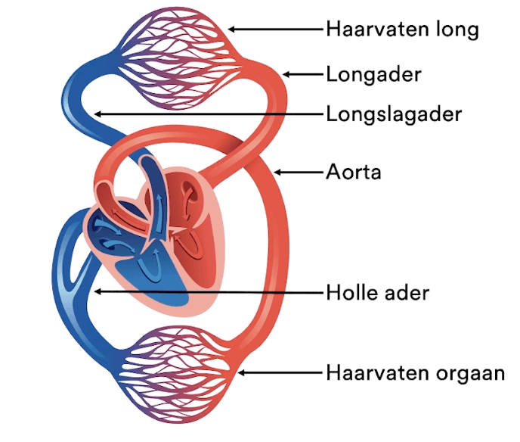
= Lung capillaries
= Pulmonary vein
= Pulmonary artery
= vein
= Tissue capillaries

Slide 4
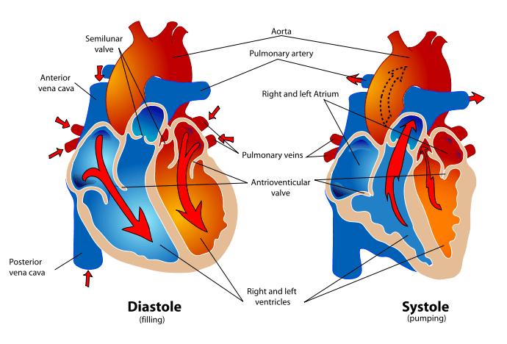
Blood Pressure?

Slide 5
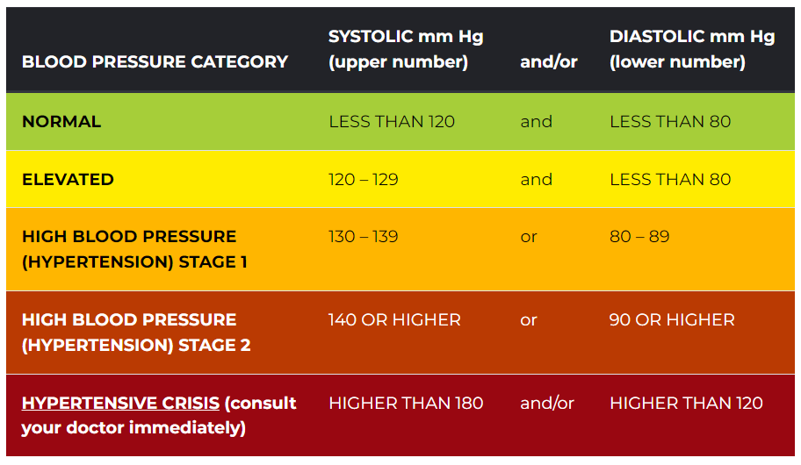
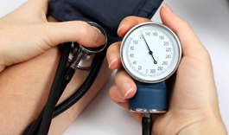
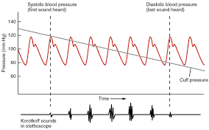

Slide 6
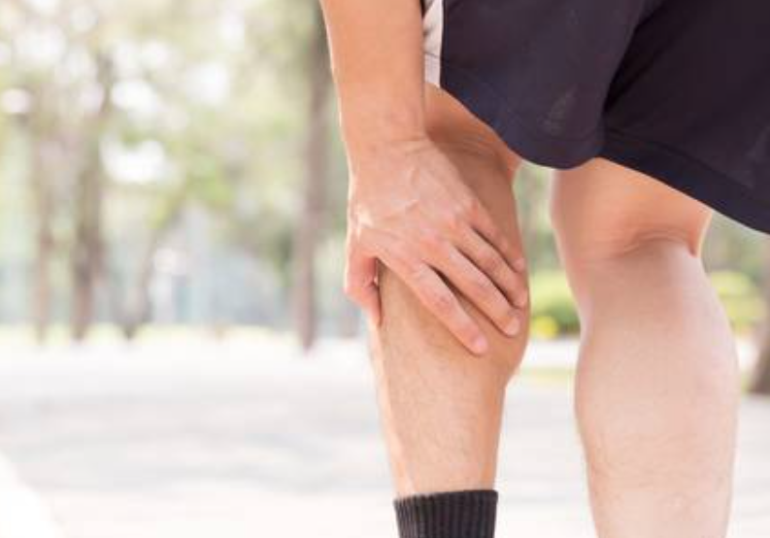
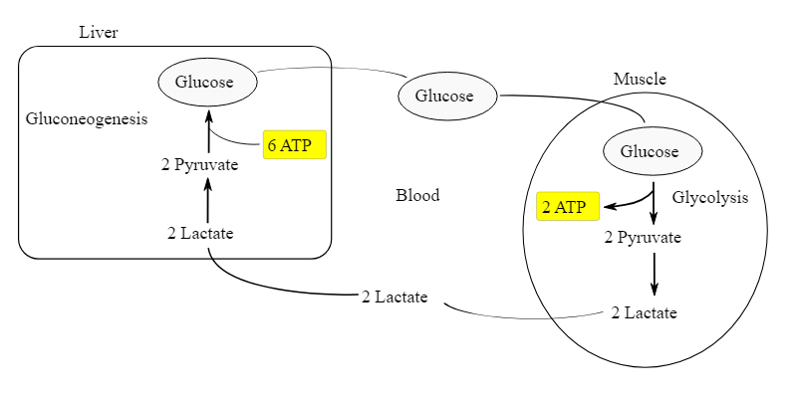
Cramps?

Slide 7
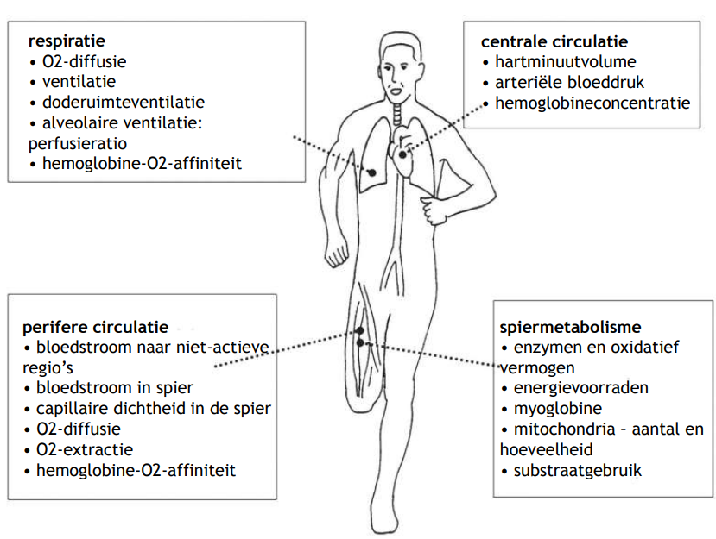
Changes during exercise
= respiration
= central circulation
= peripheral circulation
= muscle metabolism

