Slide 1
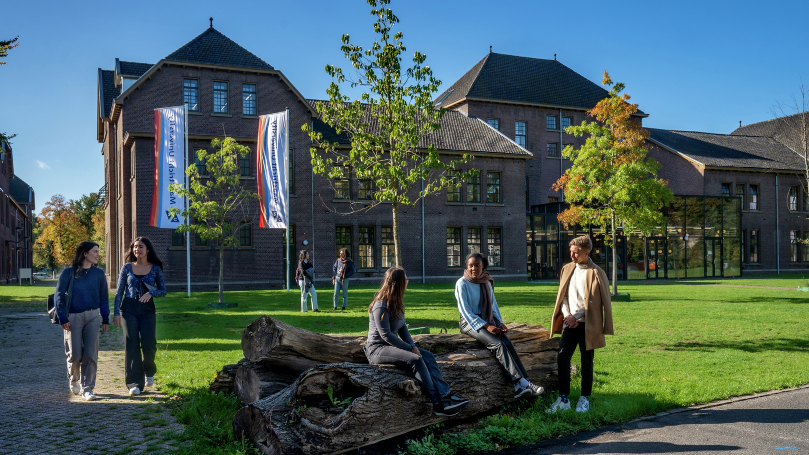
Welcome to Maastricht University
Department
Date

Slide 2
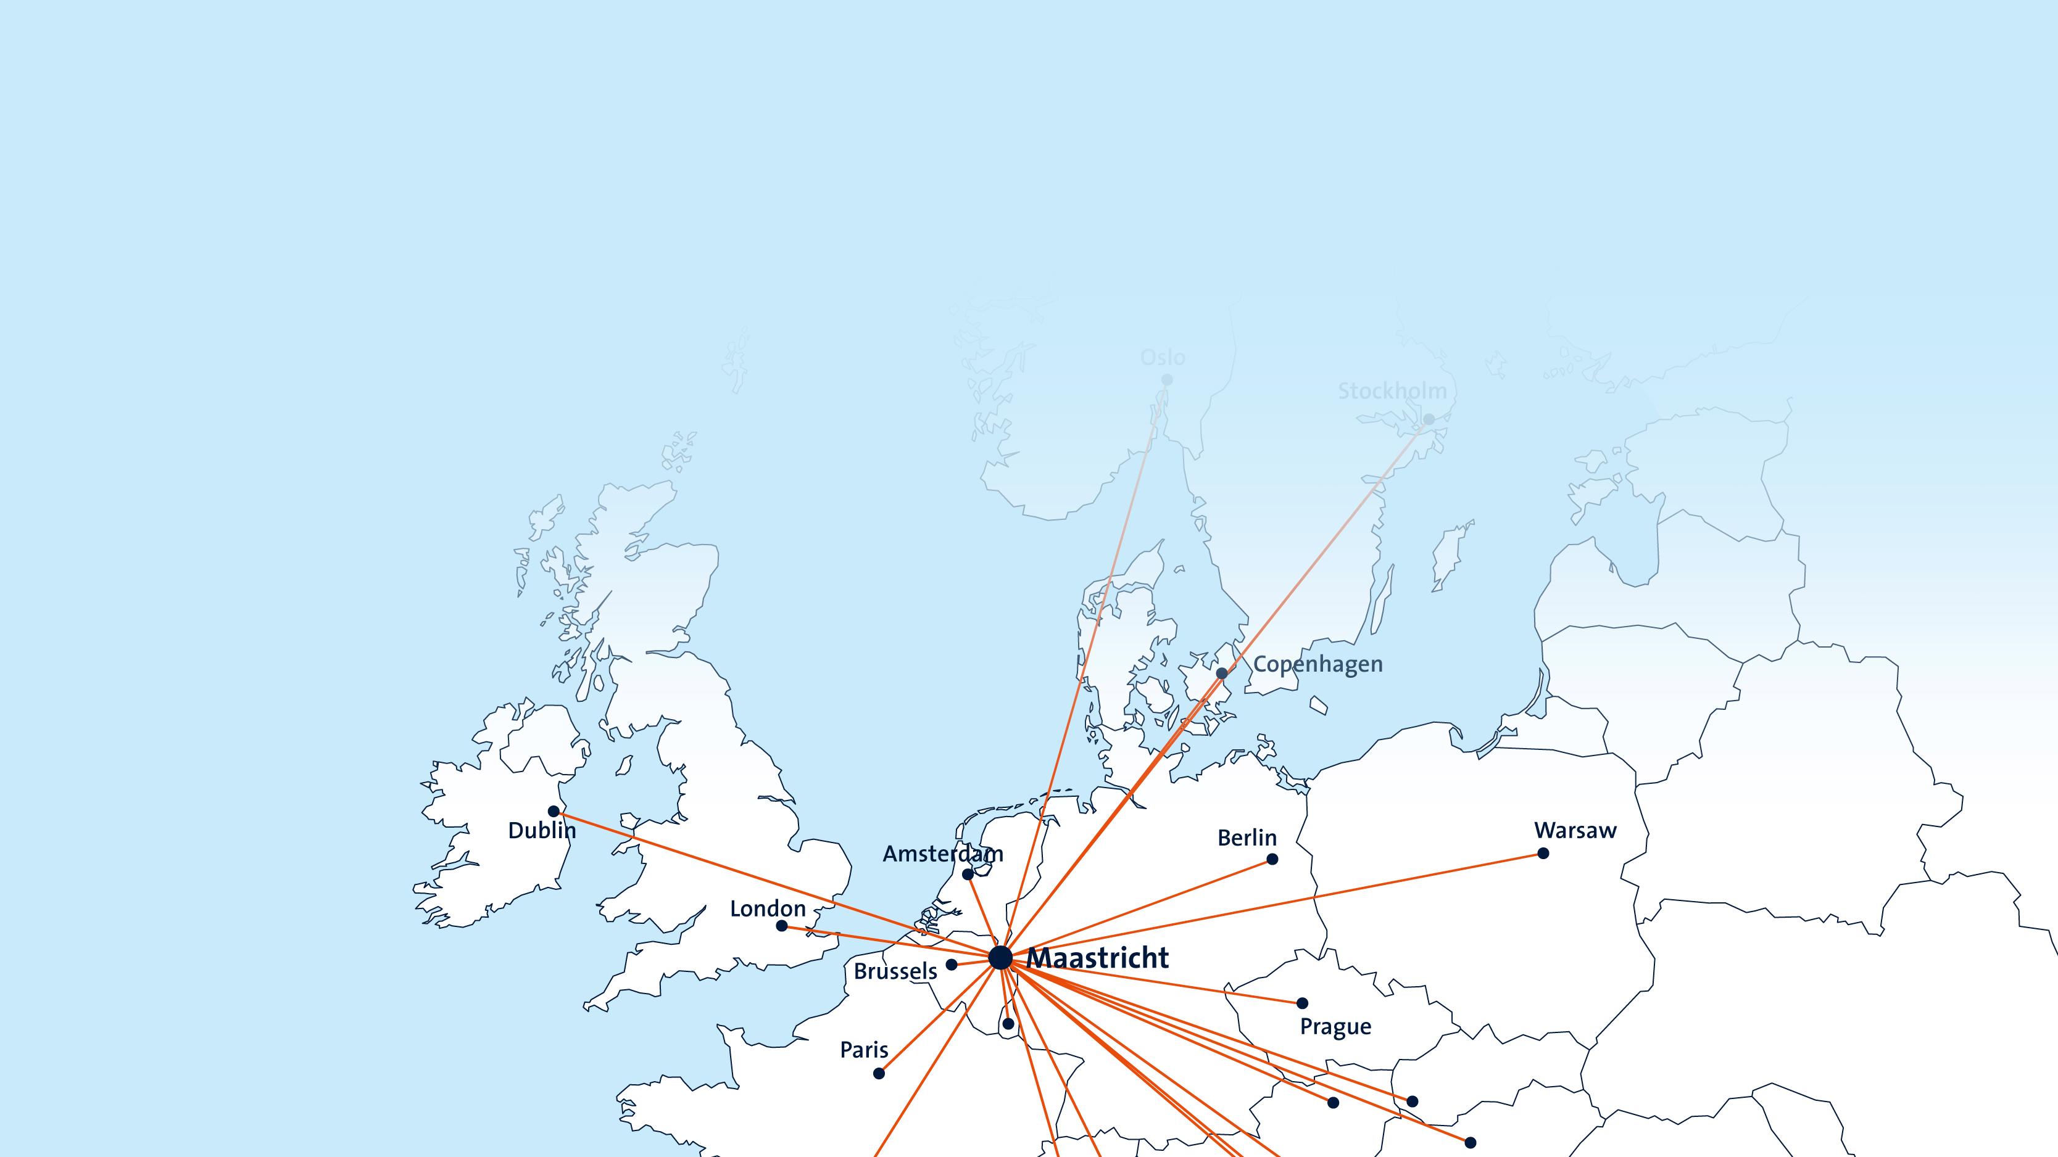
In the south of the Netherlands, at the heart of Europe
We are the European university of the Netherlands.

Slide 3
Our community (2022)

Slide 4
Alumni (2022)

Slide 5
Contributing to society

Slide 6
Contributing to the economy

Slide 7
Quality marks and finances

Slide 8
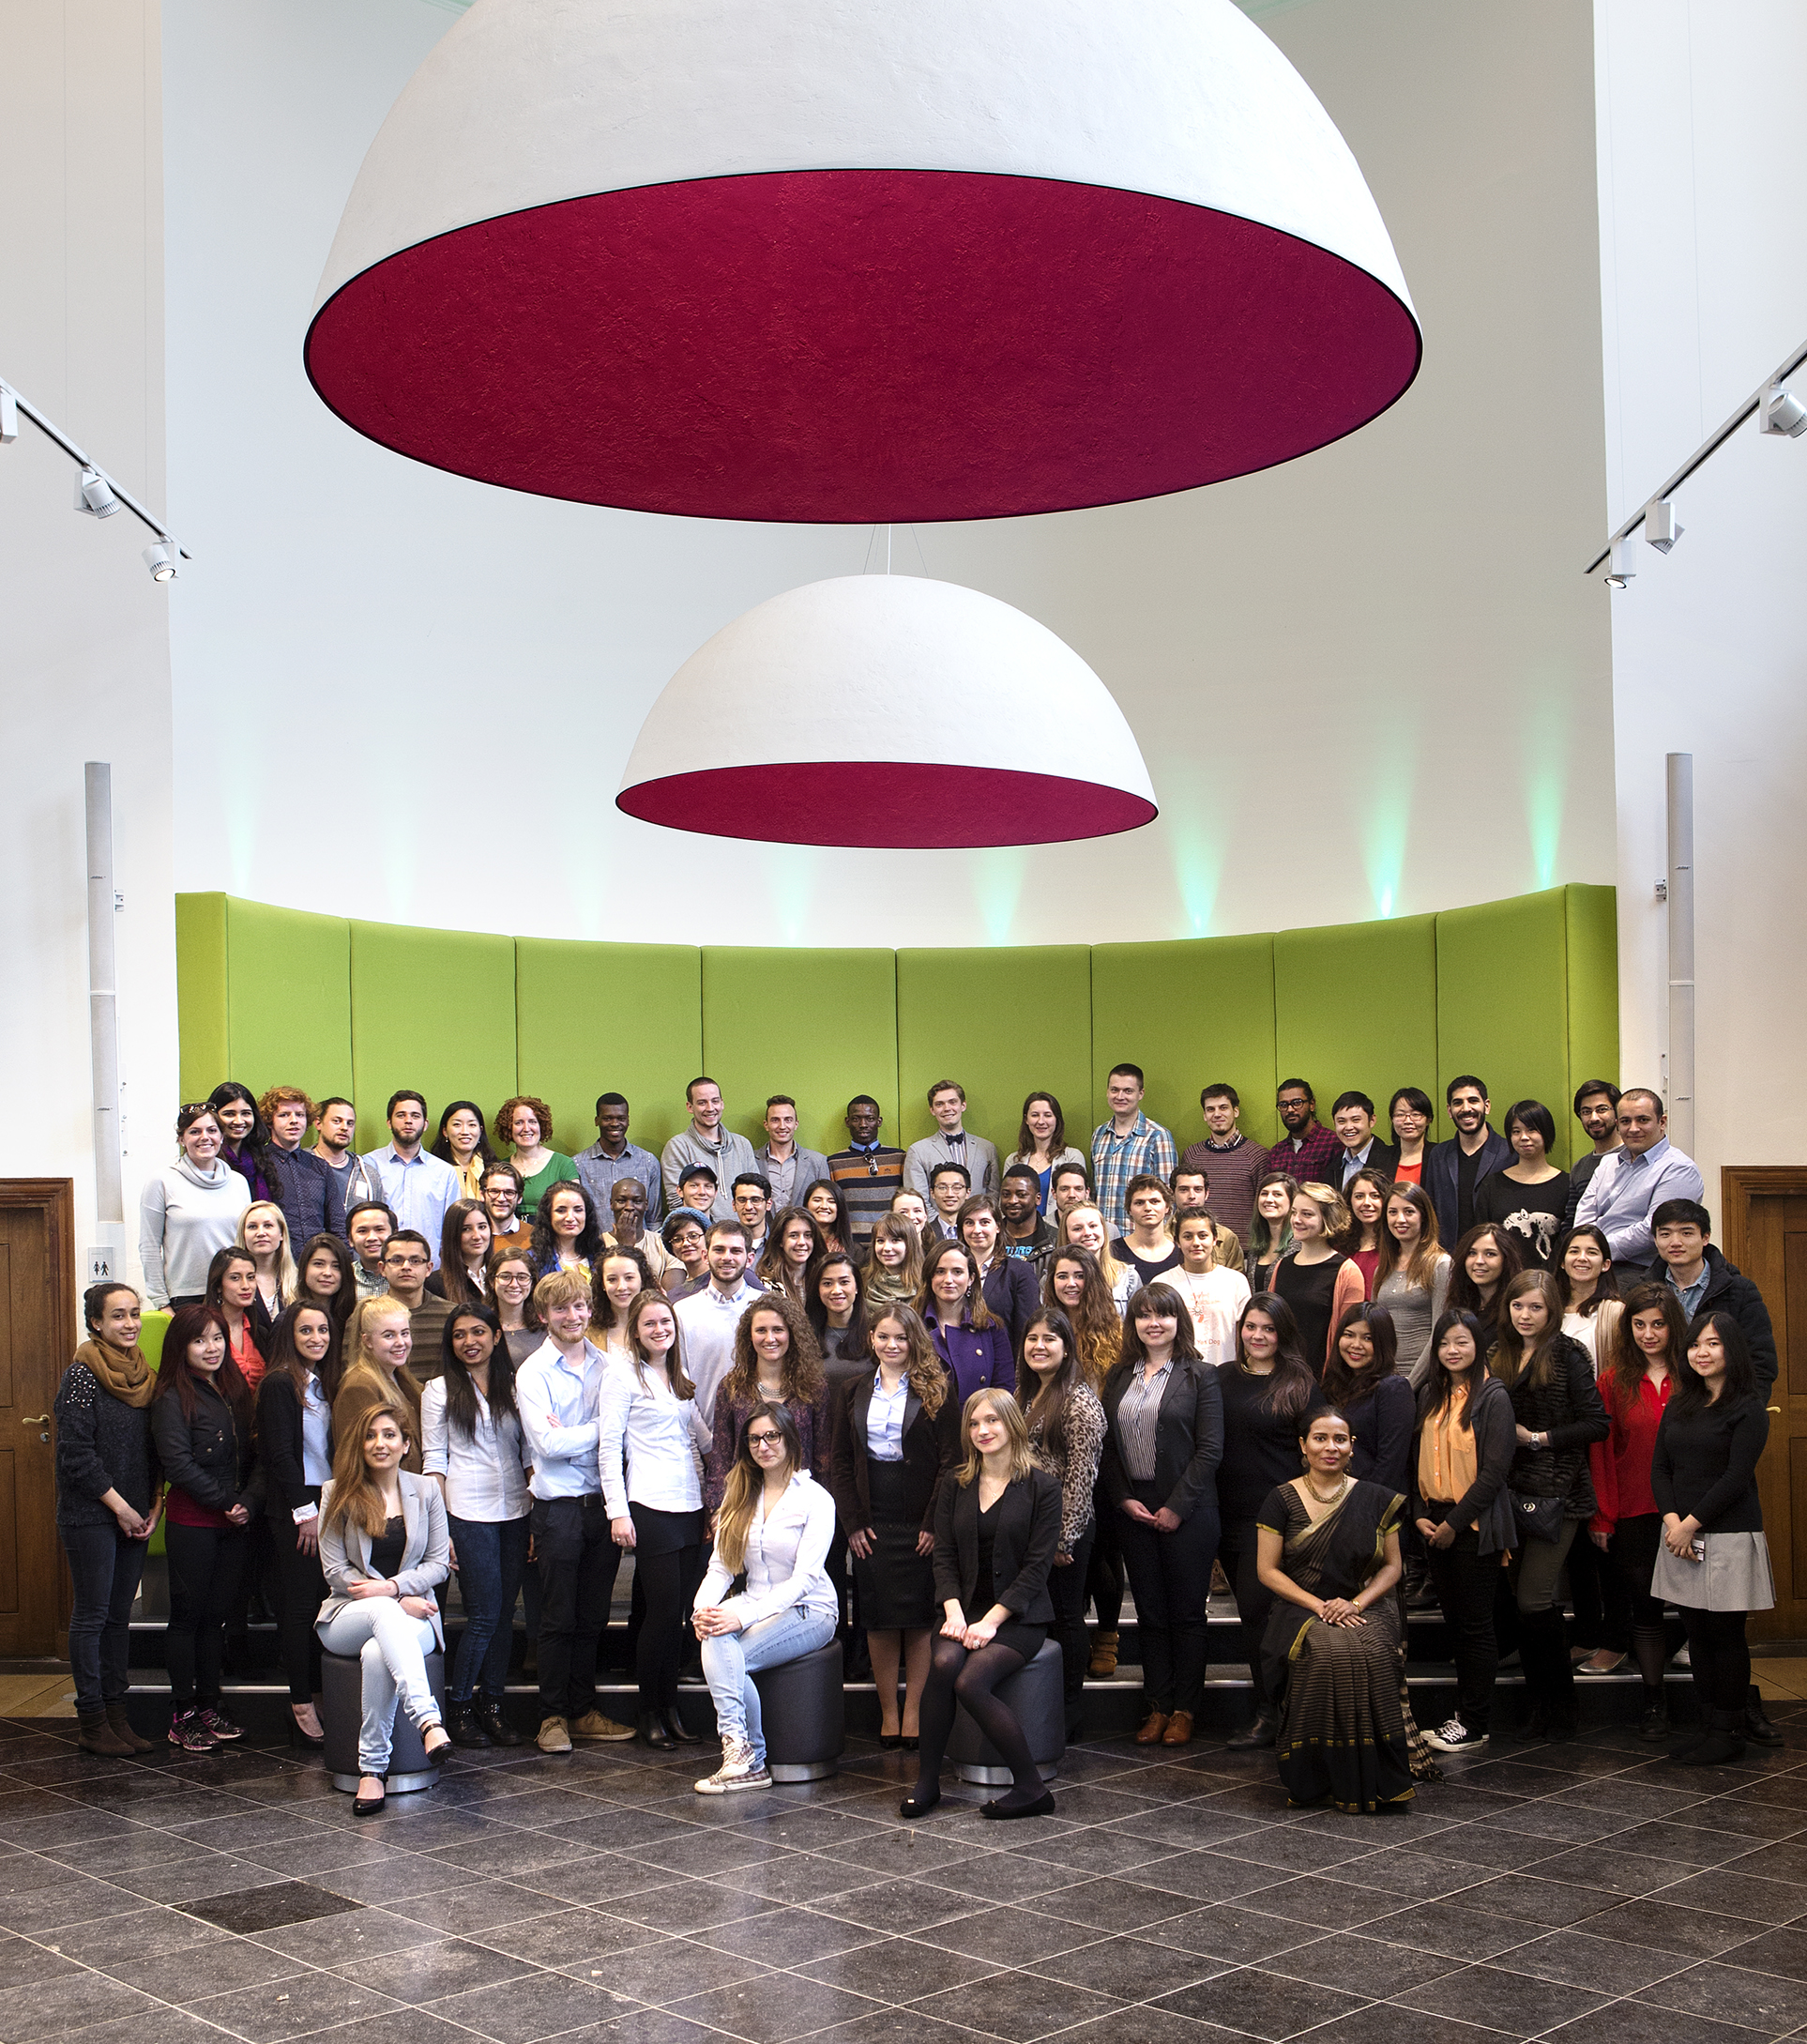
Who are we?
Most international and youngest (1976) university in the Netherlands
European pioneer of Problem-Based Learning
One of the highest ranked young universities
in the world
Member of the Worldwide Universities Network (WUN), Young European Universities Research Network (YERUN) and European Alliance for Social Science and Humanities (EASSH)
Coordinator of Young Universities
for the Future of Europe (YUFE)

Slide 9
UM membership of international networks
Worldwide Universities Network (WUN)
Young European Universities Research Network (YERUN)
European Alliance for Social Science and Humanities (EASSH)
Young Universities for the Future of Europe (YUFE)

Slide 10

Worldwide Universities Network (WUN)
Global cooperation in research to address the sustainable development agenda in a Network of 26 leading comprehensive research universities spanning 5 continents
Focus on 4 global challenges and UN SDG’s led by 4 Global Challenge Steering Groups:
  Responding to climate change
  Understanding cultures
  Health
  Global higher education research
Main network activities
  Annual conference
  Collaborative Research Projects funded by WUN Research Development Fund (RDF)
  Various Special Interest Groups, workshops, webinars, etc.
  Research Mobility Programme (RMP) grants
  Networking events for Early Career Researchers

Slide 11

Young European Universities Research Network (YERUN)
23 young European research universities collaborating to shape the European higher education system
• Three focus areas for the period 2021-2025:
  Talent development
  Open Culture of Excellence
  Responsible and Engaged Universities
• Engagement in various focus groups:
  EU policy
  Recognition & rewards
  Open Science
  Cooperation among European University alliances
  Innovating teaching and learning practices
• Other activities:
  Awards for research mobilities across the network
  Developing Joint/Double degree programs with YERUN partners
  Joint projects (for example in the field of joint PhD education)
  Building a YERUN research collaborative platform
  Connecting researchers within the network

Slide 12

European Alliance for Social Science and Humanities (EASSH)
Cooperation between 65 European member organisations to promote and strengthen the
social sciences and humanities in Europe
Focus areas:
  Developing policy proposals and position papers
  Engaging with policy institutions on the design, implementation and oversight of multi-national and European research programmes
  Developing joint activities
Engagement in various working groups

Slide 13


Young Universities for the Future of Europe (YUFE)
Coordinated by Maastricht University, funded by the European Commission
Geographically diverse: 10 universities from 10 countries & 4 non-academic partners
Building 1 European University with young universities – below 50 years
Student-centred/Research-based/Challenge-based
Innovative recognition system of extra-curricular activities
Focus on multilateral mobility in a virtual/blended/physical way, supported by a Virtual Campus
Strong embedding in own cities and regions
  Increased social participation
  Re-skilling
  Youth empowerment

Slide 14
Our core values
diversity and inclusivity
sustainability
mutual respect
integrity
democratic principles
transparency
Source: Maastricht University – The European university of the Netherlands, Strategic Programme 2022-2026

Slide 15
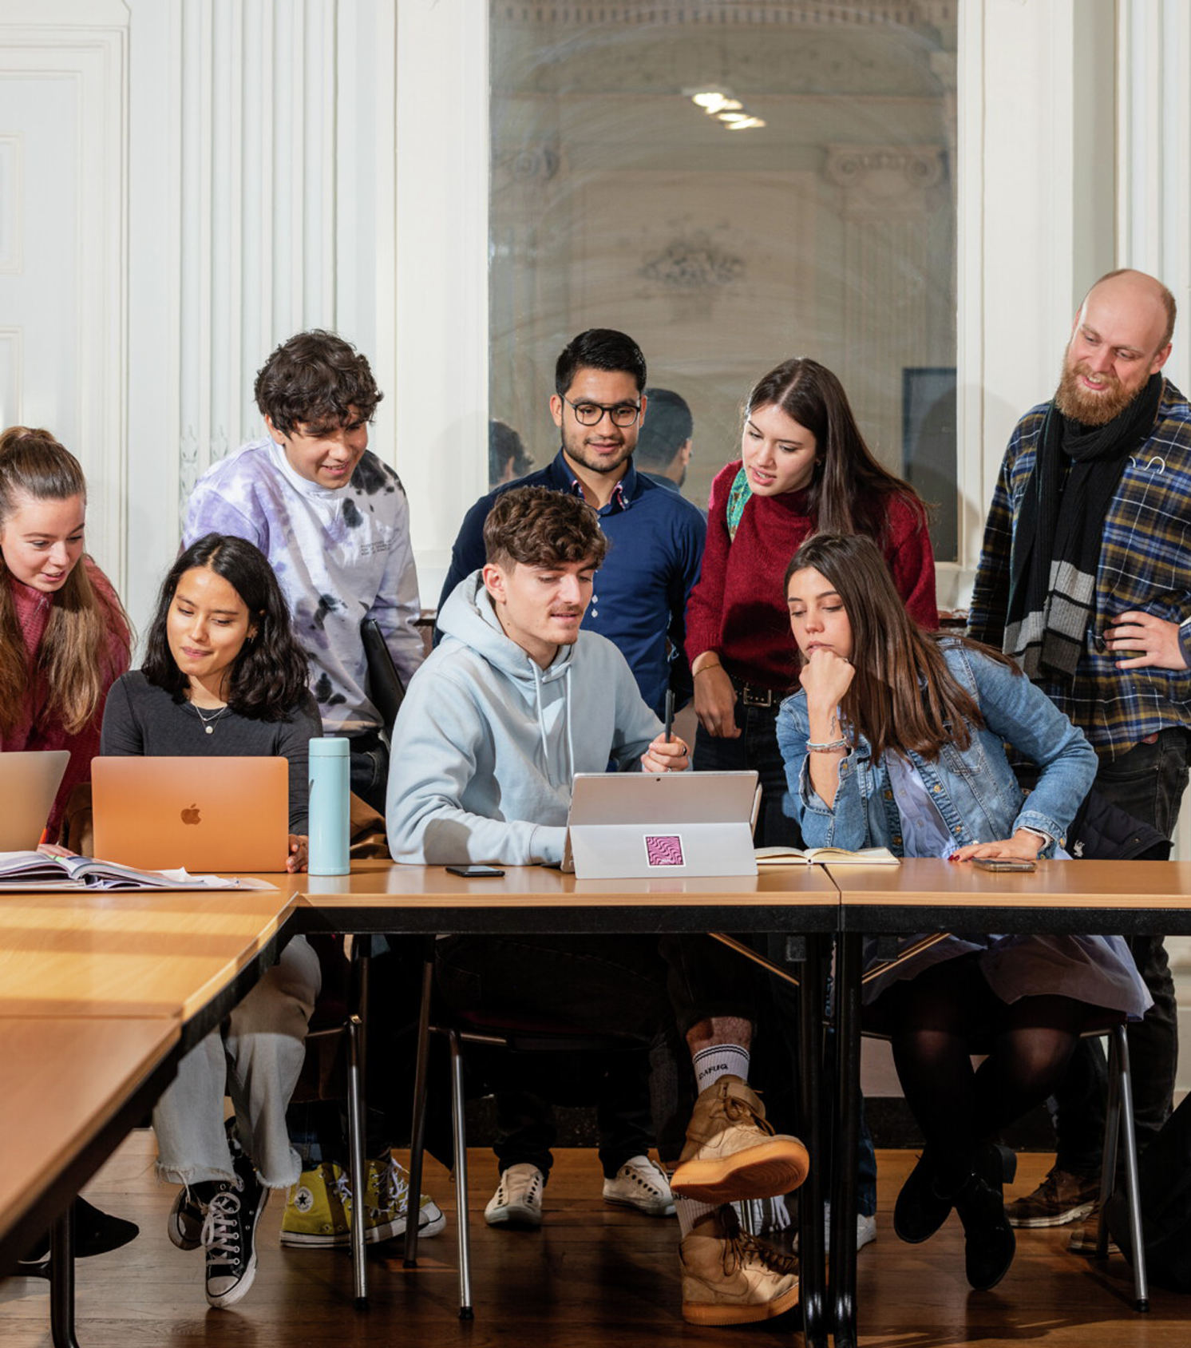
Stimulating learning environment
Problem-Based Learning: student centred, small groups
International Classroom: with over 100 nationalities
many possibilities to study abroad
honours programmes
developing global citizenship competences

Slide 16

Problem-Based Learning (PBL)
learning in a collaborative, dynamic way
examining and solving
real-world problems
developing 21st century skills
(e.g. debating, organising, thinking critically)
personal contacts with tutors and lecturers
closely monitored learning process

Slide 17
Research themes
Europe and a globalising world
Learning and innovation
Quality of life
Sustainability and Circularity

Slide 18
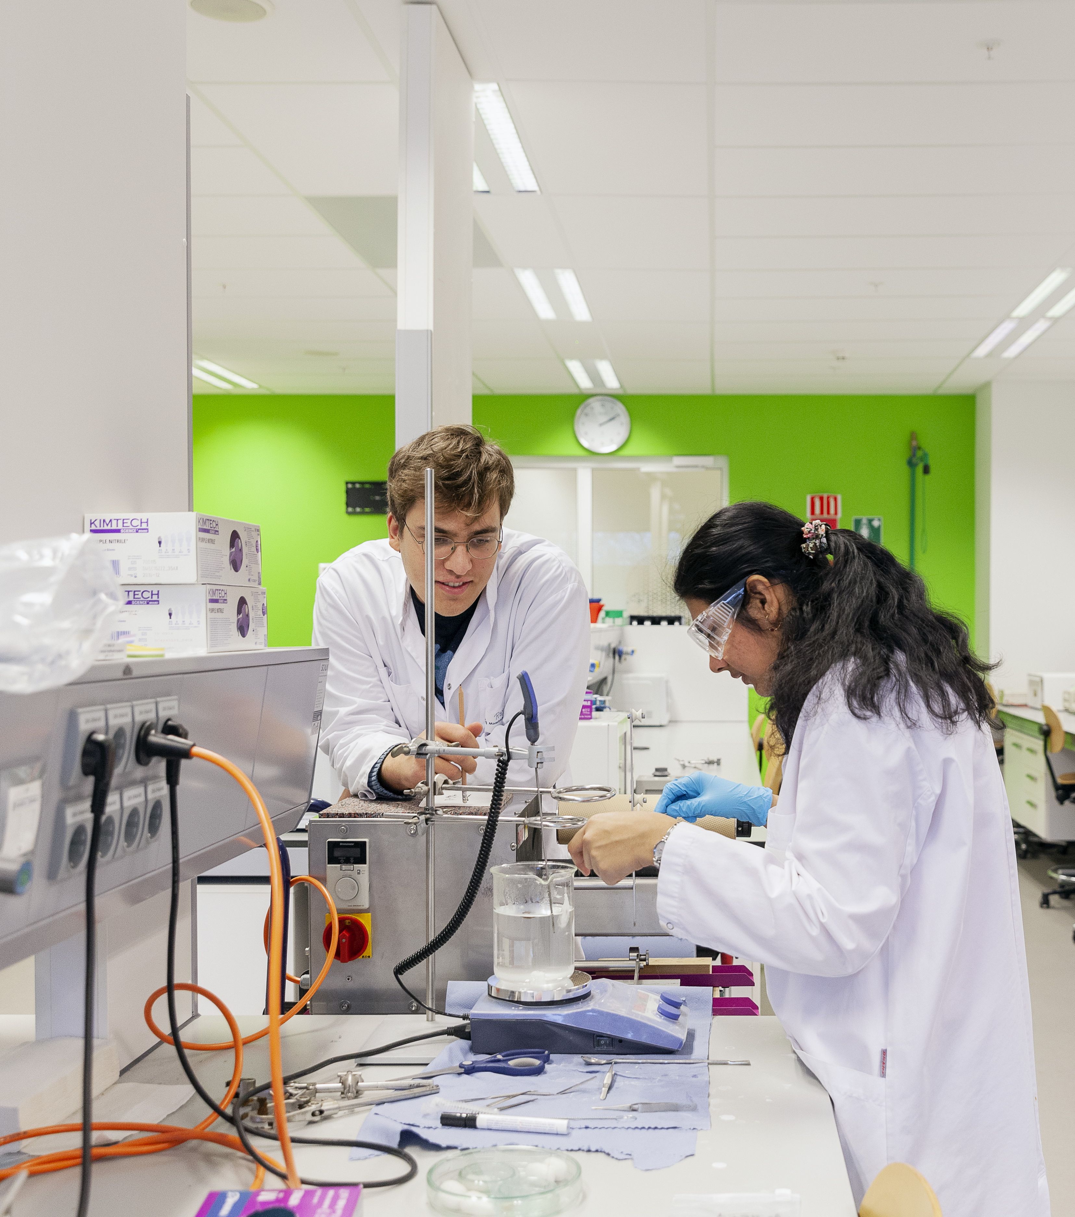
Research at UM
contributes to solving major societal issues
is both fundamental and translated into economic, financial or social value
is interdisciplinary and closely linked to education
is organised in six faculties and various interdisciplinary institutes
complies with open science principles
takes place in a first-class research climate

Slide 19
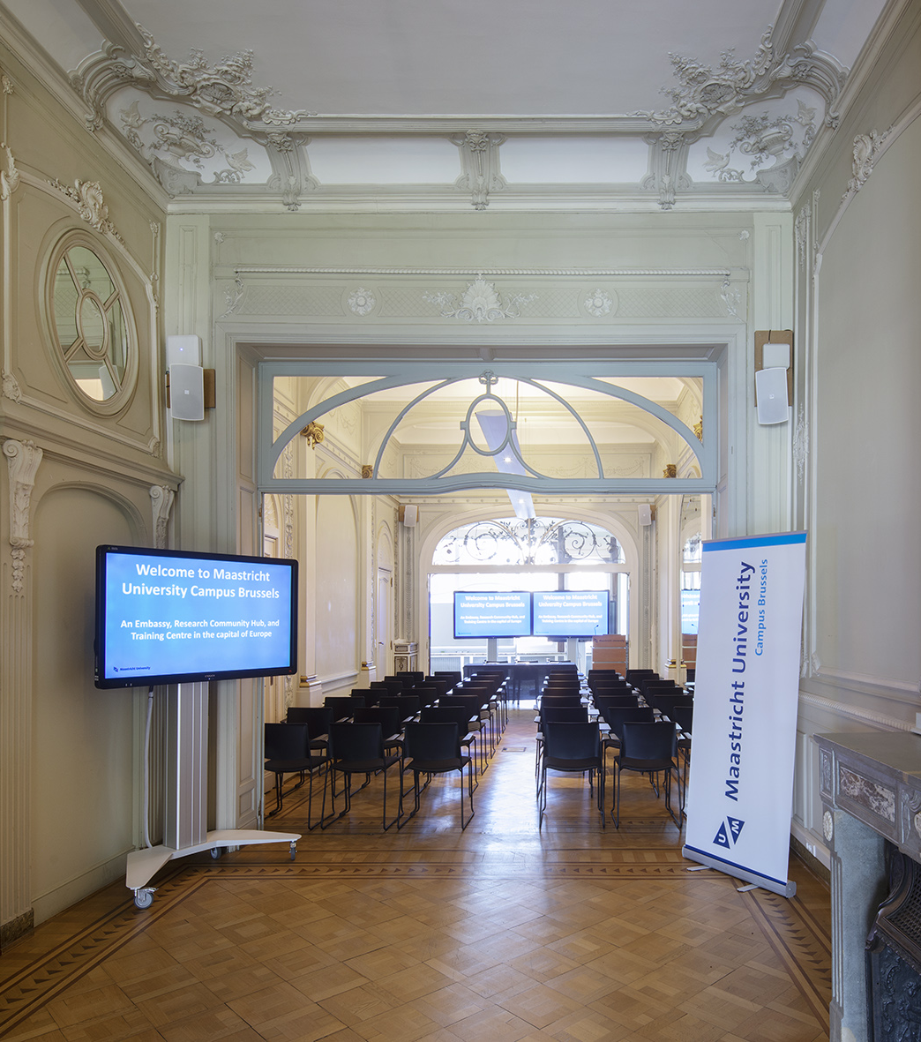
Campus Brussels
(Hub Brussels by 2024)
facilitating exchange between UM and various
EU stakeholders
assisting in UM’s public affairs strategy
post-academic courses
for professionals
networking hub

Slide 20
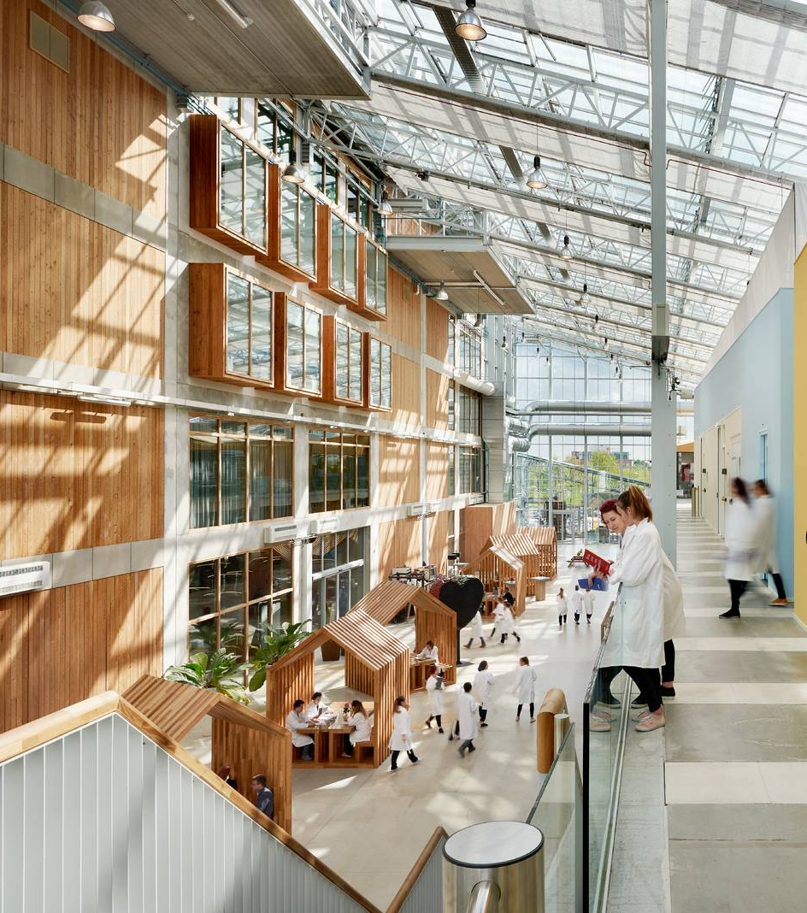
Campus Venlo
highly international campus with a small-scale academic community
education and research focus on Health, Nutrition & Business
three interdisciplinary research lines
three study programmes at Campus Venlo: one bachelor and two masters

Slide 21
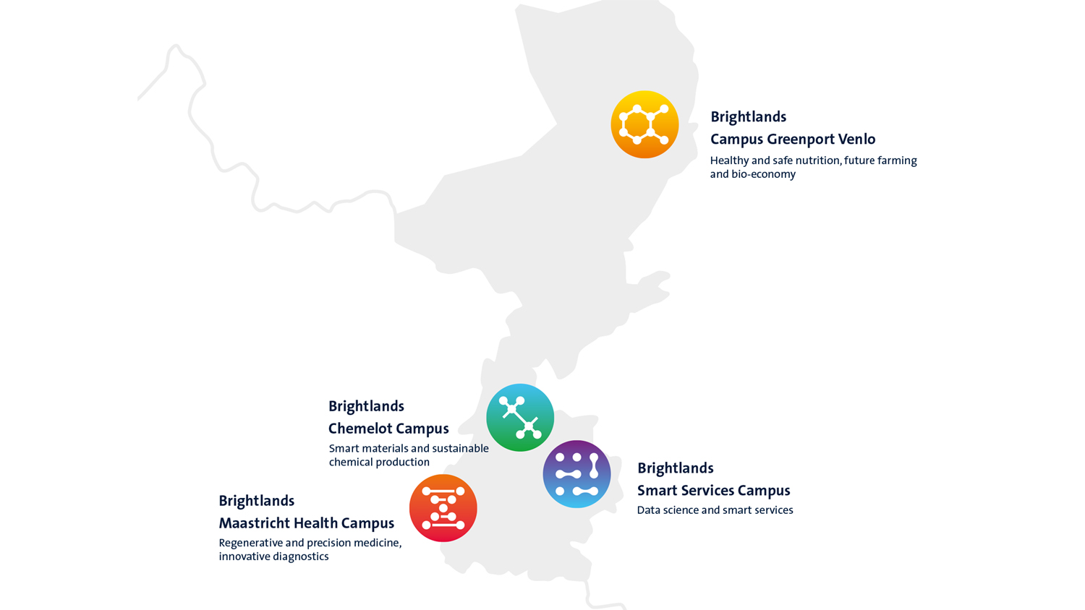

Four areas of expertise

Slide 22
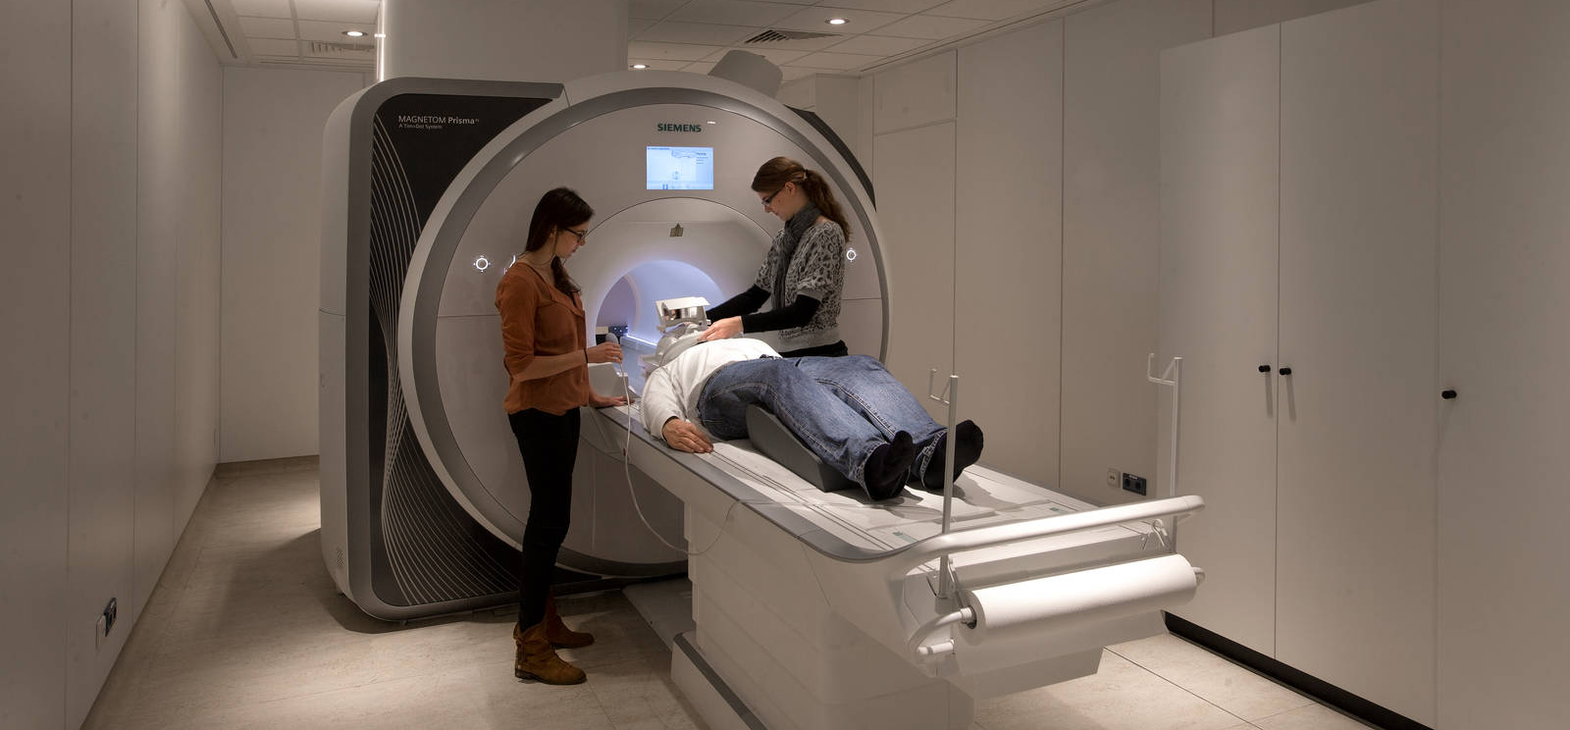


Slide 23
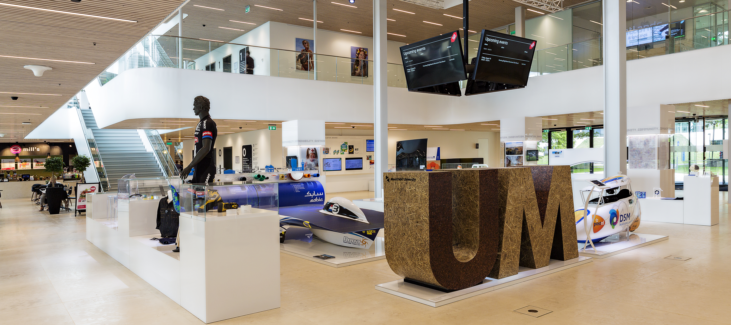


Slide 24
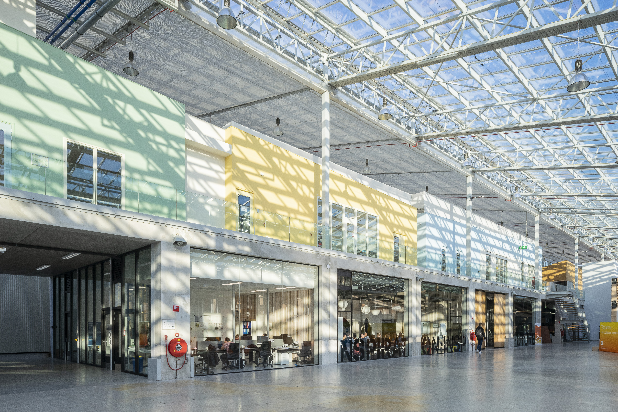


Slide 25
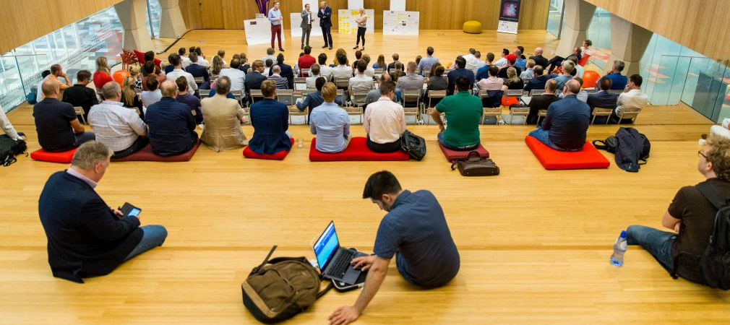


Slide 26
Thank you for your attention!
Any questions?

